Slide 1


Slide 2


Unit
1
LEISURE TIME
LESSON 1: GETTING STARTED
I’m keen on DIY (do-it-yourself).
1

Slide 3
LESSON 1: GETTING STARTED
WARM-UP
Game: Who knows more?
PRESENTATION
Vocabulary
Task 1: Listen and read.
Task 2: Read the conversation again and complete the sentences.
Task 3: Work in pairs. Write the activities from the box under the correct pictures.
Task 4: Work in pairs. Read the phrases, and guess which activities in 3 are described.
PRACTICE
PRODUCTION
Task 5: Work in groups. Ask one another the questions. Then report your friends’ answers to the class.
CONSOLIDATION
Wrap-up
Homework

Slide 4
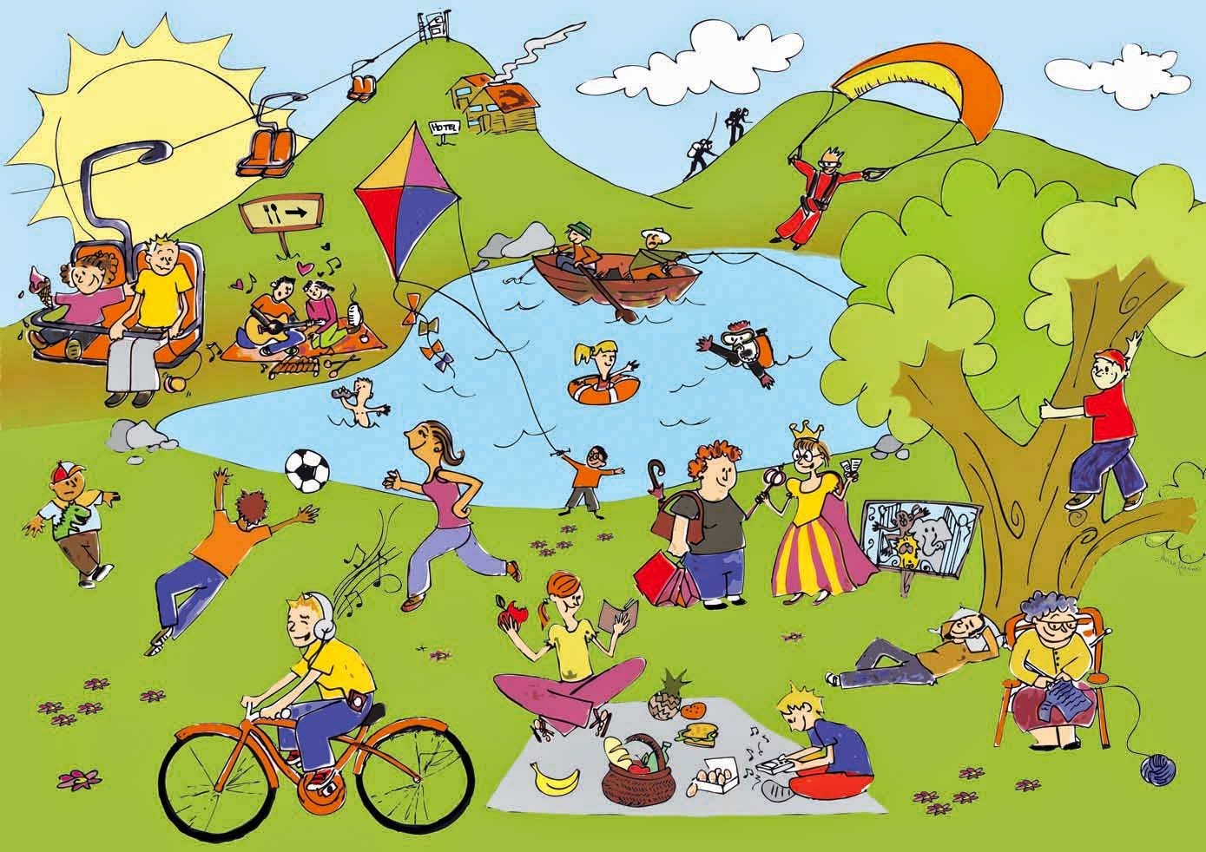
WARM-UP
Who knows more?
Name the activities in the picture:
LEISURE ACTIVITIES

Slide 5

PRESENTATION
DIY (n)
(do-it-yourself)
/ˌdiːaɪˈwaɪ/
tự tay làm

Slide 6
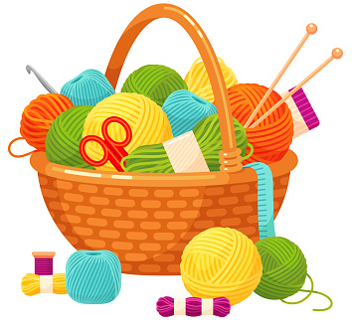
PRESENTATION
knitting kit (n)
/ˈnɪtɪŋ kɪt/
bộ dụng cụ đan len

Slide 7
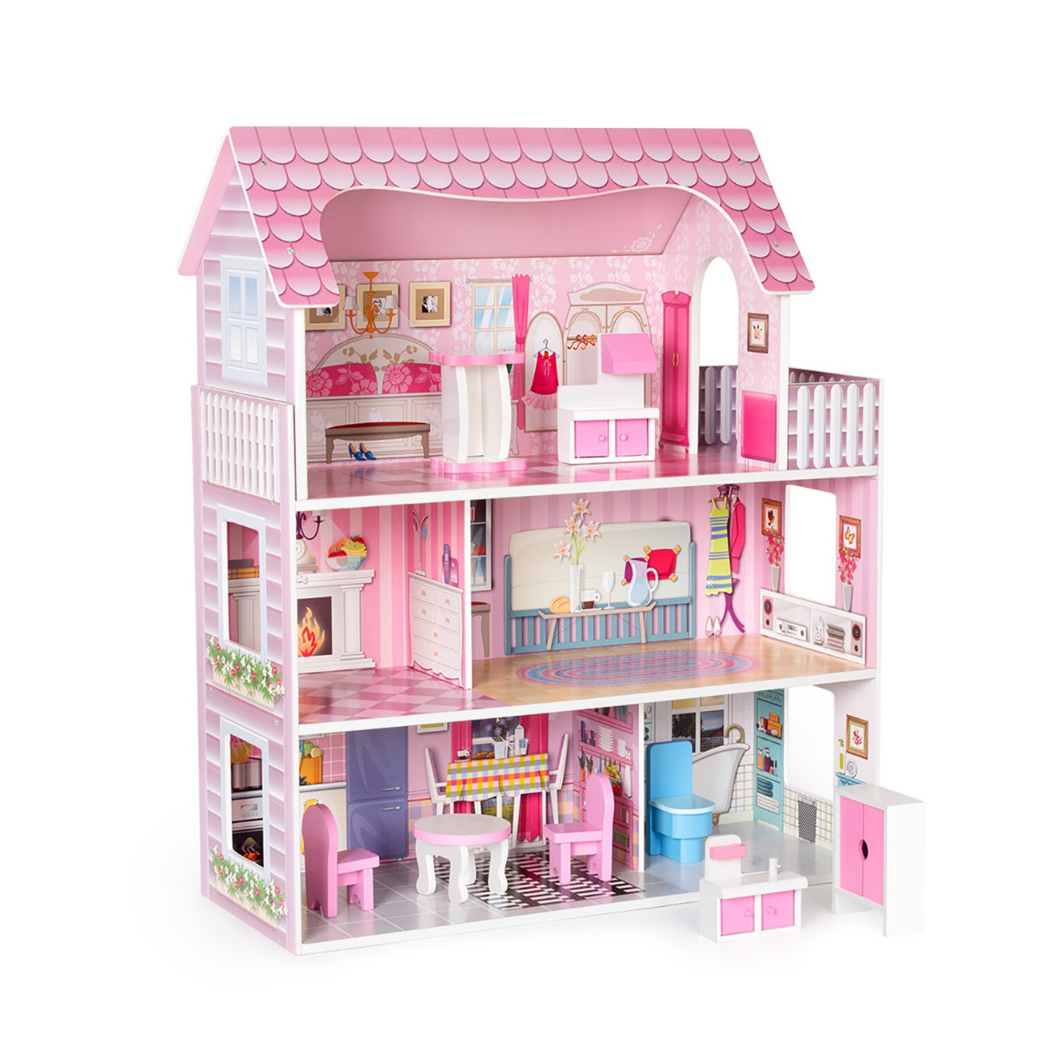
PRESENTATION
dollhouse (n)
/ˈdɒlhaʊs/
nhà búp bê

Slide 8
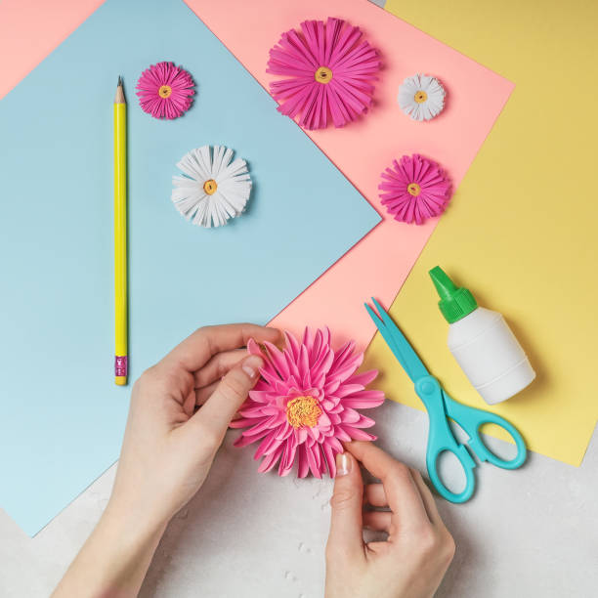
PRESENTATION
make paper flowers (v.phr)
/meɪk 'peɪpər 'flaʊərz/
làm hoa giấy

Slide 9
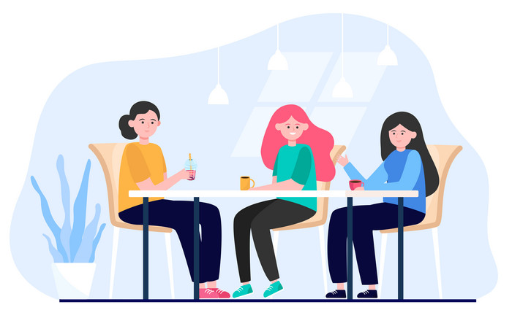
PRESENTATION
hang out (v)
/hæŋ aʊt/
đi chơi

Slide 10
PRESENTATION
New words | Pronunciation | Meaning
1. DIY (n) | /ˌdiːaɪˈwaɪ/ | tự tay làm
2. knitting kit (n) | /ˈnɪtɪŋ kɪt/ | bộ dung cụ đan len
3. dollhouse (n) | /ˈdɒlˌhaʊs/ | nhà búp bê
4. make paper flowers (v.phr) | /meɪk 'peɪpər 'flaʊərz/ | làm hoa giấy
5. hang out (v) | /hæŋ aʊt/ | đi chơi

Slide 11

PRACTICE
1
Listen and read.
Tom: Hi, Trang. Surprised to see you. What brings you here?
Trang: Oh, hello Tom. I’m looking for a knitting kit.
Tom: A knitting kit? I didn’t know you like knitting.
Trang: Actually, I’m keen on many DIY activities. In my leisure time, I love
knitting, building dollhouses, and making paper flowers.
Tom: I see. So, you like spending time on your own.
Trang: Yes. What do you do in your free time?
Tom: I’m a bit different. I usually hang out with my friends. We go to the
cinema, go cycling, or play sport in the park.
Trang: You love spending free time with other people, don’t you?
Tom: That’s right. By the way, would you like to go to the cinema with me and
Mark this Sunday? There’s a new comedy at New World Cinema.
Trang: Yes, I’d love to. Can I ask Mai to join us?
Tom: Sure. Let’s meet outside the cinema at 9 a.m.

Slide 12
PRACTICE
2
Read the conversation again and complete the sentences.
Trang is looking for a ____________.
She likes doing DIY in her ____________.
Tom loves spending his free time with ____________.
Tom and his friends usually _________ together.
Tom, Mark, Trang, and Mai are going to see a comedy this _______.
knitting kit
leisure time
other people
hang out
Sunday

Slide 13
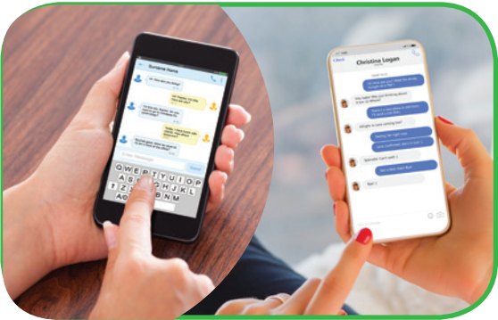
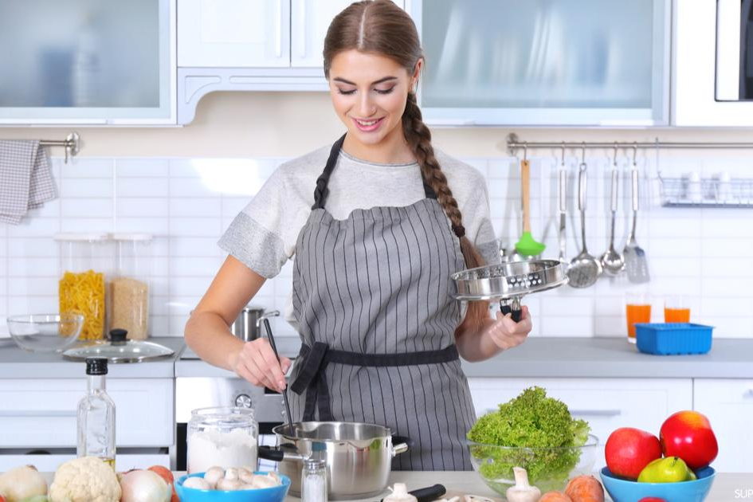
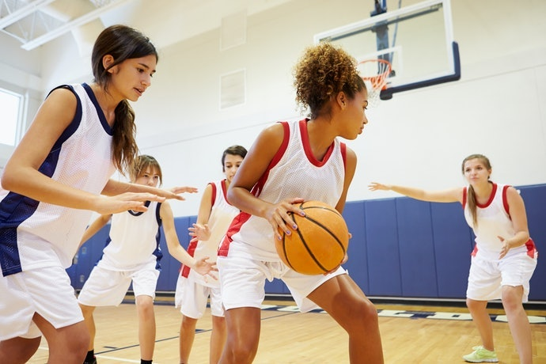
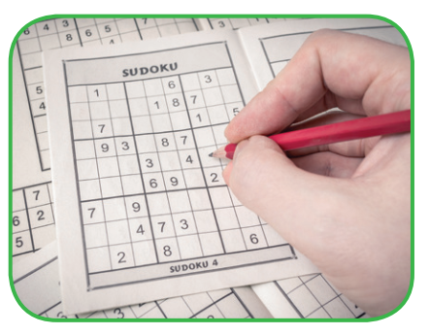
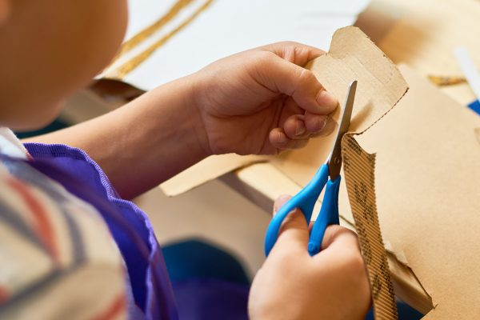

PRACTICE
3
Work in pairs. Write the activities from the box under the correct pictures.
doing DIY
cooking
doing puzzles
playing sport
surfing the net
messaging friends

Slide 14
PRACTICE
4
Work in pairs. Read the word and phrases, and guess which activities in 3 are described.
improve memory, a mental exercise
save money, increase creativity
improve physical health, make friends
keep in touch, be relaxed
learn something about IT, computer skills
doing puzzles
doing DIY
playing sport
messaging friends
surfing the net

Slide 15

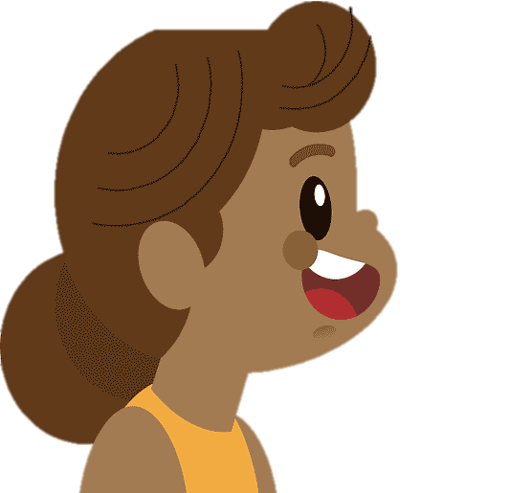

PRODUCTION
5
Work in groups. Ask one another the question below. Then report your friends’ answers to the class.
If you have some free time this weekend, what will you do?

Slide 16

CONSOLIDATION
1
Wrap-up
What have we learnt in this lesson?
identify the topic of the unit
use lexical items related to leisure activities
identify the language features that are covered in the unit

Slide 17

CONSOLIDATION
2
Homework
Name a list of cheap expensive, easy and difficult leisure activities.
Do exercises in the workbook.
Prepare for the Project of Unit 1.

Slide 18

Website: hoclieu.vn
Fanpage: facebook.com/www.tienganhglobalsuccess.vn/

