Slide 1


Hello every one !!!

Slide 2
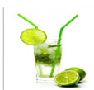
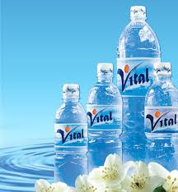
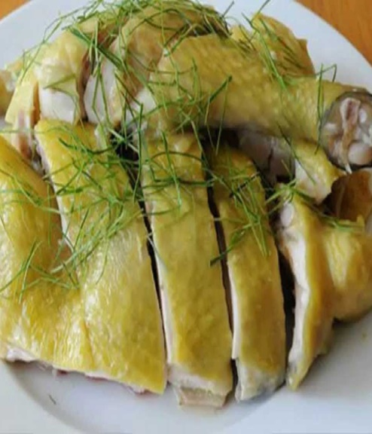
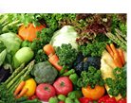
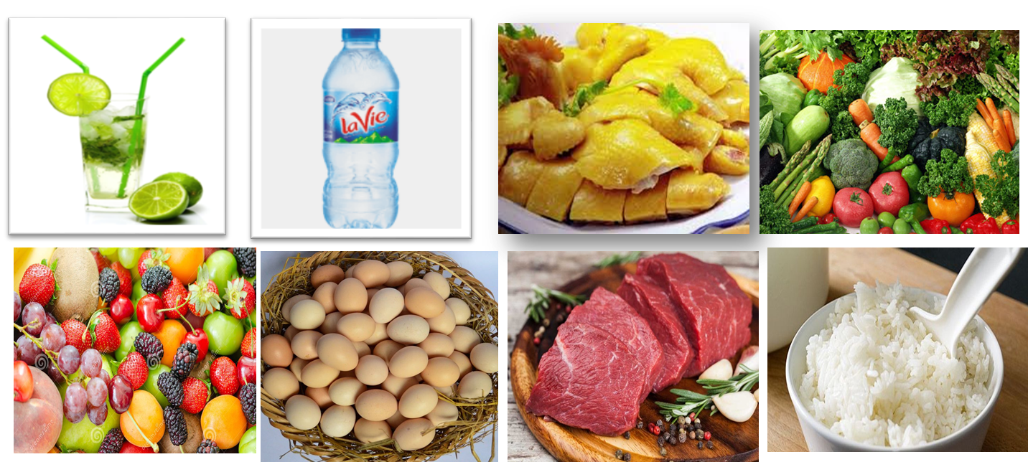
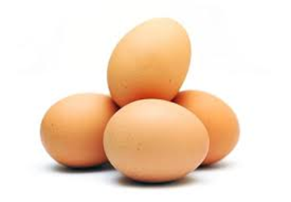
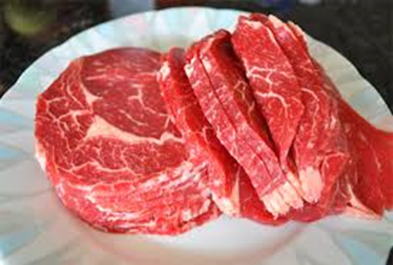
* Warm up:
Game:Pelmanism
1
lemonade
mineral
water
chicken
Vegetables
2
3
4
5
7
Fruit
eggs
beef
rice
6
8
9
10
11
12
13
14
15
16

Slide 3
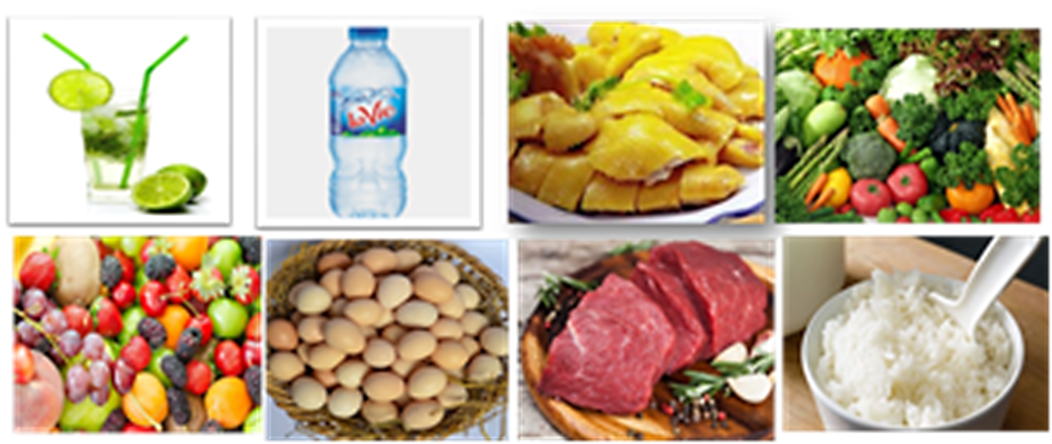
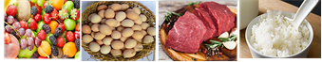
FOOD AND DRINK
lemonade | Mineral water | chicken | Vegetables
Fruit | Eggs | Beef | rice

Slide 4

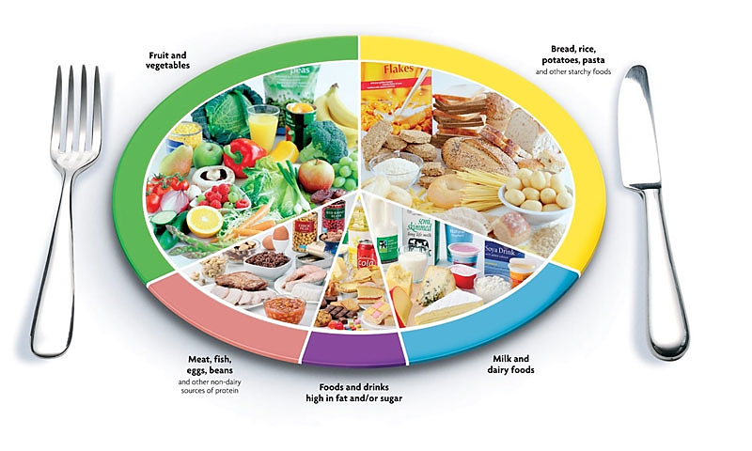
Unit
5
FOOD AND DRINK

Slide 5


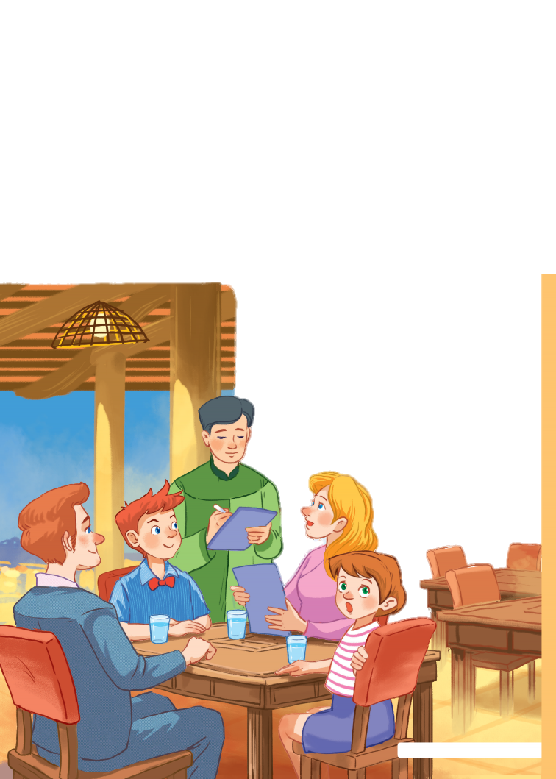

Unit
5
FOOD AND DRINK
LESSON 1: GETTING STARTED
At a Vietnamese restaurant
HOBBIES

Slide 6

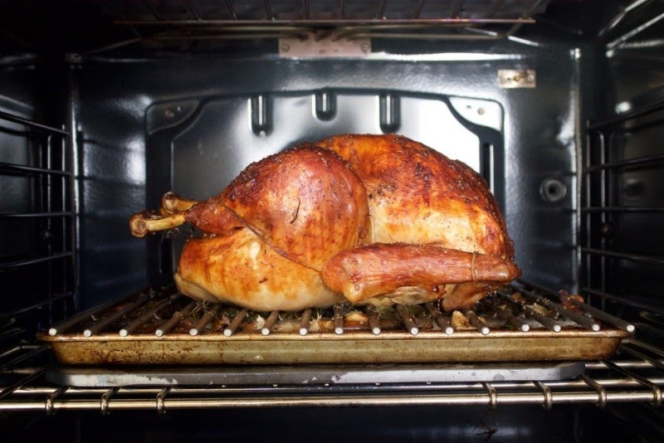
* VOCABULARY
- roast (v):
quay, nướng (thịt..)
/rəʊst/

Slide 7
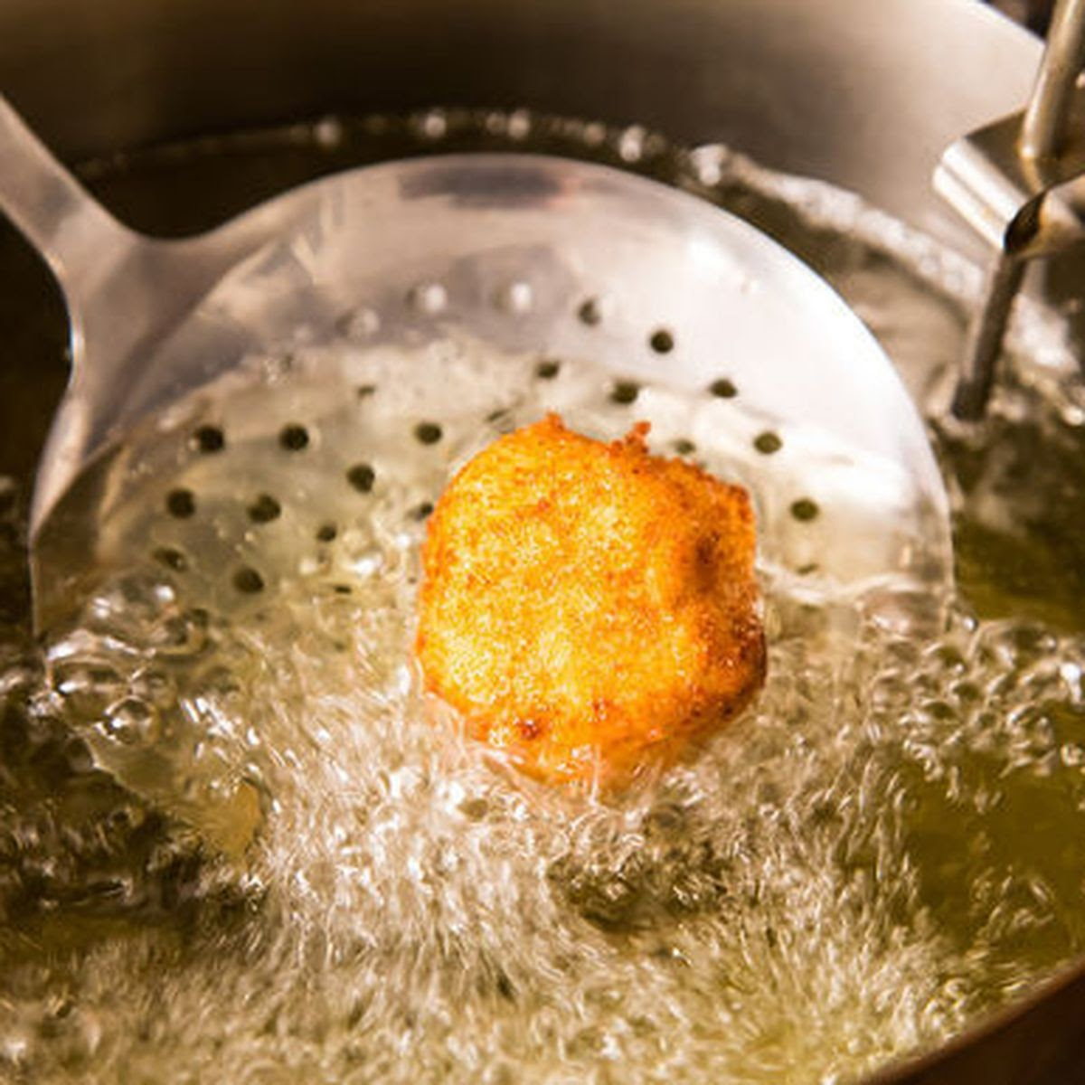
- fry (v):
rán
/fraɪ/

Slide 8
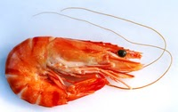
-shrimp (n):
/ʃrɪmp/
con tôm

Slide 9
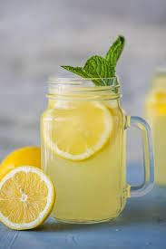
- lemonade (n):
nước chanh
/leməˈneɪd/

Slide 10
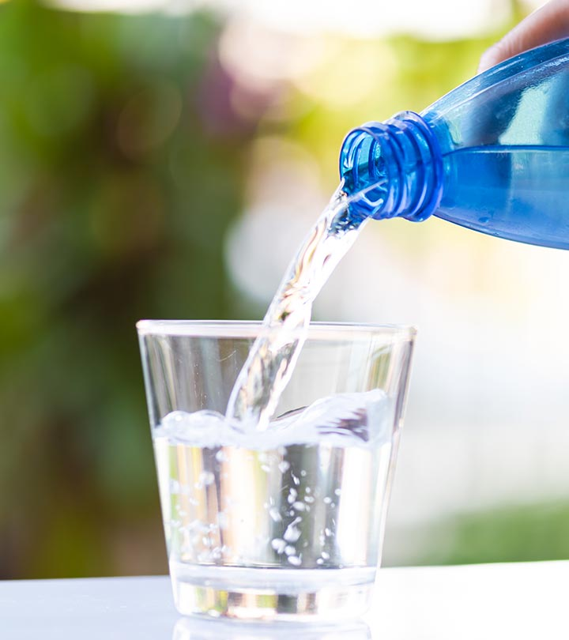
- Mineral water (n):
/ˈmɪnərəl/ /ˈwɔːtə/
Nước khoáng

Slide 11
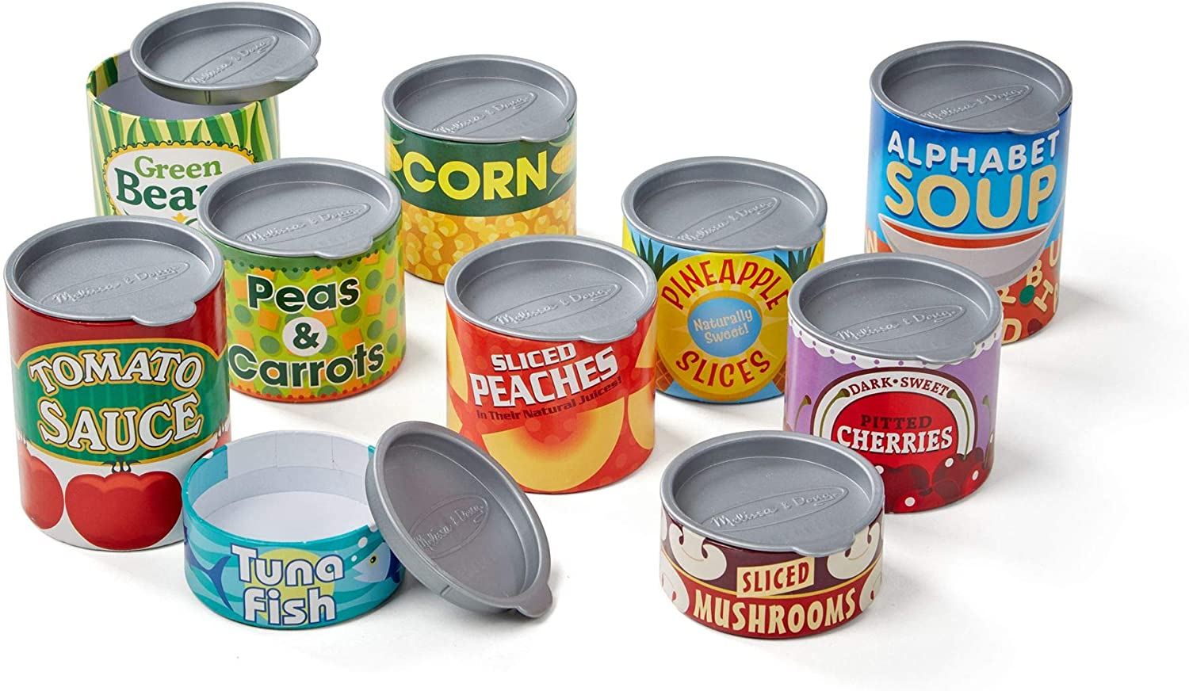
- can (n):
lon
/ˈkæn/

Slide 12
* VOCABULARY
New words | Pronunciation | Meaning
- roast | /rəʊst/ | quay, nướng (thịt..)
- fry | /fraɪ/ | rán
- shrimp | /ʃrɪmp/ | con tôm
- lemonade | /leməˈneɪd/ | nước chanh
- mineral water | /ˈmɪnərəl/ /ˈwɔːtə/ | khoáng (chất)
- can | /ˈkæn/ | lon

Slide 13
* Checking Vocabulary
New words | Meaning
 | quay, nướng (thịt..)
 | rán
 | con tôm
 | nước chanh
 | khoáng (chất)
 | lon
- roast
- fry
- shrimp
- lemonade
- mineral water
- can

Slide 14
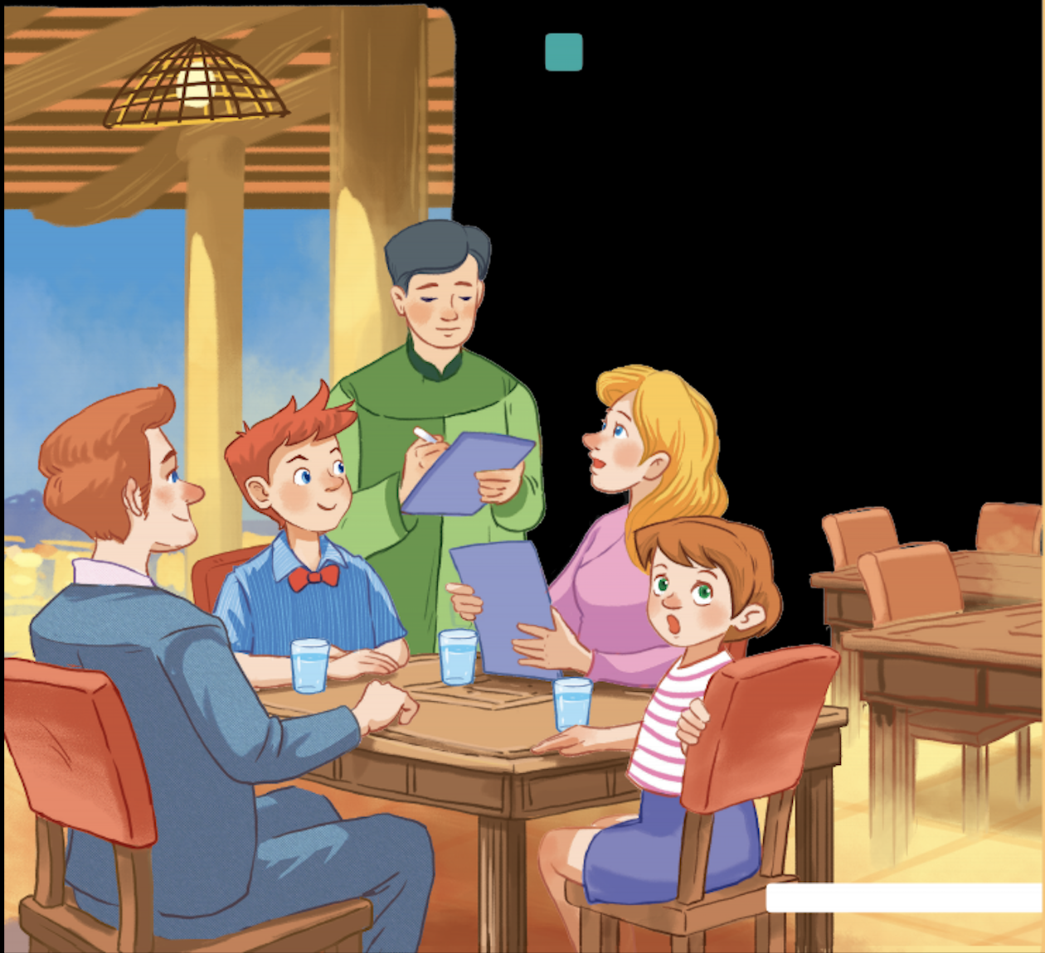
1
Listen and read.
- Where is Mark's family?
- What are they doing?
- Have you ever been to a restaurant?
- Where and when?
- What food and drink did you have there?

Slide 15
1
Listen and read.
Waiter: Good evening. What can I get you today?
Mark's mum: We'd like rice with some pork cooked in fish sauce. Oh, could we also have an order of roast chicken and fried vegetables?
Mark: And I'd like some fried tofu and spring rolls too.
Waiter: OK. Would you like any canh? It's a kind of Vietnamese soup. We often have it with rice.
Mark's dad: Let me see ... I think we'll try some canh.
Waiter: With shrimp or fish?
Mark's dad: With shrimp, please.
Waiter: Would you like anything to drink? We have a lot of drinks: juice, lemonade, green tea, mineral water, ...
Mark's mum: Mineral water for me, green tea for my husband, and juice for my children.
Waiter: What kind of juice would you like?
Mark's sister: Do you have winter melon juice?
Waiter: Let me see. Er, yes. How many cans would you like?
Mark's sister: One ... No, wait, two please. By the way, how much is a can of winter melon juice?
Mark: The menu says it's 10,000 dong.
Waiter: That's right. I'll be right back with your order.

Slide 16
2
Look at the pictures and answer the questions
What is Mark's family doing?
A. Ordering food for dinner.
B. Preparing for their dinner.
C. Talking about their favourite food.

Slide 17
3
Find the words and phrases about food and drink in the conversation and write them in the correct columns.
rice
Waiter: Good evening. What can I get you today? Mark's mum: We'd like rice with some pork cooked in fish sauce. Oh, could we also have an order of roast chicken and fried vegetables?
Mark: And I'd like some fried tofu and spring rolls too.
Waiter: OK. Would you like any canh? It's a kind of Vietnamese soup. We often have it with rice.
Mark's dad: Let me see ... I think we'll try some canh.
Waiter. With shrimp or fish?
Mark's dad: With shrimp, please.
Waiter: Would you like anything to drink? We have a lot of drinks: juice, lemonade, green tea, mineral water, ...
Mark's mum: Mineral water for me, green tea for my husband, and juice for my children.
Waiter: What kind of juice would you like?
Mark's sister: Do you have winter melon juice?
Waiter: Let me see. Er, yes. How many cans would you like?
Mark's sister: One ... No, wait, two please. By the way, how much is a can of winter melon juice?
Mark: The menu says it's 10,000 dong.
Waiter: That's right. I'll be right back with your order.
Food | Drink
pork
fish sauce
roast chicken
fried vegetables
rice
pork
fish sauce
juice
lemonade
fried tofu
spring rolls
roast chicken
canh
green tea
fried vegetables
mineral water
fried tofu
spring rolls
winter melon juice
fish
canh (soup)
shrimp
shrimp
fish
lemonade
mineral water
green tea
juice
winter melon juice

Slide 18
3
Read the conversation again and tick (✓) T (True) or F (False).
Waiter: Good evening. What can I get you today? Mark's mum: We'd like rice with some pork cooked in fish sauce. Oh, could we also have an order of roast chicken and fried vegetables?
Mark: And I'd like some fried tofu and spring rolls too.
Waiter: OK. Would you like any canh? It's a kind of Vietnamese soup. We often have it with rice.
Mark's dad: Let me see ... I think we'll try some canh.
Waiter: With shrimp or fish?
Mark's dad: With shrimp, please.
Waiter: Would you like anything to drink? We have a lot of drinks: juice, lemonade, green tea, mineral water, ...
Mark's mum: Mineral water for me, green tea for my husband, and juice for my children.
Waiter: What kind of juice would you like?
Mark's sister: Do you have winter melon juice?
Waiter: Let me see. Er, yes. How many cans would you like?
Mark's sister: One ... No, wait, two please. By the way, how much is a can of winter melon juice?
Mark: The menu says it's 10,000 dong.
Waiter: That's right. I'll be right back with your order.
a Vietnamese
restaurant
1. Mark's family is at a Vietnamese restaurant.
2. Mark wants fried tofu and beef for dinner.
3. They don't order canh.
4. Mark's mum wants mineral water.
5. His mum doesn't allow her children to drink juice during dinner.
TRUE
Mark
fried tofu
spring rolls
Vietnamese
Mark
fried tofu
beef
FALSE
we'll try some canh
don't order canh
FALSE
mum
mineral water
mum
Mineral water
juice for my
TRUE
children
mum
doesn't allow
drink
juice
FALSE

Slide 19
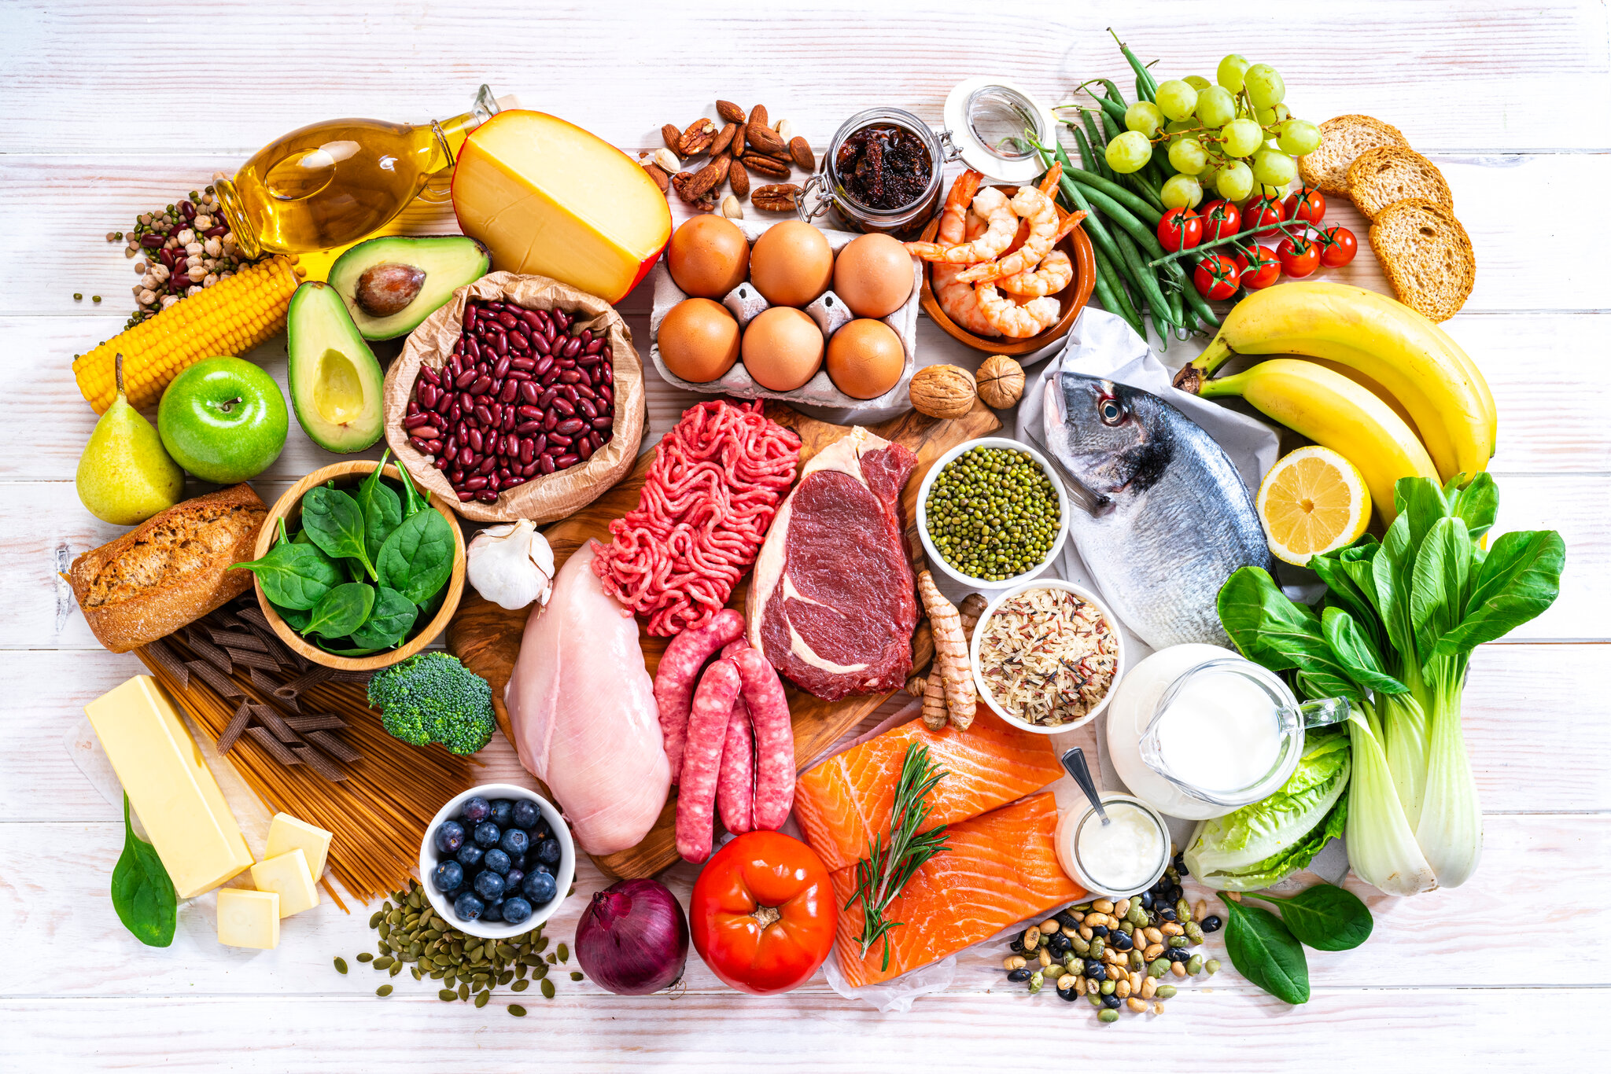
5
Work in pairs. Think about your favorite food and drink. Then ask your partner about his or her favorite food and drink.
* Example:
A: What's your favourite food?
B: It's pho bo - beef noodle soup.
A: When do you usually have it?
B: In the morning.

Slide 20
5
Work in pairs. Think about your favorite food and drink. Then ask your partner about his or her favorite food and drink.
* Example:
Ngan: What's your favourite food?
Linh: It's spring rolls.
Ngan: When do you usually have it?
Linh: I usually have it in the dinner.

Slide 21
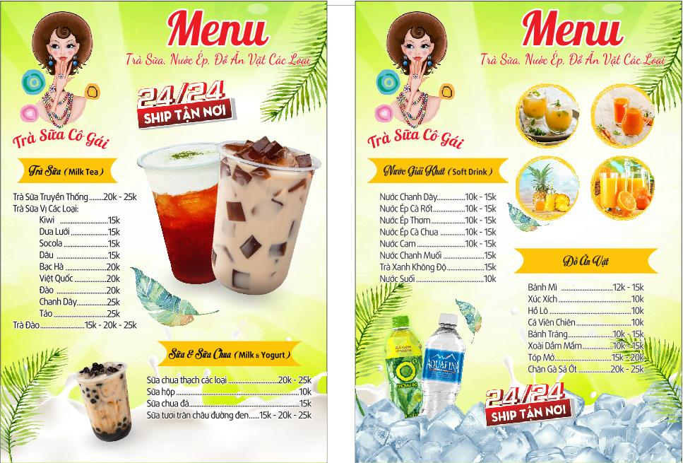
5
Work in pairs. Think about your favorite food and drink. Then ask your partner about his or her favorite food and drink.
* Example:
Ngan: What's your favourite drink?
Linh: It's milk tea.
Ngan: When do you usually have it?
Linh: I usually have it in the evening.

Slide 22
* CONSOLIDATION
1
WRAP-UP
Food and Drink
Favourite food and drink
Topic of the unit
Vocabulary

Slide 23


Homework
- Talk about your favourite food (for a minute)
- Do the exercises in the workbook .
- Prepare lesson 2 (A closer look 1).

Slide 24

Goodbye!
See you again
Thank you!
Have a nice day!

