Slide 1
Unit 3
Teenagers
Lesson 2: A closer look 1

Slide 2
OBJECTIVES
use the words related to teen school clubs, teens' use of social media, and teen stress;
01
pronounce the sounds /ʊə/ and /ɔɪ/ correctly in words and sentences
02
After this lesson, students will be able to:

Slide 3
01
Vocabulary

Slide 4


VOCABULARY
upload (v)
/ˌʌpˈləʊd/
tải lên

Slide 5

VOCABULARY
browse (v)
/braʊz/
đọc lướt, tìm
(trên mạng)

Slide 6
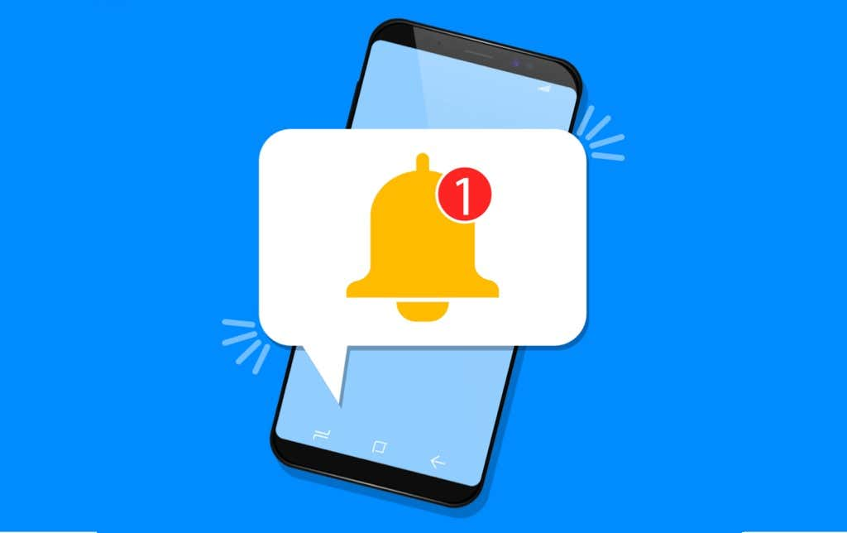
VOCABULARY
notification (n)
/ˌnəʊtɪfɪˈkeɪʃn/
thông báo

Slide 7
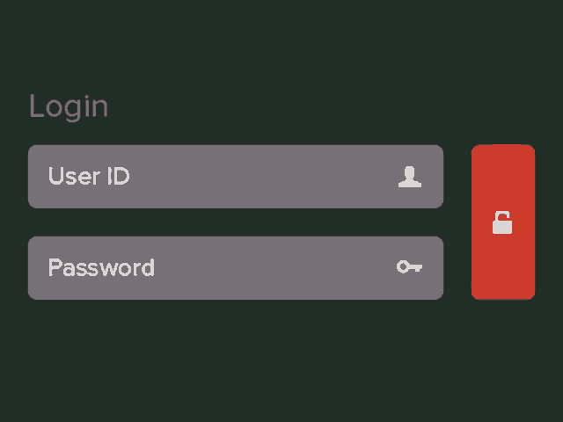
VOCABULARY
log on to (v)
/lɒɡ ɒn tə/
đăng nhập

Slide 8
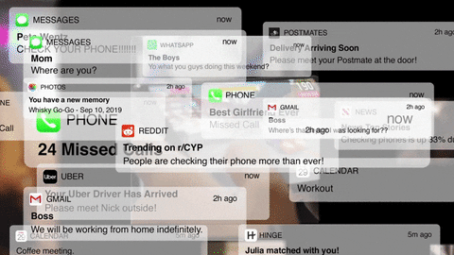
VOCABULARY
check (v)
/tʃek/
kiểm tra

Slide 9
VOCABULARY
New words | Pronunciation | Meaning
1. upload (v) | /ˌʌpˈləʊd/ | tải lên
2. browse (v) | /braʊz/ | đọc lướt, tìm (trên mạng)
3. notification (n) | /ˌnəʊtɪfɪˈkeɪʃn/ | thông báo
4. log on to (v) | /lɒɡ ɒn tə/ | đăng nhập
5. check (v) | /tʃek/ | kiểm tra

Slide 10
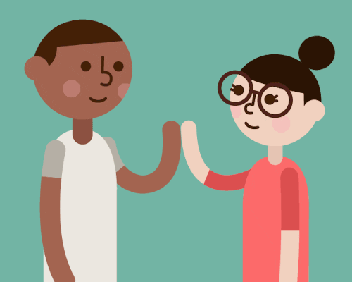
1 (p.30) Circle the correct options to complete the phrases.
1. upload
A. a picture
B. a website
2. browse
A. a website
B. a clip
3. check
A. pictures
B. notifications
4. log on
A. to a club
B. to an account
5. connect
A. a post
B. with friends

Slide 11
2 (p.30) Use the correct forms of the verbs in 1 to complete the sentences.
browsed
1. I________ the school website and found pictures of school activities.
2. Our teacher ________ a video of our last meeting in our forum for everyone to see.
3. She ________ with some old friends at the English club.
4. Tom ________ the notifications and saw some new posts.
5. Mi often ________ to her Instagram account to chat with her friends.
1. I________ the school website and found pictures of school activities.
2. Our teacher ________ a video of our last meeting in our forum for everyone to see.
3. She ________ with some old friends at the English club.
4. Tom ________ the notifications and saw some new posts.
5. Mi often ________ to her Instagram account to chat with her friends.
uploaded
connects
checked
logs on

Slide 12
3 (p.30) Choose the correct answer A, B, or C.
1. Our class has a(n)____, and we often post questions there to discuss.
A. office B. forum C. club
2. We try to meet our parents’ ______, but it is hard.
dreams B. interests C. expectations
3. He is a big ______ and scares his weaker classmates.
A. bully B. forum C. pressure
4. She was chatting with her friends, so she couldn’t ___ on the lesson.
A. concentrate B. coach C. advise
5. We have ______ from our exams, peers, and parents. This makes us feel very stressed.
A. interests B. pressure C. friends

Slide 13
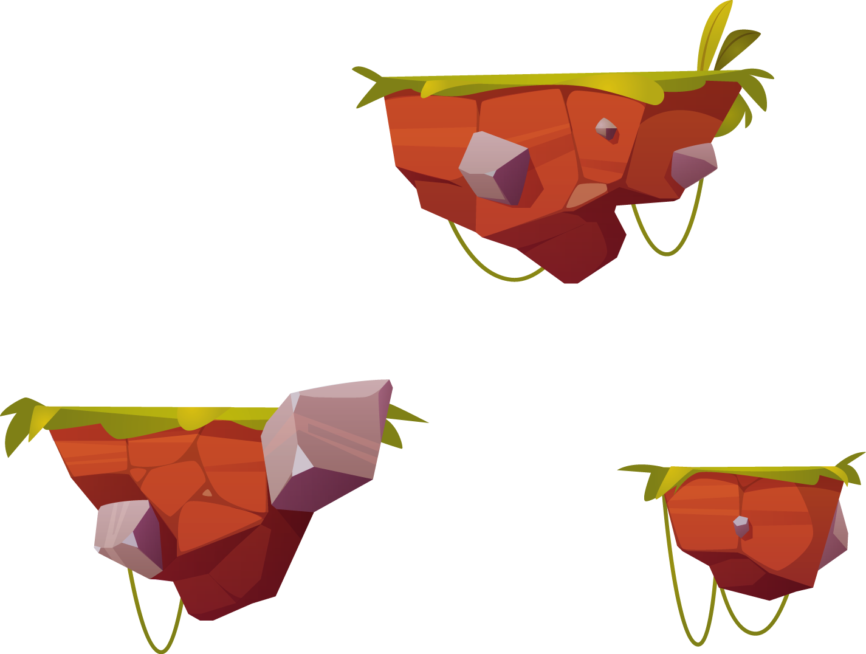
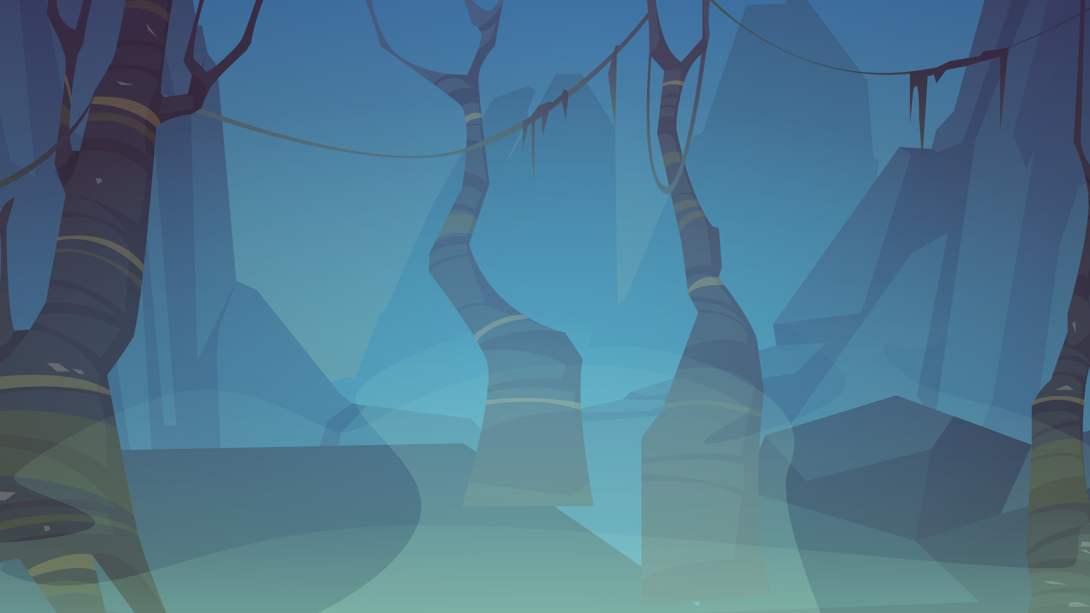
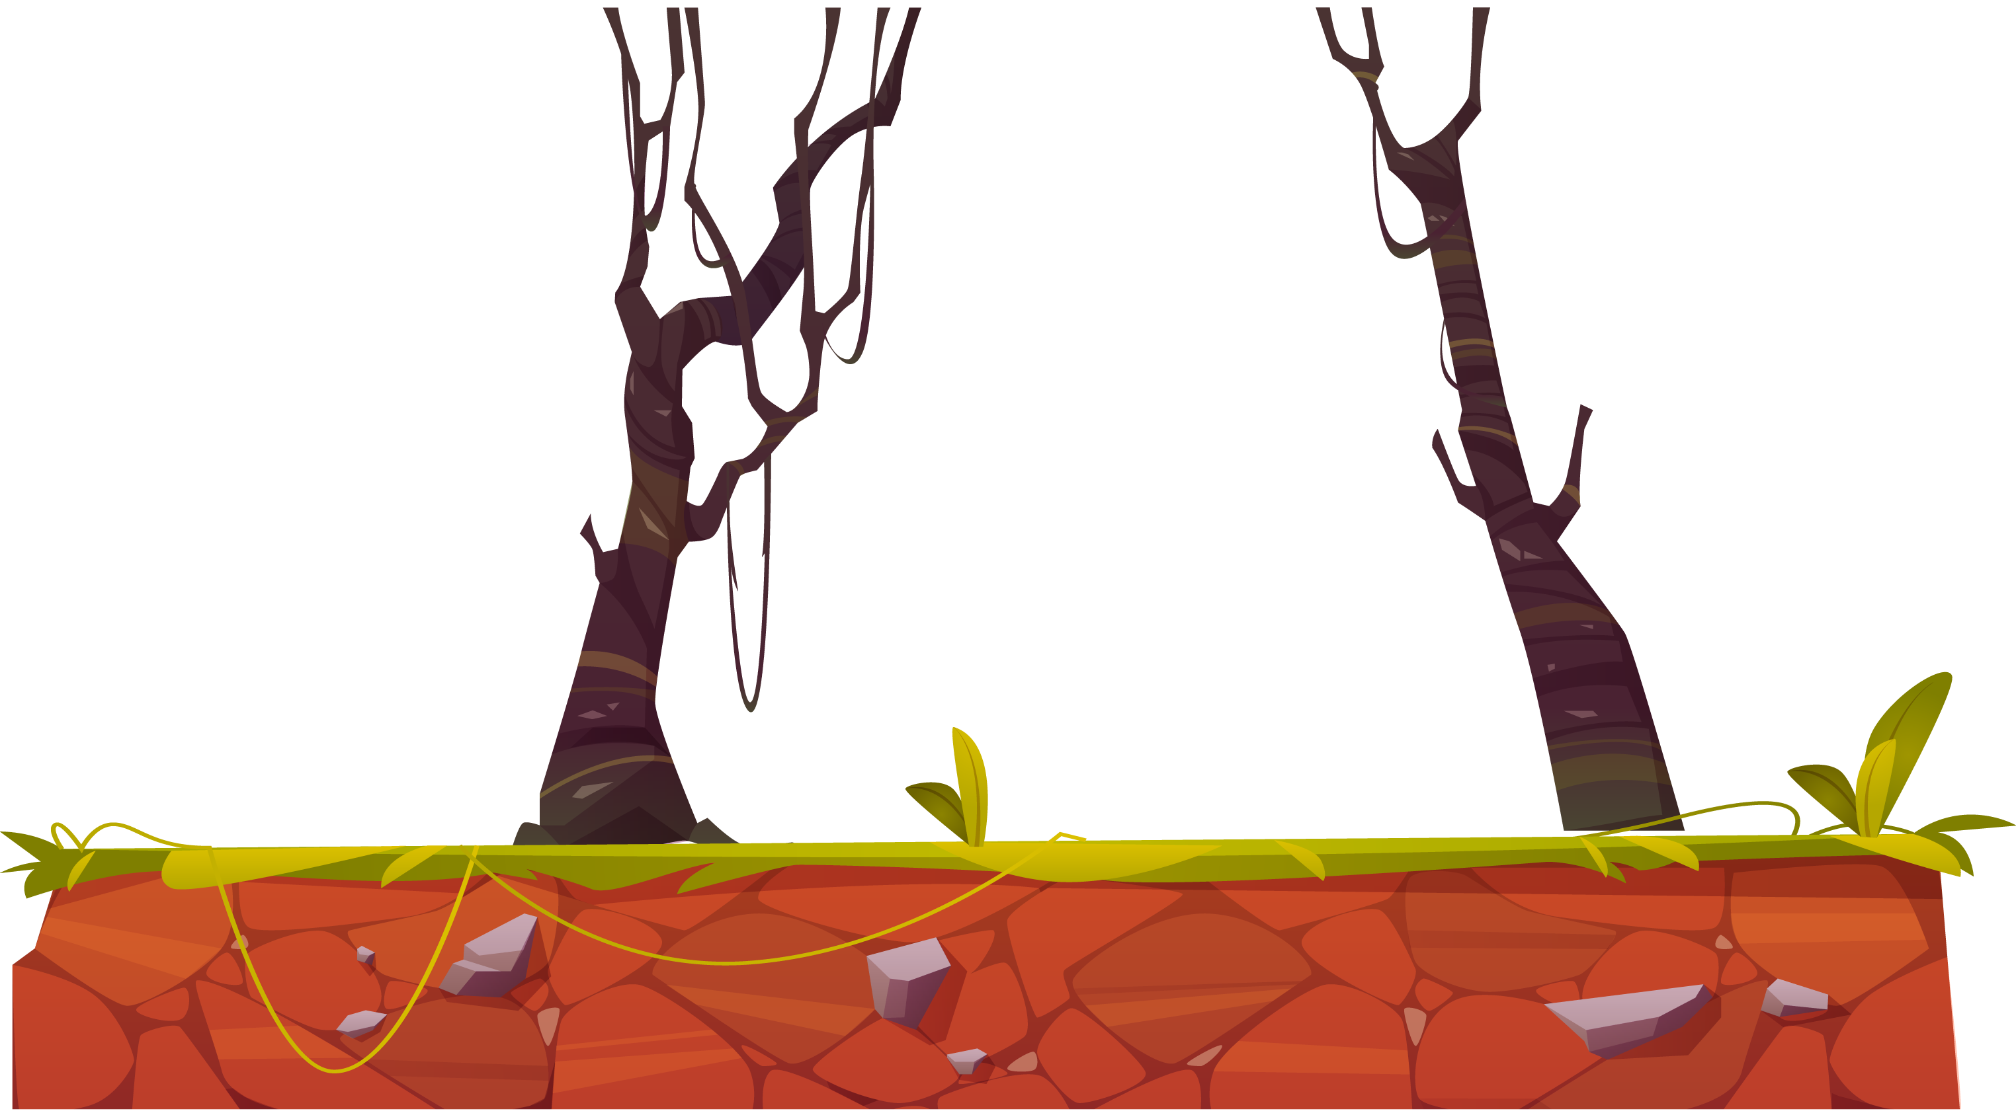
Mini Game

Slide 14
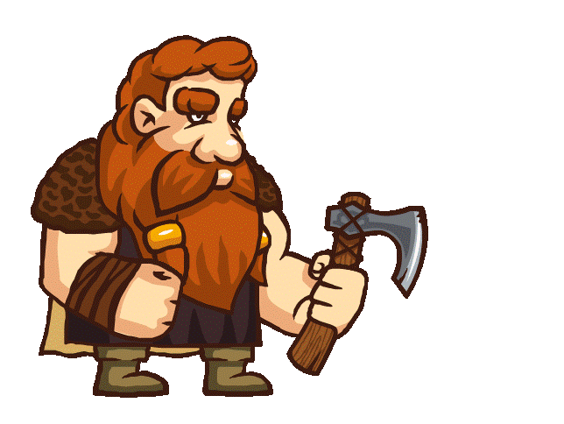
Quiz Game
4
5
2
3
1
Notes:
GV chọn vào ô số để hiện câu hỏi
Chọn vào đồng tiền để người Viking di chuyển

Slide 15
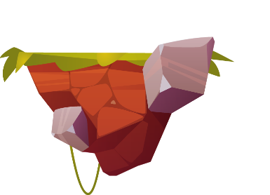
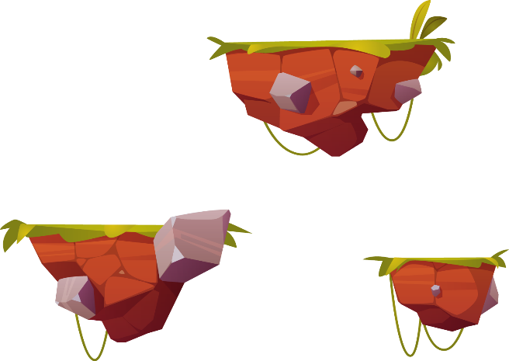
Question 1 : Our class has a(n)______, and we often post questions there to discuss.
Quiz Game
A. office
B. forum
C. club
D. club

Slide 16
Question 2 : We try to meet our parents’ ______, but it is hard.
Quiz Game
A. dreams
B. interests
C. expectations
D. hope

Slide 17
Question 3 : He is a big ______ and scares his weaker classmates.
Quiz Game
A. bully
B. forum
C. pressure
D. classmate

Slide 18
Question 4 : She was chatting with her friends, so she couldn’t ______ on the lesson.
Quiz Game
A. concentrate
B. coach
C. advise
D. participate

Slide 19
Question 5: We have ______ from our exams, peers, and parents. This makes us feel very stressed.
Quiz Game
A. interests
B. pressure
C. friends
D. skills

Slide 20


Victory

Slide 21
02
Pronunciation

Slide 22
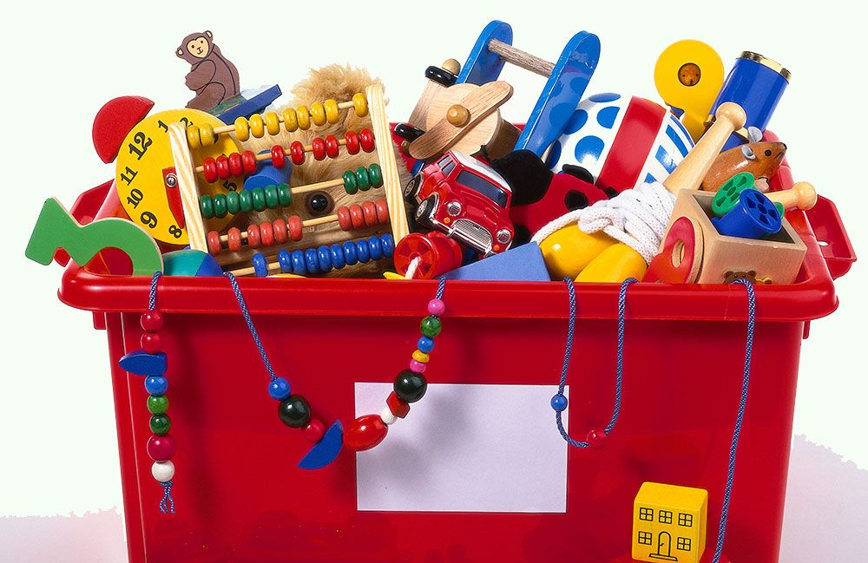
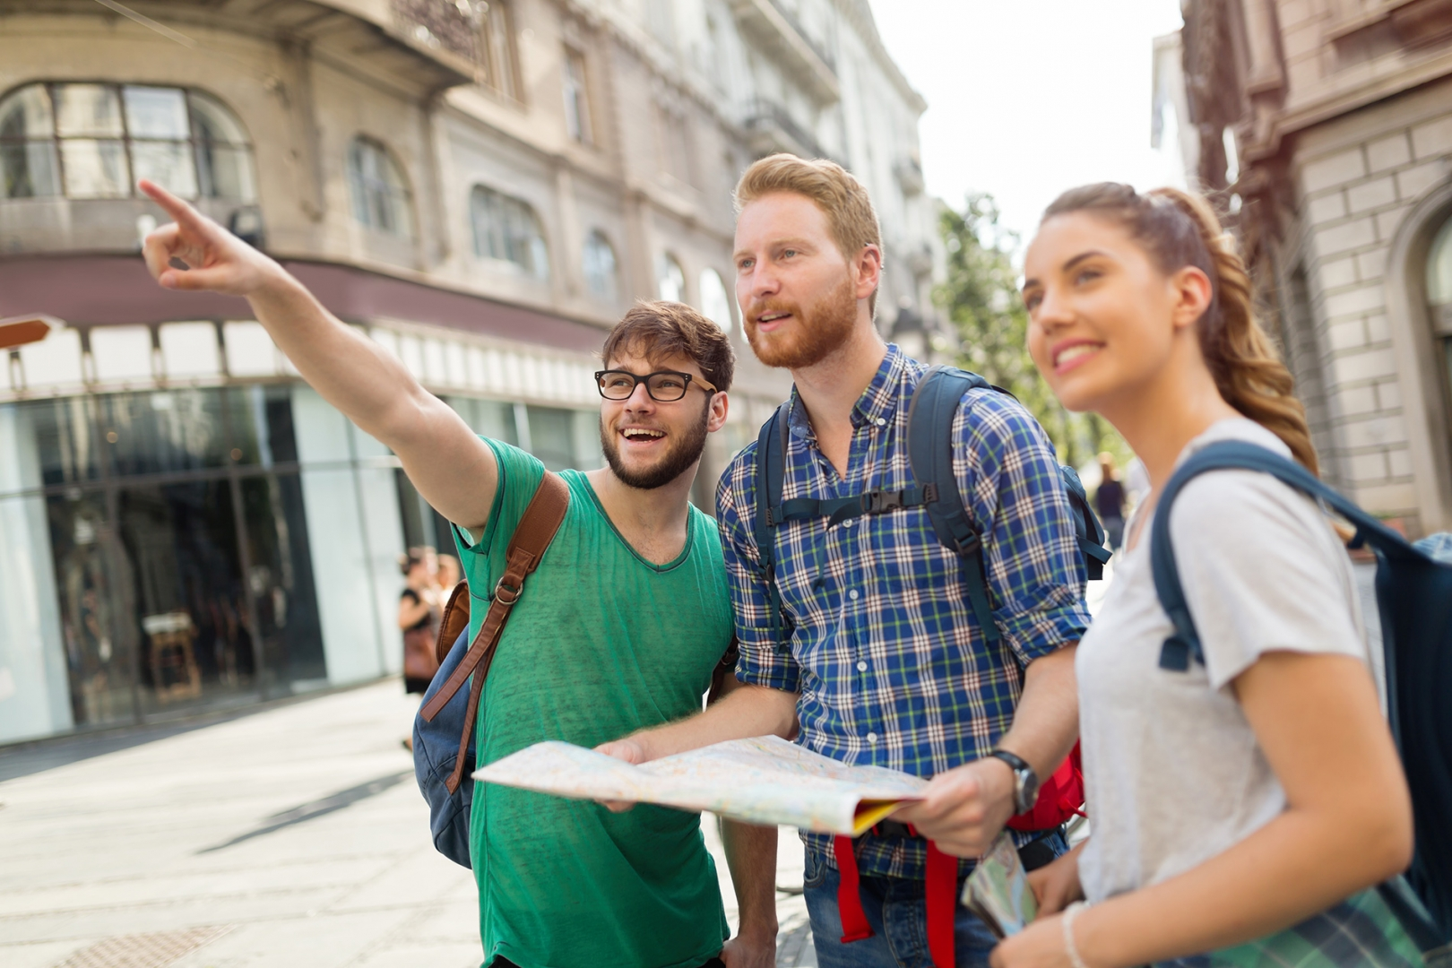
How can you pronounce?
toy
/tɔɪ/
tourist
/ˈtʊərɪst/

Slide 23


Slide 24
4 (p.30) Listen and repeat the words. Pay attention to the sound /ʊə/ and /ɔɪ/.
tourist
toy
ensure
boy tourist toy ensure
avoid choice sure tournament
boy
avoid
choice
sure
tournament

Slide 25
4 (p.30) Then put the words into the correct columns.
tourist
toy
ensure
boy tourist toy ensure
avoid choice sure tournament
boy
avoid
choice
sure
tournament
/ʊə/ | /ɔɪ/
tourist
boy
ensure
toy
sure
avoid
tournament
choice

Slide 26
5 (p.30) Listen and practice the sentences. Underline the words with /ʊə/ and circle the words /ɔɪ/.
1. She is a noisy and curious girl.
2. They joined a full-day city tour.
3. I found it enjoyable to watch the tournament.
4. She’ll record our voices during the interview.
5. He is not acting very mature and is starting to annoy me.

Slide 27
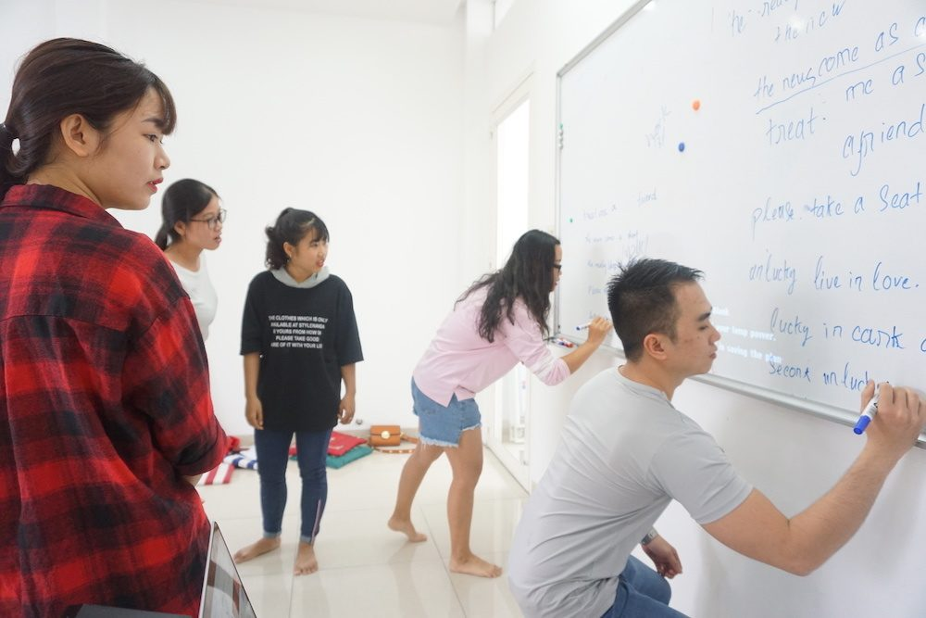
Further practice
BOARD RACE
Work in teams.
3 minutes
1 student from each team writes the words on the board.
Others speak out loud as many words that include /ʊə/ or /ɔɪ/ as possible.
The team with more correct answers is the winner.

Slide 28
Wrap-up
After this lesson, can students:
□ List some verb phrases learned in the lesson.
□ List some other learned words / phrases related to teenagers’ activities or pressure.
□ Give 2 sounds learned in the lessons and give examples.

Slide 29
Thanks for your attention!
Please keep this slide for attribution

Slide 30
Icon pack

Slide 31
Fonts & colors used
This presentation has been made using the following fonts:
Paytone One
(https://fonts.google.com/specimen/Paytone+One)
Montserrat Medium and Bold
(https://fonts.google.com/specimen/Montserrat)
#241e58
#ffffff
#f1f1f1
#dadada
#ff767a
#ffca63
#c6eaff

