Slide 1


Slide 2




Welcome to our English class .
7A

Slide 3
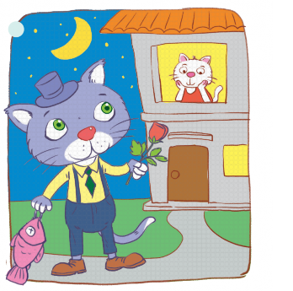
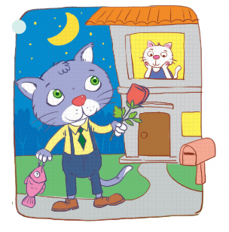
WARM UP
Work in 2 groups to write down what there are in the pictures
B
A

Slide 4
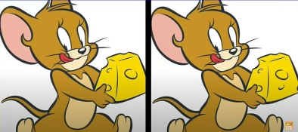
Are there any differences (≠) between the 2 pictures ?
And what are the similarities between them?
A
B

Slide 5
And today we are going to talk about the similarities and the differences by using “ Like, Different from, and as….as”

Slide 6
Tuesday, November 12th, 2024
PERIOD 30. UNIT 4: MUSIC AND ART
Lesson 3: A CLOSER LOOK 2

Slide 7
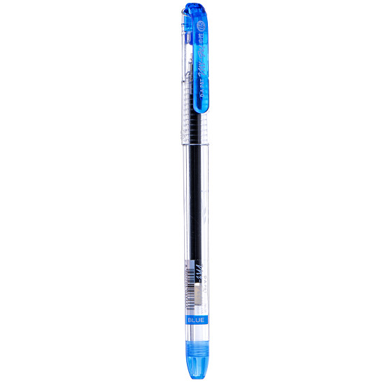
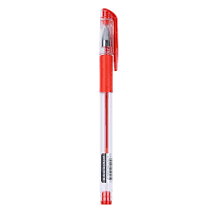
PRESENTATION
Grammar: COMPARISONS
* Different form: khác với
→ The blue pen A is different from the red pen B.
Form: S + be + different from + noun/pronoun
A
B

Slide 8

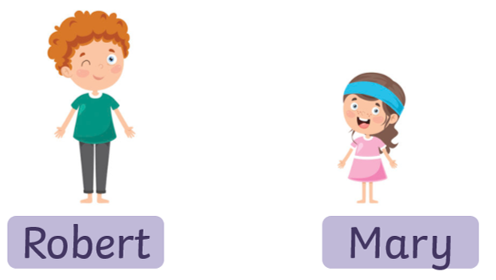
PRESENTATION: COMPARISON
*to be + like: Giống như
→ Robert’s pencil case is like Mary’s pencil case.
Form : S + Be + like + noun/pronoun

Slide 9
GRAMMAR: COMPARISON
10 cm
* As ……as: cũng như
8 cm
→ The blue pen is not as long as the red one.
→ The blue pen is as long as the red one.
From:
S + be + not as/so + adj + as +
S + be + as + adj + as +
noun/ pronoun
A
B
B

Slide 10
PRESENTATION
COMPARISONS
(not) as + adj + as
(to) be like
(to) be different from

Slide 11

1
Write like, as, or different in the gaps.
PRACTICE
This camera is not as expensive ______ I thought at first.
Her room is lovely. It is ________ a princess’s room.
You like folk songs; I like pop music. Your taste is __________ from mine.
My dad is not always as busy ________ my mum.
Some of us think that Spiderman 2 is not too __________ from Spiderman 1.
as
like
different
as
different

Slide 12

2
Finish the second sentence in each pair, using like, as … as, or different from.
PRACTICE
1. Rock is very exciting. It is not like country music.
Rock is very ________________ country music.
2. Composer Hoang Long wrote many good songs for children. Composer Pham Tuyen also wrote many good songs for children.
→ Composer Hoang Long, ____ Pham Tuyen, wrote many good songs for children.
3. The Vatican Museum has excellent works of art. The Louvre Museum has excellent works of art too.
→ The Vatican Museum ‘s works of arts are __________ excellent _________ the Louvre Museum’s works of art.
4. A vacation on the beach is relaxing, while a vacation in a big city may not be.
→ A vacation on the beach is ______________ a vacation in a big city
5. City life is busy, but country life is peaceful.
→ City life is not ____________ peaceful ___________ country life.

Slide 13
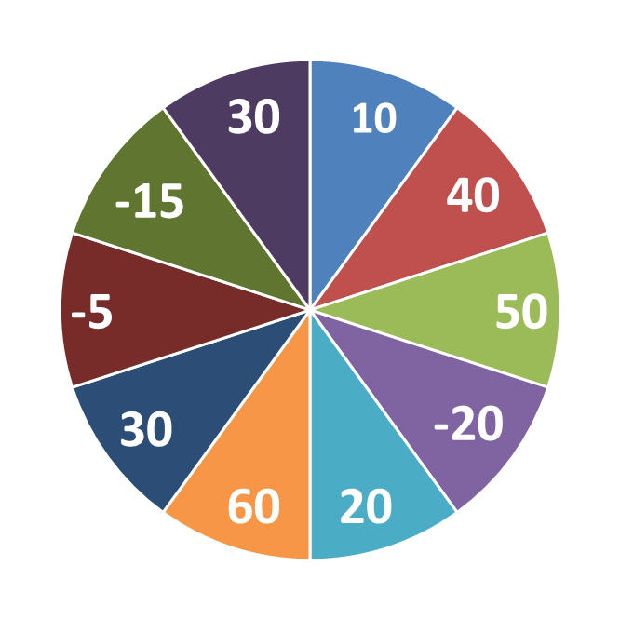
THE BIG WHEEL GAME
QUESTIONS
1
4
2
5
3

Slide 14

Finish the second sentence in each pair, using like, as … as, or different from.
2
PRACTICE
1. Rock is very exciting. It is not like country music.
Rock is very ________________ country music.
different from

Slide 15
Finish the second sentence in each pair, using like, as … as, or different from.
2
PRACTICE
2. Composer Hoang Long wrote many good songs for children. Composer Pham Tuyen also wrote many good songs for children.
→ Composer Hoang Long, ___________ Pham Tuyen, wrote many good songs for children.
like

Slide 16
2
PRACTICE
Finish the second sentence in each pair, using like, as … as, or different from.
3. The Vatican Museum has excellent works of art. The Louvre Museum has excellent works of art too.
→ The Vatican Museum ‘s works of arts are ___ excellent ____ the Louvre Museum’s works of art.
as
as

Slide 17
2
PRACTICE
Finish the second sentence in each pair, using like, as … as, or different from.
4. A vacation on the beach is relaxing, while a vacation in a big city may not be.
→ A vacation on the beach is ______________ a vacation in a big city
different from

Slide 18
2
PRACTICE
Finish the second sentence in each pair, using like, as … as, or different from.
5. City life is busy, but country life is peaceful.
→ City life is not ________ peaceful _______ country life.
as
as

Slide 19
2
Finish the second sentence in each pair, using like, as … as, or different from.
PRACTICE
1. Rock is very different from country music.
2. Composer Hoang Long like Pham Tuyen, wrote many good songs for children.
3. The Vatican Museum's works of art are as excellent as the Louvre Museum's works of art.
4. A vacation on the beach is different from a vacation in a big city.
5. City life is not as peaceful as country life.

Slide 20



3
Compare the two museums: History and Science, using like, as … as, or different from.
PRACTICE
 | History | Science
1. modern | ** | ***
2. friendly | *** | ***
3. safe | *** | **
4. expensive | ** | **

Slide 21
3
Compare the two museums: History and Science, using like, as … as, or different from.
PRACTICE
 | History | Science
1. modern | ** | ***
2. friendly | *** | ***
3. safe | *** | **
4. expensive | ** | **
Example:
1. History is not as modern as Science.
2. Friendly:
History is as friendly as Science.
3. Safe:
Science is not as safe as History.
4. Expensive:
Science is as expensive as History.

Slide 22

PRACTICE
4
Rewrite the sentences, using the words given at the beginning.
Example:
A play is usually longer than a film.
→ A film is usually not as long as a play.
1. I think action films are more interesting than comedies.
I think comedies are not ________________________________.
2. Our maths homework is more difficult than out history homework.
→ Our history homework is not ______________________________.
3. This year’s music contest is different from last year’s.
→ This year’s music contest is not ______________________________.
4. The characters in the film are not the same as the ones in the play.
The characters in the film are ________________________________.
5. This picture is brighter than that picture.
→ That picture is not ________________________________.
_{as interesting as action films}
as difficult as our maths homework
like last year’s
different from the ones in the play
as bright as this one

Slide 23


PRODUCTION
Look at the two pictures and compare them, using like, as … as, or different from.
5
Example:
- Picture A is not like / different from picture B.
- Picture A is not as big as picture B.
Suggested things:
- Moon:
- The flower:
- The fish:
- The cat’s shirt:
- The house :
- The moon:
- The top of white cat:
Picture A
Picture B

Slide 24
CONSOLIDATION
1
WRAP-UP
Grammar: Comparisons: like, different from, (not) as … as

Slide 25

CONSOLIDATION
2
HOMEWORK
Do exercises in the workbook.
Make 5 sentences with like, (not) as... as, different.
Prepare new lesson 4 communication

Slide 26

Website: hoclieu.vn
Fanpage: facebook.com/www.tienganhglobalsuccess.vn/

