Slide 1

ENGLISH 9
Chu Van An secondary school.
Hello everyone !!!

Slide 2
WARM-UP
Answer the questions:
1. Work in 2 teams.
2. Look through the conversation and the picture in page 50 in 30 seconds and try to remember as many details as possible.
3. Answer the questions.
4. 10 points/correct answer
Memorizing game

Slide 3
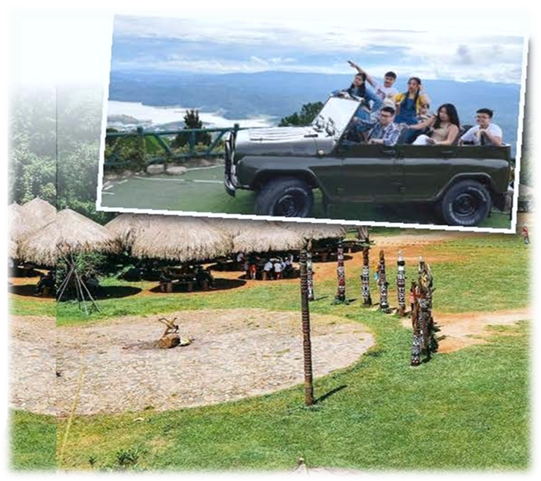
WARM-UP
Answer the questions:
How many people can you see
in the picture?
2. What type of vehicle are they riding?
3. Where are they?
6 people
A jeep
Da Lat /Langbiang mountain

Slide 4


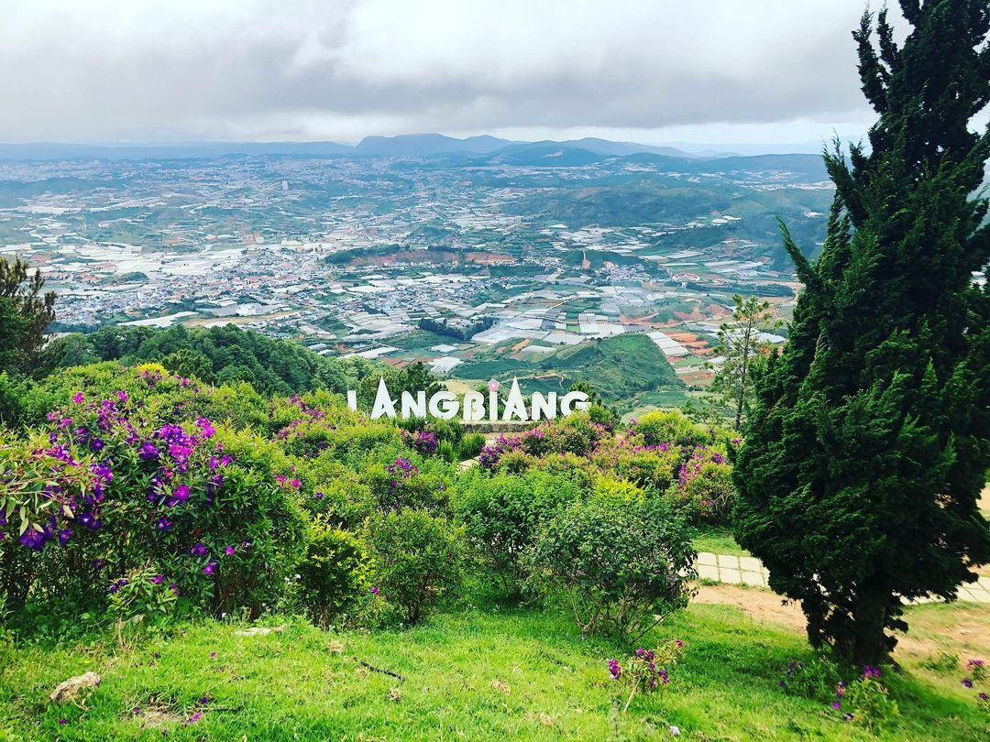
Unit
5
OUR EXPERIENCES
LESSON 1: GETTING STARTED
Experiences in Da Lat

Slide 5


Vocabulary
- experience (n)
/ɪkˈspɪəriəns/
sự trải nghiệm

Slide 6

Vocabulary
- eco-tour (n)
/ˈiːkə-tʊə(r)/
du lịch sinh thái

Slide 7
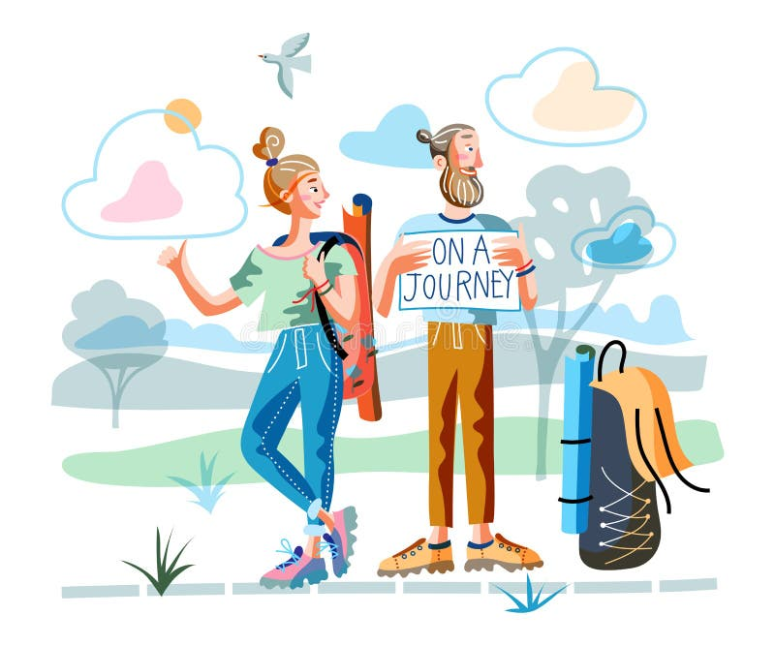
Vocabulary
- memorable (n)
/ˈmemərəbl/
đáng nhớ

Slide 8

Vocabulary
- brilliant (adj)
/ˈbrɪliənt/
rất ấn tượng

Slide 9

Vocabulary
- flora (n)
/ˈflɔːrə/
tất cả thực vật của một khu vực

Slide 10
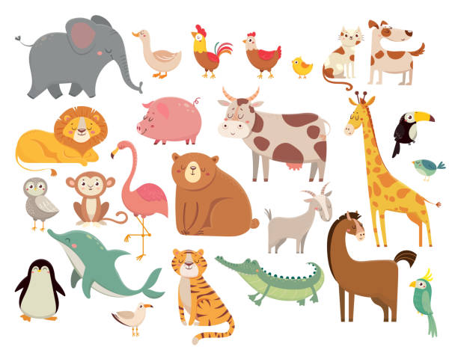
Vocabulary
- fauna (n)
/ˈfɔːnə/
tất cả động vật của một khu vực

Slide 11
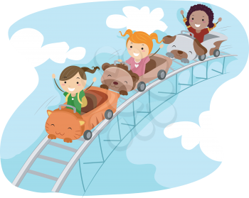
Vocabulary
- thrilling (adj)
/ˈθrɪlɪŋ/
phấn khích

Slide 12
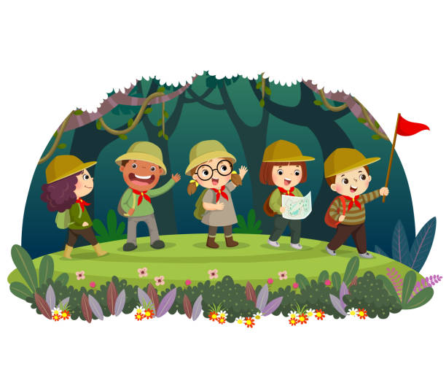
Vocabulary
- explore (V)
/ɪkˈsplɔː(r)/
khám phá

Slide 13

Vocabulary
- seabed (n)
/ˈsi:bed/
đáy biển

Slide 14
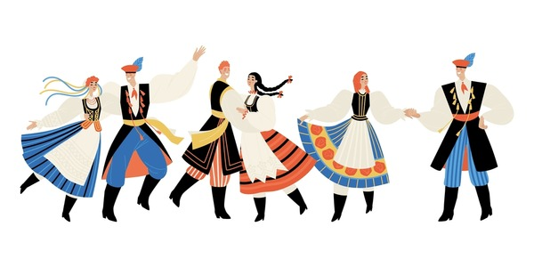
Vocabulary
- tribal dance (n)
/ˈtraɪbl dɑːns/
điệu múa của bộ tộc

Slide 15
Vocabulary
New words | Pronunciation | Meaning
1. experience (n) | /ɪkˈspɪəriəns/ | sự trải nghiệm
2. eco-tour (n) | /ˈiːkə-tʊə(r)/ | du lịch sinh thái
3. memorable (adj) | / ˈmemərəbl/ | đáng nhớ
4. brilliant (adj) | /ˈbrɪliənt/ | rất ấn tượng
5. flora (n) | /ˈflɔːrə/ | tất cả thực vật của một khu vực

Slide 16
Vocabulary
New words | Pronunciation | Meaning
6. fauna (n) | /ˈfɔːnə/ | tất cả động vật của một khu vực
7. thrilling (adj) | /ˈθrɪlɪŋ/ | phấn khích
8. explore (v) | /ɪkˈsplɔː(r)/ | khám phá
9. seabed (n) | /ˈsi:bed/ | đáy biển
10. tribal dance (n) | /ˈtraɪbl dɑːns/ | điệu múa của bộ tộc

Slide 17
PRACTICE
1
Listen and read.
Tom: Hi Mi, I’m back from Da Lat now. I have some local specialities for you.
Mi: Thanks Tom. I guess you and your family had a great time there.
Tom: Yeah. We visited LangBiang Mountain, and Cu Lan Village. We saw a gong show in the evening.
Mi: What did you do on LangBiang Mountain?
Tom: We rode a jeep to the top. It was a thrilling ride up there. Then we took an eco-tour of LangBiang Mountain. They said that the area is rich in flora and fauna with more than 150 plant and animal species.
Mi: Sounds amazing! What did you do then?
Tom: We took pictures of the magnificent scenery. It was really enjoyable!
Mi: Then did you explore Cu Lan Village?
Tom: Yes. We had a brilliant tour around the village. We also rode horses and a jeep along a stream.
Mi: That must have been exciting, Tom.
Tom: It definitely was. In the evening we saw an interesting gong show. We danced and sang with the locals. And we tried grilled pork. It was a really memorable evening. I’ll show you some pictures I took there.

Slide 18
PRACTICE
1
Listen and read.
Tom: Hi Mi, I’m back from Da Lat now. I have some local specialities for you.
Mi: Thanks Tom. I guess you and your family had a great time there.
Tom: Yeah. We visited LangBiang Mountain, and Cu Lan Village. We saw a gong show in the evening.
Mi: What did you do on LangBiang Mountain?
Tom: We rode a jeep to the top. It was a thrilling ride up there. Then we took an eco-tour of LangBiang Mountain. They said that the area is rich in flora and fauna with more than 150 plant and animal species.
Mi: Sounds amazing! What did you do then?
Tom: We took pictures of the magnificent scenery. It was really enjoyable!
Mi: Then did you explore Cu Lan Village?
Tom: Yes. We had a brilliant tour around the village. We also rode horses and a jeep along a stream.
Mi: That must have been exciting, Tom.
Tom: It definitely was. In the evening we saw an interesting gong show. We danced and sang with the locals. And we tried grilled pork. It was a really memorable evening. I’ll show you some pictures I took there.

Slide 19
2
Read the conversation again and write T (true) or F (False).
F
1. Mi and Tom had a great time in Da Lat. ______
2. Tom had an eco-tour of Langbiang Mountain. ______
3. There are more than 150 plant and animal species ______
on Langbiang Mountain.
4. Tom didn’t like his experiences in Cu Lan Village. ______
5. Tom danced and sang with the local people ______
at a gong show.
T
T
F
T

Slide 20
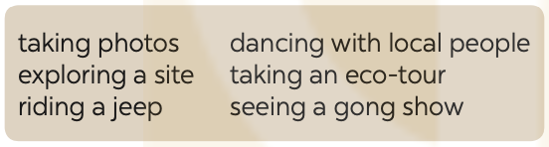
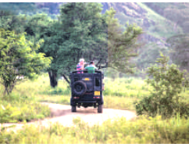
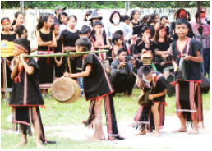
3
Write activities under the pictures.
riding a jeep
seeing a gong show
1. _______________
2. _______________

Slide 21
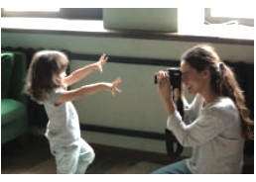
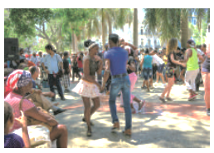
3
Write activities under the pictures.
taking photos
dancing with local people
3. _______________
4. _______________

Slide 22
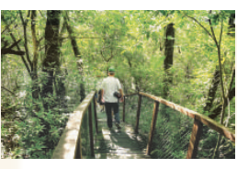
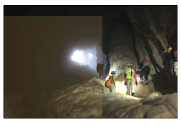
3
Write activities under the pictures.
taking an eco-tour
exploring a site
5. _______________
6. _______________

Slide 23
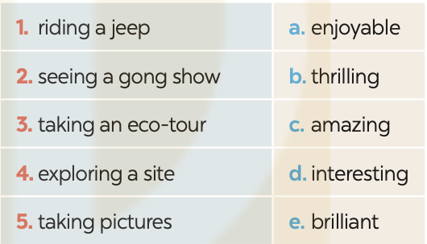
4
Read the conversation again and match the activities with the adjectives.

Slide 24
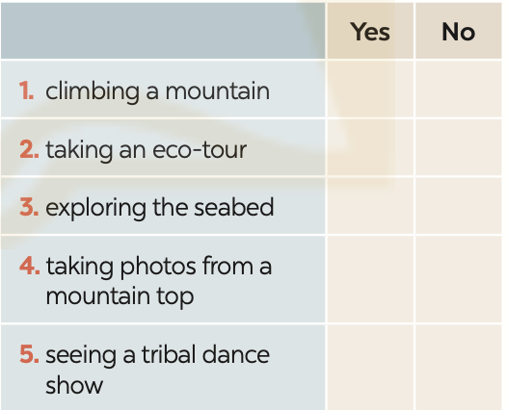
* PRODUCTION
5
Work in groups. Carry out a survey. Then report your group’s findings to the class. Do you like ...?
Example:
I did a survey with 3 peers. Two like climbing a mountain, 3 like taking eco-tours, nobody likes exploring the seabed….

Slide 25

* CONSOLIDATION
What have we learnt in this lesson?
use lexicidentify the topic of the unit
al items related to experiences
identify the language features that are covered in the unit

Slide 26

* Homework
Do exercises in the workbook.
Make a list of adjectives to describe experience.
Start preparing for the Project of the unit 5.

Slide 27


Thank you!
Goodbye!

Slide 28
LESSON 1: GETTING STARTED
LESSON 1: GETTING STARTED
WARM-UP
Asking questions
Vocabulary
PRESENTATION
Task 1: Listen and read.
Task 2: Read the conversation again and circle the correct answers.
Task 3: Write the expressions from the conversation in the correct column.
Task 4: Complete the sentences with the words from the box.
PRACTICE
Task 5: Work in pairs. Decide if the statements below are True or False about life in Viet Nam 40 years ago. Share your answers with the class.
PRODUCTION
CONSOLIDATION
Wrap-up
Homework

