Slide 1
Hello everyone !

Slide 3
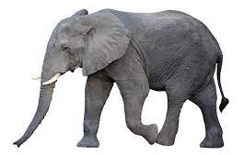
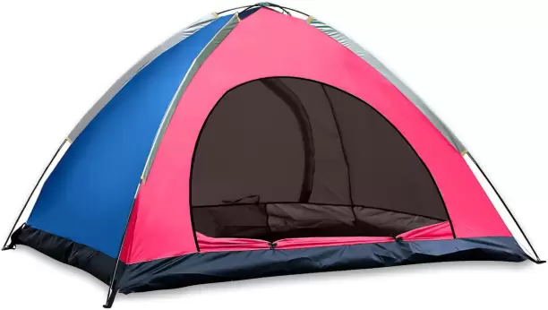
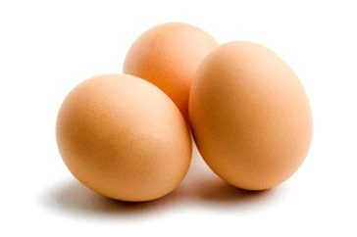
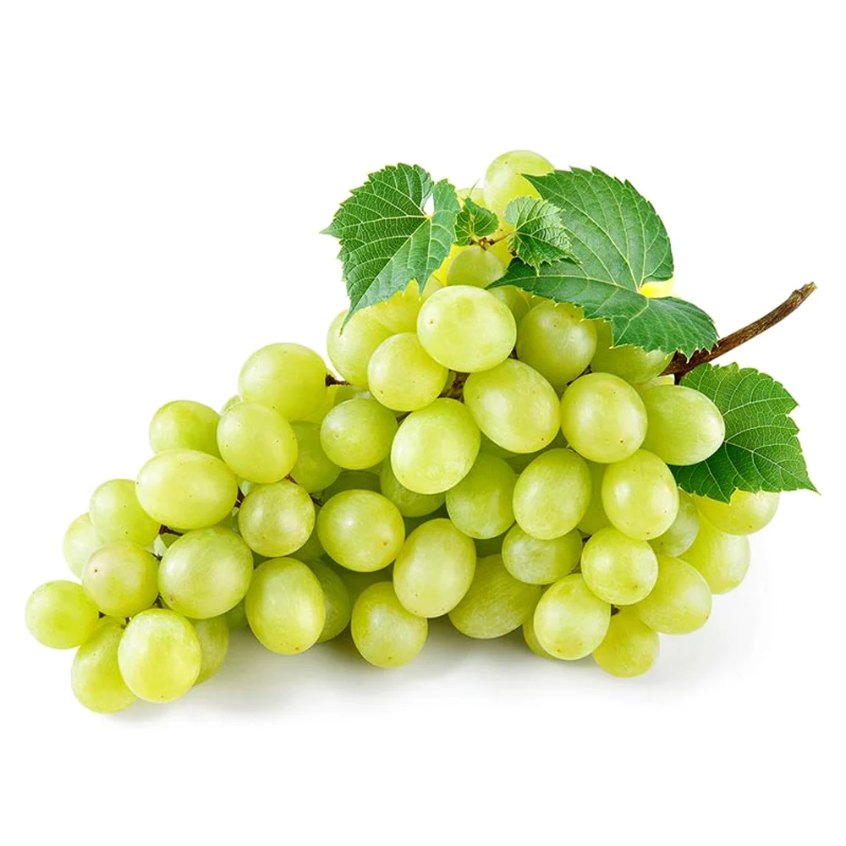
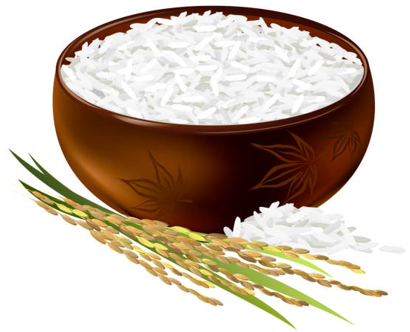
WARM-UP
Tent
Eggs
Elephant
Nose
Apple
Grapes
Eagle
Rice
Sunflower

Slide 4
t | E | E | N | A | G | E | R | S

Slide 5
Unit
3
TEENAGERS
LESSON 1: GETTING STARTED
It’s great to see you again!

Slide 6
I. VOCABULARY
forum (n):
diễn đàn
/ˈfɔːrəm/

Slide 7
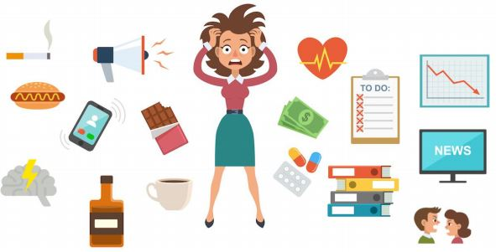
stress (n):
sự căng thẳng
/ˌstres/

Slide 8
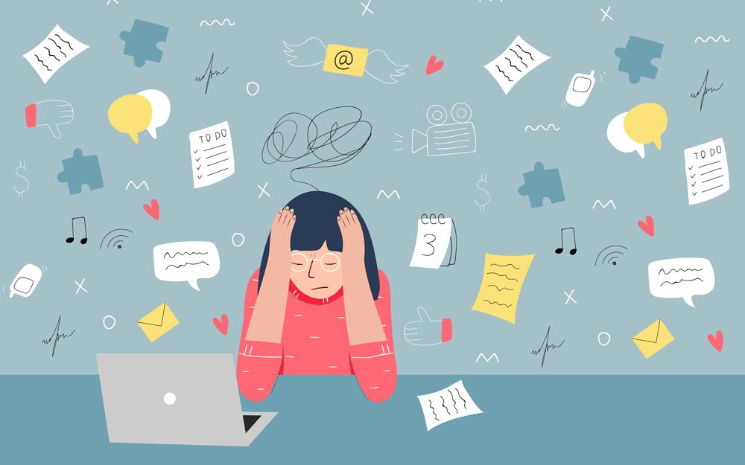
stressful (adj):
căng thẳng, tạo áp lực
/ˈstresfl/

Slide 9
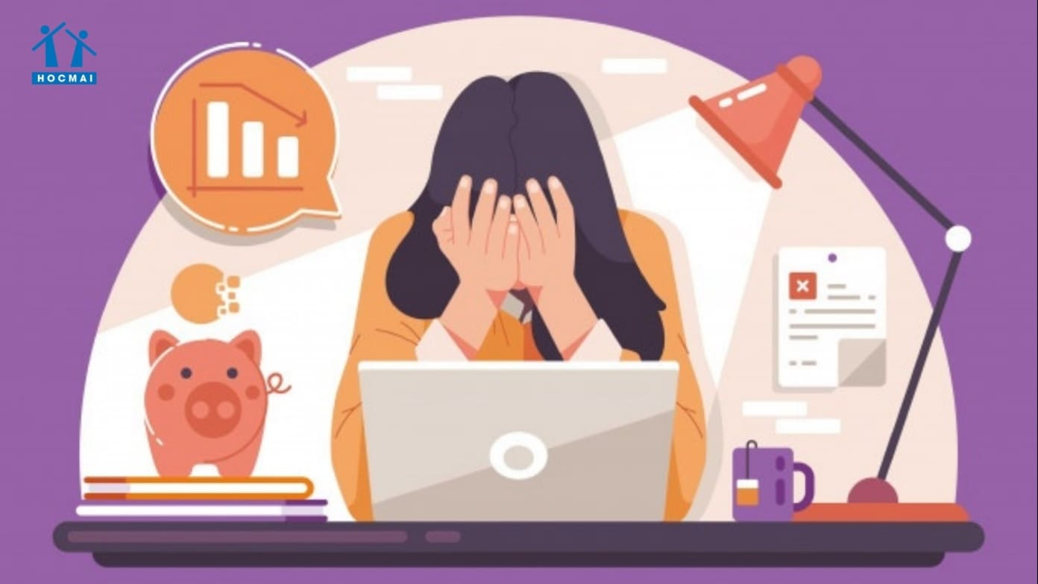
pressure (n):
áp lực
/ˈpreʃə(r)/

Slide 10
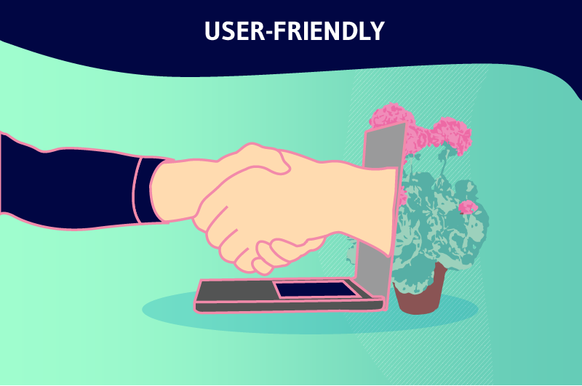
user-friendly (adj) :
thân thiện với người dùng
/ˈjuːzə-ˈfrendli/

Slide 11
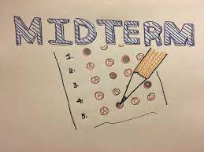
midterm (adj):
giữa kì
/ˌmɪdˈtɜːm/

Slide 12
* VOCABULARY
New words | Pronunciation | Meaning
1. forum (n) | /ˈfɔːrəm/ | diễn đàn
2. stress (n) | /stres/ | sự căng thẳng
3. stressful (adj) | /ˈstresfl/ | căng thẳng, tạo áp lực
4. pressure (n) | /ˈpreʃə(r)/ | áp lực
5. user-friendly (adj) | /ˌjuːzə ˈfrendli/ | thân thiện với người dùng, dễ dùng
6. midterm (adj) | /ˌmɪdˈtɜːm/ | giữa kì

Slide 13
* Checking vocab
Say words in English
diễn đàn
forum
Giữa kì
midterm
thân thiện với người dùng
user-friendly
stressful
căng thẳng, tạo áp lực
sự căng thẳng
stress
áp lực
pressure

Slide 14
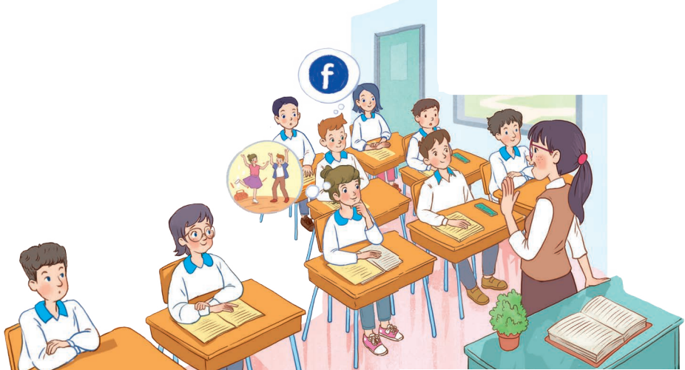
1. READ AND LISTEN
- Who are the people?
- What might they be talking about?

Slide 15
1
Listen and read.
Teacher: It’s great to see you again, class. What’s going on? Minh: We’ve decided to use Facebook for our class forum, and we joined some school club activities. We’re also preparing for the midterm tests. It’s really stressful. Teacher: I’m sorry to hear that. I know exams may give you a lot of stress. But stay calm and work hard. What other pressure do you have? Minh: Well, we also have pressure from our parents and friends. Teacher: Do you? Let’s discuss these problems in your new Facebook group. By the way, why did you choose Facebook? Ann: Because it’s user-friendly. Teacher: Good! How about club activities? Do you find them enjoyable? Ann: Yes. This year there are some new clubs like arts and crafts, and music. The club leaders will provide us with a variety of activities to suit different interests. And there will also be competitions as usual. Teacher: Awesome! I hope you all can join the clubs you like.

Slide 16
2
Read the conversation again and write T (true) or F (False).
Sentences | T | F
1. The students finished their midterm tests
2. Minh mentions the different types of pressure they are facing.
3. The teacher tells them to stay calm and work hard.
4. The class will discuss their problems offline.
5. The school has different clubs for its students.

Slide 17
2
Read the conversation again and write T (true) or F (False).
Sentences | T | F
1. The students finished their midterm tests
2. Minh mentions the different types of pressure they are facing.
3. The teacher tells them to stay calm and work hard.
4. The class will discuss their problems offline.
5. The school has different clubs for its students.
They are preparing for the midterm test.
The class will discuss their problems in their new Facebook group.

Slide 18
3
Write a word or phrases from the box under the correct pictures.
language club
pressure
1. _______________
2. _______________

Slide 19
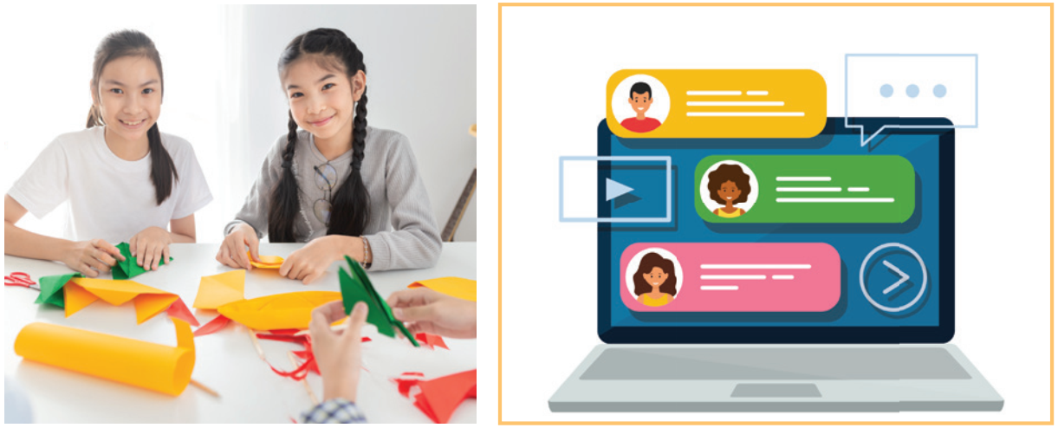
3
Write a word or phrases from the box under the correct pictures.
arts and crafts club
forum
3. _______________
4. _______________

Slide 20
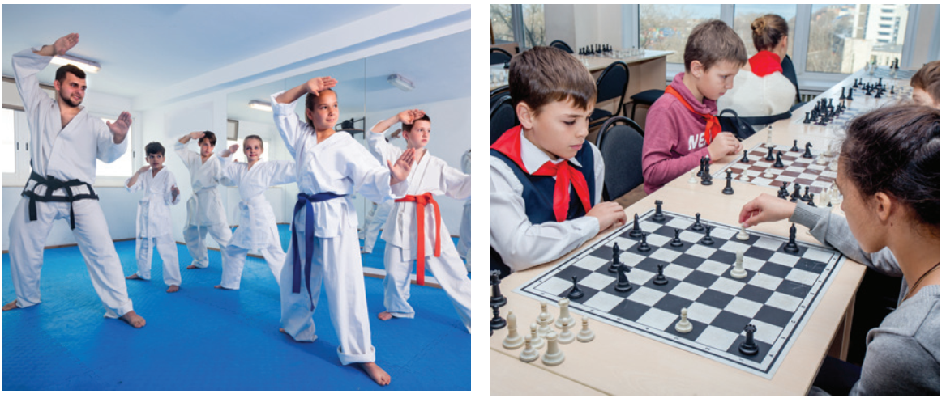
3
Write a word or phrases from the box under the correct pictures.
sports club
chess club
5. _______________
6. _______________

Slide 21
4
Complete each of the sentences with a word or phrase in 3.
1. Minh is a member of our ______________. The greeting cards he makes are really creative.
2. Students can discuss their problems in their class ________.
3. We share the essays and stories that we write in English in our ______________.
4. She is not feeling very well this weekend because of all the _________
from her school work.
5. The coach of our ____________ tells us to drink plenty of water during our practice sessions.
6. My friend, Manh likes playing chess, and he is a member of our school__________.
Game

Slide 22
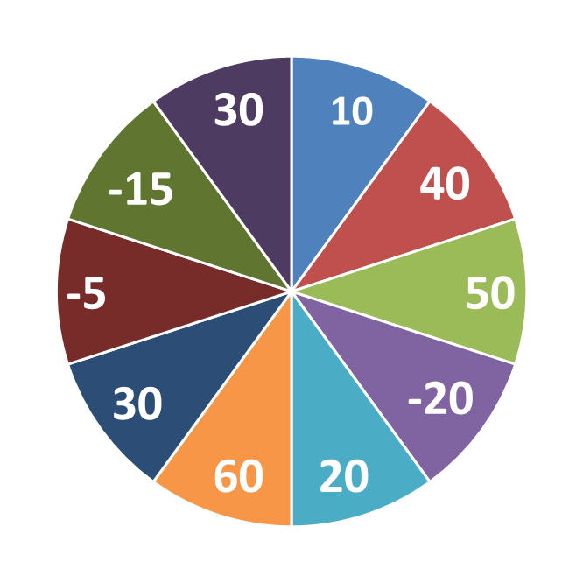
THE BIG WHEEL GAME
QUESTIONS
1
4
2
5
3
6

Slide 23
Minh is a member of our __________________. The greeting cards he makes are really creative.
arts and crafts club

Slide 24
Students can discuss their problems in their class ________.
forum

Slide 25
4
We share the essays and stories that we write in English in our ________________.
language club

Slide 26
4
She is not feeling very well this weekend because of all the
_________ from her school work.
pressure

Slide 27
The coach of our _____________ tells us to drink plenty of water during our practice sessions.
sports club

Slide 28
My friend, Manh likes playing chess, and he is a member of our school__________.
chess club

Slide 29
4
Complete each of the sentences with a word or phrase in 3.
1. Minh is a member of our __________________. The greeting cards he
makes are really creative.
2. Students can discuss their problems in their class ________.
3. We share the essays and stories that we write in English in our ________________.
4. She is not feeling very well this weekend because of all the _________
from her school work.
5. The coach of our _____________ tells us to drink plenty of water during our practice sessions.
6. My friend, Manh likes playing chess, and he is a member of our school__________.
arts and crafts club
forum
language club
pressure
sports club
chess club

Slide 30
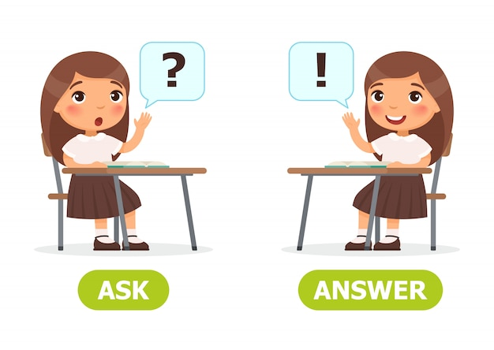
5
Work in pairs. Ask and answer the questions below. Report your friend’s answers to your class.
What types of social media do you use?
What kinds of pressure do you have?
What clubs do you participate in?
Why do you choose to participate in that club?

Slide 31
5
Work in pairs. Ask and answer the questions below.
Report your friend’s answers to your class.
What types of social media do you use?
I'm using Social Networks: Facebook; Instagram; Zalo; ...

Slide 32
5
Work in pairs. Ask and answer the questions below.
Report your friend’s answers to your class.
2. What kinds of pressure do you have?
I have pressure from my schoolwork, from my parents and also peer pressure.

Slide 33
5
Work in pairs. Ask and answer the questions below.
Report your friend’s answers to your class.
3. What clubs do you want to participate in?
I want to participate in chess club; sports club and English club.

Slide 34
5
Work in pairs. Ask and answer the questions below.
Report your friend’s answers to your class.
4. Why do you choose to participate in that club?
- I choose chess club because it improves my mental health.
- I choose English club because I will have a chance to practice EL

Slide 35
5
Work in pairs. Ask and answer the questions below. Report your friend’s answers to your class.
What types of social media do you use?
What kinds of pressure do you have?
What clubs do you participate in?
Why do you choose to participate in that club?

Slide 36
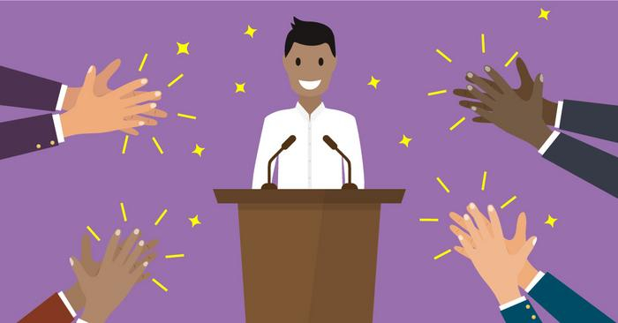
5
Report your friend’s answers to your class.
REPORTING
My friend, …, often use Facebook/ Instagram/ Zalo… to get information or keep in contact with her/his relationships.
…

Slide 37
*Homework
Do exercises in the workbook.
Start preparing for the Project of the unit.

