Slide 1


Slide 2

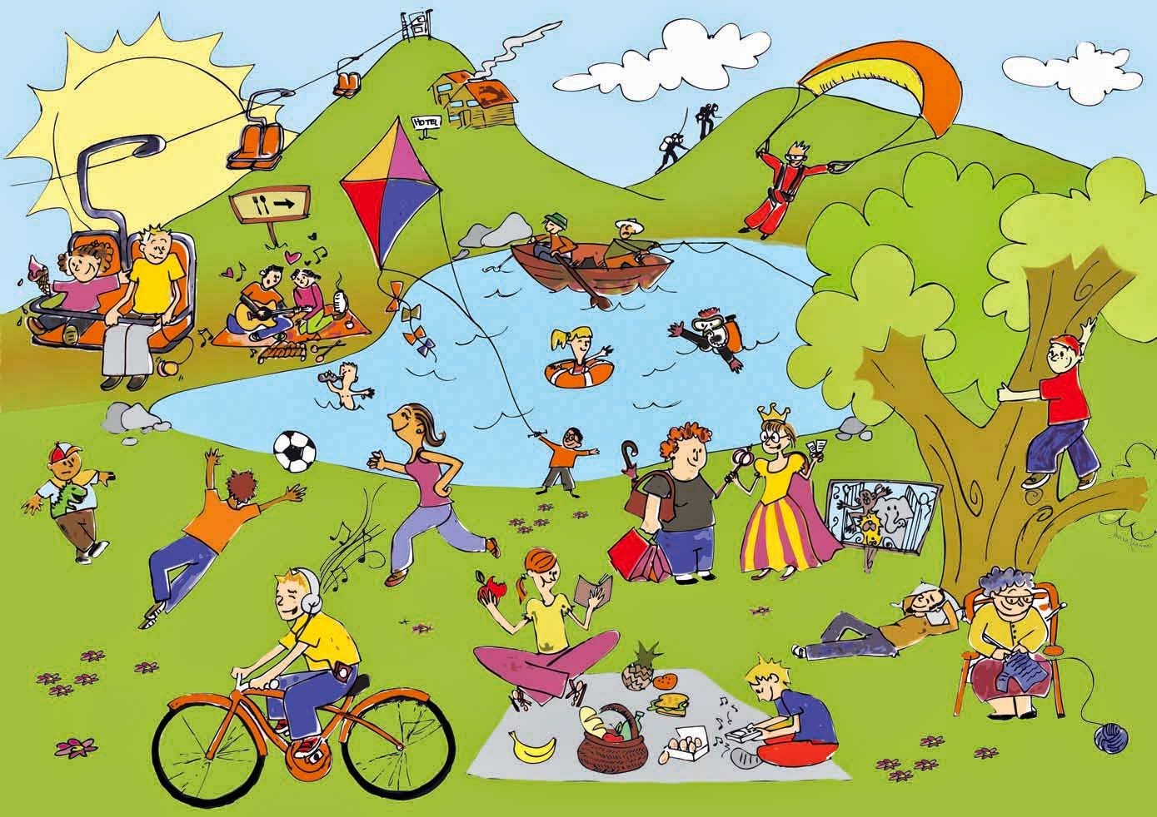
Unit
1
LEISURE TIME
LESSON 6: SKILLS 2
1

Slide 3
WARM-UP
How to play:
One student goes to the board and gets one activity from the teacher.
This student acts the activity without saying.
The rest of class guess the activity.
HOT SEAT

Slide 4

PRE-LISTENING
1
Answer the questions.
1. In your opinion, what activities can we do with our friends in our leisure time?
2. Why should we spend time
with our friends?

Slide 5

LISTENING
2
Listen to an interview with Mark about his leisure activities. Choose the correct answer.
1. When does Mark usually have free time?
A. At weekends. B. On Sundays. C. On Saturdays.
2. Who does he spend his free time with?
A. His neighbours and friends.
B. His family and relatives.
C. His family and friends.

Slide 6
PRACTICE
3
Listen to the interview again. Fill in each blank in the table with no more than two words.
Activities | Reason
Inviting friends to his house Cooking and watching a (1) ______ | Fun and better than going to the (2) ________
Going to the (3) ______ to play volleyball or skateboard | Stay in (4) ______
Going for a (5) ________ around our city | See different (6) ______
video
cinema
park
shape
bike ride
places

Slide 7
WRITING
4
Work in pairs. Ask and answer the questions.
Questions
Sample answers
1. When do you usually have free time?
2. What do you usually do with your friends in your free time?
3. Why do you do these activities?
1. I often have free time at the weekend.
2. Sometimes I hang out with my friends in our favourite café.
3. Because it’s the time that we can talk with each other.

Slide 8
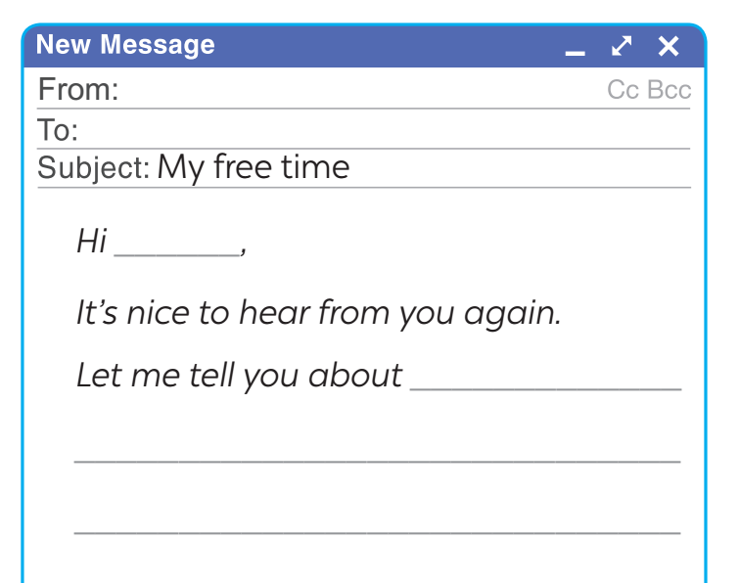

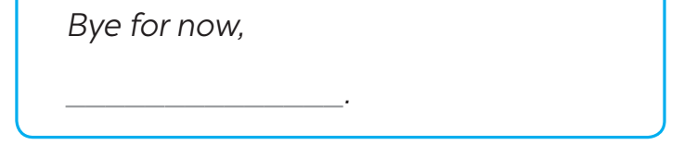
WRITING
5
Write an email (80 - 100 words) to a penfriend to tell him / her about what you usually do with your friends in your free time. Use your answers in 4.
Start and end the email as follows:

Slide 9
CONSOLIDATION
1
Sample writing
Hi Ann,
It’s nice to hear from you again. Let me tell you about the things I usually do with my friends in my free time.
I usually have free time at weekends, and I often spend Sunday mornings with my friends. I have three close friends, and they live near my house. We usually play badminton together for about one hour in the playground. After that, we cycle around the neighbourhood. It’s a lot of fun.
What about you? What do you usually do with your friends in your free time?
Tell me in your next email.
Bye for now,
Mi

Slide 10
Sample writing 2
Hi Ann,
It’s lovely to hear from you! I want/would like to share what I usually do with my friends in my free time. On weekends, I often meet up with my close friends who live nearby. We play badminton in the playground for about an hour, then cycle around the neighborhood. It’s so much fun!
We also enjoy trying out new restaurants or having movie nights at home. It’s a great way to relax and have fun together.
What about you? How do you spend your free time with friends? Can’t wait to hear!
Bye,
Mi

Slide 11
Hi Ann,
It’s lovely to hear from you! I want/would like to share what I usually do with my friends in my free time. On weekends, I often meet up with my close friends who live nearby. We play badminton in the playground for about an hour, then cycle around the neighborhood. It’s so much fun!
We also enjoy trying out new restaurants or having movie nights at home. It’s a great way to relax and have fun together.
What about you? How do you spend your free time with friends? Can’t wait to hear!
Bye,
Mi
Hi Ann,
It’s nice to hear from you again. Let me tell you about the things I usually do with my friends in my free time.
I usually have free time at weekends, and I often spend Sunday mornings with my friends. I have three close friends, and they live near my house. We usually play badminton together for about one hour in the playground. After that, we cycle around the neighbourhood. It’s a lot of fun.
What about you? What do you usually do with your friends in your free time?
Tell me in your next email.
Bye for now,
Mi

Slide 12

CONSOLIDATION
2
Homework
- Do ex E1,2 in workbook
- Rewrite the paragraph
- Prepare the next lesson: “Looking back and project”

Slide 13

Website: hoclieu.vn
Fanpage: facebook.com/www.tienganhglobalsuccess.vn/

