Slide 1


Slide 2

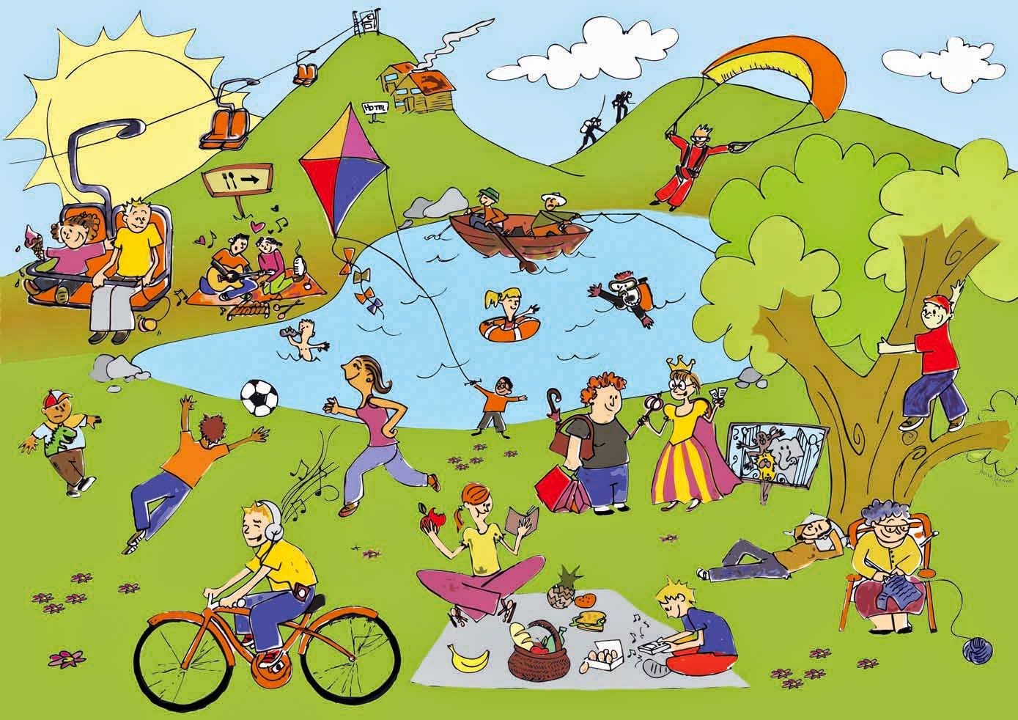
Unit
1
LEISURE TIME
LESSON 3: A CLOSER LOOK 2
1

Slide 3

PRESENTATION
Verbs of liking
love
prefer
like
enjoy
fancy
Verbs of liking are used to express positive attitudes towards people or things.

Slide 4

PRESENTATION
Verbs of disliking
detest
hate
dislike
Verbs of disliking are used to express negative attitudes towards people or things.

Slide 5

PRESENTATION
Some verbs of liking and disliking can be followed by gerunds only.
Example: They dislike surfing the net.
Some are followed by both gerunds and
to-infinitives.
Example: I love going / to go to the cinema.

Slide 6

PRACTICE
1
Work in pairs. Put the verbs in the appropriate column.
love like detest fancy
dislike enjoy hate prefer
Verbs followed by gerunds only | Verbs followed by both gerunds and to-infinitives
detest
love
fancy
like
dislike
hate
enjoy
prefer

Slide 7
PRACTICE
2
Choose the correct answer A, B, or C.
1. I love ______, so in my leisure time, I go to some villages near Ha Noi to relax and enjoy the outdoors.
A. travelling B. travelled C. to travel
2. Tom enjoys ______ puzzles, especially Sudoku.
A. doing B. do C. to do

Slide 8
PRACTICE
2
Choose the correct answer(s).
3. When do you like ______ TV?
A. watched B. watch C. to watch
4. Do you fancy ______ to the cinema this weekend?
A. go B. going C. to go
5. I detest ______. I think it’s cruel to harm animals.
A. hunting B. to hunt C. hunt

Slide 9
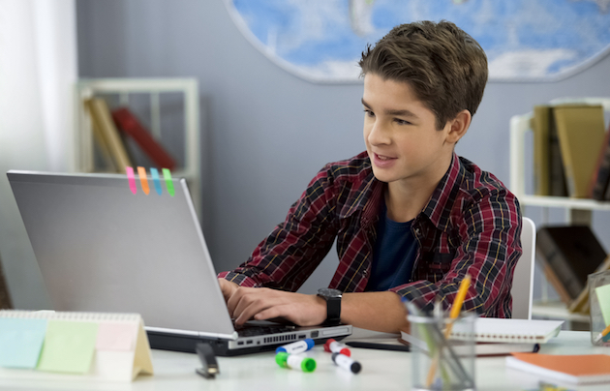
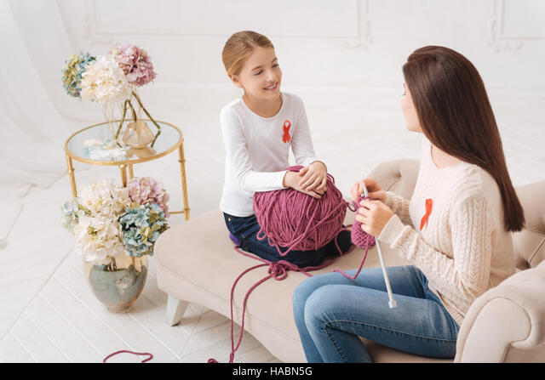
PRACTICE
3
Look at the pictures and complete the sentences, using the verbs in brackets in their suitable form.
likes surfing / to surf the Internet
1. Mark ___________________________. (like)
2. The girls ____________. (enjoy)
enjoy knitting

Slide 10
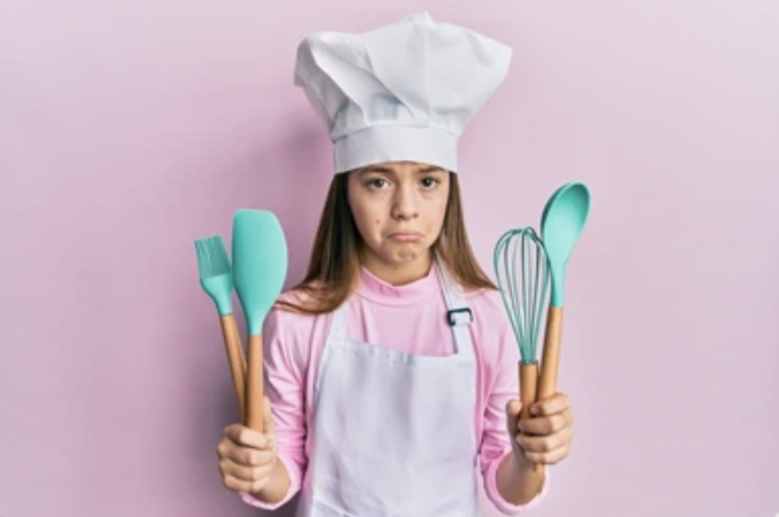
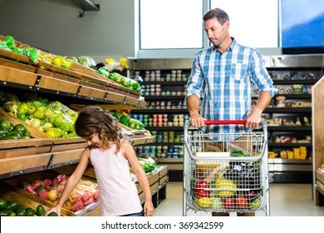
PRACTICE
3
Look at the pictures and complete the sentences, using the verbs in brackets in their suitable form.
3. My cousin ______________. (dislike)
dislikes cooking
hates going / to go shopping
4. My father________________________. (hate)

Slide 11
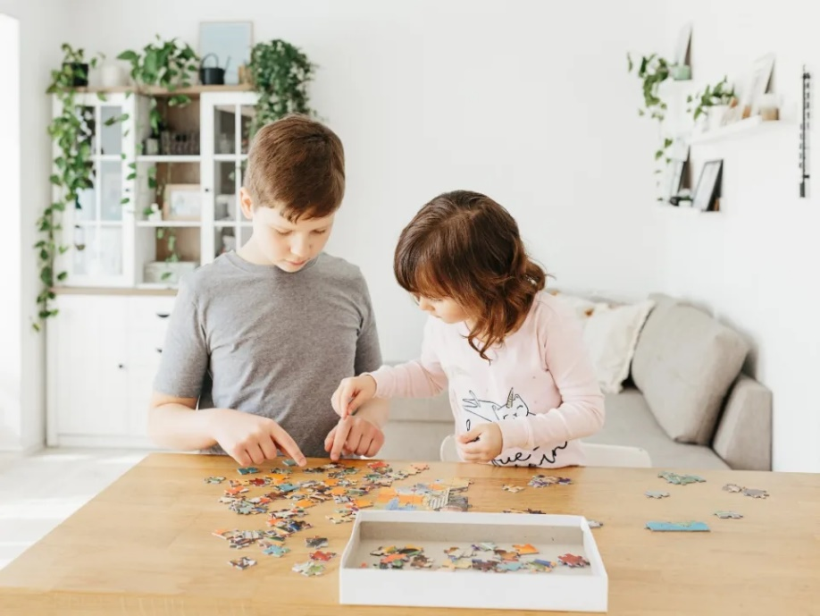
PRACTICE
3
Look at the pictures and complete the sentences, using the verbs in brackets in their suitable form.
5. Tom and his sister ______________________. (prefer)
prefer doing / to do puzzles

Slide 12


PRACTICE
4
Complete the sentences about yourself.
All about me
I like ______. I prefer ______. I love ______. | I dislike ______. I hate ______. I detest ______.

Slide 13

PRODUCTION
5
Likes and dislikes mimes
Work in groups. One mimes a leisure activity he / she likes or dislikes.
The others guess the activity by asking yes / no questions using the verbs they have learnt.
Example:
A: Do you like surfing the net?
B: No, I don’t.
C: Do you love messaging your friends?
B: Yes, I do.

Slide 14

CONSOLIDATION
1
Wrap-up
What have we learnt in this lesson?
How to use verbs of liking and disliking

Slide 15

CONSOLIDATION
2
Homework
- Complete the exercises in the Workbook B3,4, 5; D 1, 2

Slide 16

Website: hoclieu.vn
Fanpage: facebook.com/www.tienganhglobalsuccess.vn/

