Slide 1
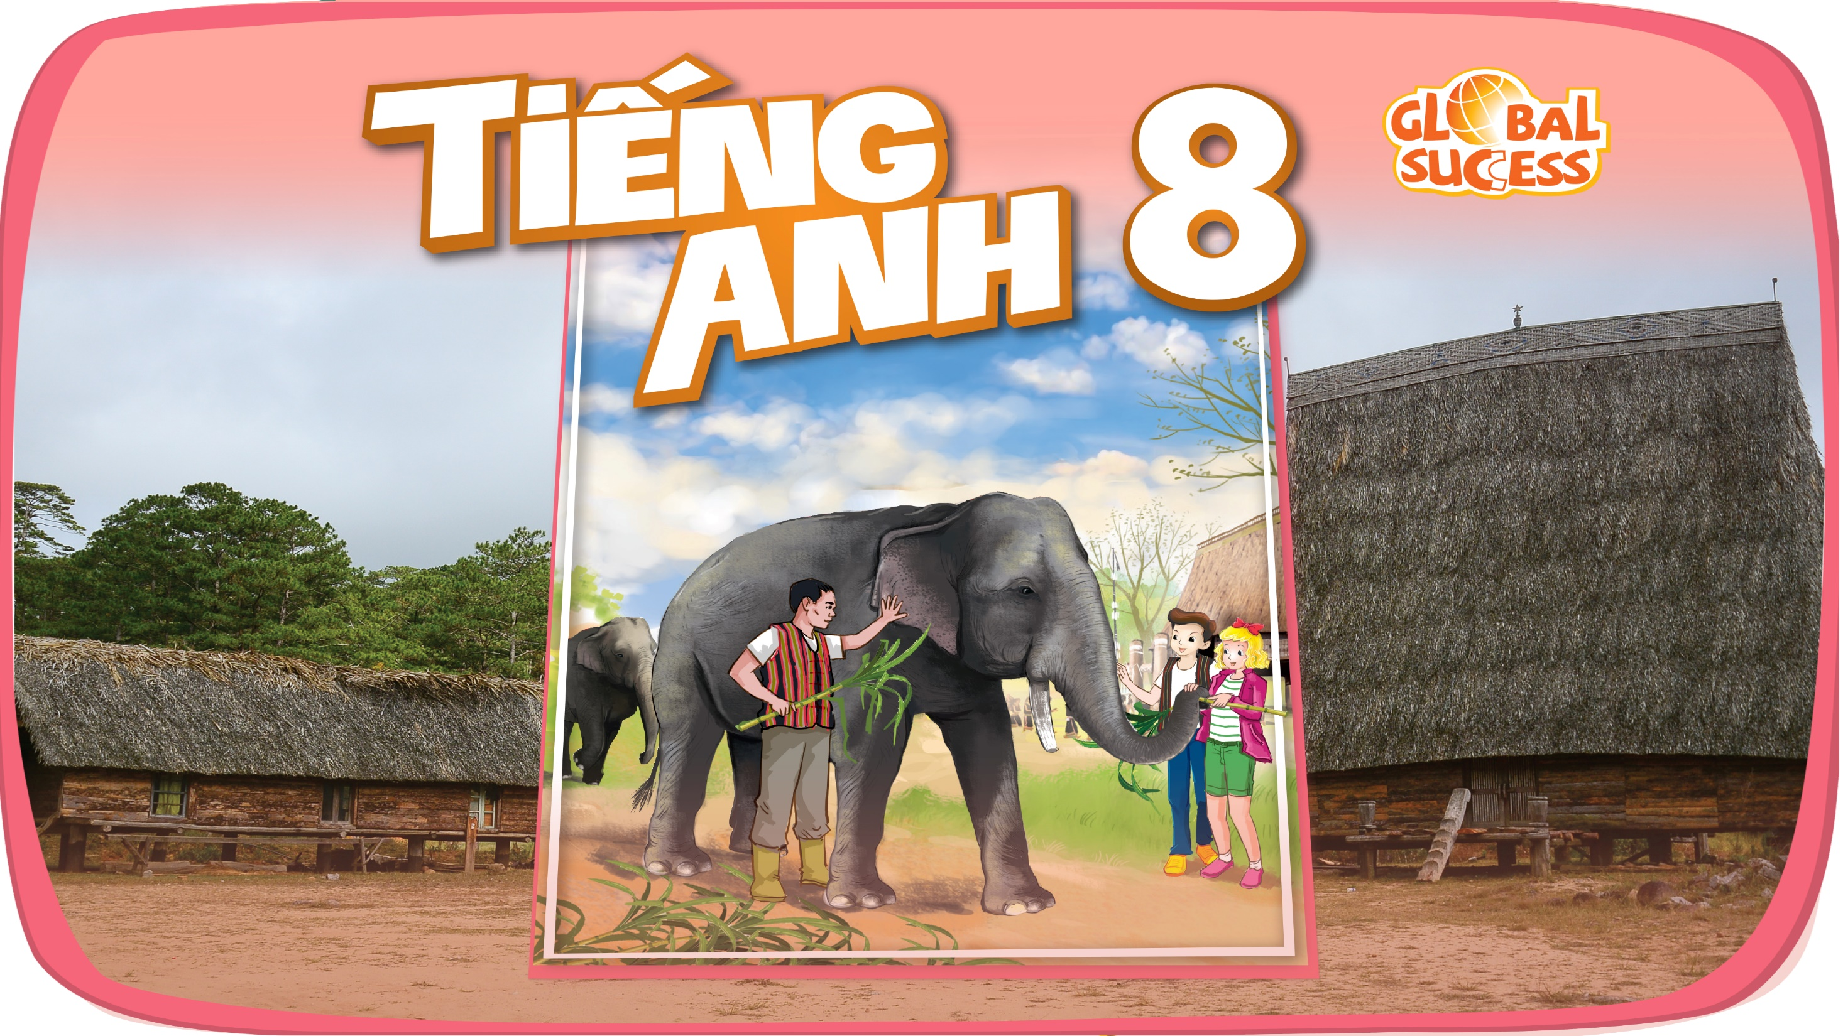

Slide 2


Unit
1
LEISURE TIME
LESSON 1: GETTING STARTED
I’m keen on DIY (do-it-yourself).
1

Slide 3

WARM-UP
Who knows more?
Matching appropriate pairs
LEISURE ACTIVITIES

Slide 4

PRESENTATION
DIY (n)
(do-it-yourself)
/ˌdiːaɪˈwaɪ/
tự tay làm

Slide 5
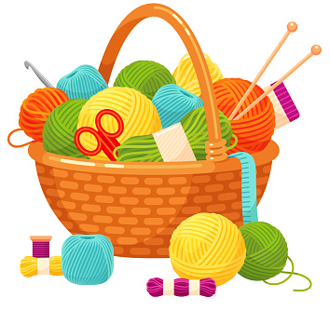
PRESENTATION
knitting kit (n)
/ˈnɪtɪŋ kɪt/
bộ dụng cụ đan len

Slide 6
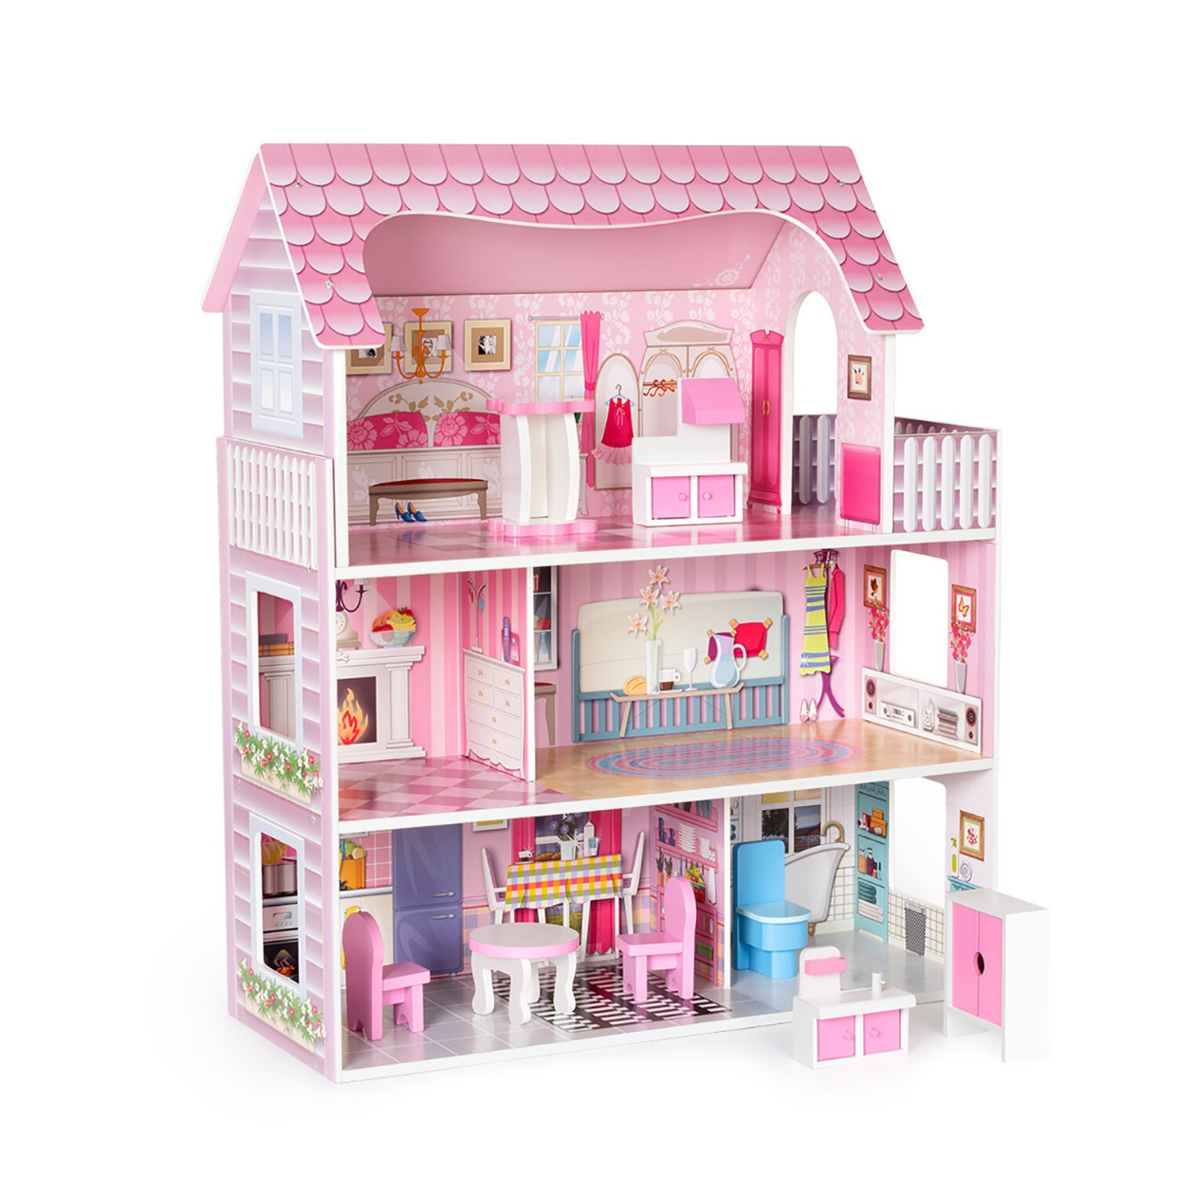
PRESENTATION
dollhouse (n)
/ˈdɒlhaʊs/
nhà búp bê

Slide 7
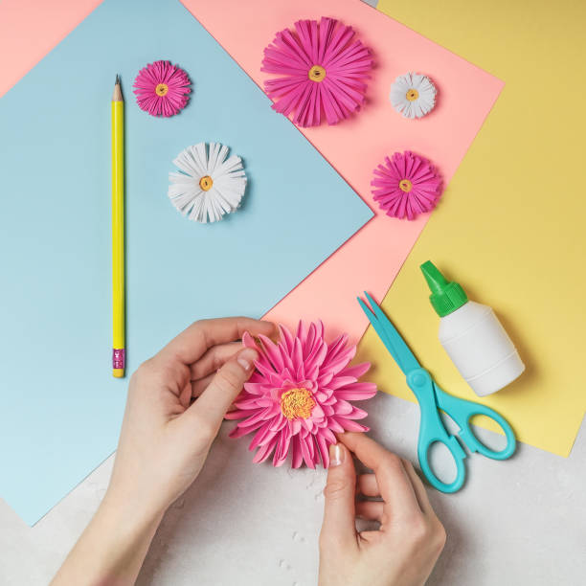
PRESENTATION
make paper flowers (v.phr)
/meɪk 'peɪpər 'flaʊərz/
làm hoa giấy

Slide 8
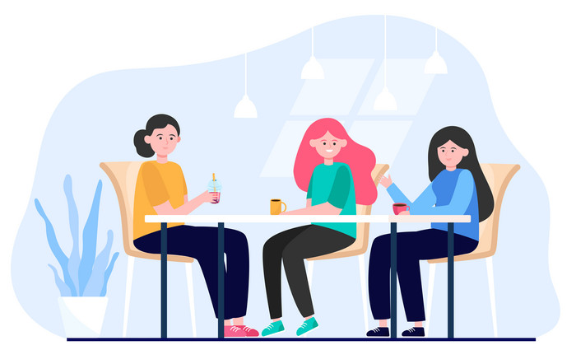
PRESENTATION
hang out (v)
/hæŋ aʊt/
đi chơi

Slide 9
PRESENTATION
New words | Pronunciation | Meaning
1. DIY (n) | /ˌdiːaɪˈwaɪ/ | tự tay làm
2. knitting kit (n) | /ˈnɪtɪŋ kɪt/ | bộ dung cụ đan len
3. dollhouse (n) | /ˈdɒlˌhaʊs/ | nhà búp bê
4. make paper flowers (v.phr) | /meɪk 'peɪpər 'flaʊərz/ | làm hoa giấy
5. hang out (v) | /hæŋ aʊt/ | đi chơi

Slide 10
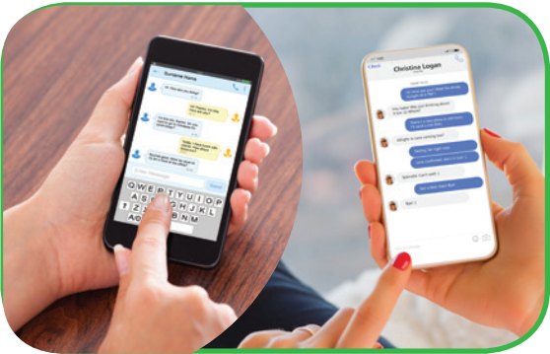
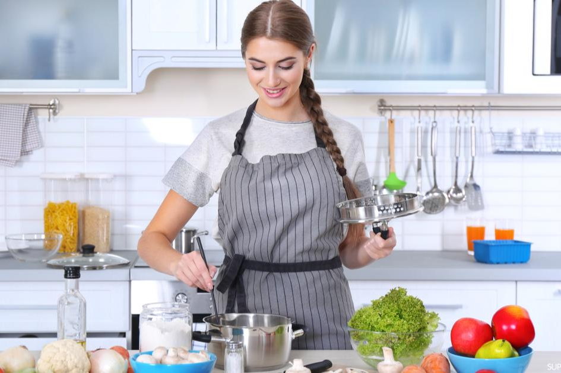
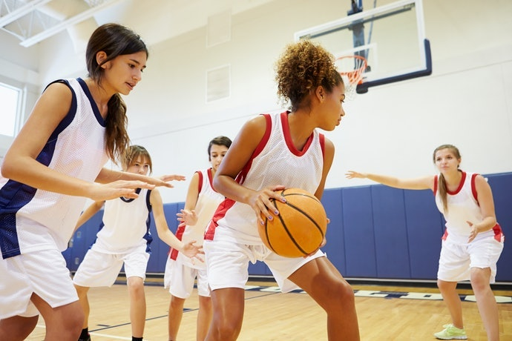
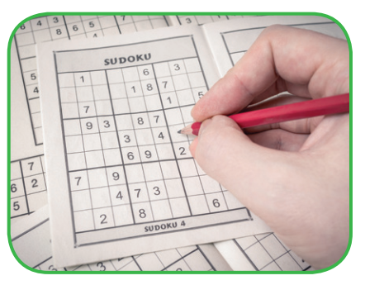
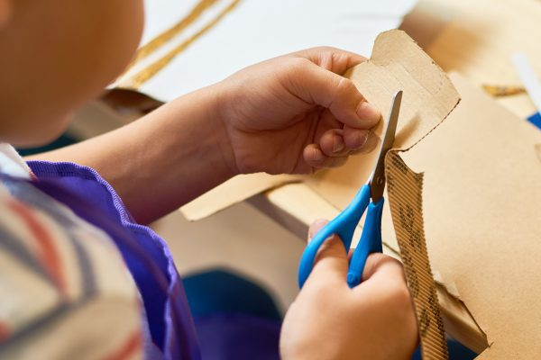
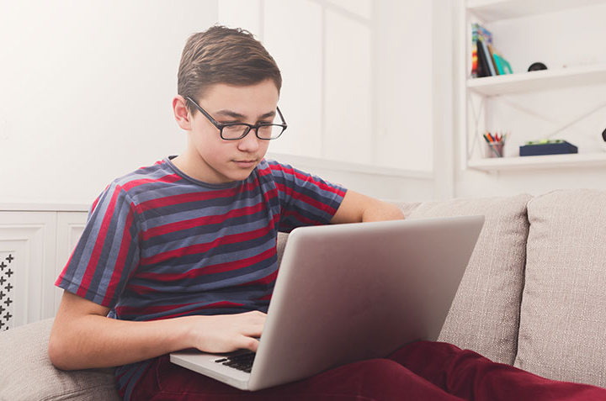
Work in pairs. Write the activities from the box under the correct pictures.
doing DIY
cooking
doing puzzles
playing sport
surfing the net
messaging friends

Slide 11
PRACTICE
4
Work in pairs. Read the word and phrases, and guess which activities in 3 are described.
improve memory, a mental exercise
save money, increase creativity
improve physical health, make friends
keep in touch, be relaxed
learn something about IT, computer skills
doing puzzles
doing DIY
playing sport
messaging friends
surfing the net

Slide 12

PRACTICE
1
Listen and read.
Tom: Hi, Trang. Surprised to see you. What brings you here?
Trang: Oh, hello Tom. I’m looking for a knitting kit.
Tom: A knitting kit? I didn’t know you like knitting.
Trang: Actually, I’m keen on many DIY activities. In my leisure time, I love
knitting, building dollhouses, and making paper flowers.
Tom: I see. So, you like spending time on your own.
Trang: Yes. What do you do in your free time?
Tom: I’m a bit different. I usually hang out with my friends. We go to the
cinema, go cycling, or play sport in the park.
Trang: You love spending free time with other people, don’t you?
Tom: That’s right. By the way, would you like to go to the cinema with me and
Mark this Sunday? There’s a new comedy at New World Cinema.
Trang: Yes, I’d love to. Can I ask Mai to join us?
Tom: Sure. Let’s meet outside the cinema at 9 a.m.

Slide 13
Which activities can you listen?

Slide 14
1
Listen and read.
Tom: Hi, Trang. Surprised to see you. What brings you here?
Trang: Oh, hello Tom. I’m looking for a knitting kit.
Tom: A knitting kit? I didn’t know you like knitting.
Trang: Actually, I’m keen on many DIY activities. In my leisure time, I love
knitting, building dollhouses, and making paper flowers.
Tom: I see. So, you like spending time on your own.
Trang: Yes. What do you do in your free time?
Tom: I’m a bit different. I usually hang out with my friends. We go to the
cinema, go cycling, or play sport in the park.
Trang: You love spending free time with other people, don’t you?
Tom: That’s right. By the way, would you like to go to the cinema with me and
Mark this Sunday? There’s a new comedy at New World Cinema.
Trang: Yes, I’d love to. Can I ask Mai to join us?
Tom: Sure. Let’s meet outside the cinema at 9 a.m.
knitting.
DIY activities
building dollhouses
making paper flowers
hang out with my friends
go cycling
play sport
go to the cinema

Slide 15
PRACTICE
2
Read the conversation again and complete the sentences.
Trang is looking for a ____________.
She likes doing DIY in her ____________.
Tom loves spending his free time with ____________.
Tom and his friends usually _________ together.
Tom, Mark, Trang, and Mai are going to see a comedy this _______.
knitting kit
leisure time
other people
hang out
Sunday

Slide 16
PRACTICE
1
Listen and read.
Tom: Hi, Trang. Surprised to see you. What brings you here?
Trang: Oh, hello Tom. I’m looking for a knitting kit.
Tom: A knitting kit? I didn’t know you like knitting.
Trang: Actually, I’m keen on many DIY activities. In my leisure time, I love
knitting, building dollhouses, and making paper flowers.
Tom: I see. So, you like spending time on your own.
Trang: Yes. What do you do in your free time?
Tom: I’m a bit different. I usually hang out with my friends. We go to the
cinema, go cycling, or play sport in the park.
Trang: You love spending free time with other people, don’t you?
Tom: That’s right. By the way, would you like to go to the cinema with me and
Mark this Sunday? There’s a new comedy at New World Cinema.
Trang: Yes, I’d love to. Can I ask Mai to join us?
Tom: Sure. Let’s meet outside the cinema at 9 a.m.

Slide 17
Name leisure activites in the lesson
Doing DIY - going cycling
Doing puzzles - going to the cinema
Surfing the net - making paper flowers
Cooking - going cycling
Playing sport - hanging out with friends
Messaging friends - seeing a comedy
Knitting - building dollhouses

Slide 18

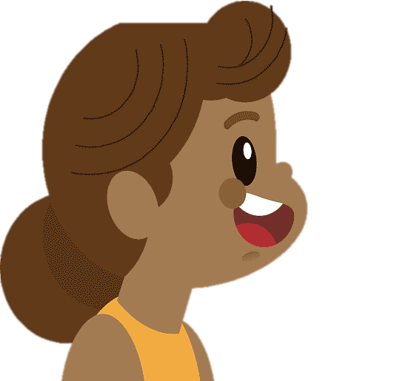

PRODUCTION
5
Work in groups. Ask one another the question below. Then report your friends’ answers to the class.
If you have some free time this weekend, what will you do?

Slide 19

CONSOLIDATION
2
Homework
Name a list of outdoor and indoor leisure activities.
Make 5 sentences with leisure activities
Prepare for the Project of Unit 1: Making a survey
about leisure activities in your class

Slide 20

Website: hoclieu.vn
Fanpage: facebook.com/www.tienganhglobalsuccess.vn/

