Slide 1

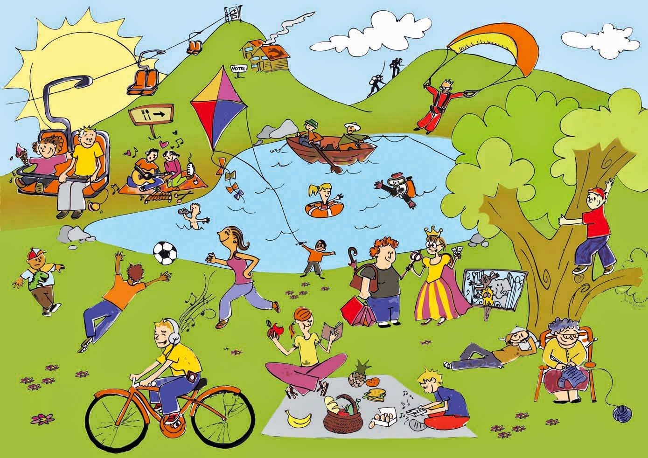
Unit
1
LEISURE TIME
LESSON 5: SKILL 1
1

Slide 2
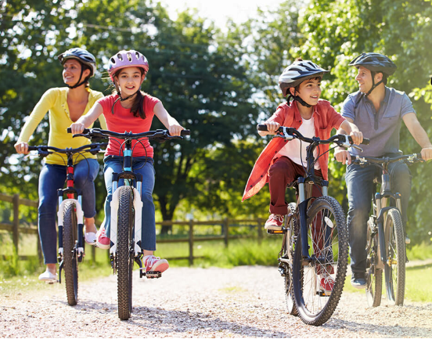
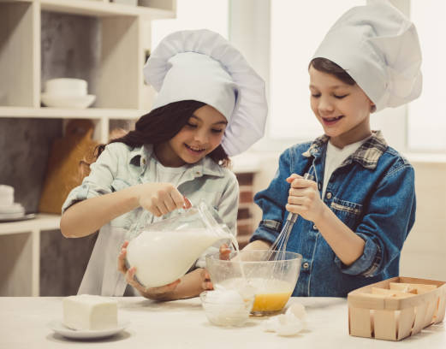
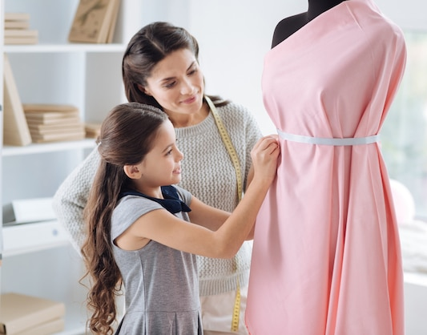
WARM-UP
1
Look at the pictures. What activities can you see?
riding a bike/ cycling
LEISURE ACTIVITIES
cooking
making a dress

Slide 3
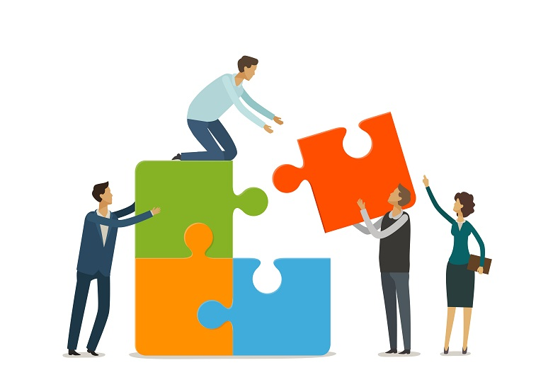

PRESENTATION
connect (v)
/kəˈnekt/
kết nối

Slide 4
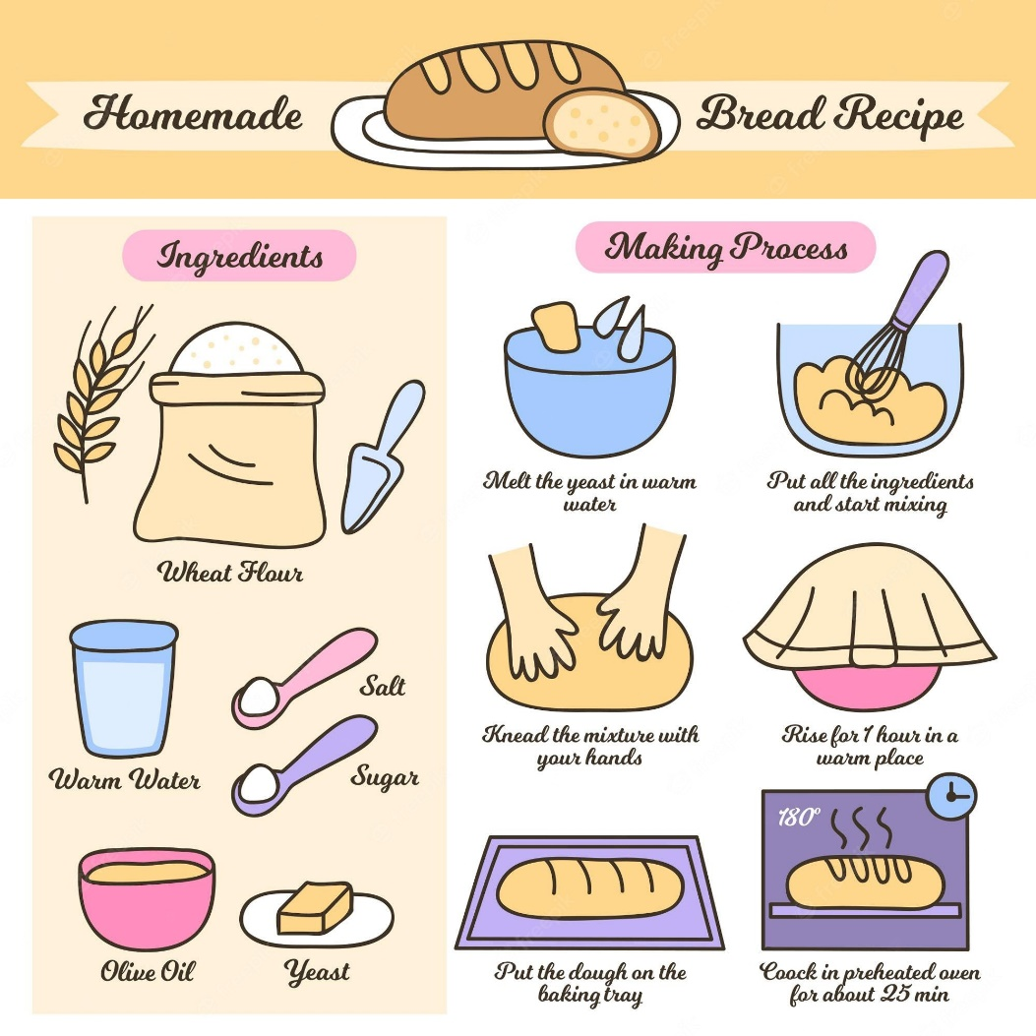
PRESENTATION
recipe (n)
/ˈresɪpi/
công thức

Slide 5
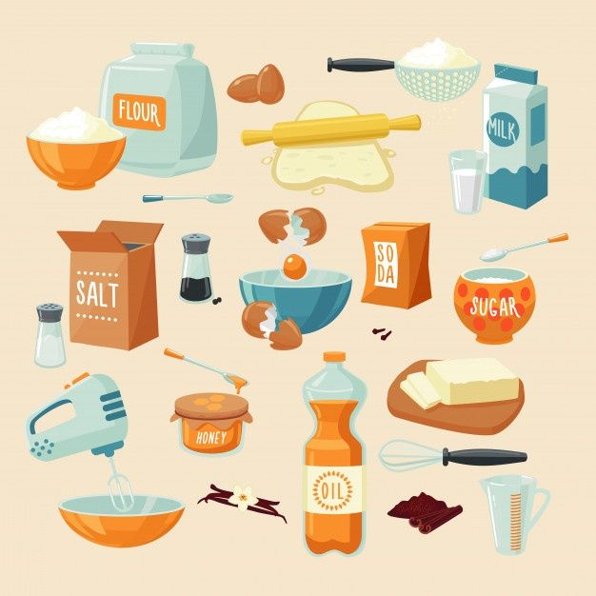
PRESENTATION
ingredient (n)
/ɪnˈɡriːdiənt/
nguyên liệu

Slide 6
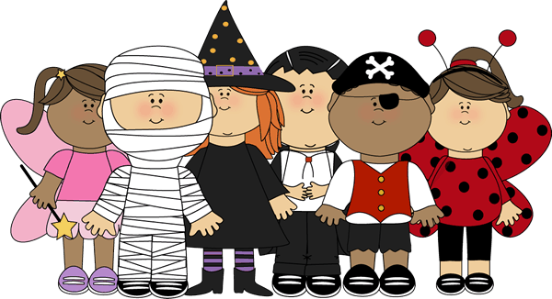
PRESENTATION
costume (n)
/ˈkɒstʃuːm/
trang phục

Slide 7
PRESENTATION
New words | Pronunciation | Meaning
1. connect (v) | /kəˈnekt/ | kết nối
2. recipe (n) | /ˈresɪpi/ | công thức
3. ingredient (n) | /ɪnˈɡriːdiənt/ | nguyên liệu
4. costume (n) | /ˈkɒstʃuːm/ | trang phục

Slide 8
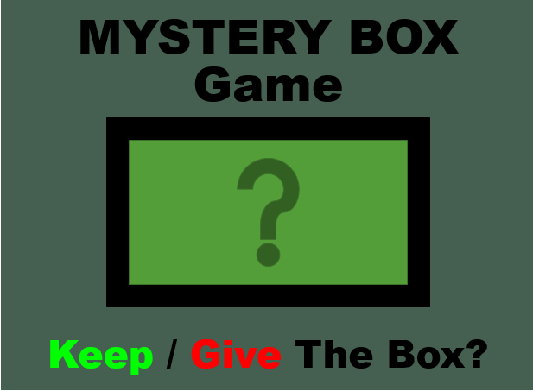

Slide 9







12
1
11
2
10
3
9
4
8
5
7
6

Slide 10
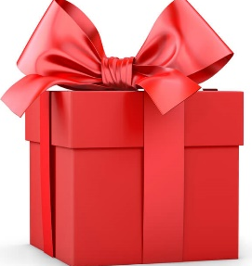
1. What does Trang do with her family members at the weekend?
Go to the movies B) Go for a bike ride
C) Play video games D) Visit friends
CHECK

Slide 11


Slide 12

+50
WHEEL

Slide 13
Spin and stop the pointer and click the pointed topic
12
1
11
2
10
3
9
4
8
5
7
6

Slide 14
2. Who looks for recipes when Trang and her brother cook?
Trang B) Their mum
C) Their dad D) Trang's brother
CHECK

Slide 16

-50
WHEEL

Slide 17
Spin and stop the pointer and click the pointed topic
12
1
11
2
10
3
9
4
8
5
7
6

Slide 18
4. What did she win?
A bike
B) A cooking contest
C) First prize in a costume contest
D) A photo contest
CHECK

Slide 20
-50
WHEEL

Slide 21
Spin and stop the pointer and click the pointed topic
12
1
11
2
10
3
9
4
8
5
7
6

Slide 22
3. Which leisure activity does she love the most?
Cooking B) DIY projects
C) Bike riding D) Photography
CHECK

Slide 24
+100
BACK

Slide 25
Read about Trang’s leisure activities
Some teenagers enjoy spending free time with their friends. Others prefer doing leisure activities with their family members. I love spending time with my family because it's a great way to connect with them.
At the weekend, we usually go for a bike ride. We cycle to some nearby villages to enjoy the fresh air. We take photos and look at them later. My big brother and I are also into cooking. My brother looks for easy recipes. After that, we prepare the ingredients and cook. Sometimes the food is good, but sometimes it isn't; nevertheless, we love whatever we cook. The leisure activity I like the most is doing DIY projects with my mum. She teaches me to make my own dresses and doll clothes. On special occasions, we make special dresses together. Once I won the first prize in a costume contest at my school.

Slide 26
Choose the correct answer:
1. What does Trang do with her family members at the weekend?
A) Go to the movies B) Go for a bike ride C) Play video games D) Visit friends
2. Who looks for recipes when Trang and her brother cook?
A) Trang B) Their mum C) Their dad D) Trang's brother
3. Which leisure activity does she love the most?
A) Cooking B) DIY projects C) Bike riding D) Photography
4. What did she win?
A) A bike B) A cooking contest
C) First prize in a costume contest D) A photo contest

Slide 27
SPEAKING
4
Work in groups. Take turns to ask and answer the questions. Record your friends’ answer in the table below.
1. What leisure activities do you usually do with your family?
2. Which one do you like the most? Why?
3. How do you feel when you spend time with your family members?
Friends’ name | Questions 1 | Questions 2 | Questions 3

Slide 28

SPEAKING
5
Report your group members’ answers to the class. What activities are the most common?
The most common activities is …

Slide 29
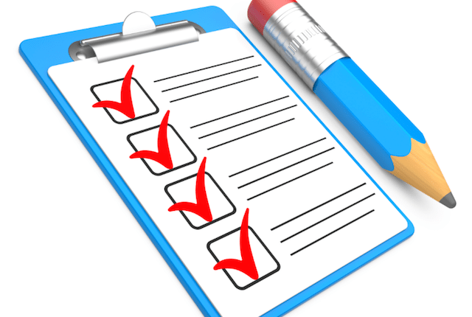
CONSOLIDATION
1
Wrap-up
What have we learnt in this lesson?
read about teen’s leisure activities
talk about friends’ leisure activities

Slide 30
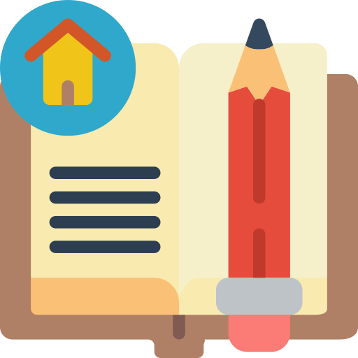
CONSOLIDATION
2
Homework
Do exercises in the workbook.

Slide 31

Website: hoclieu.vn
Fanpage: facebook.com/www.tienganhglobalsuccess.vn/

