Slide 1
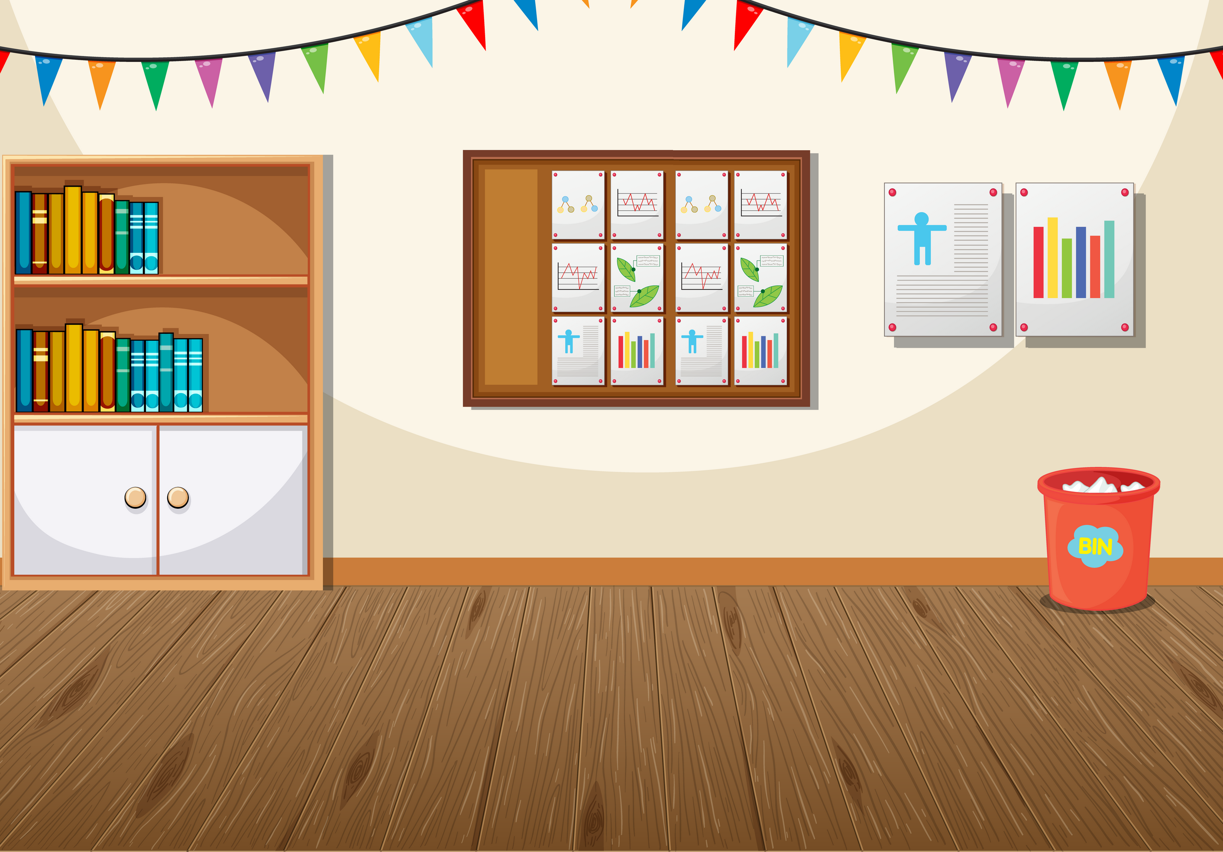
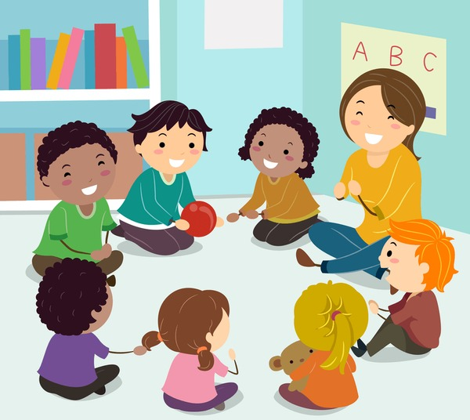
PASS THE BALL
Pass the ball while playing music.
When the music stops, the student having the ball says out a key word that related to local community.

Slide 2

PASS THE BALL

Slide 3
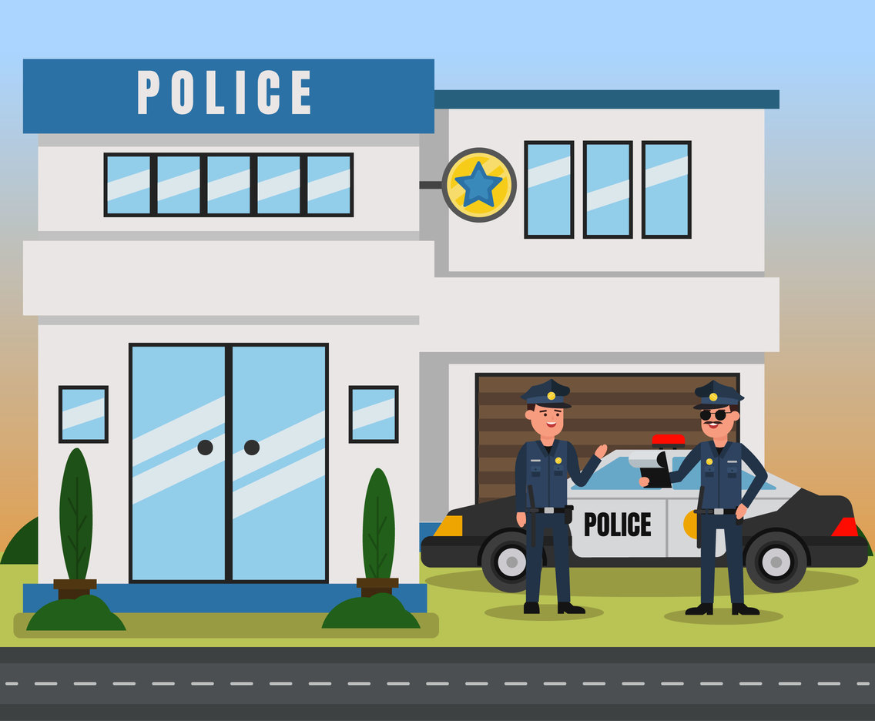
Suggested answer
police station

Slide 4
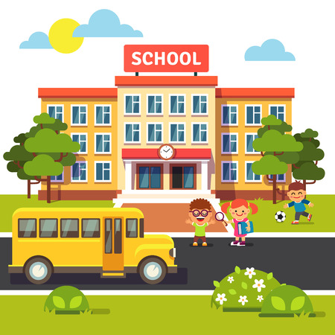
Suggested answer
school

Slide 5
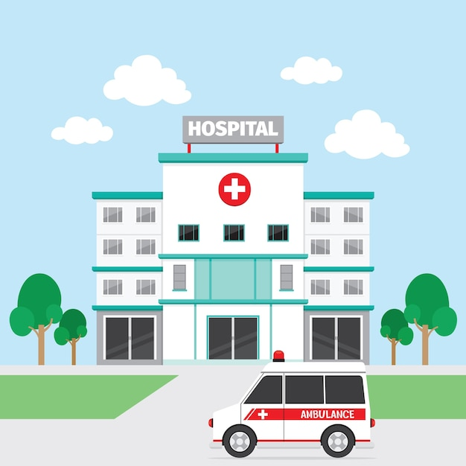
Suggested answer
hospital

Slide 6
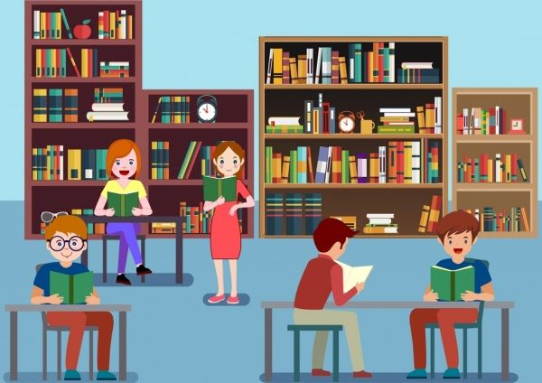
Suggested answer
library

Slide 7
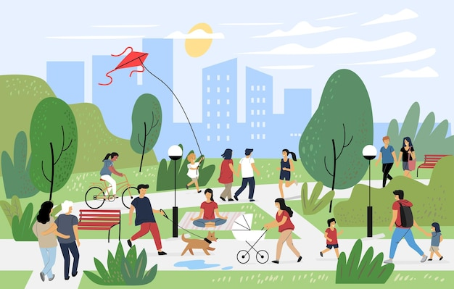
Suggested answer
park

Slide 8
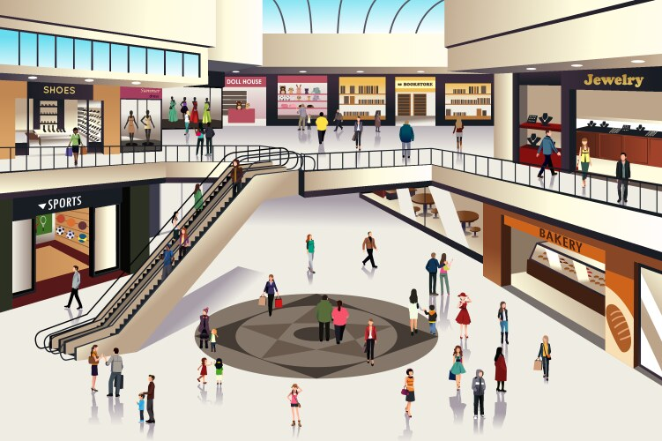
Suggested answer
shopping mall

Slide 9
Can you add more things in local community?

Slide 10

UNIT 1:
LOCAL COMMUNITY
Lesson 1: Getting started

Slide 11

OBJECTIVES
By the end of the lesson, students will be able to:
gain an overview about the topic:
Local community.
Gain vocabulary to talk about community.

Slide 12

01
NEW WORDS

Slide 13
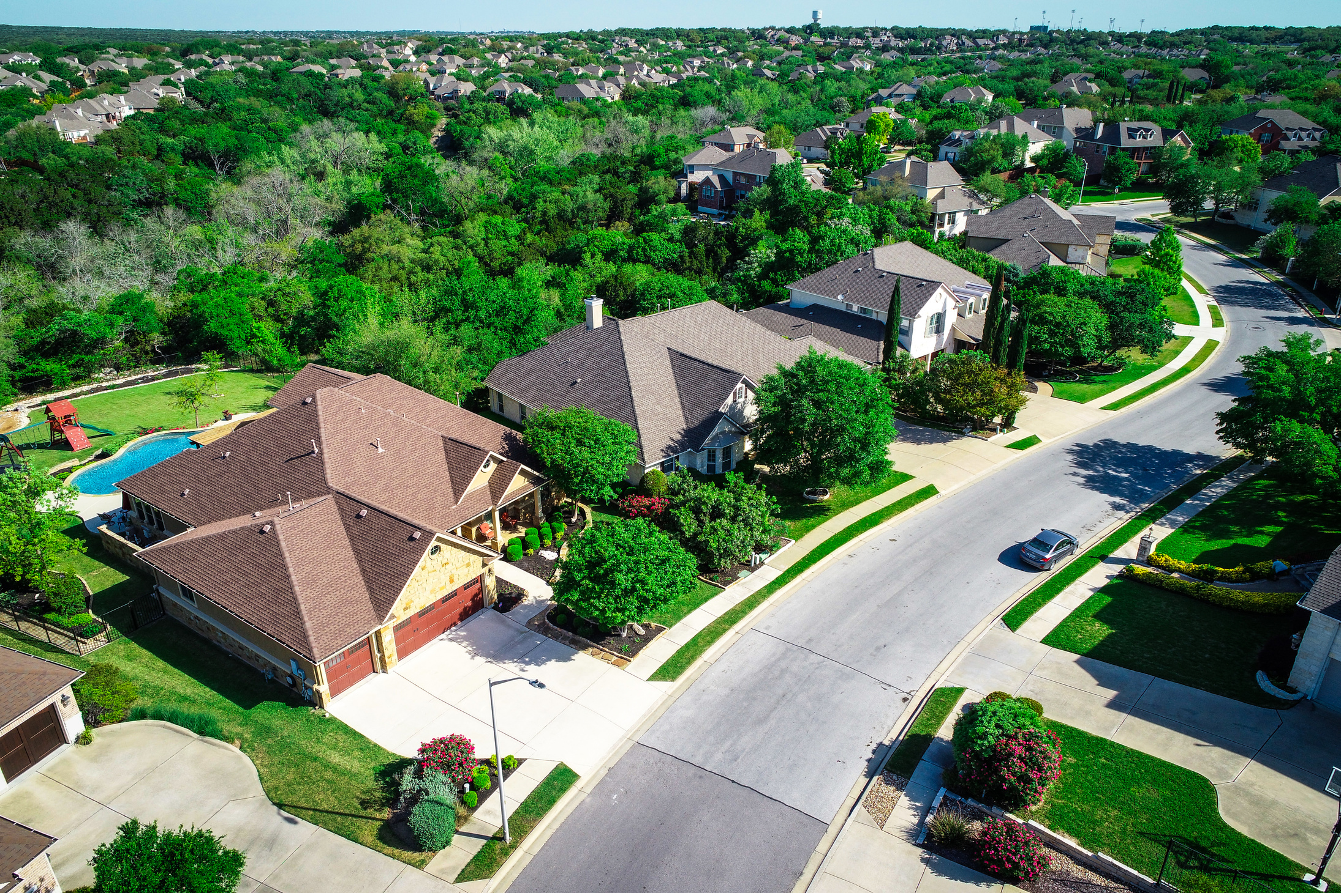

suburb (n)
/ˈsʌb.ɜːb/
vùng ngoại ô

Slide 14
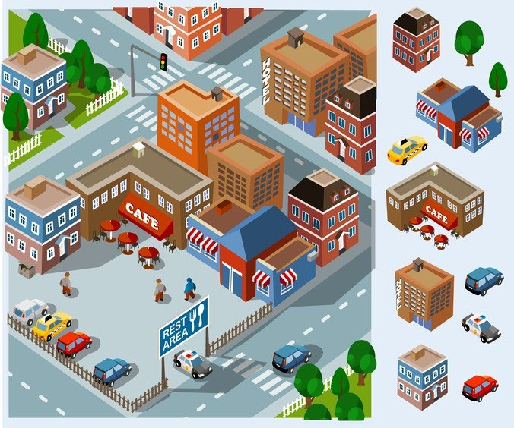
facilities
(plural noun)
/fəˈsɪlətiz/
cơ sở vật chất

Slide 15

look for
(phrasal verb)
/lʊk fɔːr/
tìm kiếm

Slide 16

remind sb of sb/sth
(phrasal verb)
/rɪˈmaɪnd/
Gợi nhớ ai đó về điều gì/ về ai
to make someone think of something or someone else
Harry reminds me of my father.

Slide 17
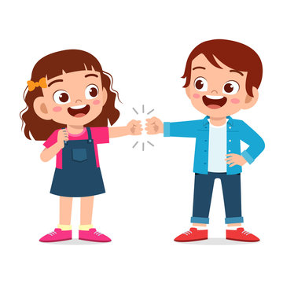
get on with sb
(phrasal verb)
/ɡet ɒn wɪð/
thân thiết với ai
Do you get on with your brother?
to have a good relationship

Slide 18
NEW WORDS
Words | Pronunciation | Meanings
suburb (n) | /ˈsʌb.ɜːb/ | vùng ngoại ô
facilities (plural n) | /fəˈsɪlətiz/ | cơ sở vật chất
look for (phr.v) | /lʊk fɔːr/ | tìm kiếm
remind sb of sth/sb (phr.v) | /rɪˈmaɪnd/ | gợi nhớ ai đó về điều gì/ về ai
get on with sb (phr.v) | /ɡet ɒn wɪð/ | thân thiết với ai

Slide 19
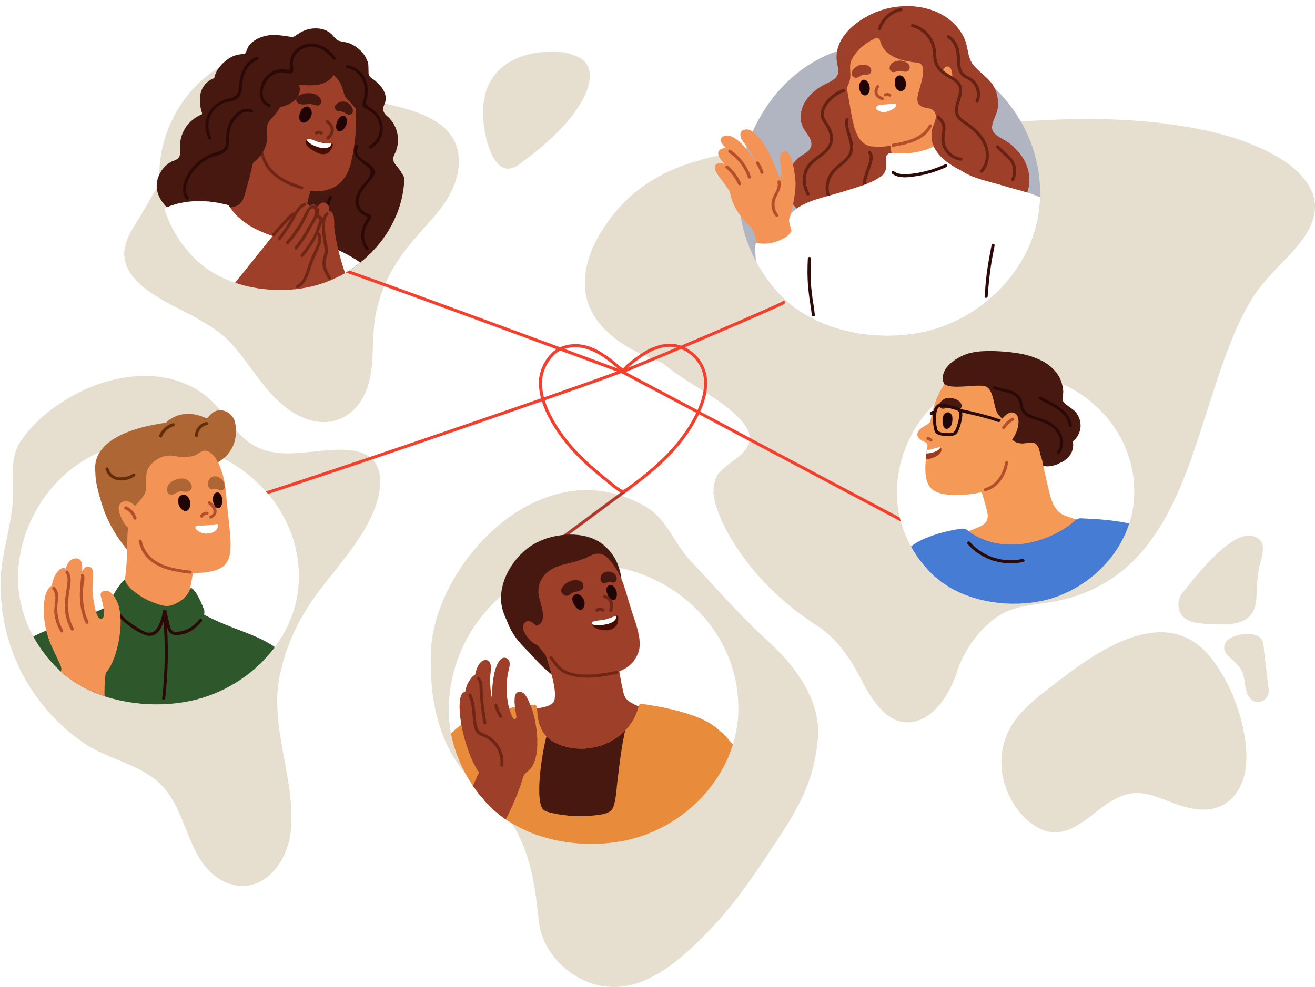
02
PRACTICE

Slide 20
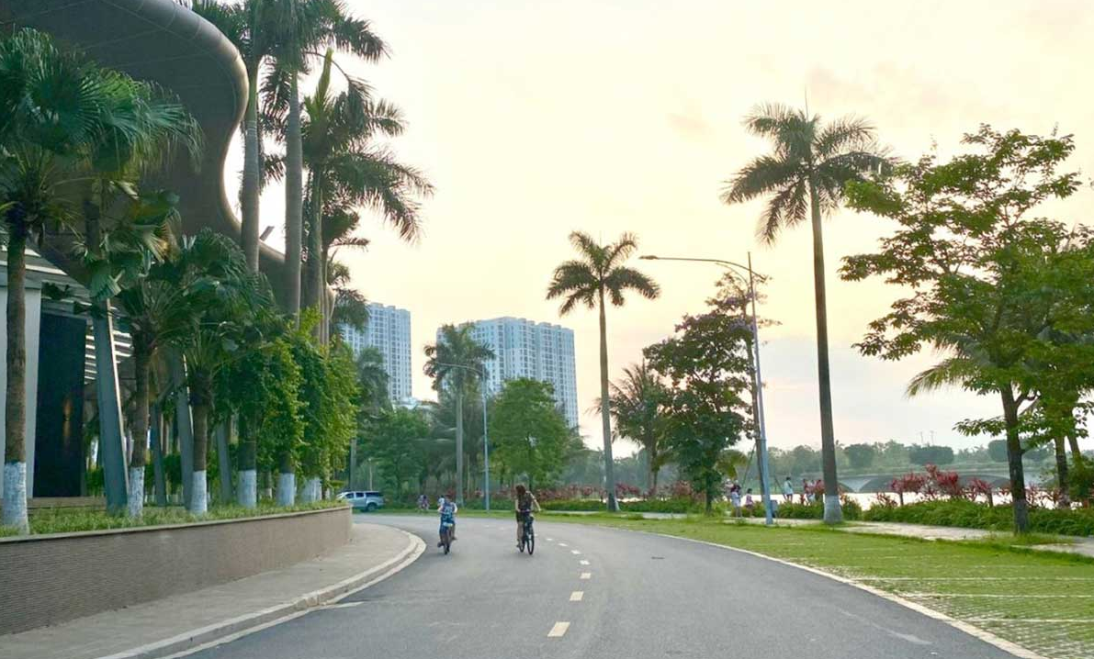
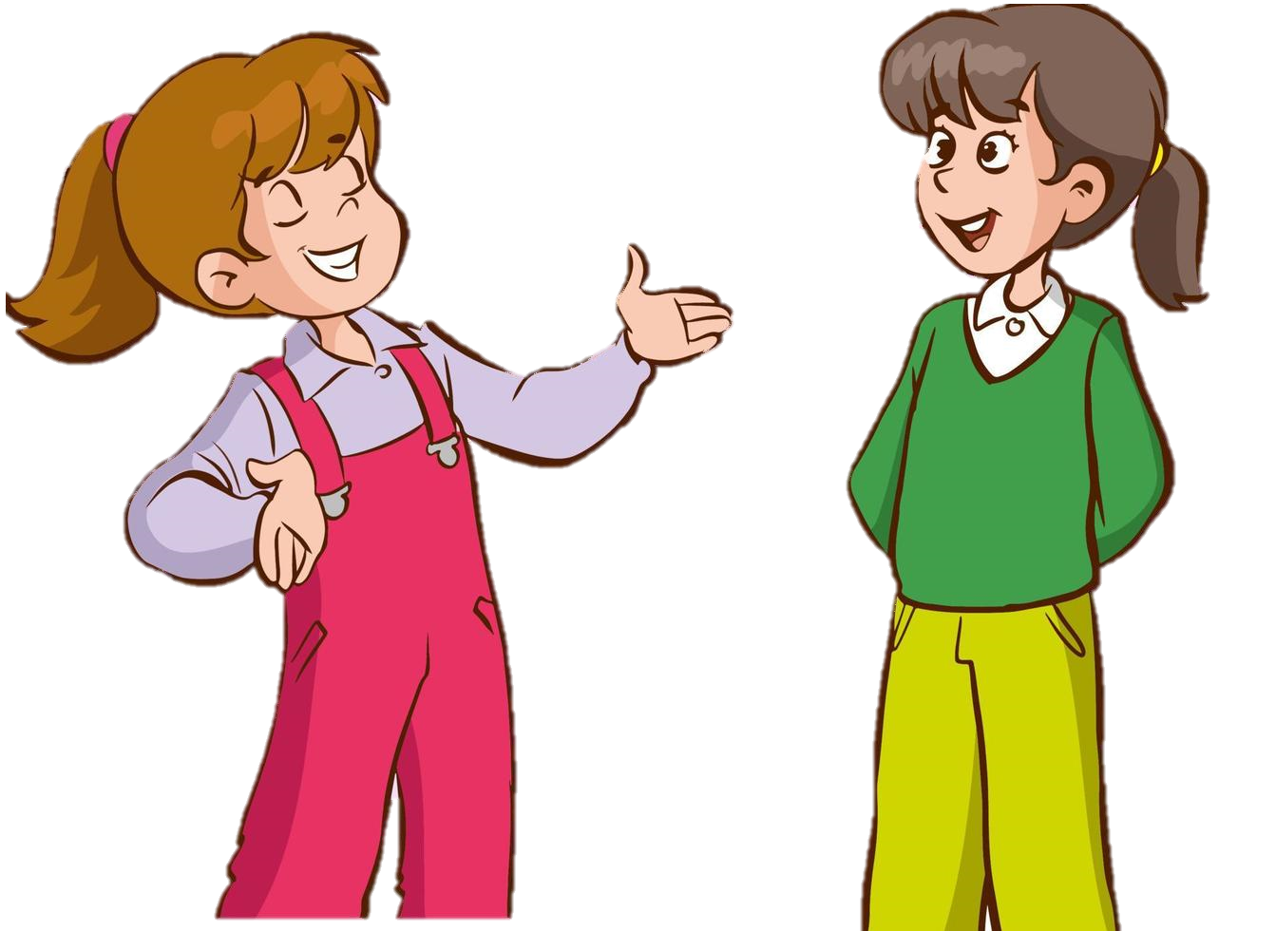
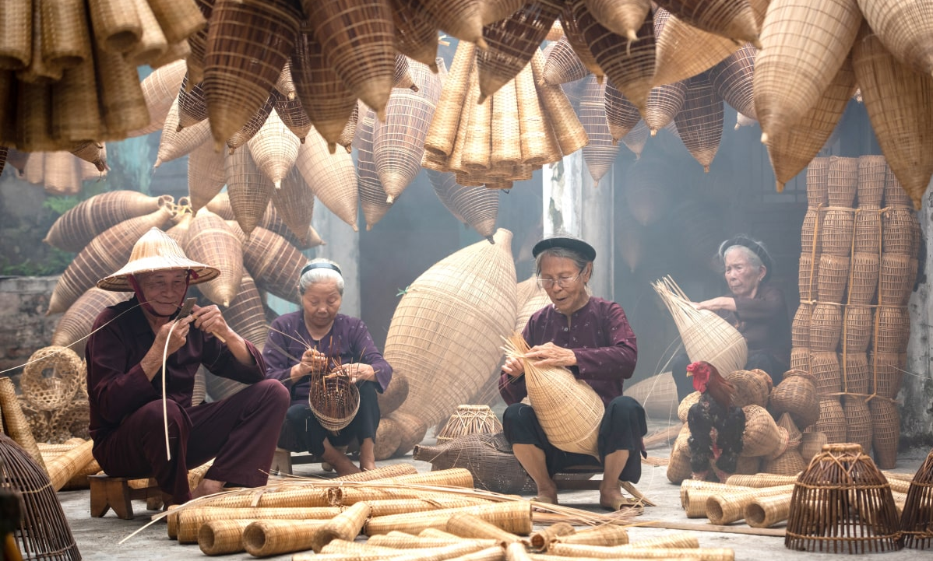
LISTEN AND READ
street
Ann
Mi
What are they talking about?
craft village

Slide 21
LISTEN AND READ
Ann: Hi, Mi. Long time no see. How’re you doing?
Mi: I’m fine, thanks. By the way, we moved to a new house in a suburb last month.
Ann: Oh, that’s why I haven’t seen you in the Reading Club very often.
Mi: Yes. We’re still busy moving in, you know.
Ann: How’s your new neighbourhood?
Mi: It’s much bigger than our old one. The streets are wider, and there are fewer people.
Ann: What about the facilities?
Mi: It has all the things we need: shopping malls, parks, and hospitals. And there’s a craft village near our house.
Ann: Great! How’re your new neighbours?
Mi: They’re nice. Last Sunday when I was looking for the way to the bus station, a lady came and showed me the way. I think we will get on with them.
Ann: That reminds me of the time our family moved to Viet Nam. We didn’t know where to buy stuff for our house, and the new neighbours in the community gave us useful advice. I guess you like your new place.
Mi: Sure. I really love where I live now.

Slide 22
What are they talking about?
It’s about Mi’s new neighbourhood since her family moved to a new house in a suburb.
Ann
Mi

Slide 23
Ex 2. Read again. Fill in the blank with NO MORE THAN TWO WORDS.
1. Mi’s family moved to a new house in a suburb ______.
2. Her new neighbourhood is bigger with wider streets and ______.
3. There is a ____________ near Mi’s house.
4. Mi thinks she will get on with her new ______.
5. People in Ann’s community gave her family ______ on where to buy stuff.

Slide 24
Ex 2. Read again. Fill in the blank with NO MORE THAN TWO WORDS.
1. Mi’s family moved to a new house in a suburb _________.
last month
Ann: Hi, Mi. Long time no see. How’re you doing?
Mi: I’m fine, thanks. By the way, we moved to a new house in a suburb last month.
Ann: Oh, that’s why I haven’t seen you in the Reading Club very often.

Slide 25
Ex 2. Read again. Fill in the blank with NO MORE THAN TWO WORDS.
2. Her new neighbourhood is bigger with wider streets and __________.
fewer people
Ann: How’s your new neighbourhood?
Mi: It’s much bigger than our old one. The streets are wider, and there are fewer people.
Ann: What about the facilities?
Mi: It has all the things we need: shopping malls, parks, and hospitals. And there’s a craft village near our house.

Slide 26
Ex 2. Read again. Fill in the blank with NO MORE THAN TWO WORDS.
3. There is a __________ near Mi’s house.
craft village
Ann: How’s your new neighbourhood?
Mi: It’s much bigger than our old one. The streets are wider, and there are fewer people.
Ann: What about the facilities?
Mi: It has all the things we need: shopping malls, parks, and hospitals. And there’s a craft village near our house.

Slide 27
Ex 2. Read again. Fill in the blank with NO MORE THAN TWO WORDS.
4. Mi thinks she will get on with her new _________.
neighbours
Ann: Great! How’re your new neighbours?
Mi: They’re nice. Last Sunday when I was looking for the way to the bus station, a lady came and showed me the way. I think we will get on with them.

Slide 28
Ex 2. Read again. Fill in the blank with NO MORE THAN TWO WORDS.
5. People in Ann’s community gave her family __________ on where to buy stuff.
useful advices
Ann: That reminds me of the time our family moved to Viet Nam. We didn’t know where to buy stuff for our house, and the new neighbours in the community gave us useful advice. I guess you like your new place.
Mi: Sure. I really love where I live now.

Slide 29
Ex 3. Match each word or phrase with its definition.
a. the people living in a particular area
1. suburb
b. to make somebody remember or think about somebody or something.
2. facilities
3. community
c. to have a good relationship with somebody
4. get on with
d. an area outside the centre of a city
5. remind somebody of
e. the buildings, equipment, and services provided for a particular purpose

Slide 30
Ex 4. Complete each sentence with a word or phrase from 3.
suburb
facilities
community
get on with
remind somebody of
1. They don’t live in the city centre but in a ________ of Ha Noi.
2. I love our new neighbourhood because we ___________ the people here.
3. There are enough sports ____________ for people of all ages in our local park.
4. Souvenirs _________ people ______ a place, an occasion, or a holiday.
5. The local ____________ encourages us to protect the environment and keep our neighbourhood clean.
don’t live
the city centre
but
suburb
love
new neighbourhood
get on with
the people
sports
facilities
Souvenirs
remind
people
of
local
community

Slide 31
Ex 5. GAME. What is the place?
Example: DO THE FOLLOWING QUIZ.
1. People watch sports such as football there.
2. People go there for health check-ups.
3. Parents take their children there so that they can have fun.
4. Children learn to read and write there.
5. Visitors see objects from the past there.
stadium
hospital
park
library
museum

Slide 32
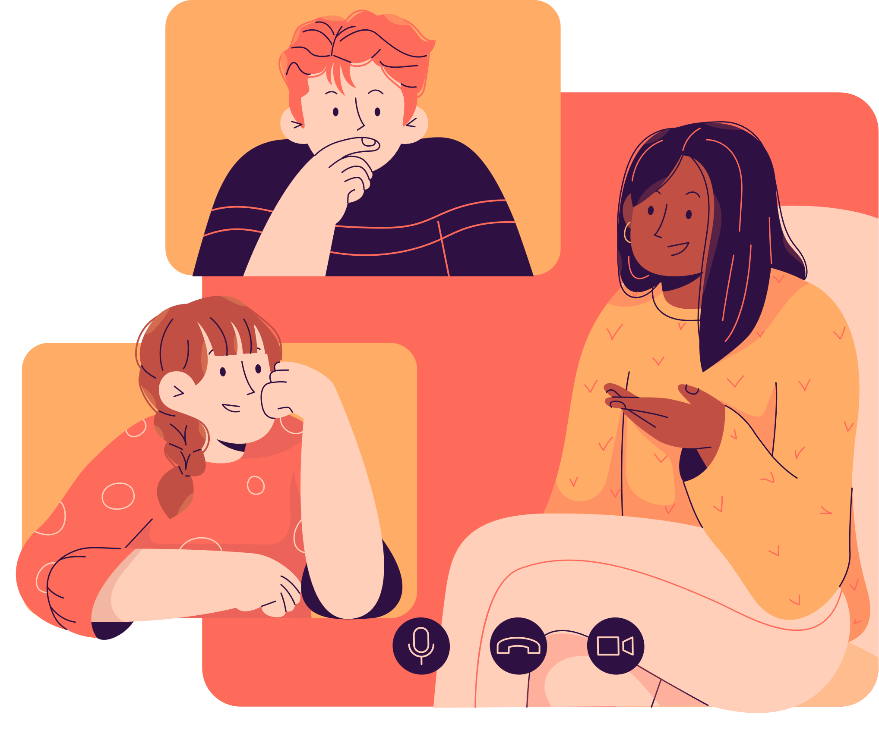
Game:
What is the place?

Slide 33
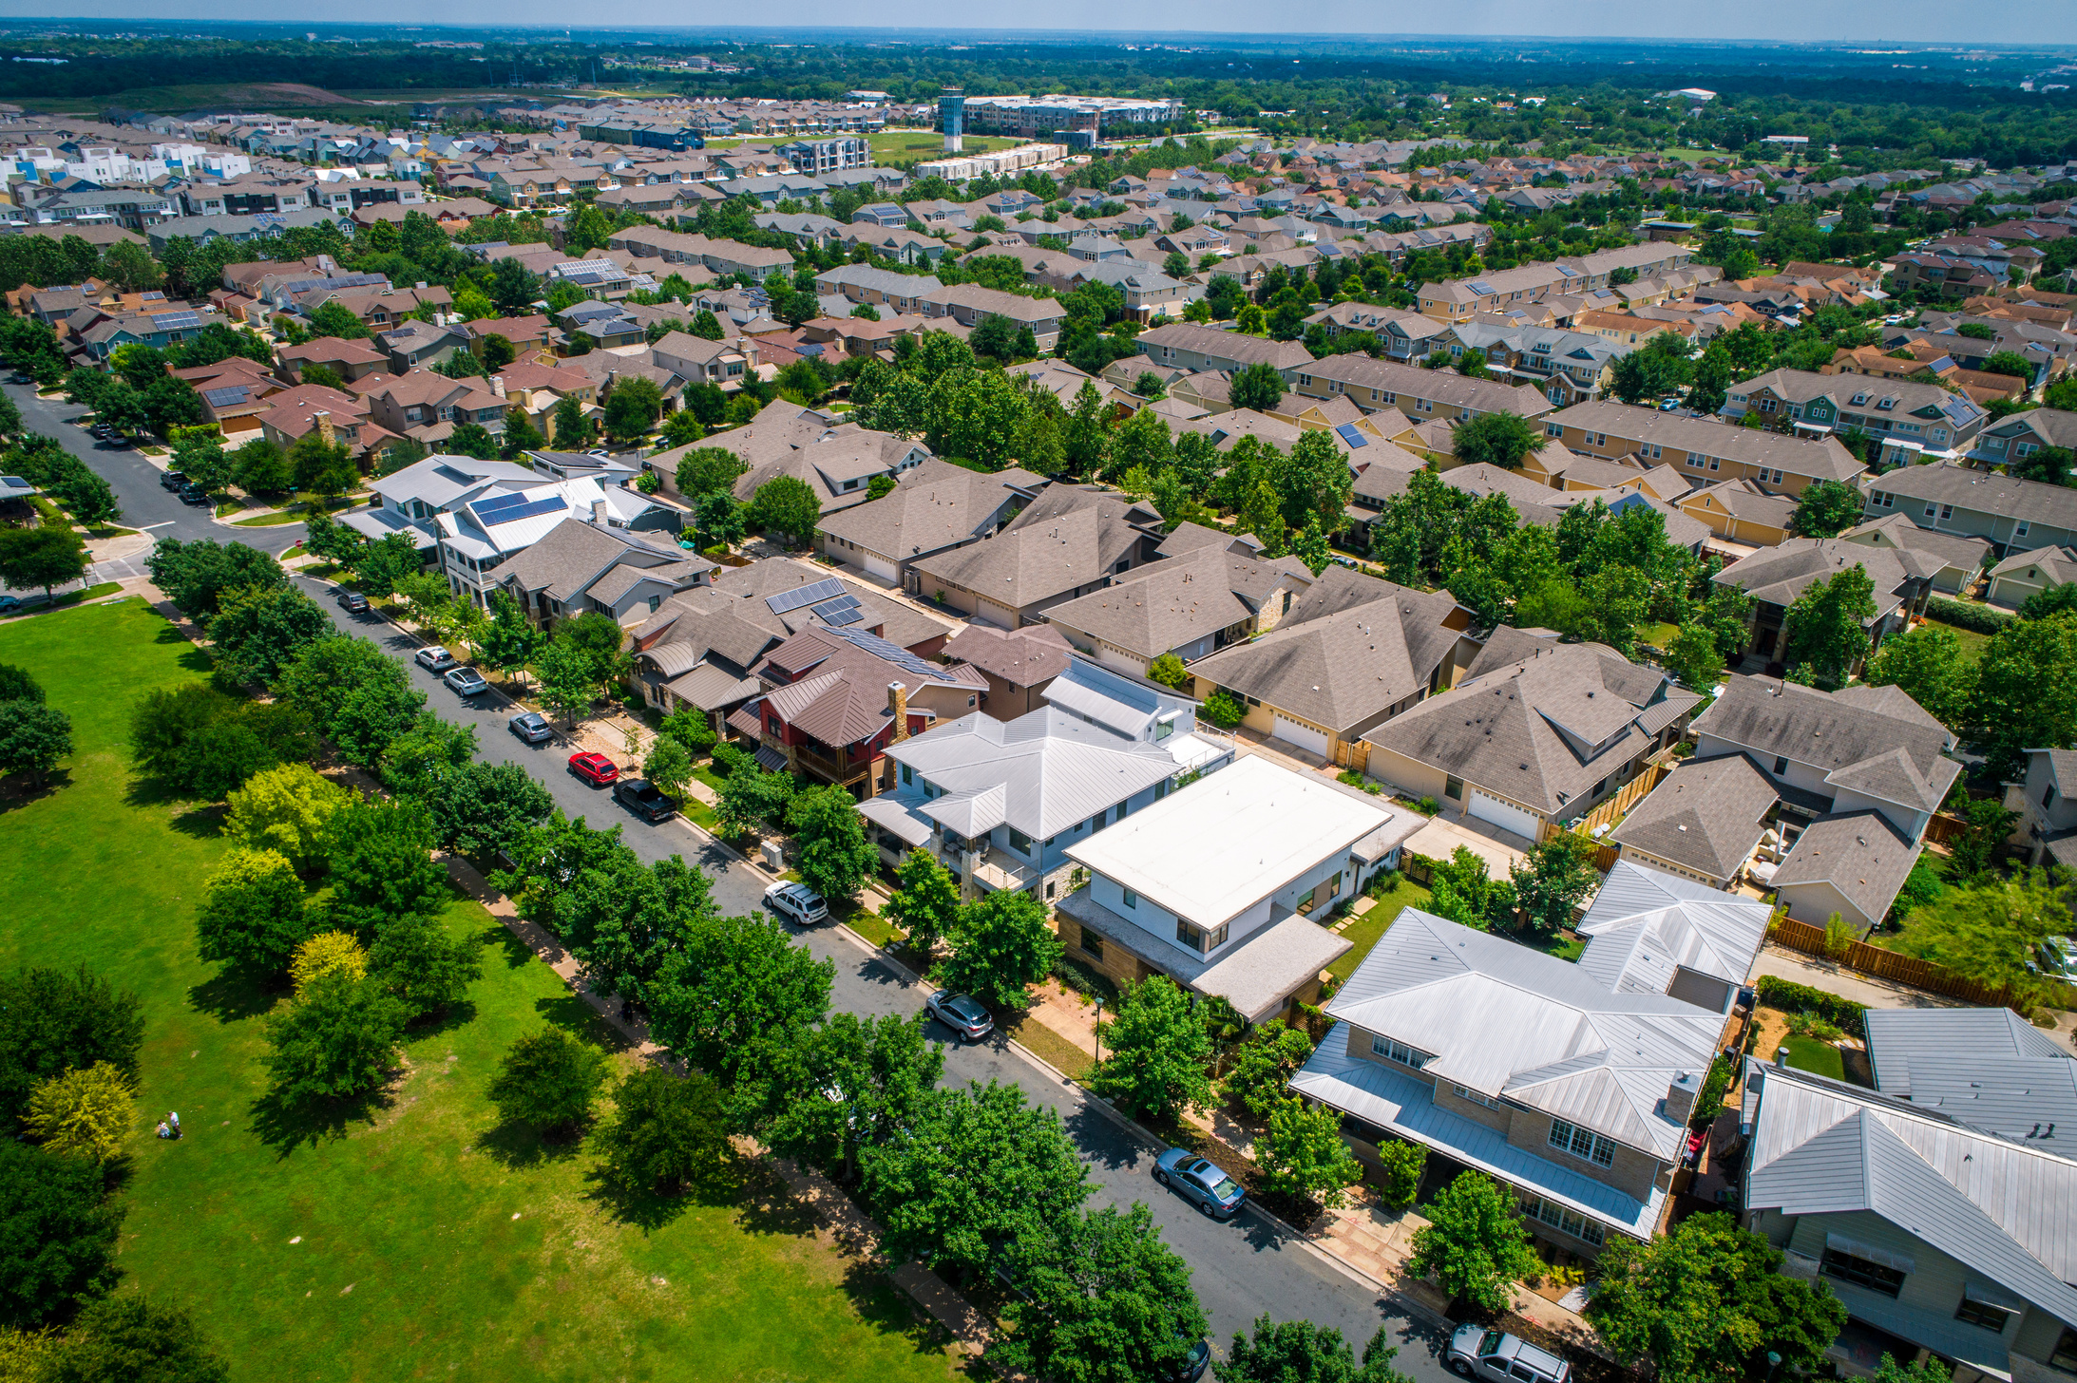
WRAP-UP
What do you have learnt in the lesson today?
01
What is it?
A. urban
B. suburb
C. city
02
What is the closest meaning of “search for”?
A. get on with B. remind of C. look for

Slide 34
HOMEWORK
Learn by heart the new words.
Do exercises in the workbook.

