Slide 1


Unit 0
Getting Started

Slide 2
Unit 0:
Getting Started
Lesson 1

Slide 3
UNIT 0
GETTING STARTED
English Time Chant
English, (clap) English, (clap)
English (clap) today! (clap, clap)
English, (clap) English, (clap)
Hip, hip, (clap) hooray! (clap, clap)

Slide 4

UNIT 0
GETTING STARTED
Eddie
Freddy
Mia
Polly
Notes:
Say Hello, class! Do you remember these animals?
That’s right! They are Eddie the elephant, Freddy the
frog, Mia the monkey, and Polly the parrot.
Point to each animal as you say its name.

Slide 5


UNIT 0
GETTING STARTED
Notes:
Play TR: B2, pausing after each word for
students to repeat.
Point to the animals in random order and ask
students to say what animal it is.
Students should say [An elephant]

Slide 6
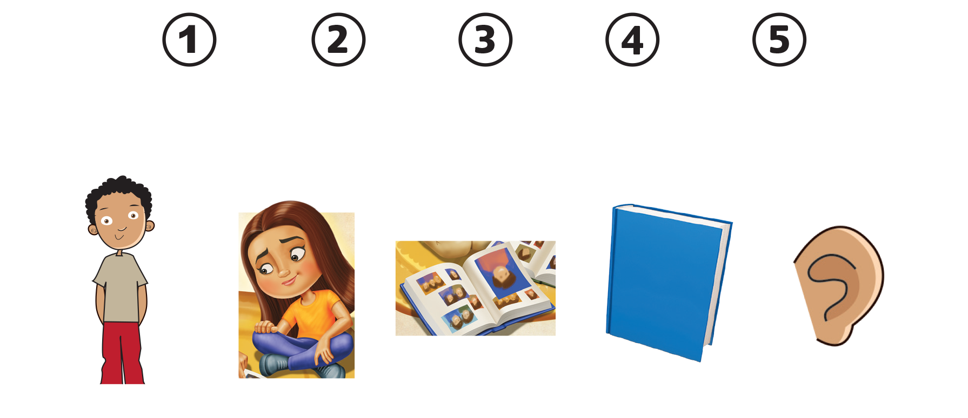
UNIT 0
GETTING STARTED
open your book
close
your book
stand up
sit down
listen
Notes:
Show students the pictures in Activity 2 on p. 2.
Say Do you remember these actions?
Do each action as you say it, and gesture for
students to do the action with you. Use props such
as a book, if necessary.

Slide 7
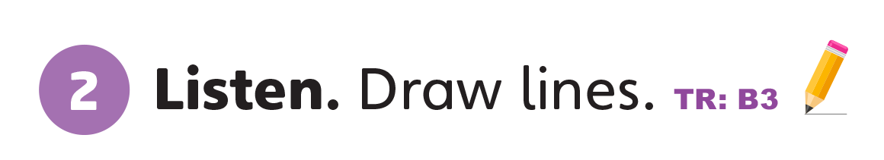
UNIT 0
GETTING STARTED
Notes:
Play TR: B3.
Have students listen and draw lines to match each
number with the correct picture.

Slide 8
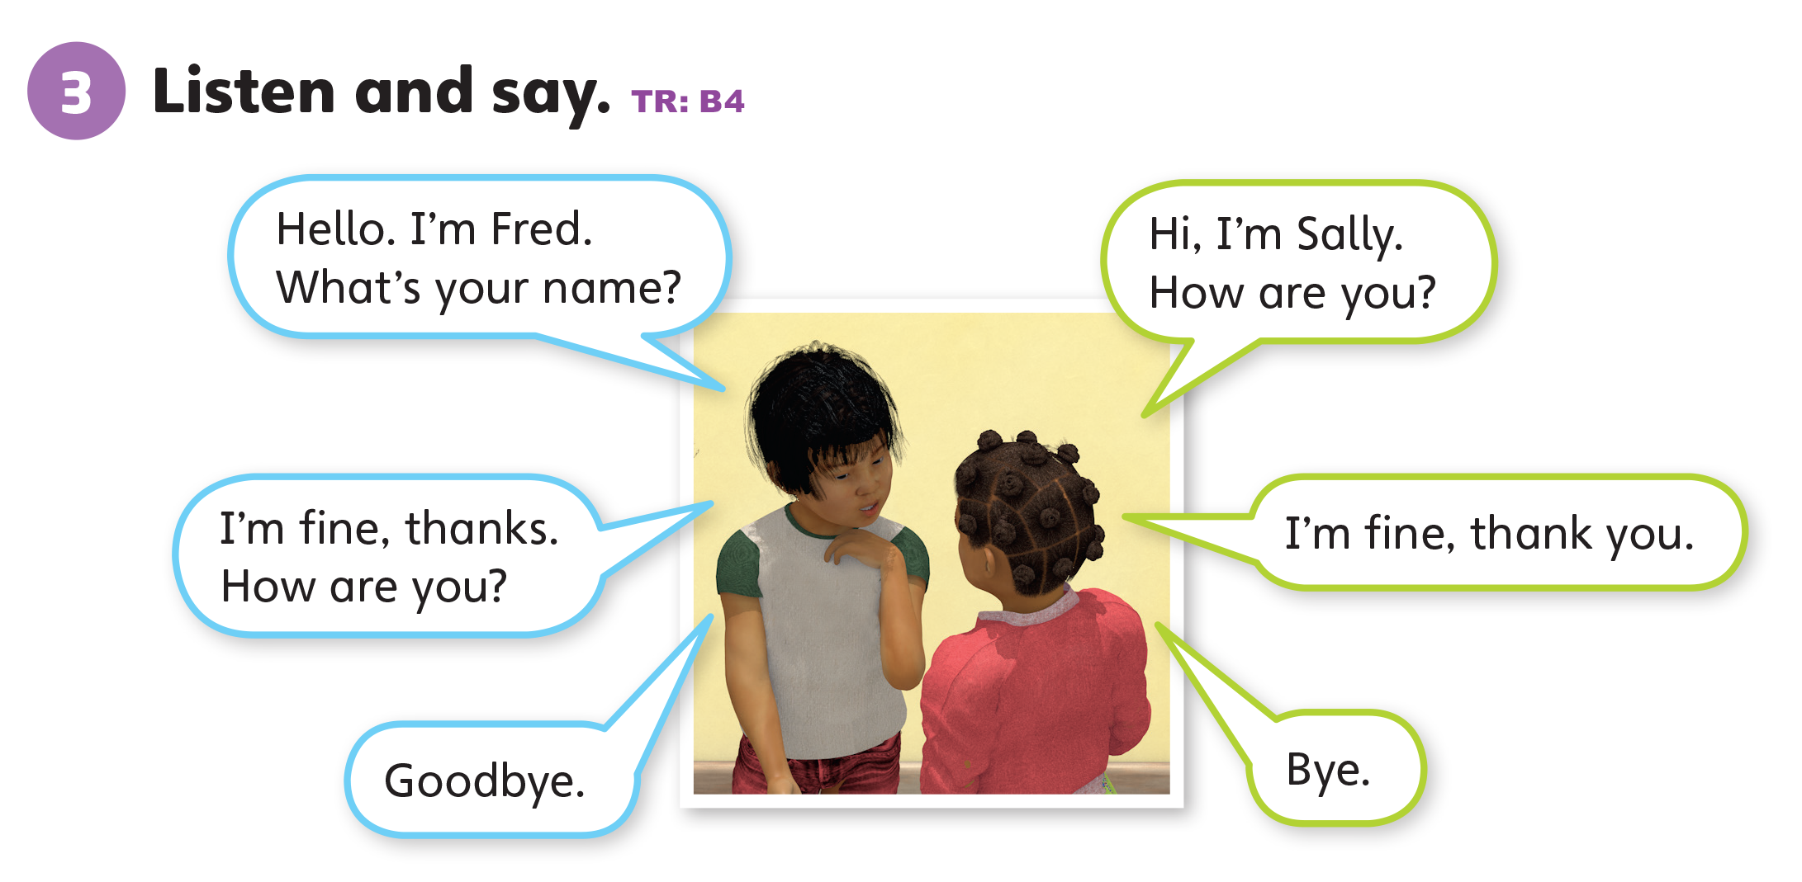
UNIT 0
GETTING STARTED
Notes:
Have students open their books, and then point
to the dialogue in Activity 3 on p. 2. Say Let’s listen to
what they say.
Play TR: B4 and have students listen. Model the
dialogue again by using different voices for the boy
and girl.
Say Now it’s your turn to talk to your classmate.
Put students in pairs and have them practice the
dialogue using their own names.

Slide 9
UNIT 0
GETTING STARTED
Eddie
Freddy
Mia
Polly
Notes:
Point to Activity 1 again and write the animals’ names
on the board as you read them out loud.
Say Eddie, Freddy, Mia, Polly.
Ask students to choose the animal they want to be.
Have them practice the dialogue again using the
names of the animals they have chosen.

Slide 10
UNIT 0
GETTING STARTED
Goodbye Chant
Good work, class.
Hip hip, hooray!
Goodbye for now.
Have a nice day!
Notes:
Say Good job today class. Now let’s chant.
Lead the class in the Goodbye chant.

Slide 11

UNIT 0
GETTING STARTED
Let’s check!
How do you feel?
Notes:
Can students use the simple present tense in
greetings and talk about how they feel?
Ask them how they feel as they leave the class.

Slide 12
UNIT 0
GETTING STARTED
Thank you!

Slide 13
Unit 0:
Getting Started
Lesson 2

Slide 14
UNIT 0
GETTING STARTED
English Time Chant
English, (clap) English, (clap)
English (clap) today! (clap, clap)
English, (clap) English, (clap)
Hip, hip, (clap) hooray! (clap, clap)

Slide 15
UNIT 0
GETTING STARTED
Eddie
Freddy
Mia
Polly
Notes:
Say Hello, class! Do you remember these animals?
That’s right! They are Eddie the elephant, Freddy the
frog, Mia the monkey, and Polly the parrot.
Point to each animal as you say its name.

Slide 16
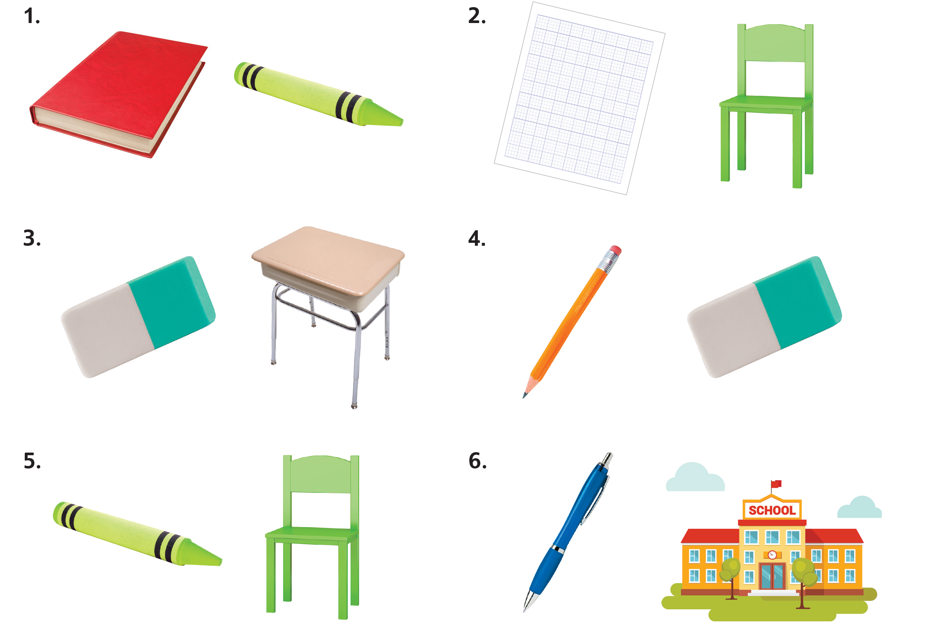
UNIT 0
GETTING STARTED
a crayon
an eraser
a book
a pen
a desk
a pencil
lined paper
a school
a chair
Notes:
Show students classroom objects and remind them what they are.
Say Do you remember these objects?
Point to each object and name them.
Say [A book] or [A red book].

Slide 17

UNIT 0
GETTING STARTED
Notes:
Find some of the classroom objects in the class
and ask students to name them.
Pick up a pen and ask What’s this?
Students should say [A pen] or It’s [a pen].
Say Listen and circle the item you hear.
Have students open their books to page 3.
Play TR: B5. Have students circle the correct
pictures.

Slide 18
UNIT 0
GETTING STARTED
Let’s play!
What do you have?
I have a pen.
He has a pen.
I have a book.
He has a pen.
She has a book.
I have an eraser
_______.
Notes:
Have each student pick up a classroom object.
Divide the students into two groups. Get them into a circle.
Say Today, we’re going to play a game. Let’s name what item each classmate has.
Invite two students to stand at the front of the class with you to model the game.
The first student should hold up a pen and say I have a pen.
The second student should hold up a book and say [He] has a pen. I have a book.
Hold up an eraser and say [He] has a pen. [She] has a book. I have an eraser.

Slide 19

UNIT 0
GETTING STARTED
have
has
Notes:
Give out lined paper to each student.
Say Let’s practice writing some of the letters we
know.
On the board, write the letter H. Show the students
how to draw the first, second, and third strokes.
Say This is uppercase (big) H. H is for have and has.
Then do the same for the lowercase h.
Have students practice writing the letter in uppercase
and lowercase.
Continue this activity for the letters G, V, E, P, O, T,
and B.

Slide 20
UNIT 0
GETTING STARTED
Goodbye Chant
Good work, class.
Hip hip, hooray!
Goodbye for now.
Have a nice day!
Notes:
Say Good job today class. Now let’s chant.
Lead the class in the Goodbye chant.

Slide 21

UNIT 0
GETTING STARTED
Let’s check!
What is it?
Notes:
Can students use the simple present tense to talk
about classroom objects?
Point to different classroom objects and ask the students What is it? as they leave the class.

Slide 22
UNIT 0
GETTING STARTED
Thank you!

Slide 23
Unit 0:
Getting Started
Lesson 3

Slide 24
UNIT 0
GETTING STARTED
English Time Chant
English, (clap) English, (clap)
English (clap) today! (clap, clap)
English, (clap) English, (clap)
Hip, hip, (clap) hooray! (clap, clap)

Slide 25
UNIT 0
GETTING STARTED
Who is ...?
Eddie
Freddy
Mia
Polly
Notes:
Say Hello, class! Do you remember these animals?
That’s right! They are Eddie the elephant, Freddy the frog, Mia the monkey, and Polly the parrot.
Point to each animal as you say its name.

Slide 26

UNIT 0
GETTING STARTED
Notes:
Point to the classroom objects on p. 3.
Name the classroom objects and have students repeat after you.
Point to each classroom object in random order and ask students to say what it is.
Students should say [Eraser / An eraser].

Slide 27
UNIT 0
GETTING STARTED
What is this?
It’s a pen.
a pen
Notes:
Review classroom items by showing some items to
the class and asking students to name them.
For example, pick up a pen and ask What’s this?
Students should say It’s a pen.

Slide 28
UNIT 0
GETTING STARTED
a crayon
an eraser
a book
a pen
a desk
a pencil
paper
a school
a chair
Notes:
Review classroom items by showing some items to
the class and asking students to name them.
For example, pick up a pen and ask What’s this?
Students should say It’s a pen.

Slide 29

UNIT 0
GETTING STARTED
Draw and guess.
Notes:
Break the class up into two teams.
Bring a student from each team up to the board.
Point to an object in the book and have the two students draw the object.
Award a point to the first student to guess correctly what the object is.
Students should raise their hand and say It’s [a pen].

Slide 30
UNIT 0
GETTING STARTED
Goodbye Chant
Good work, class.
Hip hip, hooray!
Goodbye for now.
Have a nice day!
Notes:
Say Good job today class. Now let’s chant.
Lead the class in the Goodbye chant.

Slide 31
UNIT 0
GETTING STARTED
Let’s check!
What is it?
Notes:
Can students use the simple present tense to talk
about classroom objects?
Point to different classroom objects and ask the students What is it? as they leave the class.

Slide 32
UNIT 0
GETTING STARTED
Thank you!

Slide 33
Unit 0:
Getting Started
Lesson 4

Slide 34
UNIT 0
GETTING STARTED
English Time Chant
English, (clap) English, (clap)
English (clap) today! (clap, clap)
English, (clap) English, (clap)
Hip, hip, (clap) hooray! (clap, clap)

Slide 35
UNIT 0
GETTING STARTED
Notes:
Show students the classroom objects on p. 3 and
remind them what they are.
Say Do you remember these objects?
Point to each object and name them.
Say [A book] or [A red book].

Slide 36
UNIT 0
GETTING STARTED
What is this?
It’s a pen.
a pen
Notes:
Review classroom items by showing some items to
the class and asking students to name them.
For example, pick up a pen and ask What’s this?
Students should say It’s [a pen].

Slide 37
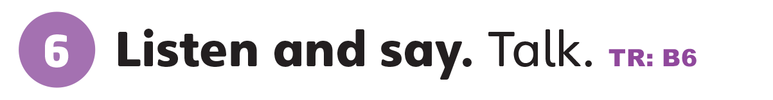
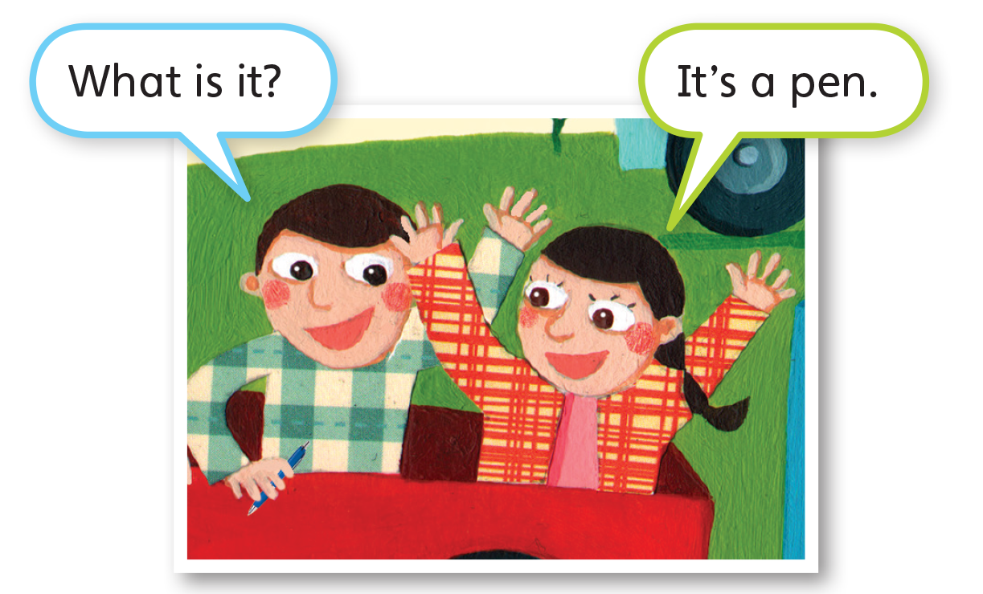
UNIT 0
GETTING STARTED
Notes:
Point to the dialogue in Activity 6 on p. 3.
Say Let’s listen to what they say.
Play TR: B6.
Then put students in pairs and say Now it’s your turn
to talk.
Students should take turns asking each other what
the different items are.
Student A should say What is it?
Student B should say It’s [a pen].

Slide 38
UNIT 0
GETTING STARTED
What is this?
It’s a ___.
Notes:
Point to the dialogue in Activity 6 on p. 3.
Say Let’s listen to what they say.
Play TR: B6.
Then put students in pairs and say Now it’s your turn
to talk.
Students should take turns asking each other what
the different items are.
Student A should say What is it?
Student B should say It’s [a pen].

Slide 39
UNIT 0
GETTING STARTED
Goodbye Chant
Good work, class.
Hip hip, hooray!
Goodbye for now.
Have a nice day!
Notes:
Say Good job today class. Now let’s chant.
Lead the class in the Goodbye chant.

Slide 40
UNIT 0
GETTING STARTED
Let’s check!
What is it?
Notes:
Can students use the simple present tense to talk
about classroom objects?
Point to different classroom objects and ask the
students What is it? as they leave the class.

Slide 41
UNIT 0
GETTING STARTED
It’s a chair.
Notes:
Can students use the simple present tense to identify and name toys?
Point to the different toys in Activity 8 on p. 4 and ask the students What is it? as they leave the class.

Slide 42
UNIT 0
GETTING STARTED
It’s a book.
Notes:
Can students use the simple present tense to identify and name toys?
Point to the different toys in Activity 8 on p. 4 and ask the students What is it? as they leave the class.

Slide 43
UNIT 0
GETTING STARTED
It’s an eraser.
Notes:
Can students use the simple present tense to identify and name toys?
Point to the different toys in Activity 8 on p. 4 and ask the students What is it? as they leave the class.

Slide 44
UNIT 0
GETTING STARTED
It’s a crayon.
Notes:
Can students use the simple present tense to identify and name toys?
Point to the different toys in Activity 8 on p. 4 and ask the students What is it? as they leave the class.

Slide 45
UNIT 0
GETTING STARTED
It’s a school.
Notes:
Can students use the simple present tense to identify and name toys?
Point to the different toys in Activity 8 on p. 4 and ask the students What is it? as they leave the class.

Slide 46
UNIT 0
GETTING STARTED
It’s a pencil.
Notes:
Can students use the simple present tense to identify and name toys?
Point to the different toys in Activity 8 on p. 4 and ask the students What is it? as they leave the class.

Slide 47
UNIT 0
GETTING STARTED
It’s paper.
Notes:
Can students use the simple present tense to identify and name toys?
Point to the different toys in Activity 8 on p. 4 and ask the students What is it? as they leave the class.

Slide 48
UNIT 0
GETTING STARTED
It’s a desk.
Notes:
Can students use the simple present tense to identify and name toys?
Point to the different toys in Activity 8 on p. 4 and ask the students What is it? as they leave the class.

Slide 49
UNIT 0
GETTING STARTED
Thank you!

Slide 50
Unit 0:
Getting Started
Lesson 5

Slide 51
UNIT 0
GETTING STARTED
English Time Chant
English, (clap) English, (clap)
English (clap) today! (clap, clap)
English, (clap) English, (clap)
Hip, hip, (clap) hooray! (clap, clap)

Slide 52
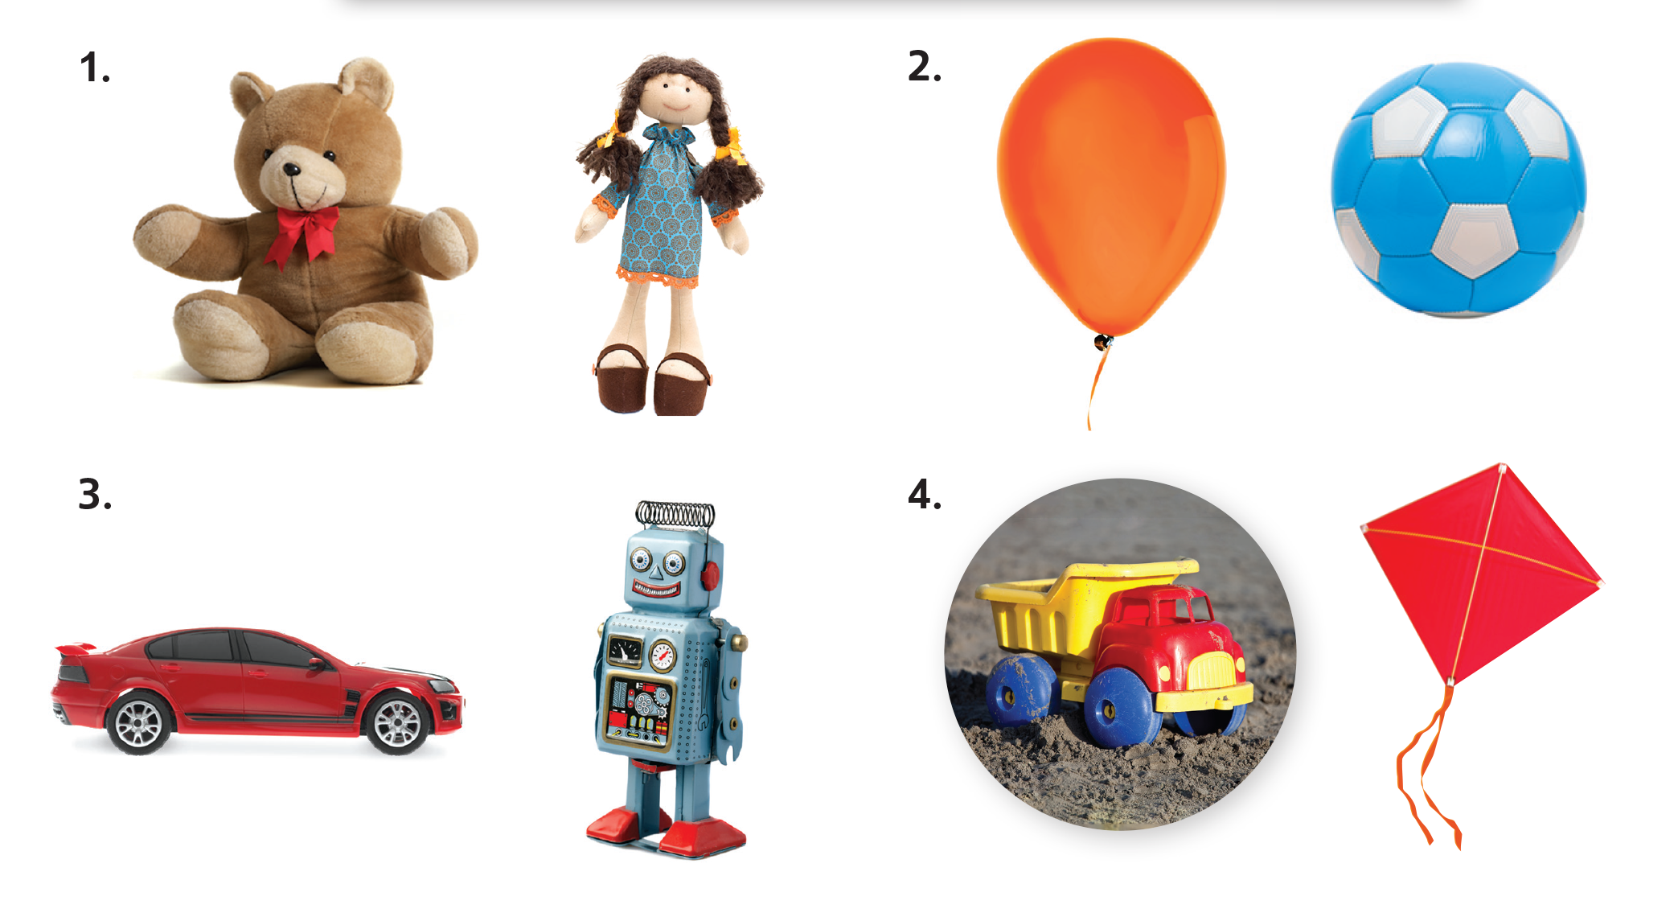
UNIT 0
GETTING STARTED
teddy bear
doll
balloon
ball
kite
truck
robot
car
Notes:
Say What toys do you play with here?
If they can’t remember the words for any toys, review
the words with them by holding up some toys and
asking What is it?
Students should say It’s [a ball].

Slide 53

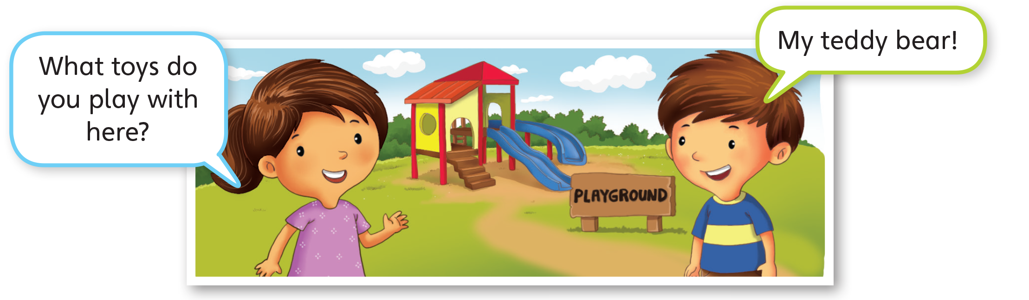
UNIT 0
GETTING STARTED
Notes:
Have students look at Activity 7 on p. 4.
Say Listen and circle the item you hear.
Play TR: B7 and have students circle the correct
pictures.

Slide 54
UNIT 0
GETTING STARTED
Notes:
Have students look at Activity 7 on p. 4.
Say Listen and circle the item you hear.
Play TR: B7 and have students circle the correct
pictures.

Slide 55

UNIT 0
GETTING STARTED
Notes:
Point to each picture and have students tell you
what it is.
Students should say It’s [a teddy bear]

Slide 56
UNIT 0
GETTING STARTED
Name the toy
This is a teddy bear.
This is a ____.
Notes:
Show students each toy, have them name the toy,
put it in a paper bag, and then randomize the bags.
Students should say [A doll].
Put pictures of the toys on the whiteboard or write
their names on the whiteboard. Name the toys.
Say This is [a doll].

Slide 57

UNIT 0
GETTING STARTED
What toy is it?
Notes:
Have students form groups of three.
Have the first student choose a bag, look into it, and
whisper to the second student to tell them what is
inside.
Students should say I have [a doll].
The second student then whispers what it is to the
third student.
The third student should then run to the board to
touch the picture or word belonging to the item in the
bag. The first student then shows what’s in the bag
and says what it is. If the answers match, the team
gets a point.
Say Good job!
Continue playing until all three students on each
team have had a chance to look in one of the bags.

Slide 58
UNIT 0
GETTING STARTED
Can you find the toy?
Can you find a teddy bear?
Can you find _________?
Notes:
Hide toys (doll, teddy bear, ball, car, etc.) around the
classroom.
Students then look for the objects.
Hide toys (doll, teddy bear, ball, car, etc.) around the
classroom.
Students then look for the objects.

Slide 59
UNIT 0
GETTING STARTED
Goodbye Chant
Good work, class.
Hip hip, hooray!
Goodbye for now.
Have a nice day!
Notes:
Say Good job today class. Now let’s chant.
Lead the class in the Goodbye chant.

Slide 60
UNIT 0
GETTING STARTED
Let’s check!
What is it?
Notes:
Can students use the simple present tense to identify and name toys?
Point to the different toys in Activity 8 on p. 4 and ask the students What is it? as they leave the class.

Slide 61
UNIT 0
GETTING STARTED
It’s a balloon.
Notes:
Can students use the simple present tense to identify and name toys?
Point to the different toys in Activity 8 on p. 4 and ask the students What is it? as they leave the class.

Slide 62
UNIT 0
GETTING STARTED
It’s a teddy bear.
Notes:
Can students use the simple present tense to identify and name toys?
Point to the different toys in Activity 8 on p. 4 and ask the students What is it? as they leave the class.

Slide 63
UNIT 0
GETTING STARTED
It’s a teddy bear.
Notes:
Can students use the simple present tense to identify and name toys?
Point to the different toys in Activity 8 on p. 4 and ask the students What is it? as they leave the class.

Slide 64
UNIT 0
GETTING STARTED
It’s a ball.
Notes:
Can students use the simple present tense to identify and name toys?
Point to the different toys in Activity 8 on p. 4 and ask the students What is it? as they leave the class.

Slide 65
UNIT 0
GETTING STARTED
It’s a car.
Notes:
Can students use the simple present tense to identify and name toys?
Point to the different toys in Activity 8 on p. 4 and ask the students What is it? as they leave the class.

Slide 66
UNIT 0
GETTING STARTED
It’s a robot.
Notes:
Can students use the simple present tense to identify and name toys?
Point to the different toys in Activity 8 on p. 4 and ask the students What is it? as they leave the class.

Slide 67
UNIT 0
GETTING STARTED
It’s a doll.
Notes:
Can students use the simple present tense to identify and name toys?
Point to the different toys in Activity 8 on p. 4 and ask the students What is it? as they leave the class.

Slide 68
UNIT 0
GETTING STARTED
Thank you!

Slide 69
Unit 0:
Getting Started
Lesson 6

Slide 70
UNIT 0
GETTING STARTED
English Time Chant
English, (clap) English, (clap)
English (clap) today! (clap, clap)
English, (clap) English, (clap)
Hip, hip, (clap) hooray! (clap, clap)

Slide 71
UNIT 0
GETTING STARTED
teddy bear
doll
balloon
ball
kite
truck
robot
car
Notes:
Say What toys do you play with here?
If they can’t remember the words for any toys, review
the words with them by holding up some toys and
asking What is it?
Students should say It’s [a ball].

Slide 72

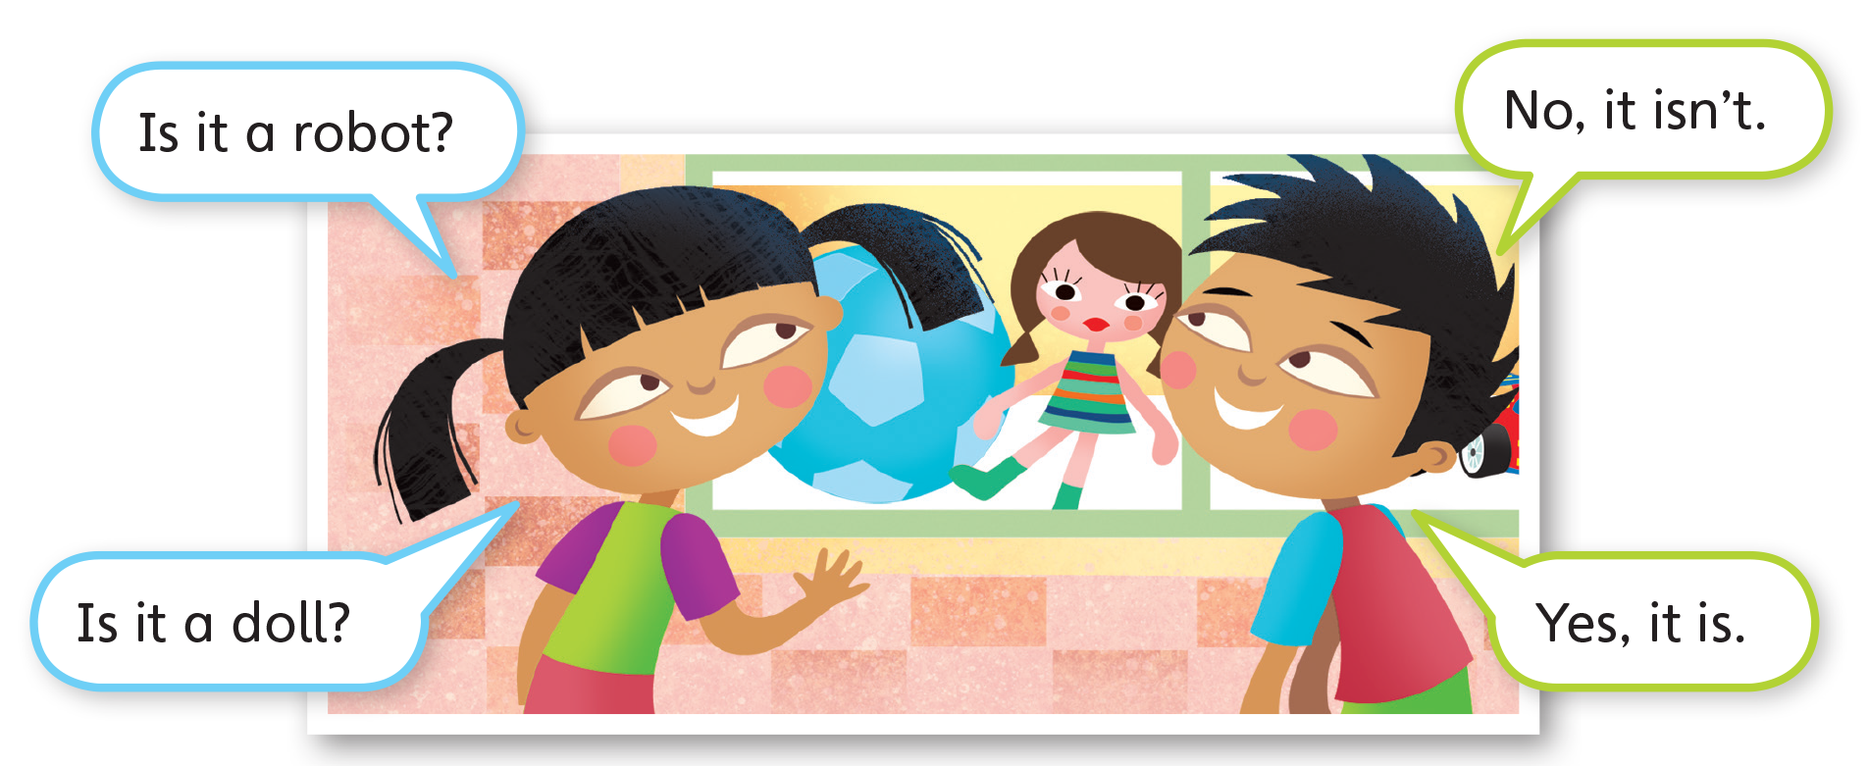
UNIT 0
GETTING STARTED
Notes:
Point to the dialogue in Activity 9 on p. 4. Say
Let’s listen to what they say.
Play TR: B8 and have students listen to the dialogue.

Slide 73
UNIT 0
GETTING STARTED
Is this a ____?
Yes, it is.
No, it isn’t.
Notes:
Put students in pairs and say Now it’s your turn to
talk.
Students should take turns pointing to a picture and
asking each other Is it [a ball]? and answering Yes, it
is. / No, it isn’t.

Slide 74
UNIT 0
GETTING STARTED
Guess the toy
It’s red and can run.
Is it a kite?
No, it isn’t.
Is it a car?
Yes, it is.
Notes:
Show the students some flash cards or pictures of
toys before putting them all in a bag.
Pick one card at random and describe the toy
using simple language. Use gestures for illustration
whenever possible.
Say: It’s red and can run.
Students should say Is it [a kite]?
Say No, it isn’t.
Students should say Is it [a car]?
Say Yes, it is.
Continue with the other flash cards.

Slide 75
UNIT 0
GETTING STARTED
Goodbye Chant
Good work, class.
Hip hip, hooray!
Goodbye for now.
Have a nice day!

Slide 76
UNIT 0
GETTING STARTED
Let’s check!
Tell me about your toy.
This is my doll. I like my doll. It is pretty.
Notes:
Write the target language for the students on the
board. For example, write: This is my doll. I like my
doll. It is pretty.
Each student should then come to the front of the
class and talk about what they have brought to class

Slide 77
UNIT 0
GETTING STARTED
Thank you!

Slide 78
Unit 0:
Getting Started
Lesson 7

Slide 79
UNIT 0
GETTING STARTED
English Time Chant
English, (clap) English, (clap)
English (clap) today! (clap, clap)
English, (clap) English, (clap)
Hip, hip, (clap) hooray! (clap, clap)

Slide 80
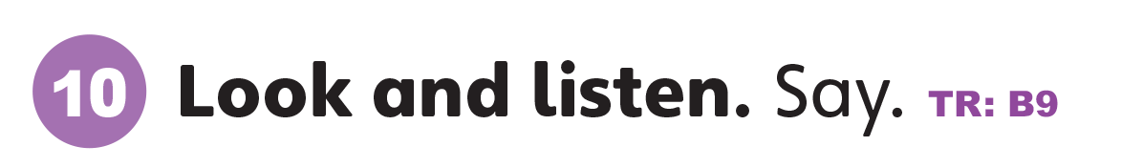
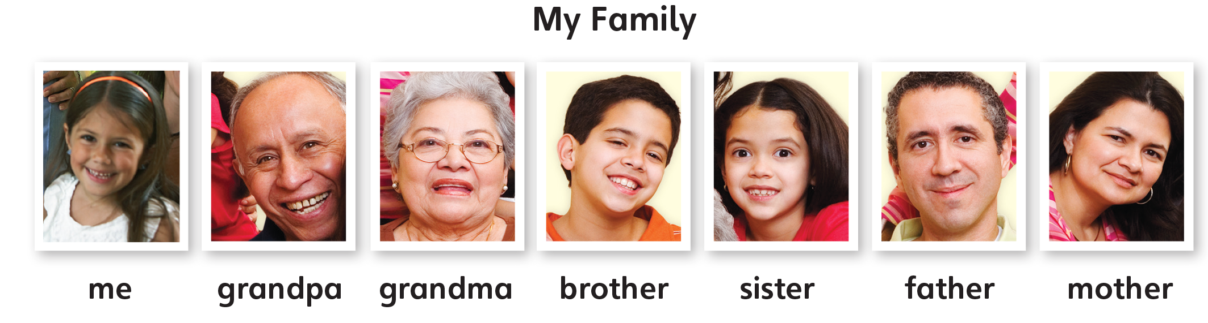
UNIT 0
GETTING STARTED
Notes:
Have students look at Activity 10 on p. 5.
Play TR: B9, pausing after each word for students to
repeat.

Slide 81
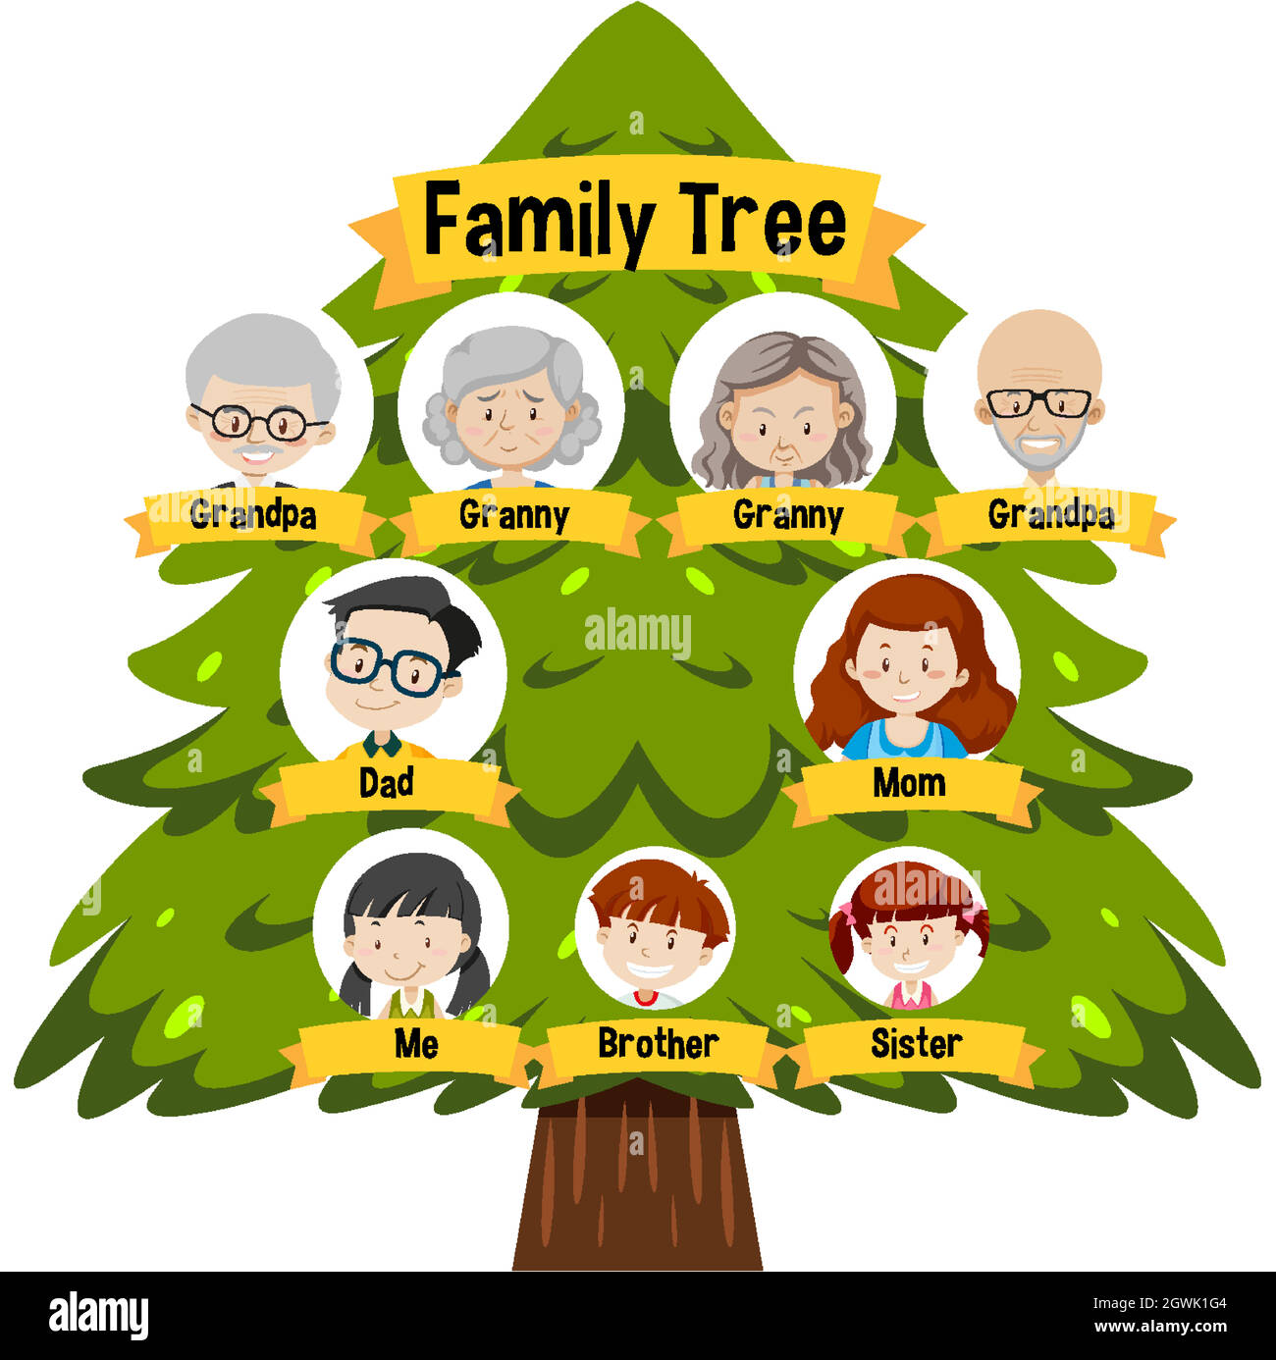
UNIT 0
GETTING STARTED
Notes:
Draw a family tree on the board. A family tree shows the hierarchy of a family.
Illustrate the diagram so that it looks like a tree.
Say This is a family tree. Let’s fill in the tree with the correct words.

Slide 82

UNIT 0
GETTING STARTED
Let’s draw
your family tree.
Notes:
Have students draw their family tree. Walk around to make sure students are following the instructions.
Afterward, pair students up and have them ask each other about their family tree.
Students should point to each other’s pictures and ask Who’s this?
Their partner should say It’s my [grandmother]

Slide 83
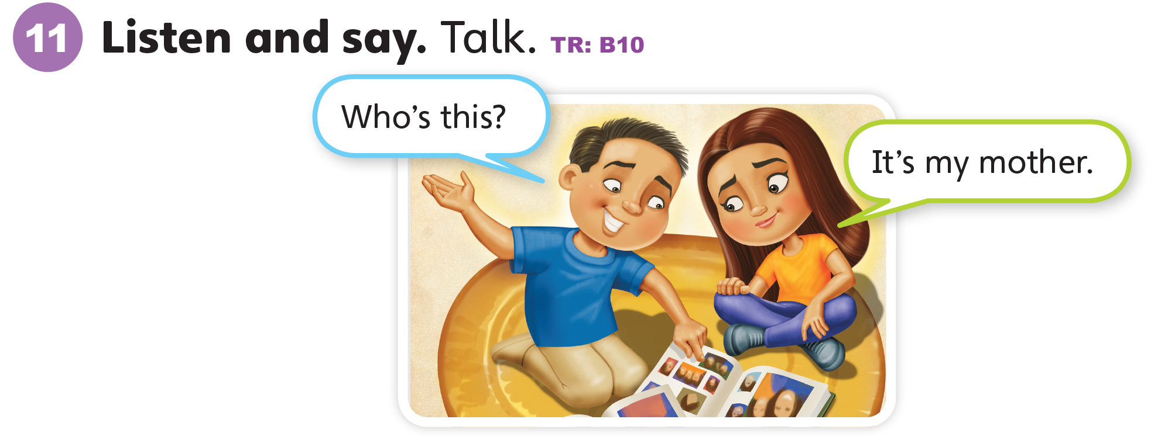
UNIT 0
GETTING STARTED
Notes:
Have students open their books to p. 5 and look
at Activity 11.
Say Let’s listen to what they say.
Play TR: B10 and have students listen to the
dialogue. Ask students to repeat after the track.

Slide 84
UNIT 0
GETTING STARTED
Who is this?
It’s my _____.
Notes:
Say Now, it’s your turn to talk.
Have students pair up. Ask them to look at the
pictures in Activity 10 and repeat the dialogue with
different family members.
Student A should say Who’s this?
Student B should say It’s my [brother]

Slide 85
UNIT 0
GETTING STARTED
Goodbye Chant
Good work, class.
Hip hip, hooray!
Goodbye for now.
Have a nice day!

Slide 86
UNIT 0
GETTING STARTED
Let’s check!
Who is it?
Notes:
Can students use the simple present tense to identify
family members?
Point to the different family members on p. 5 and ask the students Who is it? as they leave the class.

Slide 87
UNIT 0
GETTING STARTED
It’s Grandpa.
Notes:
Can students use the simple present tense to identify and name family members?
Point to the different family member in on p. 5 and ask the students Who is it? as they leave the class.

Slide 88
UNIT 0
GETTING STARTED
It’s Sister.
Notes:
Can students use the simple present tense to identify and name family members?
Point to the different family member in on p. 5 and ask the students Who is it? as they leave the class.

Slide 89
UNIT 0
GETTING STARTED
It’s Mother.
Notes:
Can students use the simple present tense to identify and name family members?
Point to the different family member in on p. 5 and ask the students Who is it? as they leave the class.

Slide 90
UNIT 0
GETTING STARTED
It’s Brother.
Notes:
Can students use the simple present tense to identify and name family members?
Point to the different family member in on p. 5 and ask the students Who is it? as they leave the class.

Slide 91
UNIT 0
GETTING STARTED
It’s Grandma.
Notes:
Can students use the simple present tense to identify and name family members?
Point to the different family member in on p. 5 and ask the students Who is it? as they leave the class.

Slide 92
UNIT 0
GETTING STARTED
It’s Father.
Notes:
Can students use the simple present tense to identify and name family members?
Point to the different family member in on p. 5 and ask the students Who is it? as they leave the class.

Slide 93
UNIT 0
GETTING STARTED
Thank you!

Slide 94
Unit 0:
Getting Started
Lesson 8

Slide 95
UNIT 0
GETTING STARTED
English Time Chant
English, (clap) English, (clap)
English (clap) today! (clap, clap)
English, (clap) English, (clap)
Hip, hip, (clap) hooray! (clap, clap)

Slide 96
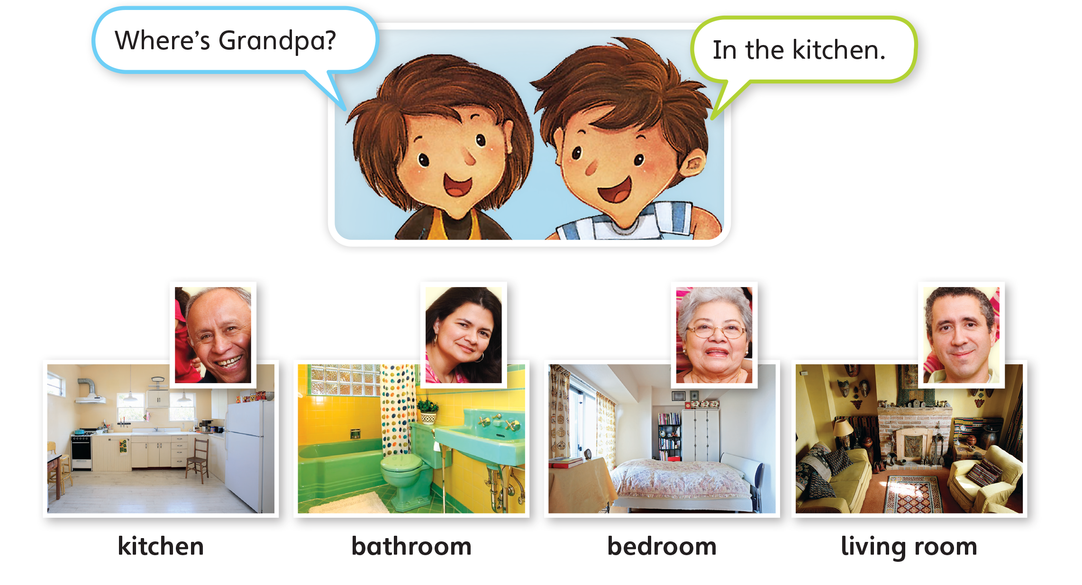
UNIT 0
GETTING STARTED
Notes:
Have students look at the pictures of the four rooms in Activity 12 on p. 5.
Say the names of the rooms and have students repeat.
Students should say It’s [a kitchen].
Point to the rooms in random order and have students tell you what room it is.

Slide 97
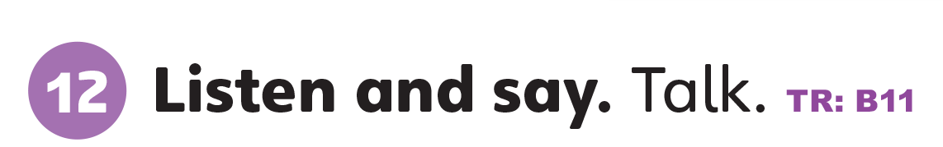
UNIT 0
GETTING STARTED
Notes:
Have students open their books to p. 5. Point to
the dialogue in Activity 12.
Say Let’s listen to what they say.
Play TR: B11 and have students listen to the
dialogue.

Slide 98
UNIT 0
GETTING STARTED
Where is _____?
In the _____.
Notes:
Put students in pairs and say Now it’s your turn to
talk.
Ask students to look at the remaining three pictures
under the dialogue and take turns asking and
answering about where each person is.
Student A should point to the second picture and
asks Where is [Mother/the mother]?
Student B should say In the [bathroom]

Slide 99
UNIT 0
GETTING STARTED
Your family picture
Notes:
Can students use the simple present tense to identify family members?
Point to the different family members on p. 5 and ask
the students Who is it? as they leave the class.

Slide 100
UNIT 0
GETTING STARTED
Goodbye Chant
Good work, class.
Hip hip, hooray!
Goodbye for now.
Have a nice day!

Slide 101
UNIT 0
GETTING STARTED
Let’s Check
Who is it?
Notes:
Can students use the simple present tense to identify family members?
Point to the different family members on p. 5 and ask
the students Who is it? as they leave the class.

Slide 102
UNIT 0
GETTING STARTED
It’s Grandma.
Notes:
Can students use the simple present tense to identify and name family members?
Point to the different family member in on p. 5 and ask the students Who is it? as they leave the class.

Slide 103
UNIT 0
GETTING STARTED
It’s Sister.
Notes:
Can students use the simple present tense to identify and name family members?
Point to the different family member in on p. 5 and ask the students Who is it? as they leave the class.

Slide 104
UNIT 0
GETTING STARTED
It’s Father.
Notes:
Can students use the simple present tense to identify and name family members?
Point to the different family member in on p. 5 and ask the students Who is it? as they leave the class.

Slide 105
UNIT 0
GETTING STARTED
It’s Brother.
Notes:
Can students use the simple present tense to identify and name family members?
Point to the different family member in on p. 5 and ask the students Who is it? as they leave the class.

Slide 106
UNIT 0
GETTING STARTED
It’s Mother.
Notes:
Can students use the simple present tense to identify and name family members?
Point to the different family member in on p. 5 and ask the students Who is it? as they leave the class.

Slide 107
UNIT 0
GETTING STARTED
It’s Grandpa.
Notes:
Can students use the simple present tense to identify and name family members?
Point to the different family member in on p. 5 and ask the students Who is it? as they leave the class.

Slide 108
UNIT 0
GETTING STARTED
Thank you!

Slide 109
Unit 0:
Getting Started
Lesson 9

Slide 110
UNIT 0
GETTING STARTED
English Time Chant
English, (clap) English, (clap)
English (clap) today! (clap, clap)
English, (clap) English, (clap)
Hip, hip, (clap) hooray! (clap, clap)

Slide 111

UNIT 0
GETTING STARTED
Body Parts
Notes:
Review parts of the body with students by pointing
to different parts of your body and asking students to
name them.
Students should say [Head].
Help students if they have forgotten the names of
body parts.

Slide 112
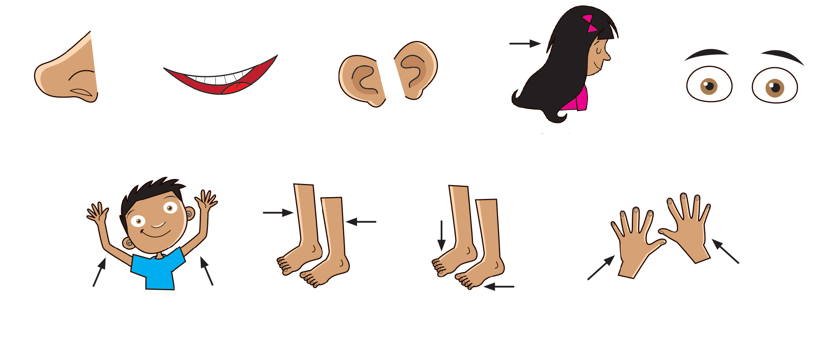
UNIT 0
GETTING STARTED
Body Parts
a nose
a mouth
ears
hair
eyes
arms
legs
feet
hands
Notes:
Review parts of the body with students by pointing
to different parts of your body and asking students to
name them.
Students should say [Head].
Help students if they have forgotten the names of
body parts.

Slide 113

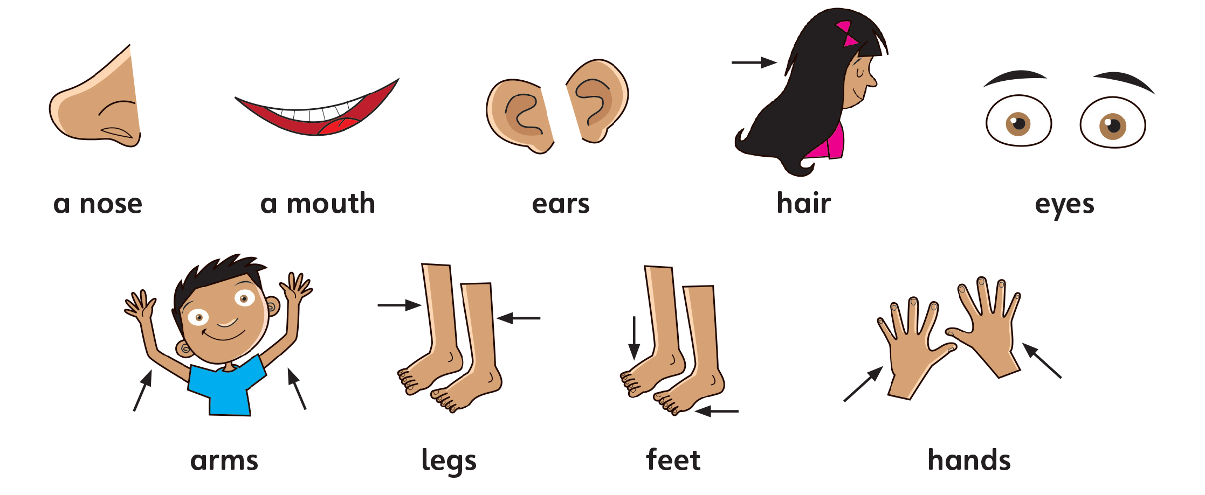
UNIT 0
GETTING STARTED
Notes:
Have students look at Activity 13 on p. 6.
Say Let’s listen.
Play TR: B12 and have students listen.
Then, play TR: B12 again, pausing after each word
for students to repeat.

Slide 114

UNIT 0
GETTING STARTED
Notes:
Point to each picture in Activity 14 in random
order and have students tell you what it is.
Students should say [It’s a nose].

Slide 115
UNIT 0
GETTING STARTED
Head, Shoulders, Knees, and Toes
Head, shoulders, knees and toes, knees and toes,
Head, shoulders, knees and toes, knees and toes,
And eyes and ears and mouth and nose,
Head, shoulders, knees and toes, knees and toes.
Ankles, elbows, feet and seat, feet and seat,
Ankles, elbows, feet and seat, feet and seat,
And hair and hips and chin and cheeks,
Ankles, elbows, feet and seat, feet and seat.
Notes:
Have students stand up and follow your directions.
Sing or use music and act out the song “Head, Shoulders, Knees, and Toes.”
Touch the parts of the body and sing.
Students should copy your gestures and sing the song.

Slide 116
UNIT 0
GETTING STARTED
Goodbye Chant
Good work, class.
Hip hip, hooray!
Goodbye for now.
Have a nice day!

Slide 117
UNIT 0
GETTING STARTED
Let’s check!
Body Parts
Notes:
Can students use the simple present tense to identify body parts?
When each student leaves the class, have them touch or point to one of the parts of the body that they have learned. For example, the first student says [A nose], and the second student says [A mouth].

Slide 118
UNIT 0
GETTING STARTED
Thank you!

Slide 119
Unit 0:
Getting Started
Lesson 10

Slide 120
UNIT 0
GETTING STARTED
English Time Chant
English, (clap) English, (clap)
English (clap) today! (clap, clap)
English, (clap) English, (clap)
Hip, hip, (clap) hooray! (clap, clap)

Slide 121
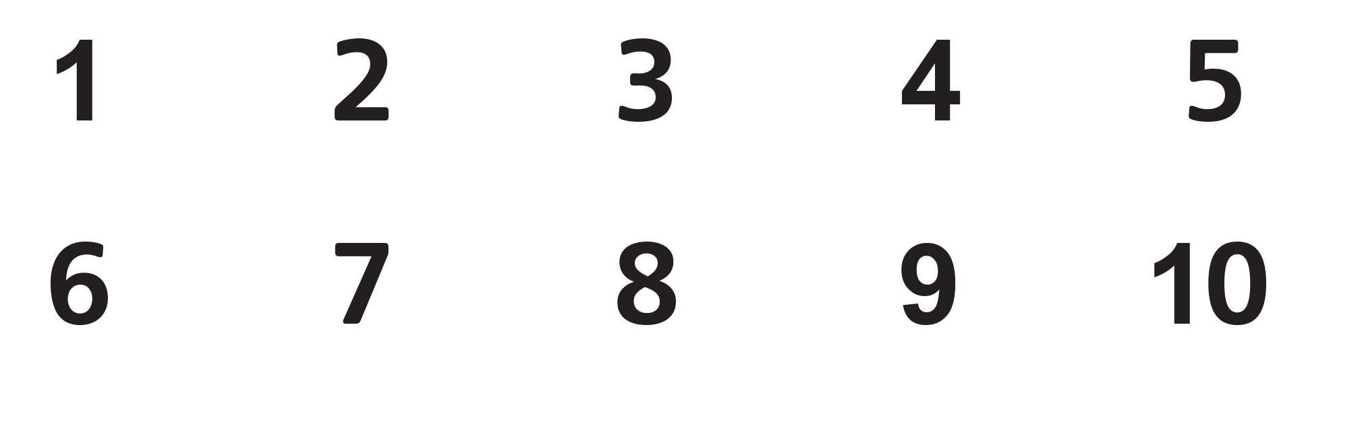
UNIT 0
GETTING STARTED
Review Numbers
one
two
three
four
five
six
seven
eight
nine
ten
Notes:
Review numbers one to ten.
Students should say One, two, three, four, five, six,
seven, eight, nine, ten.

Slide 122
UNIT 0
GETTING STARTED
Review Body Parts
One nose
Two ears
Notes:
Review parts of the body with students by pointing to different parts of your body and asking students to name them. Make use of this time to review the
numbers 1 and 2 with the body parts.
Students should say [One head/Two hands].

Slide 123
UNIT 0
GETTING STARTED
Two legs
Notes:
Review parts of the body with students by pointing to different parts of your body and asking students to name them. Make use of this time to review the
numbers 1 and 2 with the body parts.
Students should say [One head/Two hands].

Slide 124
UNIT 0
GETTING STARTED
One ear
Notes:
Review parts of the body with students by pointing to different parts of your body and asking students to name them. Make use of this time to review the
numbers 1 and 2 with the body parts.
Students should say [One head/Two hands].

Slide 125
UNIT 0
GETTING STARTED
One eye
Notes:
Review parts of the body with students by pointing to different parts of your body and asking students to name them. Make use of this time to review the
numbers 1 and 2 with the body parts.
Students should say [One head/Two hands].

Slide 126
UNIT 0
GETTING STARTED
Two hands
Notes:
Review parts of the body with students by pointing to different parts of your body and asking students to name them. Make use of this time to review the
numbers 1 and 2 with the body parts.
Students should say [One head/Two hands].

Slide 127
UNIT 0
GETTING STARTED
Two feet
Notes:
Review parts of the body with students by pointing to different parts of your body and asking students to name them. Make use of this time to review the
numbers 1 and 2 with the body parts.
Students should say [One head/Two hands].

Slide 128
UNIT 0
GETTING STARTED
One mouth
Notes:
Review parts of the body with students by pointing to different parts of your body and asking students to name them. Make use of this time to review the
numbers 1 and 2 with the body parts.
Students should say [One head/Two hands].

Slide 129
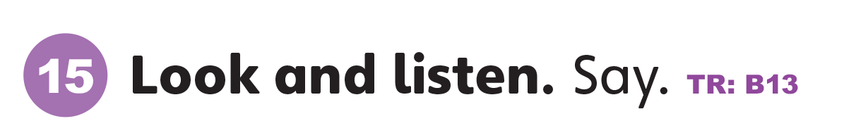
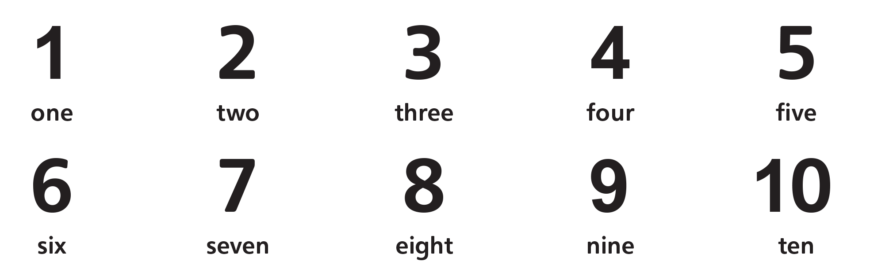
UNIT 0
GETTING STARTED
Notes:
Say Now listen to these numbers.
Play TR: B13 and have students listen.
Then, play TR: B13 again, pausing after each word
for students to repeat.
Students should say [Ten].

Slide 130
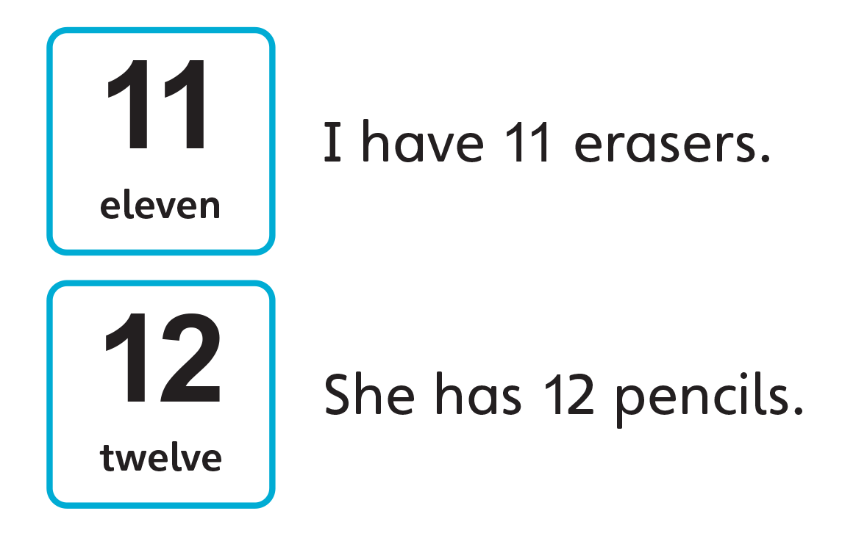
UNIT 0
GETTING STARTED
Notes:
Say The number 11 comes after 10. 12 comes after
11.

Slide 131
UNIT 0
GETTING STARTED
Notes:
Count from 1 to 12, and have students repeat after
you.
Students should say One, two, three, four, five, six,
seven, eight, nine, ten, eleven, twelve.

Slide 132
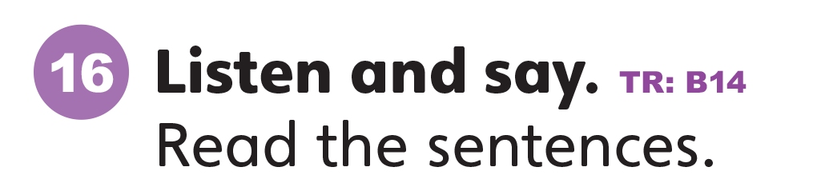
UNIT 0
GETTING STARTED
Notes:
Play TR: B14 and have students listen.
Then, play TR: B14 again, pausing after each number
for students to repeat.
Students should say Eleven. Twelve.
Then call for volunteers to read each of the sentences
aloud.
Students should say I have 11 erasers. She has 12
pencils.

Slide 133
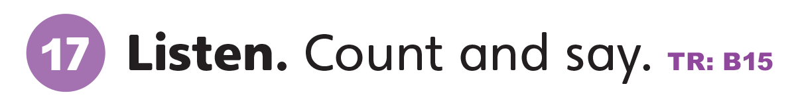
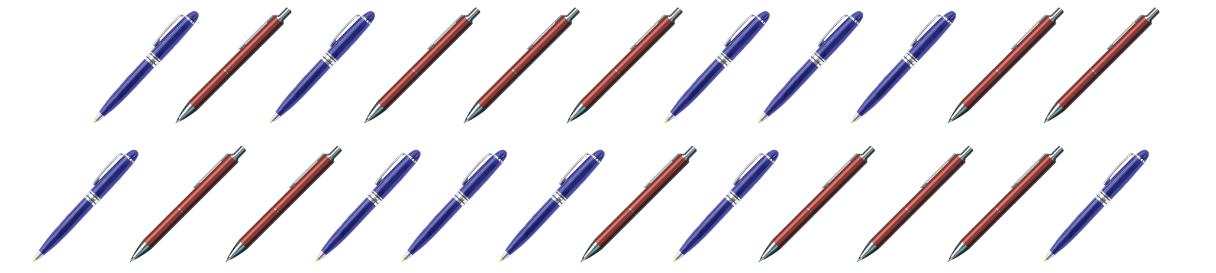
UNIT 0
GETTING STARTED
Notes:
Have students look at Activity 17 on p. 7. Say
Let’s listen.
Play TR: B15 and pause after the first question.
Repeat it and pause for students to count.
Students should say Eleven blue pens.
Then play the rest of TR: B15, again pausing after
the question and repeating it for the students if
necessary. Check the answers as a class.
Students should say Twelve red pens.

Slide 134
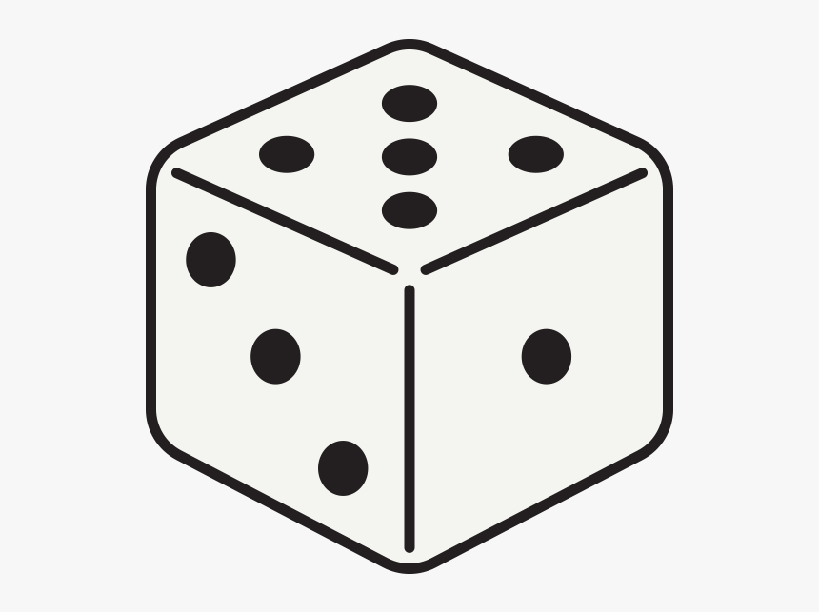
UNIT 0
GETTING STARTED
DRAW YOUR MONSTER
HEAD
BODY
ARMS
LEGS
FEET
Notes:
Break the students up into groups. Give each student
their own crayons and paper. Each group gets one
die.
Write the words head, body, arms, hands, legs, and
feet on the board.
Point to the word head and say Head.
Roll a die and say My monster has [three heads].
Students should say Three heads.
Draw a monster with three heads on the board.
Ask each group to roll their die. They should draw as
many heads on their paper as appear on their die.
Repeat the activity for each part of the body.
Students should say My monster has [four arms].
If time allows, write fingers and toes on the board
and teach students what they mean. Ask students to
talk about what their monsters have.
Say Now give your monster [eleven] fingers. Give
your monster [twelve] toes.
Students should say My monster has [eleven fingers].

Slide 135
UNIT 0
GETTING STARTED
Goodbye Chant
Good work, class.
Hip hip, hooray!
Goodbye for now.
Have a nice day!

Slide 136
UNIT 0
GETTING STARTED
Let’s Check
Body parts
Notes:
Can students use the simple present tense to identify
body parts?
When each student leaves the class, have them touch or point to one of the parts of the body that they have learned. For example, the first student says
[A nose], and the second student says [A mouth].

Slide 137
UNIT 0
GETTING STARTED
Thank you!

Slide 138
Unit 0:
Getting Started
Lesson 11

Slide 139
UNIT 0
GETTING STARTED
English Time Chant
English, (clap) English, (clap)
English (clap) today! (clap, clap)
English, (clap) English, (clap)
Hip, hip, (clap) hooray! (clap, clap)

Slide 140

UNIT 0
GETTING STARTED
Notes:
Say Now let’s learn about some sounds of
English.
Have students look at Activity 18 on p.7.
Make a few sounds, such as /b/, /p/, and /h/ to help students understand the sounds of English.
Say Let’s listen to some new sounds. Play TR: B16
Say Stand has the /s/ sound.
Say the /s/ sound again, and have students repeat the sound and the word.
Students should repeat the sound and the word.

Slide 141
UNIT 0
GETTING STARTED
Which has the /s/ sound?
SIT
TALK
✓
Notes:
Then, ask Which has /s/—sit or talk?
Students should say Sit.
Emphasize the first sound of these words. Go through a few more examples using simple words
such as school, sister, and spin.

Slide 142
UNIT 0
GETTING STARTED
Which has the /s/ sound?
TOY
SCHOOL
✓
Notes:
Then, ask Which has /s/—sit or talk?
Students should say Sit.
Emphasize the first sound of these words. Go through a few more examples using simple words
such as school, sister, and spin.

Slide 143
UNIT 0
GETTING STARTED
Which has the /s/ sound?
MOUTH
SPIN
✓
Notes:
Then, ask Which has /s/—sit or talk?
Students should say Sit.
Emphasize the first sound of these words. Go through a few more examples using simple words
such as school, sister, and spin.

Slide 144
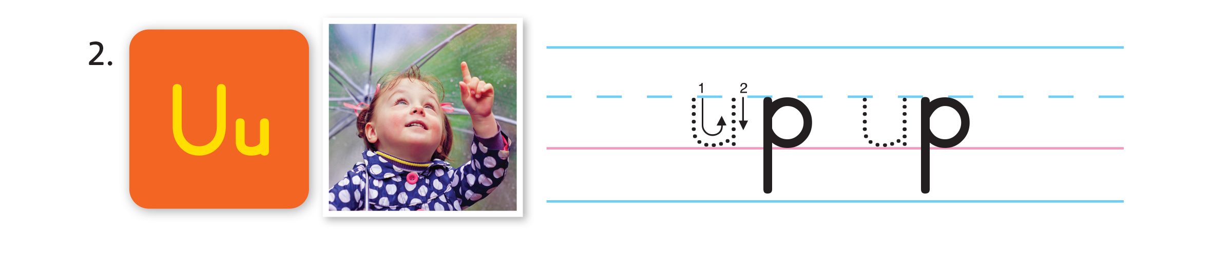
UNIT 0
GETTING STARTED
Notes:
Say Up has the /ʌ/ sound.
Repeat the word, emphasizing the /ʌ/. Have students
repeat the sound and the word.
Students should repeat the sound and the word.

Slide 145
UNIT 0
GETTING STARTED
Which has the /^/ sound?
UMBRELLA
PENCIL
✓
Notes:
Then, ask Which has /ʌ/—umbrella or pencil?
Students should say Umbrella.
Emphasize the first sound of these words as you say
them. Go through a few more examples using simple words, such as under and unhappy

Slide 146
UNIT 0
GETTING STARTED
Which has the /^/ sound?
UP
BOOK
✓
Notes:
Then, ask Which has /ʌ/—umbrella or pencil?
Students should say Umbrella.
Emphasize the first sound of these words as you say
them. Go through a few more examples using simple words, such as under and unhappy

Slide 147
UNIT 0
GETTING STARTED
Which has the /^/ sound?
BEAR
UNDER
✓
Notes:
Then, ask Which has /ʌ/—umbrella or pencil?
Students should say Umbrella.
Emphasize the first sound of these words as you say
them. Go through a few more examples using simple words, such as under and unhappy

Slide 148
UNIT 0
GETTING STARTED
Let’s Pronounce
STAND
Notes:
Write Ss on the board.
Ask What letter is this?
Students should say S.
Then say This letter makes the sound /s/. Have
students make the /s/ sound.
Ask students to open their books to p. 7. Then say
Let’s learn to pronounce /s/. Listen and repeat what
you hear.

Slide 149
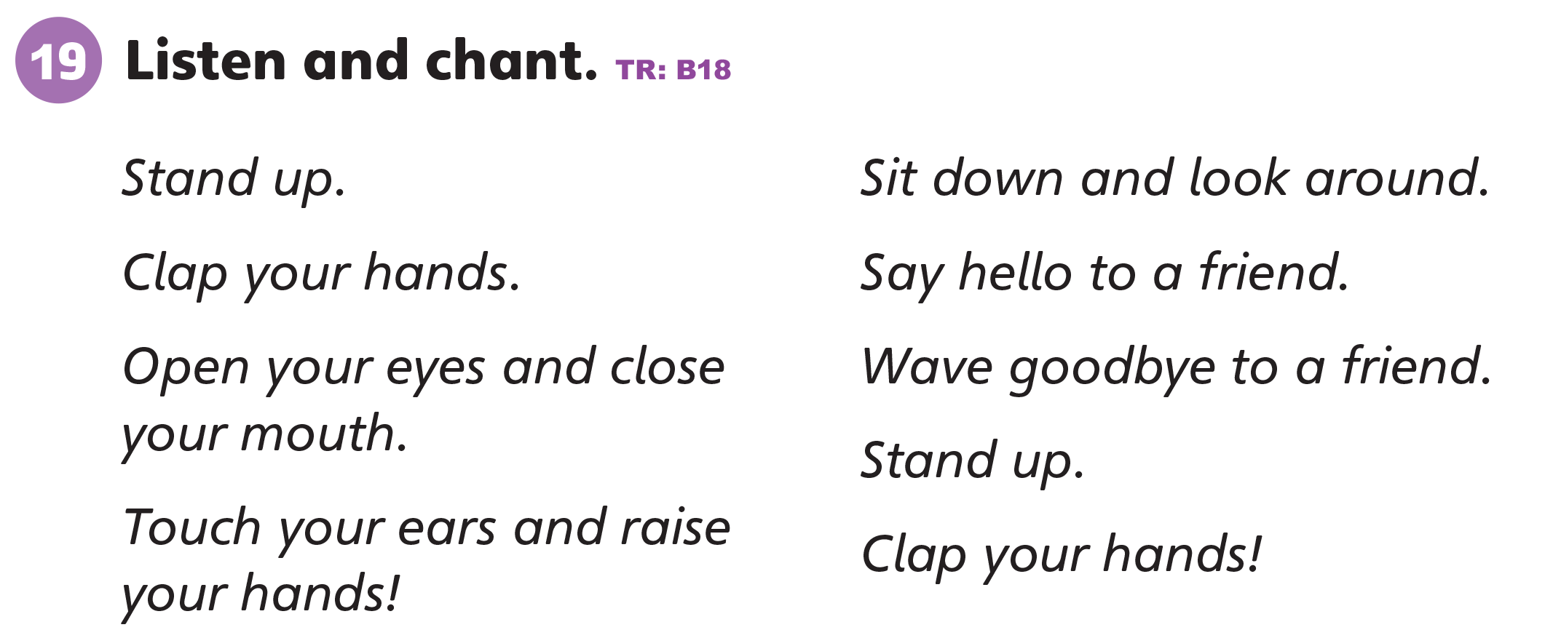
UNIT 0
GETTING STARTED
Notes:
Have students look at Activity 19 on p. 7. Say
Let’s listen to a chant.
Play TR: B18 two times.
Play the first half of TR: B18.
Have students should say the first half of the chant.
When it’s comfortable for the students, play the
second half of TR: B18.
Have students say the second half of the chant.
Play TR: B18 and have students say the whole chant.

Slide 150
UNIT 0
GETTING STARTED
Do the action
STAND UP
CLAP
OPEN
CLOSE
TOUCH
SIT DOWN
RAISE
SAY HELLO
WAVE GOODBYE
AND
Notes:
Divide the class into two groups.
Tell students that they can combine two commands
by using the word and.
Write a few possible actions on the board. For
example, write:
Stand up, clap, open, close, touch, sit down, raise,
look around, say hello, wave goodbye
Choose a student from one group to say two
commands and have the other group do the actions.
A student from Group A should say [Sit down and
talk].
Students from Group B should sit down and talk
among themselves.
Repeat with the other group and with other students.
Play a few rounds with the other actions.

Slide 151
UNIT 0
GETTING STARTED
Let’s Trace
Notes:
Draw Ss in dotted outline on the board. Say Let’s
trace the letter s. Model tracing over the outline.
Students should find and trace s.
Then say Look at the word and picture for stand
again. Listen to the sound /s/ and use your pencil to
trace the letter s. Play TR: B17 and stop after stand.
Students should say Stand.
Make sure students trace s two times for stand. Then
call on volunteers to say the word aloud. Repeat the
activity for u and play the rest of TR: B17.

Slide 152
UNIT 0
GETTING STARTED
Let’s Trace
Notes:
Draw Ss in dotted outline on the board. Say Let’s
trace the letter s. Model tracing over the outline.
Students should find and trace s.
Then say Look at the word and picture for stand
again. Listen to the sound /s/ and use your pencil to
trace the letter s. Play TR: B17 and stop after stand.
Students should say Stand.
Make sure students trace s two times for stand. Then
call on volunteers to say the word aloud. Repeat the
activity for u and play the rest of TR: B17.

Slide 153
UNIT 0
GETTING STARTED
Goodbye Chant
Good work, class.
Hip hip, hooray!
Goodbye for now.
Have a nice day!

Slide 154
UNIT 0
GETTING STARTED
Let’s Check
Follow the instruction
Notes:
Can students follow and give simple instructions?
Have students line up in a row to leave the class.
Give the first student an instruction to follow, such as Touch your nose and have that student do that
action. Then ask the student to give the next student
an instruction for him/her to follow.

Slide 155
UNIT 0
GETTING STARTED
Touch your nose.
Notes:
Can students follow and give simple instructions?
Have students line up in a row to leave the class.
Give the first student an instruction to follow, such as Touch your nose and have that student do that
action. Then ask the student to give the next student
an instruction for him/her to follow.

Slide 156
UNIT 0
GETTING STARTED
Open your mouth.
Notes:
Can students follow and give simple instructions?
Have students line up in a row to leave the class.
Give the first student an instruction to follow, such as Touch your nose and have that student do that
action. Then ask the student to give the next student
an instruction for him/her to follow.

Slide 157
UNIT 0
GETTING STARTED
Close your mouth.
Notes:
Can students follow and give simple instructions?
Have students line up in a row to leave the class.
Give the first student an instruction to follow, such as Touch your nose and have that student do that
action. Then ask the student to give the next student
an instruction for him/her to follow.

Slide 158
UNIT 0
GETTING STARTED
Look around.
Notes:
Can students follow and give simple instructions?
Have students line up in a row to leave the class.
Give the first student an instruction to follow, such as Touch your nose and have that student do that
action. Then ask the student to give the next student
an instruction for him/her to follow.

Slide 159
UNIT 0
GETTING STARTED
Say hello.
Notes:
Can students follow and give simple instructions?
Have students line up in a row to leave the class.
Give the first student an instruction to follow, such as Touch your nose and have that student do that
action. Then ask the student to give the next student
an instruction for him/her to follow.

Slide 160
UNIT 0
GETTING STARTED
Wave goodbye.
Notes:
Can students follow and give simple instructions?
Have students line up in a row to leave the class.
Give the first student an instruction to follow, such as Touch your nose and have that student do that
action. Then ask the student to give the next student
an instruction for him/her to follow.

Slide 161
UNIT 0
GETTING STARTED
Thank you!

Slide 162
Unit 0:
Getting Started
Lesson 12

Slide 163
UNIT 0
GETTING STARTED
English Time Chant
English, (clap) English, (clap)
English (clap) today! (clap, clap)
English, (clap) English, (clap)
Hip, hip, (clap) hooray! (clap, clap)

Slide 164
UNIT 0
GETTING STARTED
How many?
Red pens
Blue pens
6 - six
5 - five
Notes:
Review numbers 1–12 by showing different numbersof crayons on your desk or by drawing different
numbers of lines on the board and asking students to say the number.
Students should say [One].

Slide 165
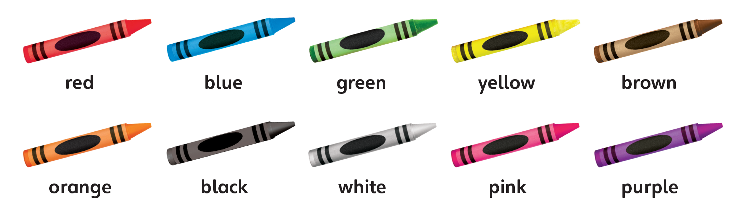
UNIT 0
GETTING STARTED
How many?
Crayons
4 - four
Notes:
Review numbers 1–12 by showing different numbers
of crayons on your desk or by drawing different numbers of lines on the board and asking students to say the number.
Students should say [One].

Slide 166
UNIT 0
GETTING STARTED
Notes:
Count from 1 to 12, and have students repeat after you.
Students should say One, two, three, four, five, six, seven, eight, nine, ten, eleven, twelve.

Slide 167
UNIT 0
GETTING STARTED
This crayon is ____.
Notes:
Review colors by using the crayons.
Hold up a crayon, for example, and say This crayon is [black]. Then hold up a crayon with a different color,
say This crayon is and let students name the color.
Students should say [Blue].
Repeat with the other crayons, and focus on blue, red, and orange in particular.

Slide 168

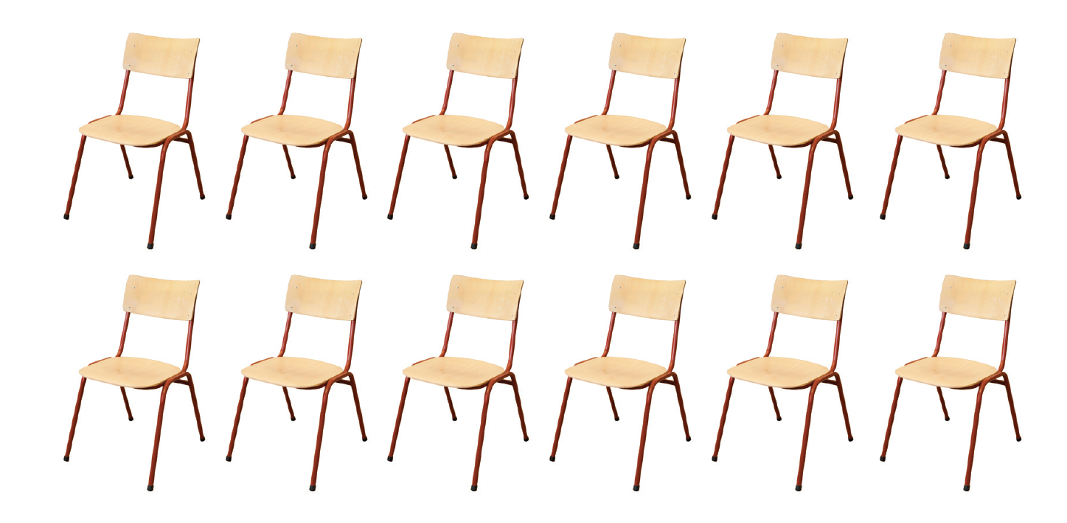

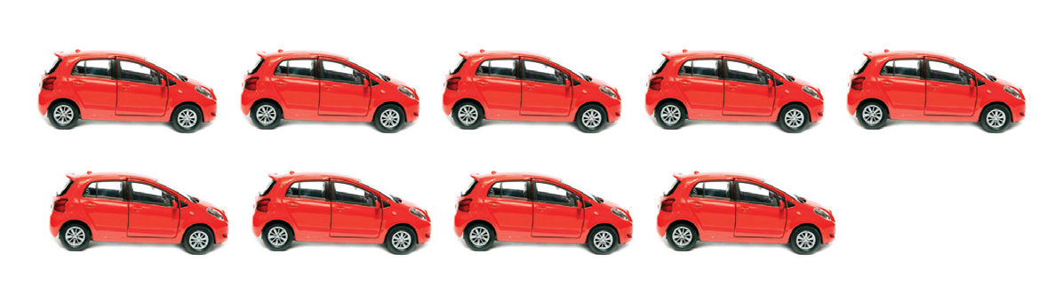
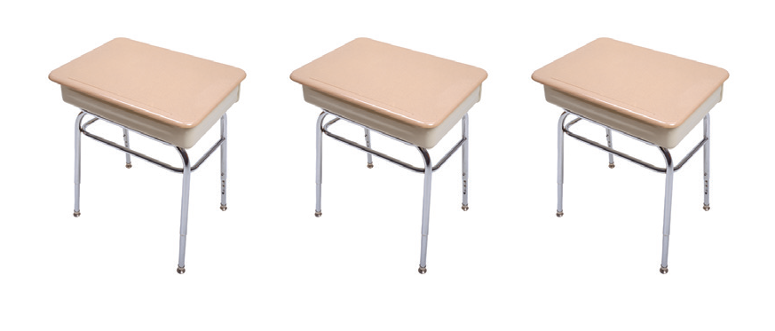

UNIT 0
GETTING STARTED
What is this?
a robot
a desk
a chair
a book
a ball
a car
This is a ____.
Notes:
Have students look at Activity 20 on p. 8 to review toys and classroom objects.
Point to one of the books and ask What’s this?
Students should say A book.
Repeat with the other pictures.

Slide 169

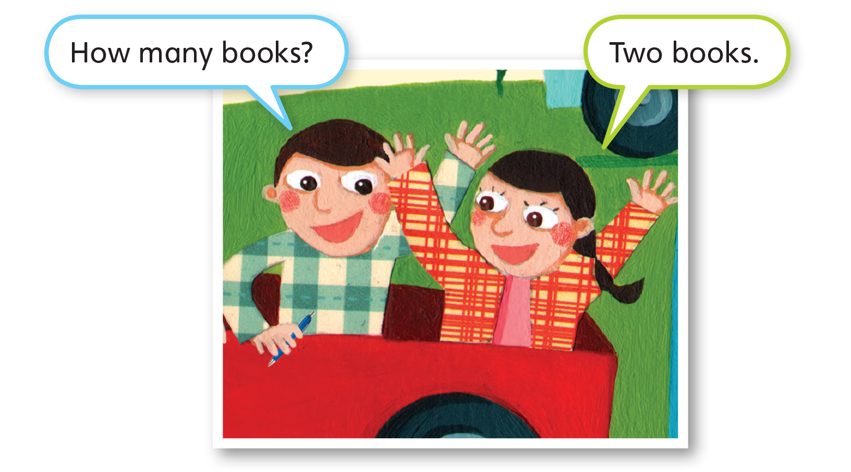
UNIT 0
GETTING STARTED
Notes:
Have students look at Activity 20 on p. 8.
Say Let’s listen to what they say.
Play TR: B19 and have students listen to the
dialogue.

Slide 170
UNIT 0
GETTING STARTED
How many books?
Two books
Notes:
Point to the two books under the dialogue and model the dialogue again. Then put students in pairs and
say Now it’s your turn to talk.
Ask students to look at the remaining pictures under the dialogue and take turns asking and answering about how many objects there are.

Slide 171
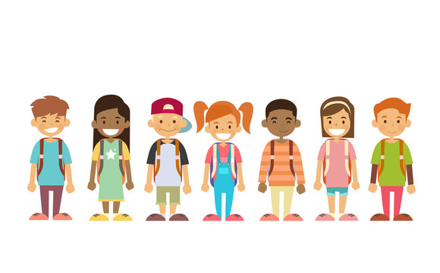
UNIT 0
GETTING STARTED
Number and Toy
Say your number and your toy.
Notes:
Have students stand in rows of twelve, each holding
one classroom object or toy. In each row, start with
the student closest to the front of the class and have
him or her say One [eraser].
Have the next student in that row say Two [balls].
Students should say the number corresponding to
their place in the line and the object they are holding
in their hands.

Slide 172
UNIT 0
GETTING STARTED
Bingo!
Notes:
Say Today, we’re going to play Bingo.
Give each student a card/paper with a 3x3 grid or have them draw the grid on their card/paper. Leave the middle empty. Give each student crayons in five
different colors.
Each box must have a different combination of colors.
Say Color each box with two different colors.
Randomly call different color combinations and have the students cross out the box on their paper if it has those two colors.
Say Blue and yellow.
Continue until a student gets 3 boxes in a row (vertically or horizontally). Have them say Bingo. The
first student to say Bingo wins.
Students with 3 boxes in a row should say Bingo!

Slide 173
UNIT 0
GETTING STARTED
Goodbye Chant
Good work, class.
Hip hip, hooray!
Goodbye for now.
Have a nice day!

Slide 174
UNIT 0
GETTING STARTED
Let’s check!
How many crayons?
What color are they?
Notes:
Can students use the simple present tense to identify numbers and colors?
As each student leaves the class, hold up a different
number of crayons and have the student tell you how
many crayons he/she sees and what colors they are.

Slide 175
UNIT 0
GETTING STARTED
Seven crayons
Yellow, brown, red, blue, green, pink, purple
Notes:
Can students use the simple present tense to identify numbers and colors?
As each student leaves the class, hold up a different
number of crayons and have the student tell you how
many crayons he/she sees and what colors they are.

Slide 176
UNIT 0
GETTING STARTED
Eleven crayons
Red, blue, green, yellow
Notes:
Can students use the simple present tense to identify numbers and colors?
As each student leaves the class, hold up a different
number of crayons and have the student tell you how
many crayons he/she sees and what colors they are.

Slide 177
UNIT 0
GETTING STARTED
Nine crayons
Red, blue, green, yellow, orange, black, white, pink, purple
Notes:
Can students use the simple present tense to identify numbers and colors?
As each student leaves the class, hold up a different
number of crayons and have the student tell you how
many crayons he/she sees and what colors they are.

Slide 178
UNIT 0
GETTING STARTED
Thank you!

Slide 179
Unit 0:
Getting Started
Lesson 12

Slide 180
UNIT 0
GETTING STARTED
English Time Chant
English, (clap) English, (clap)
English (clap) today! (clap, clap)
English, (clap) English, (clap)
Hip, hip, (clap) hooray! (clap, clap)

Slide 181
UNIT 0
GETTING STARTED
How many?
Red pen
Blue pen
6 - six
5 - five
Notes:
Review numbers 1–12 by showing different numbers
of crayons on your desk or by drawing different
numbers of lines on the board and asking students to
say the number.
Students should say [One].

Slide 182
UNIT 0
GETTING STARTED
Notes:
Count from 1 to 12, and have students repeat after
you.
Students should say One, two, three, four, five, six,
seven, eight, nine, ten, eleven, twelve.

Slide 183
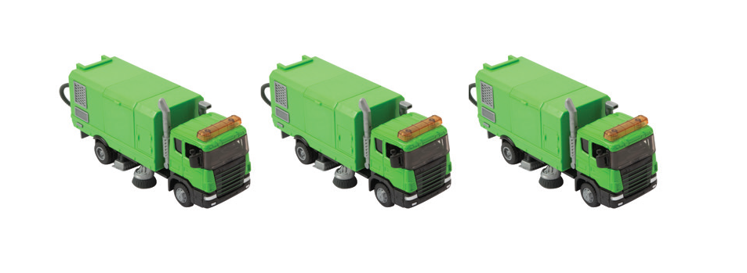
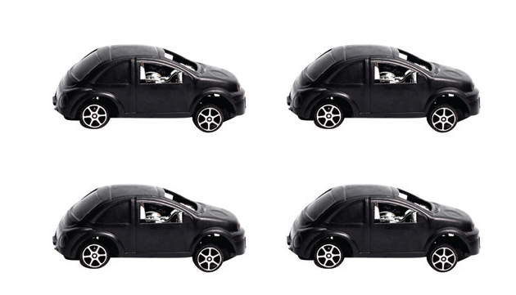
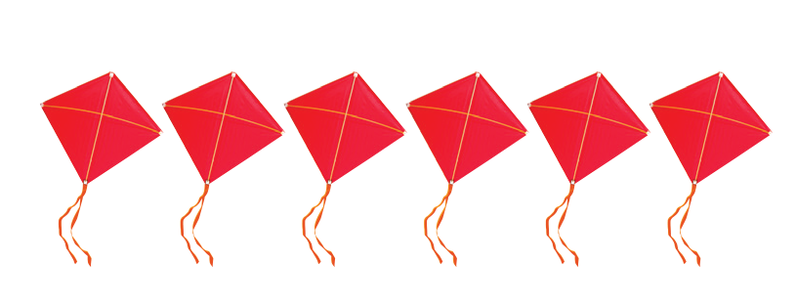
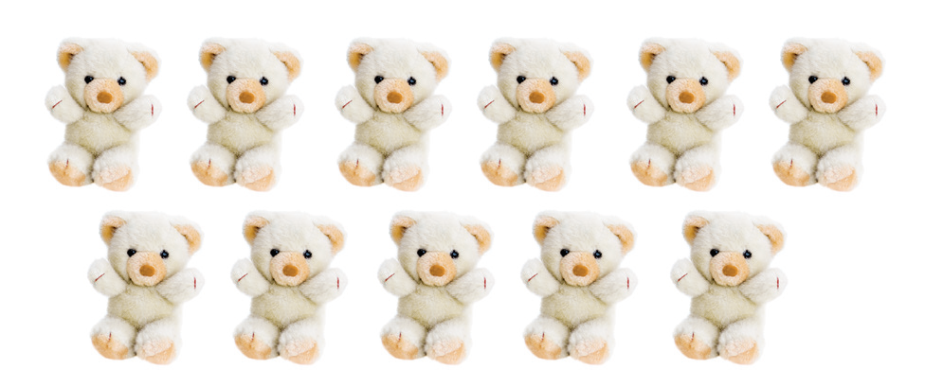
UNIT 0
GETTING STARTED
What is this?
a truck
a car
a kite
a pencil
a teddy bear
This is a ____.
Notes:
Have students look at the school objects and toys on
p. 9.
Ask What is this?
Students should say It’s a [truck].
Repeat with the other toys and school objects.

Slide 184

UNIT 0
GETTING STARTED
Notes:
Have students look at Activity 21 on p. 9.
Say Let’s listen. Play TR: B20 and have students
listen.
Then, play TR: B20 again, pausing after each word
for students to repeat.
Students should say [Red].
Then, point to each color in random order and have
students tell you what it is.

Slide 185
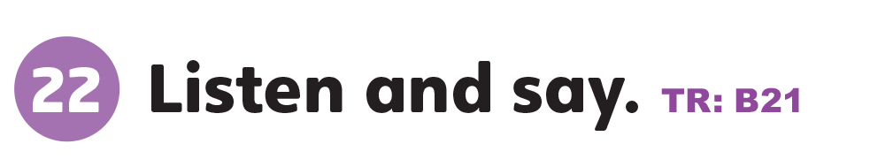
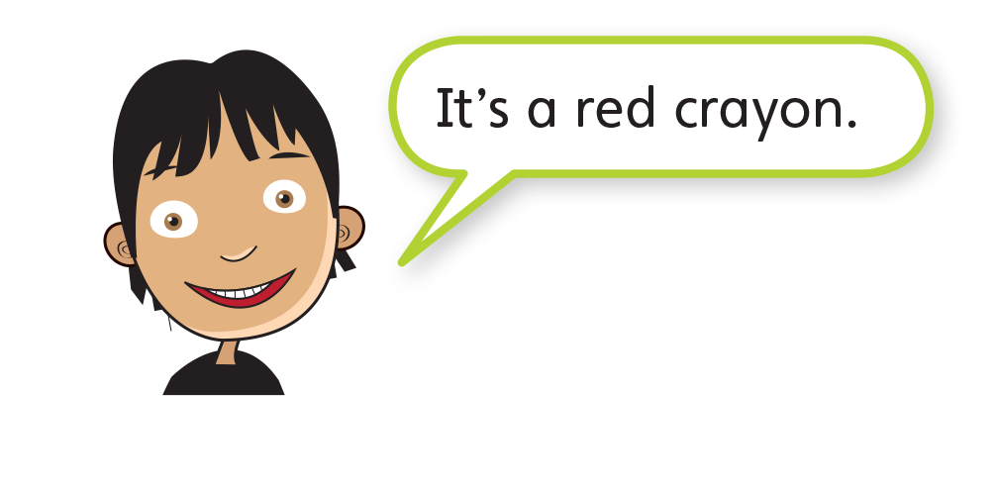
UNIT 0
GETTING STARTED
Notes:
Point to the boy in Activity 22 on p. 9.
Say Let’s listen to what he says. Play TR: B21 and
have students listen.

Slide 186
UNIT 0
GETTING STARTED
It’s a ____ crayon.
Notes:
Then put students in pairs and say Now it’s your turn
to talk.
Ask students in each pair to take turns talking about
the crayons in Activity 21.
Students should say It’s a [red] crayon.

Slide 187

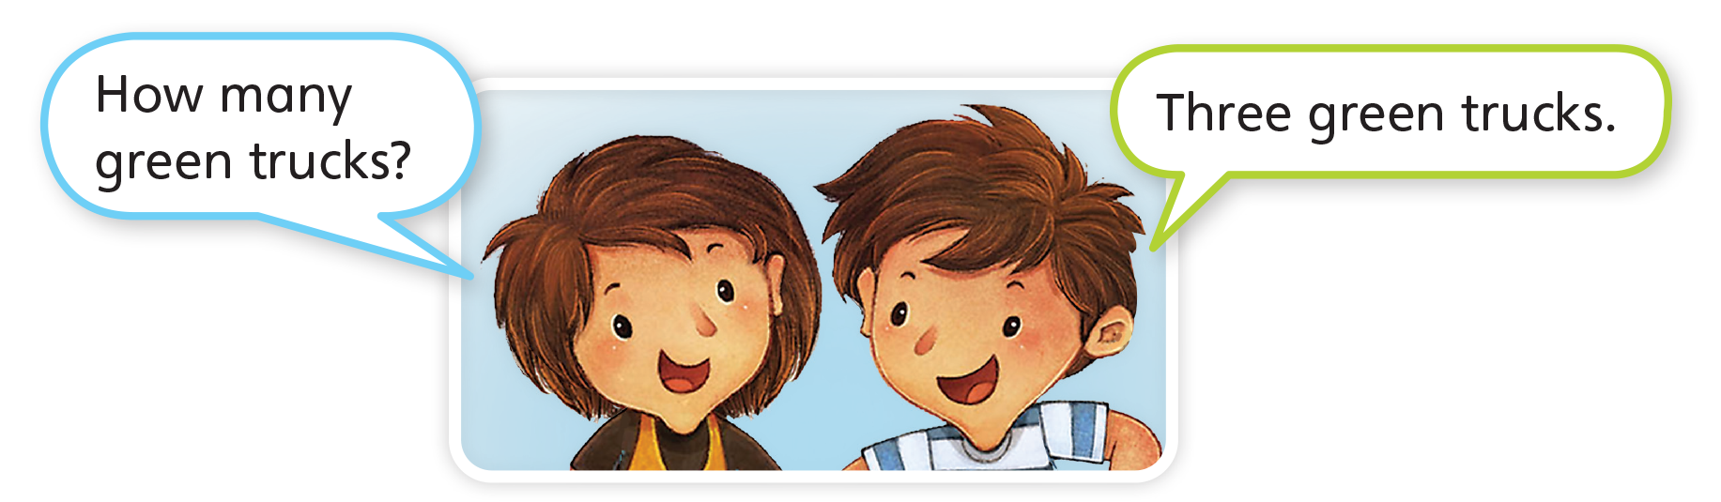
UNIT 0
GETTING STARTED
Notes:
Point to the dialogue in Activity 23 on p. 9.
Invite a pair of students to read the dialogue and help
them with any words they do not know.
Student A should say How many green trucks?
Student B should say Three green trucks.
Point to the three green trucks under the dialogue
and model the dialogue again.

Slide 188

UNIT 0
GETTING STARTED
How many green trucks?
Three green truck
Notes:
Then put students in pairs and say Now it’s your turn
to talk. Ask students to look at the remaining pictures
under the dialogue and take turns asking and
answering about how many objects there are.
Remind students to also describe the color of the
objects.

Slide 189

UNIT 0
GETTING STARTED
Changing Chairs
Find the chair with the correct color sticker.
Red
Blue
Yellow
Notes:
Say Today we’re going to play Changing Chairs.
Stick a piece of paper on each student’s chair with
a color written or colored on it. Give each student a
crayon corresponding to their chair.
Make sure there are at least two of each color for
each chair. Arrange chairs in two rows facing each
other or in a circle.
Ask the students to stand. Walk around the chairs.
Say Blue and yellow. Quickly sit down on one of
the students’ chairs that is marked blue or yellow.
Students holding blue or yellow crayons have to rush
to sit on to one of the remaining chairs marked blue
or yellow.
The student left without a chair has to name another
pair of colors.

Slide 190
UNIT 0
GETTING STARTED
Goodbye Chant
Good work, class.
Hip hip, hooray!
Goodbye for now.
Have a nice day!

Slide 191
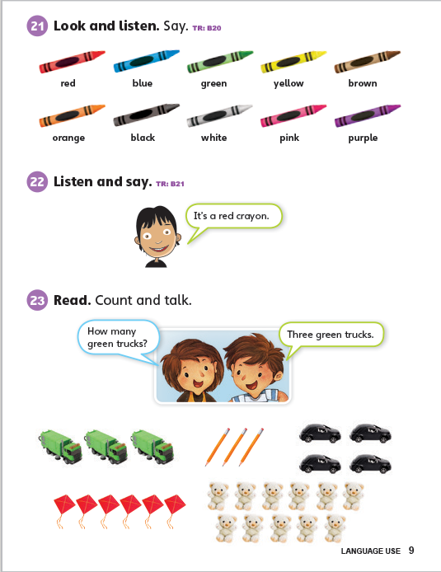
UNIT 0
GETTING STARTED
Let’s Check
Name the color
Notes:
Can students ask about and identify colors, toys and school objects?
When each student leaves the class, name a different color on p. 9 and have the student name something that they see on the page in that color.

Slide 192
UNIT 0
GETTING STARTED
Thank you!

