Slide 2
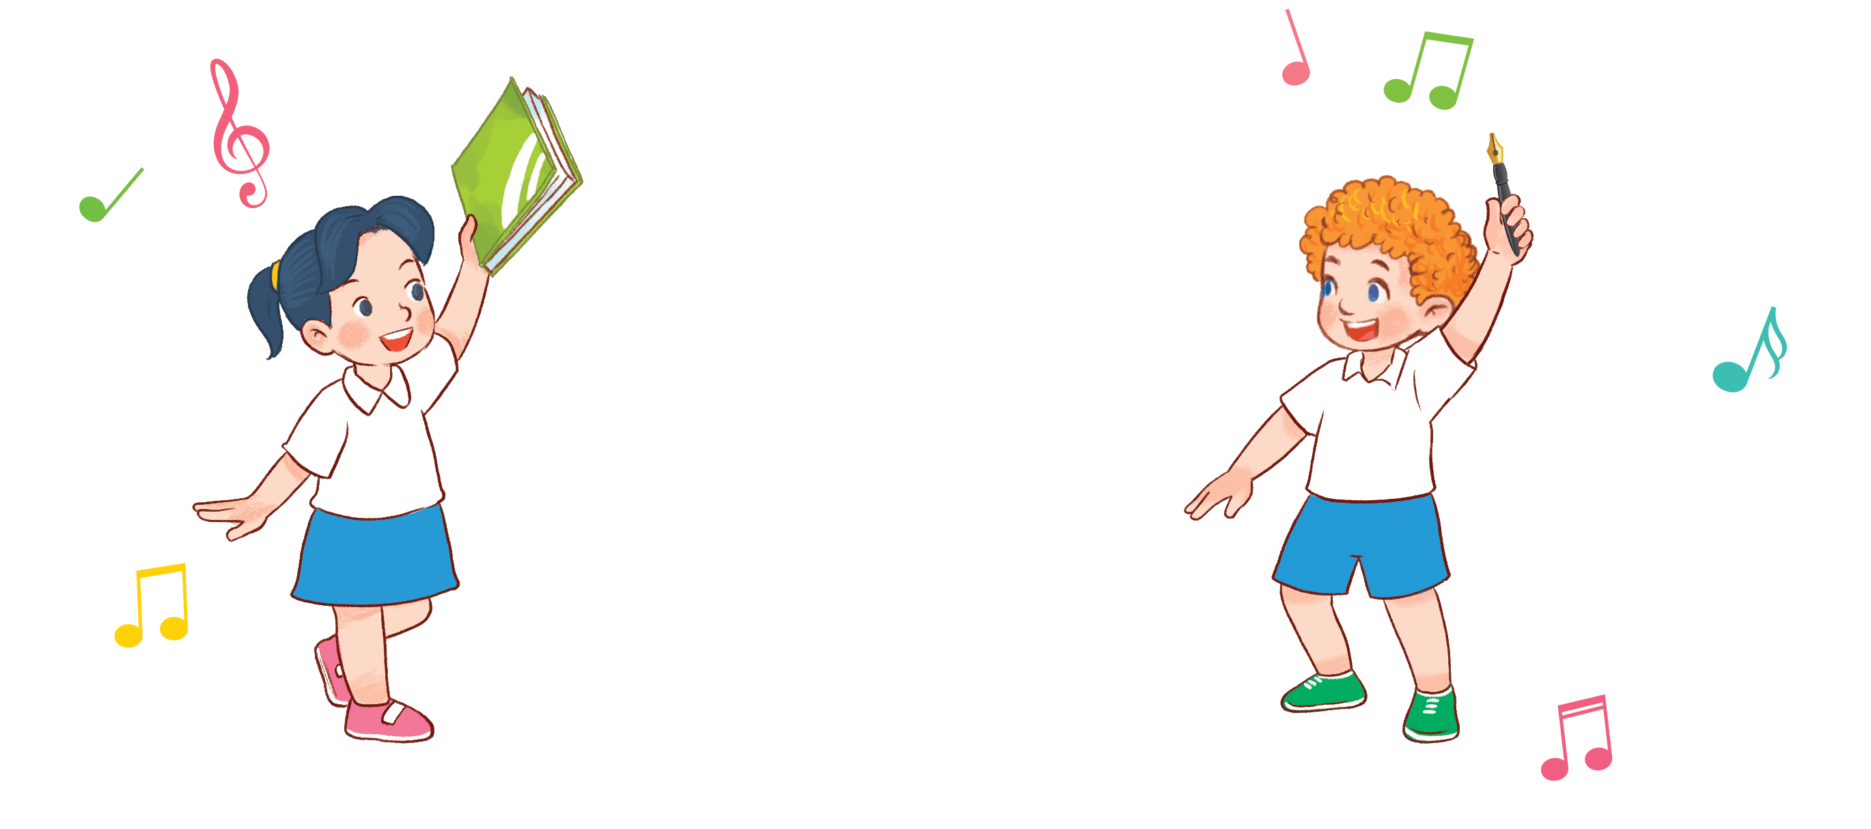
8
My school things
Lesson 2 – 1,2,3

Slide 3
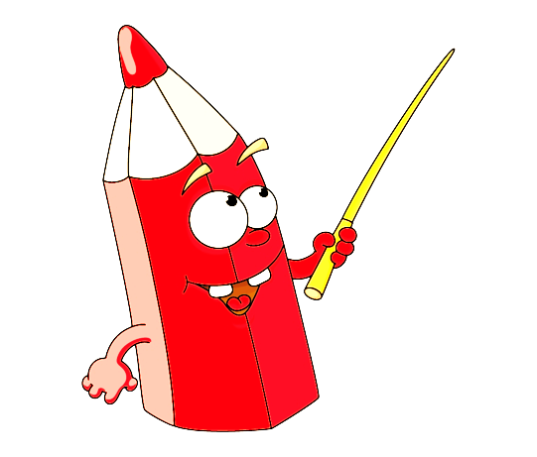
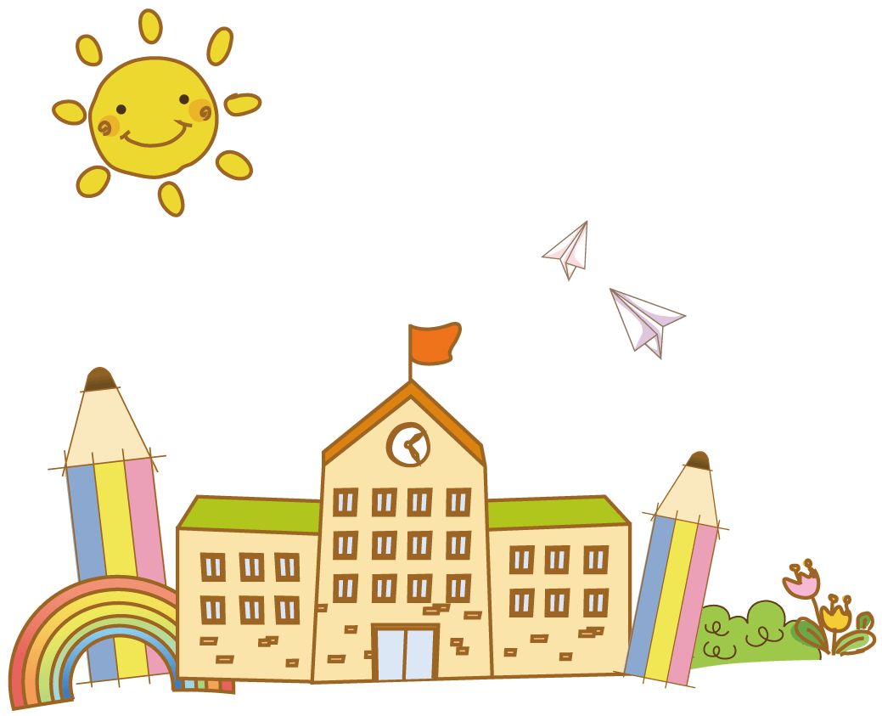
Warm-up

Slide 4
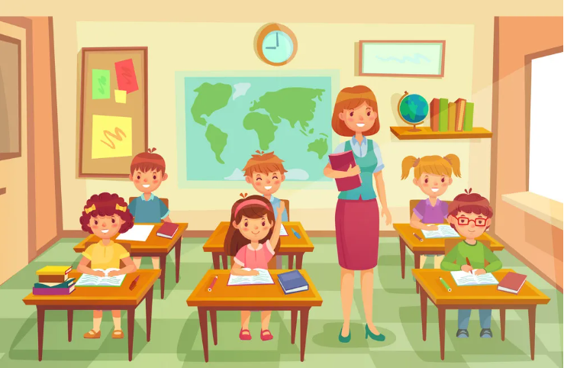
PASS THE TEDDY

Slide 5
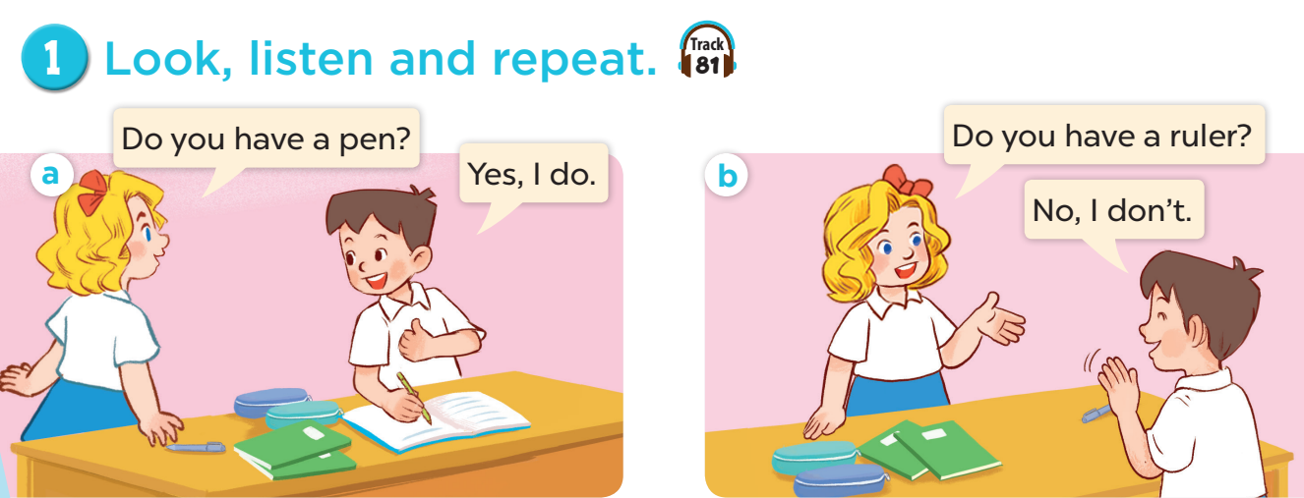

Slide 8
LUCKY WHEEL
30
20
1
2
3
40
10
Stop
SPIN
50
80
4
5
6
60
70
7
8
9
Next activity
Notes:
Game: LUCKY WHEEL
- Divide the class into four groups.
- Each group takes turns to pick a number.
- Look at the picture cue and answer the question on the slide.

Slide 9
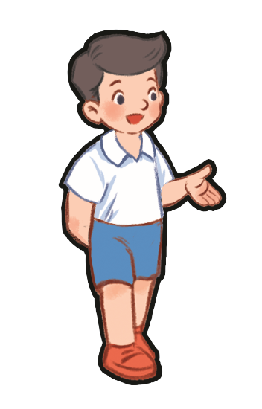
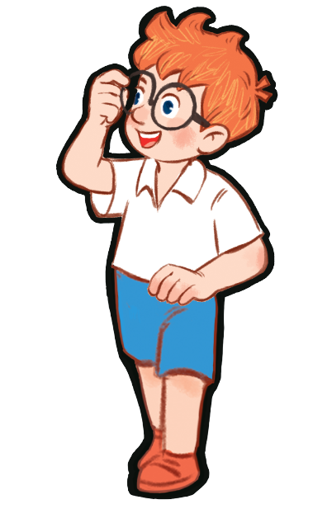
Do you have a pen?
☑
Yes, I do.
…………
Notes:
Game: Do you have…?

Slide 10
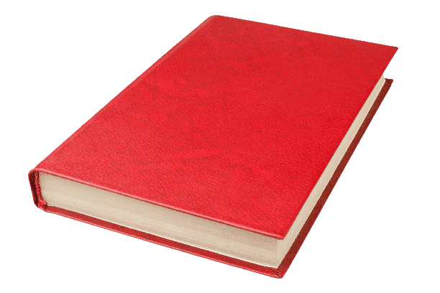
Do you have a book?

No, I don’t.
…………
Notes:
Game: Do you have…?

Slide 11
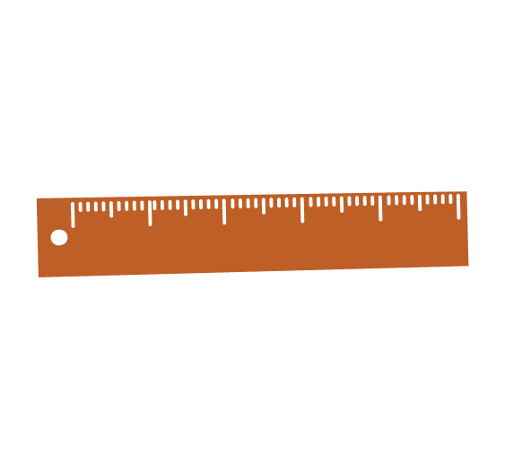
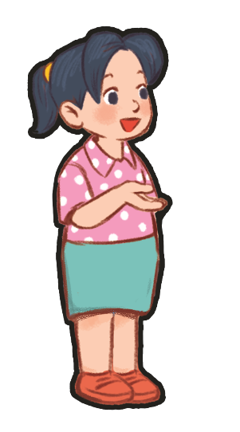
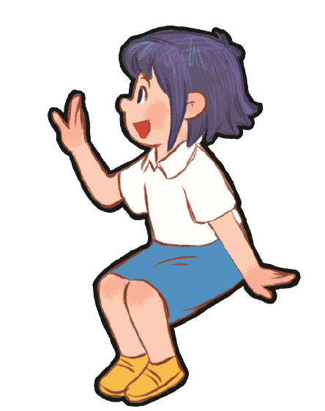
Do you have a ruler?

No, I don’t.
…………
Notes:
Game: Do you have…?

Slide 12
Do you have a pencil?
☑
Yes, I do.
…………
Notes:
Game: Do you have…?

Slide 13
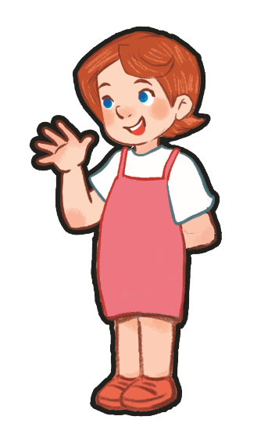
Do you have a ruler?
☑
Yes, I do.
…………
Notes:
Game: Do you have…?

Slide 14
Do you have a pen?

No, I don’t.
…………
Notes:
Game: Do you have…?

Slide 15
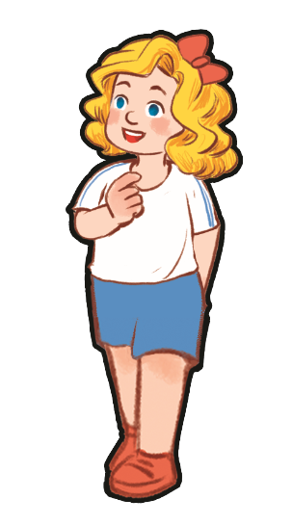
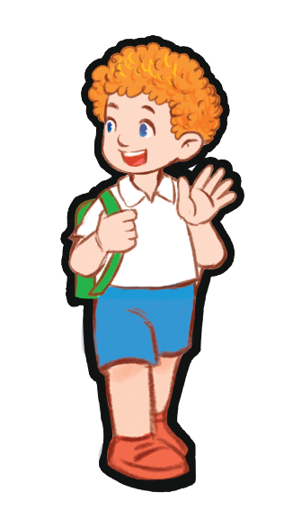
Do you have a book?

No, I don’t.
…………
Notes:
Game: Do you have…?

Slide 16
Do you have a pencil?

No, I don’t.
…………
Notes:
Game: Do you have…?

Slide 17
Do you have a ruler?
☑
Yes, I do.
…………
Notes:
Game: Do you have…?

Slide 18
3.
Let’s talk.

Slide 20
⑤
Fun corner and wrap-up
Notes:
Teacher tells pupils to put their school things on the desk.
Ask them: Do you have a pen/book/ruler…?
If they have that item, say: Yes, I do. If not, then say: No, I don’t.

Slide 21
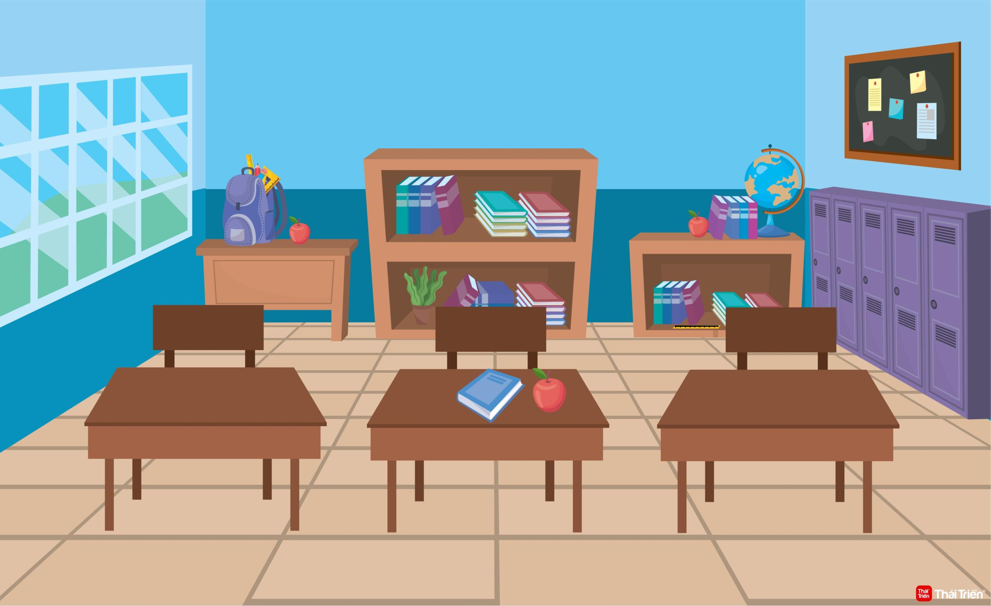
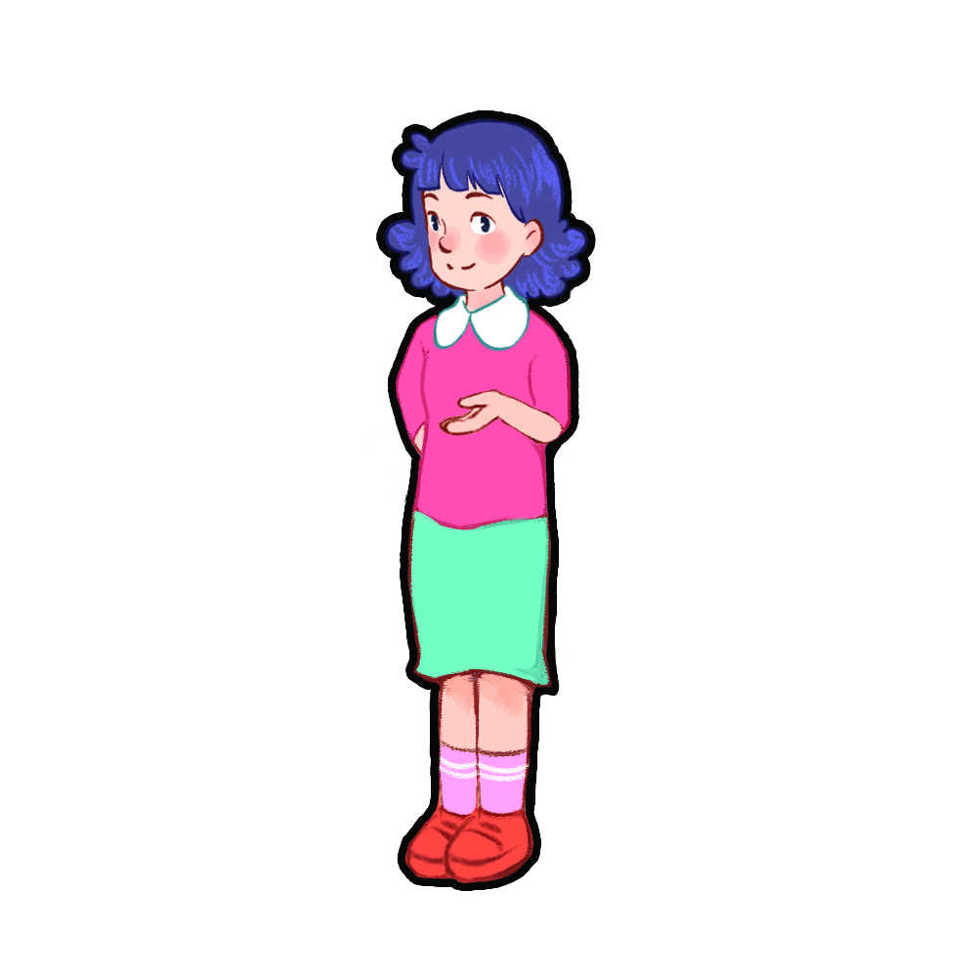
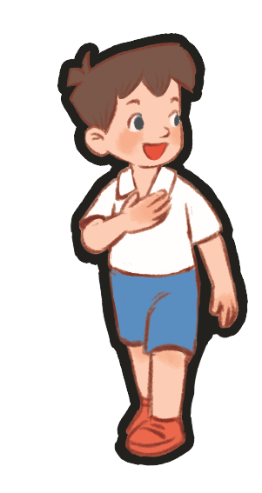
Do you have a ruler?
No, I don’t.
Yes, I do.
Yes, I do.

Slide 22
Website: sachmem.vn
Fanpage: www.facebook.com/sachmem.vn

