Slide 2
8
Period 1

Slide 3
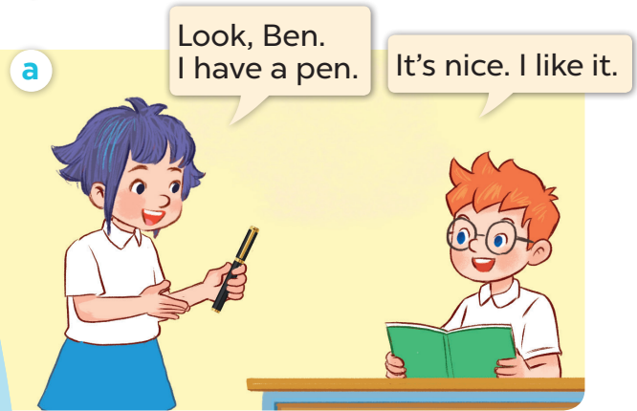
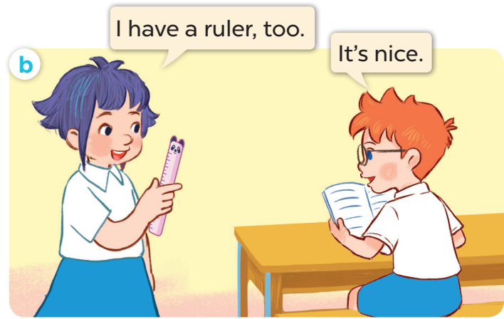
1. Look, listen and repeat.

Slide 6
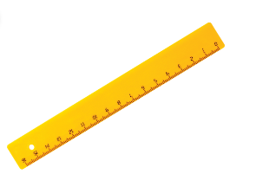

Slide 8
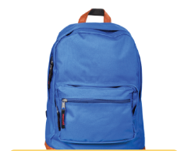

Slide 9
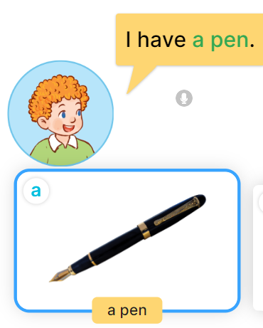

Slide 10
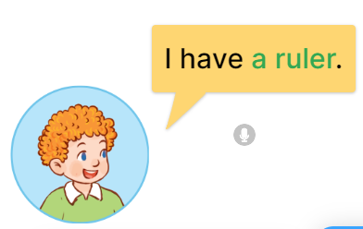
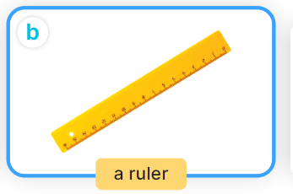

Slide 11
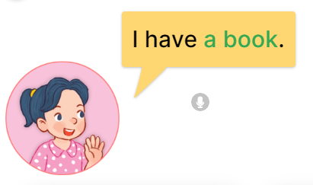

Slide 12
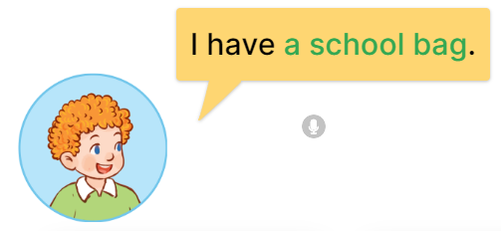
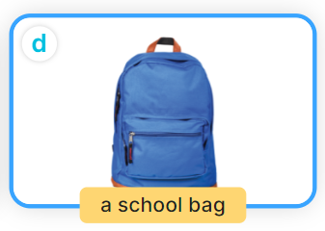

Slide 13
Game: pass the teddy

Slide 14
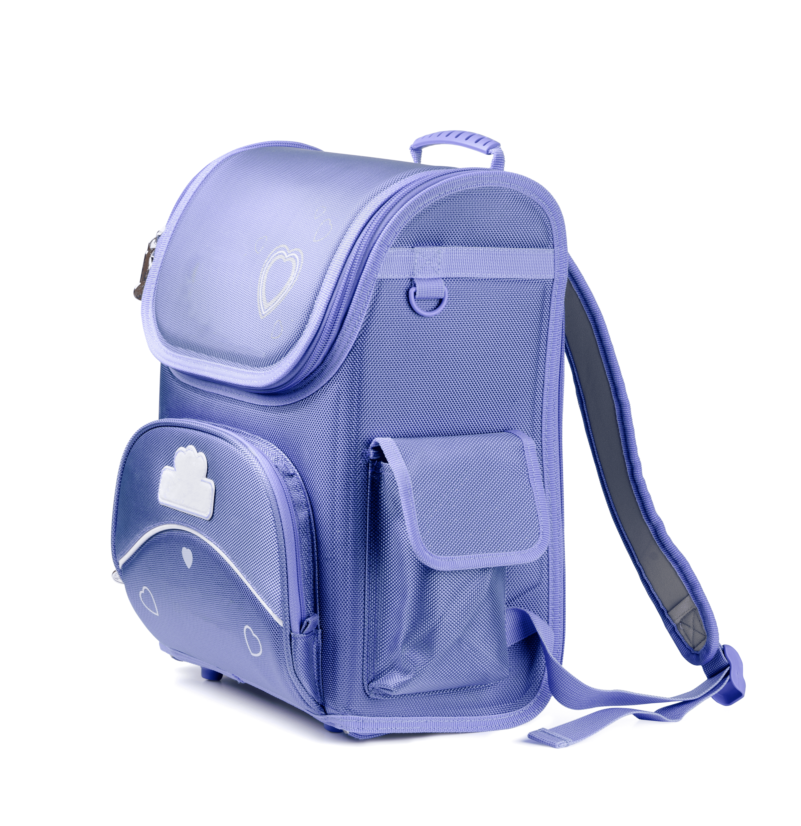
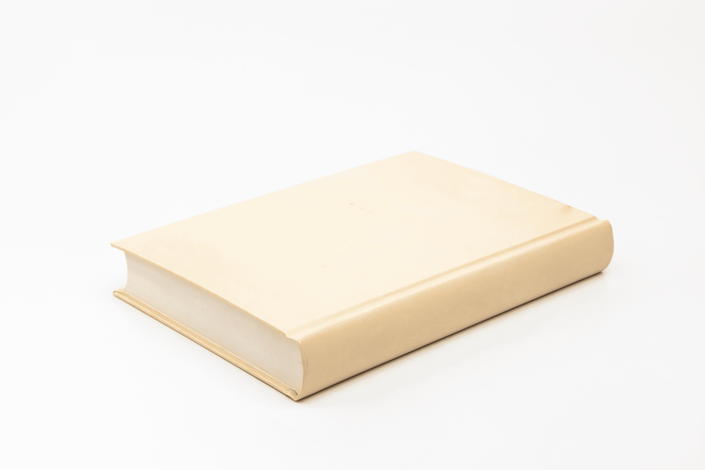
Notes:
Game: Slap the board.
- Divide the class into four teams.
- Stick the pictures of school things on the board.
- T says a sentence, a pupil from each team has to point/slap the right picture and says the sentence again. The faster pupil will get points for their team.

Slide 15
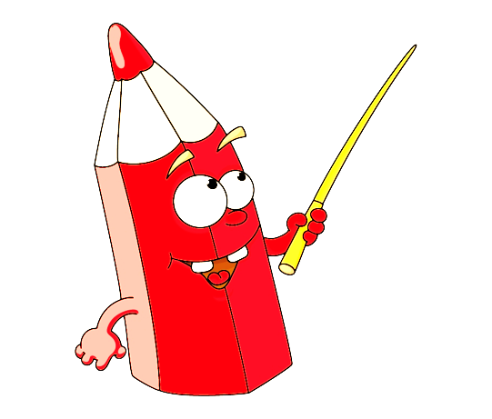
④
Let’s talk.

Slide 16
I have a school bag!
I have a book!

Slide 17
Wrap-up and assignment
Notes:
Preparation for the project:
Tell pupils about the project on page 61. Ask them to prepare three school things at home and the language to present about them. Tell students to bring their school things to the classroom at the project time to talk with their classmates. Guide them with the presentation language.

Slide 18
Website: sachmem.vn
Fanpage: www.facebook.com/sachmem.vn

