Slide 2
WELCOME TO CLASS 3C

Slide 3
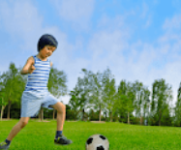
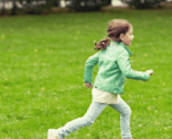
5
My hobbies
LESSON 2
Period 3

Slide 4
CONTENTS
1
LOOK, LISTEN AND REPEAT
2
LISTEN, POINT AND SAY
3
LET’S TALK

Slide 5
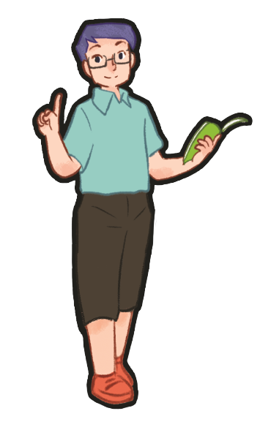
1 Look, listen and repeat.
Notes:
Review Numbers 1-10 and Alphabet

Slide 6
Notes:
Step 1: Have pupils look at Pictures a and b and identify the characters in the pictures.
Step 2: Ask pupils to look at Picture a. Play the recording for them to listen. Play the recording
again, sentence by sentence, for pupils to listen and repeat. Follow the same procedure with
Picture b. Correct their pronunciation where necessary.
Step 3: Play the recording again for pupils to listen and repeat in chorus sentence by sentence.
Step 4: Invite a few pairs to the front of the classroom to listen and repeat the sentences in the
recording.
Step 5: Draw their attention to the question What’s your hobby? and the answers I like cooking.
and I like walking. Tell pupils that they are a question and answers about hobbies.

Slide 7
Notes:
Step 1: Have pupils look at Pictures a and b and identify the characters in the pictures.
Step 2: Ask pupils to look at Picture a. Play the recording for them to listen. Play the recording
again, sentence by sentence, for pupils to listen and repeat. Follow the same procedure with
Picture b. Correct their pronunciation where necessary.
Step 3: Play the recording again for pupils to listen and repeat in chorus sentence by sentence.
Step 4: Invite a few pairs to the front of the classroom to listen and repeat the sentences in the
recording.
Step 5: Draw their attention to the question What’s your hobby? and the answers I like cooking.
and I like walking. Tell pupils that they are a question and answers about hobbies.

Slide 8
2 Listen, point and say.
Notes:
Review Numbers 1-10 and Alphabet

Slide 9
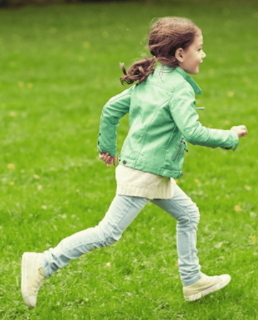
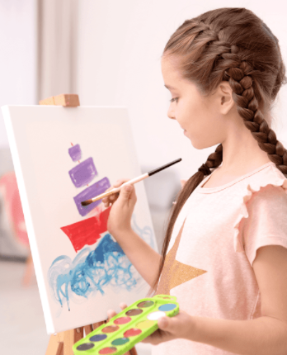
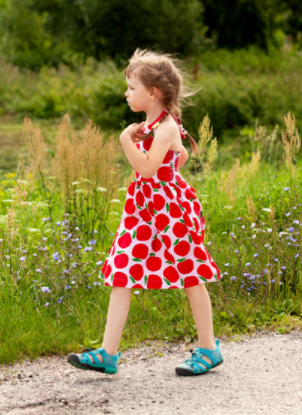
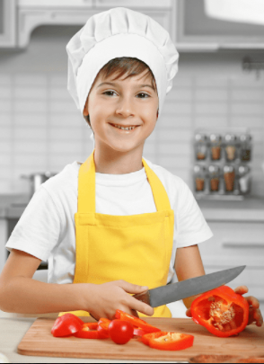
running
painting
walking
cooking
Notes:
Let pupils do the action and say.
Set group competition to make it more interesting.

Slide 10
Notes:
Step 1: Have pupils look at the pictures and elicit the names of the hobbies.
Step 2: Have pupils point at Picture a (a boy running), listen to the recording and repeat the
word (running). Follow the same procedure with the other three pictures. Have the class
repeat the words a few times.
Step 3: Point at the bubble and have pupils listen and repeat after the recording (What’s your
hobby?). Point at Picture a and have pupils listen and repeat after the recording (I like
running.). Follow the same procedure with the other three pictures.
Step 4: Have pairs practise asking and answering the question What’s your hobby? – I like
_____.
Step 5: Invite a few pairs to point at the pictures and say the questions and answers in front of
the class.

Slide 11
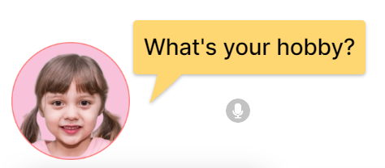
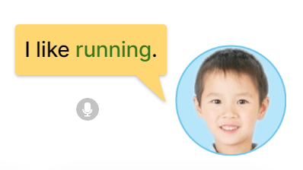
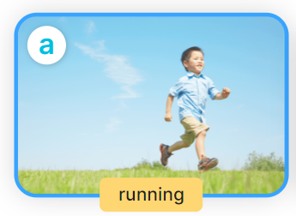

Slide 12
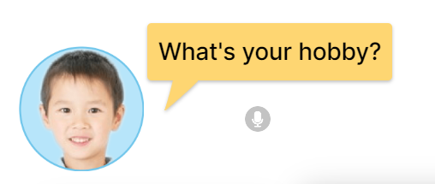
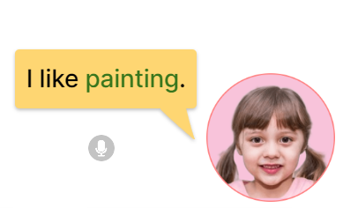
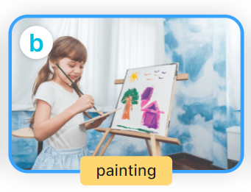

Slide 13
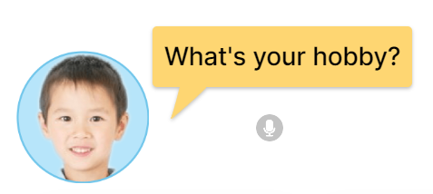
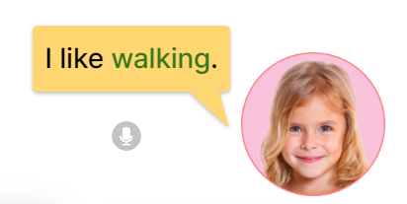
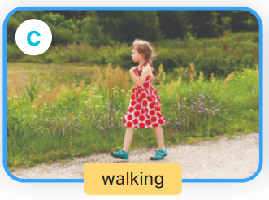

Slide 14
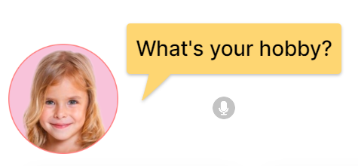
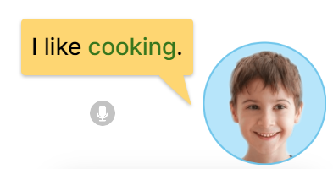
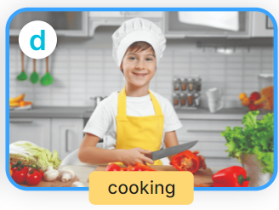

Slide 15
Notes:
Step 1: Have pupils look at the pictures and elicit the names of the hobbies.
Step 2: Have pupils point at Picture a (a boy running), listen to the recording and repeat the
word (running). Follow the same procedure with the other three pictures. Have the class
repeat the words a few times.
Step 3: Point at the bubble and have pupils listen and repeat after the recording (What’s your
hobby?). Point at Picture a and have pupils listen and repeat after the recording (I like
running.). Follow the same procedure with the other three pictures.
Step 4: Have pairs practise asking and answering the question What’s your hobby? – I like
_____.
Step 5: Invite a few pairs to point at the pictures and say the questions and answers in front of
the class.

Slide 16
3 Let’s talk.

Slide 17
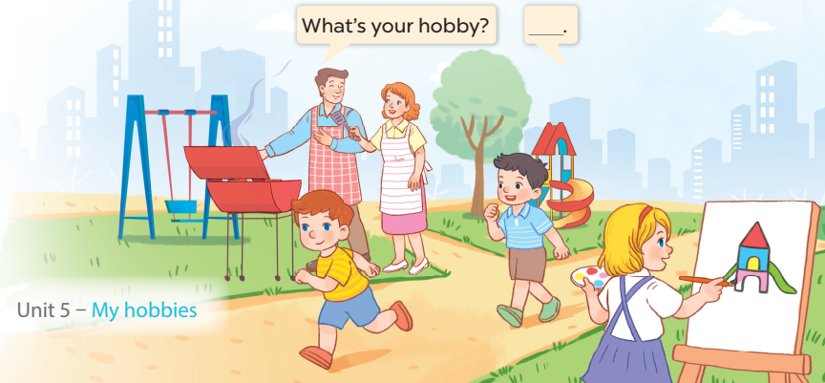
Notes:
Step 1: Draw pupils’ attention to the picture. Tell them about the activity. Ask questions to help
them understand the context (see Input).
Step 2: Put pupils into pairs and encourage them to ask and answer questions using the target
sentence patterns. Go around the classroom to offer support where necessary.
Step 3: Invite some pairs to stand up to perform their exchanges.

Slide 18
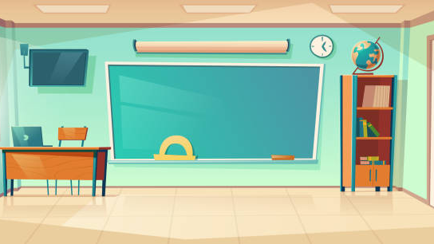
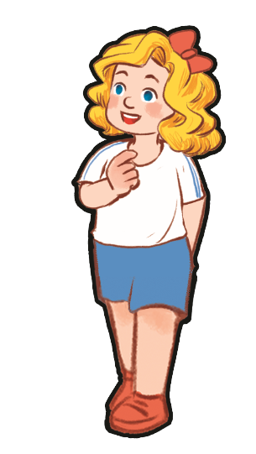
What’s your hobby?
I like ____.
Notes:
- T asks pupils to practise in pairs asking and answering.
- T asks some pairs to present in front of class.

Slide 19
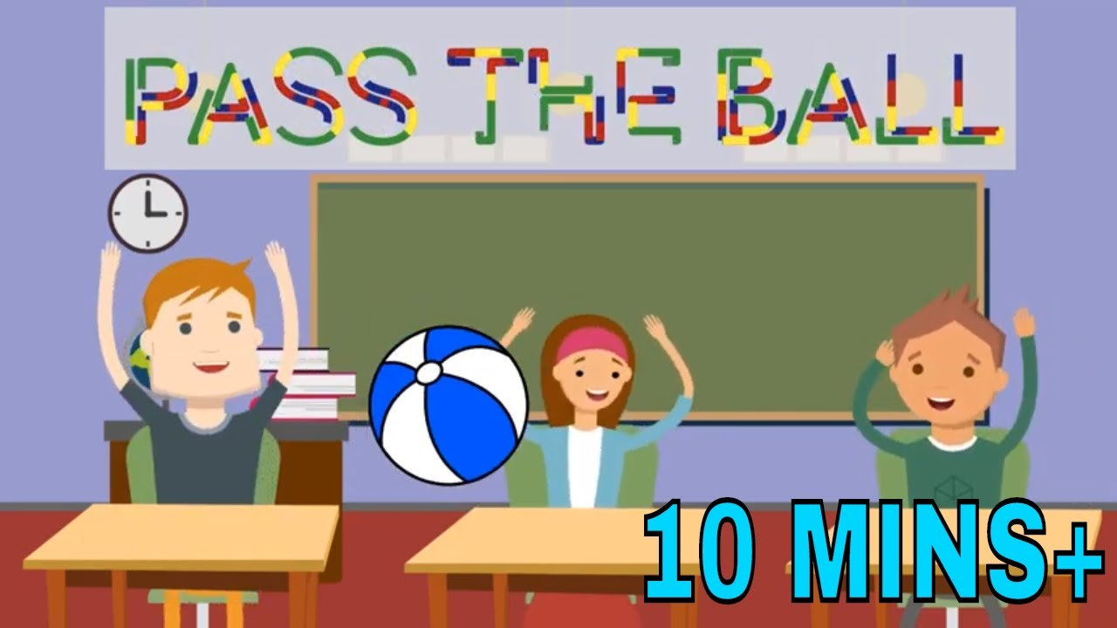

Slide 20
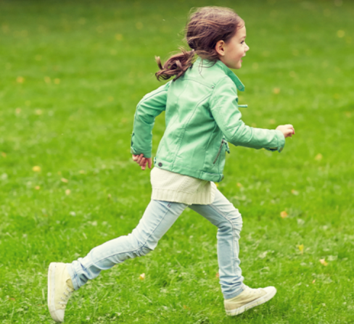
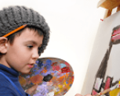
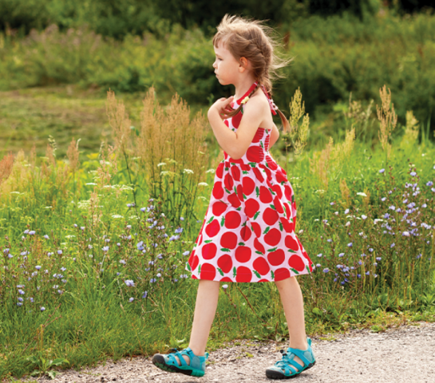
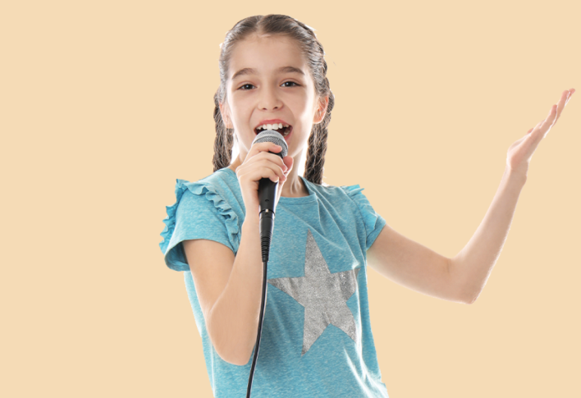
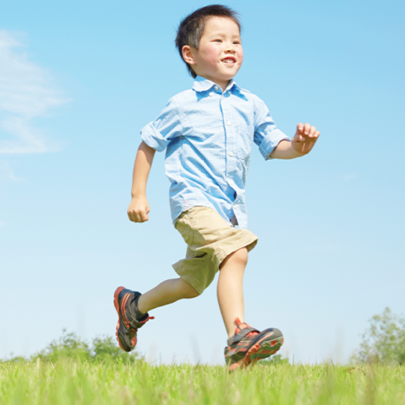
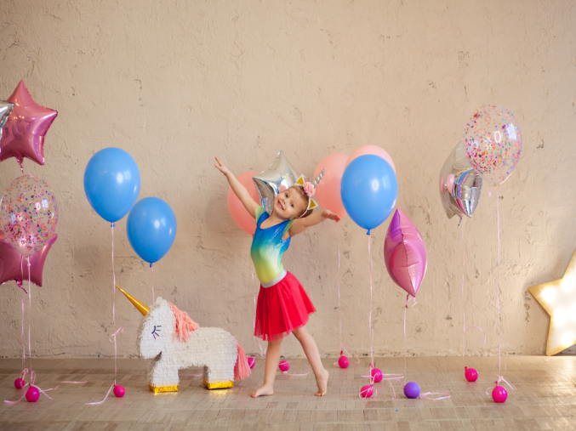
Notes:
T lets the pupils review the pictures of hobbies. (flash cards)

Slide 21
Notes:
MADE BY FACEBOOK :TRAN THI THANH TAM

