Slide 3
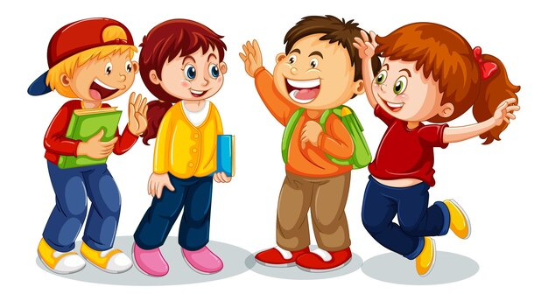
Were you at the ____ yesterday?
Yes, we were.
No, we weren’t.

Slide 5
Unit 9 Our outdoor activities
Lesson 1 (4,5,6)

Slide 6
01
Listen and tick or cross

Slide 7
Listen and tick or cross

Slide 8
Listen and tick or cross
✓
Notes:
1. A: Were you at the funfair yesterday?
B: Yes, we were.

Slide 9
Listen and tick or cross
✗
Notes:
2. A: Were you and your cousins at the theatre?
B: No, we weren’t. We were at the sports centre.

Slide 10
Listen and tick or cross
✗
Notes:
3. A: I didn’t see you and Mai at the gym. Where were you?
B: We were at the campsite.

Slide 11
Listen and tick or cross
✓

Slide 12
Listen and tick or cross

Slide 13
02
Read and complete

Slide 14
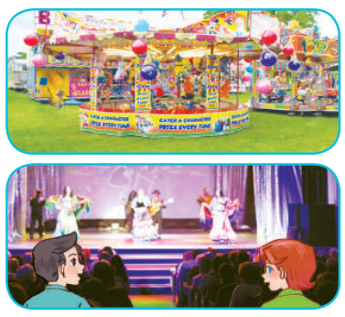
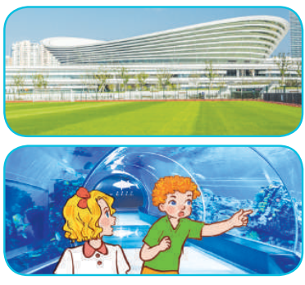
Read and complete.

Slide 15
1. A: Were you and Linh at the _______ last weekend?
B: Yes, ________.
2. A: Were you at the cinema last Saturday?
B: No, _________. We were at the ______.
3. A: Where were you and Ben last Sunday?
B: ________ at the sports centre.
4. A: Where were you and Mary yesterday?
B: ____________________.

Slide 16
Read and complete.
1. A: Were you and Linh at the _______ last weekend?
B: Yes, ________.
funfair
we were

Slide 17
Read and complete.
2. A: Were you at the cinema last Saturday?
B: No, _________. We were at the ______.
we weren’t
theatre

Slide 18
Read and complete.
3. A: Where were you and Ben last Sunday?
B: ________ at the sports centre.
We were

Slide 19
Read and complete.
4. A: Where were you and Mary yesterday?
B: ____________________.
We were at the aquarium

Slide 20
funfair
1. A: Were you and Linh at the _______ last weekend?
B: Yes, ________.
we were
2. A: Were you at the cinema last Saturday?
B: No, _________. We were at the ______.
we weren’t
theatre
3. A: Where were you and Ben last Sunday?
B: ________ at the sports centre.
We were
4. A: Where were you and Mary yesterday?
B: ____________________.
We were at the aquarium

Slide 21
03
Let’s play

Slide 22
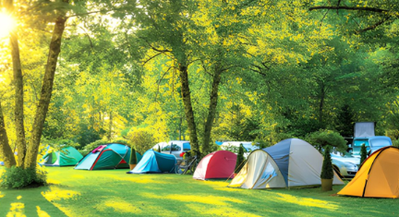
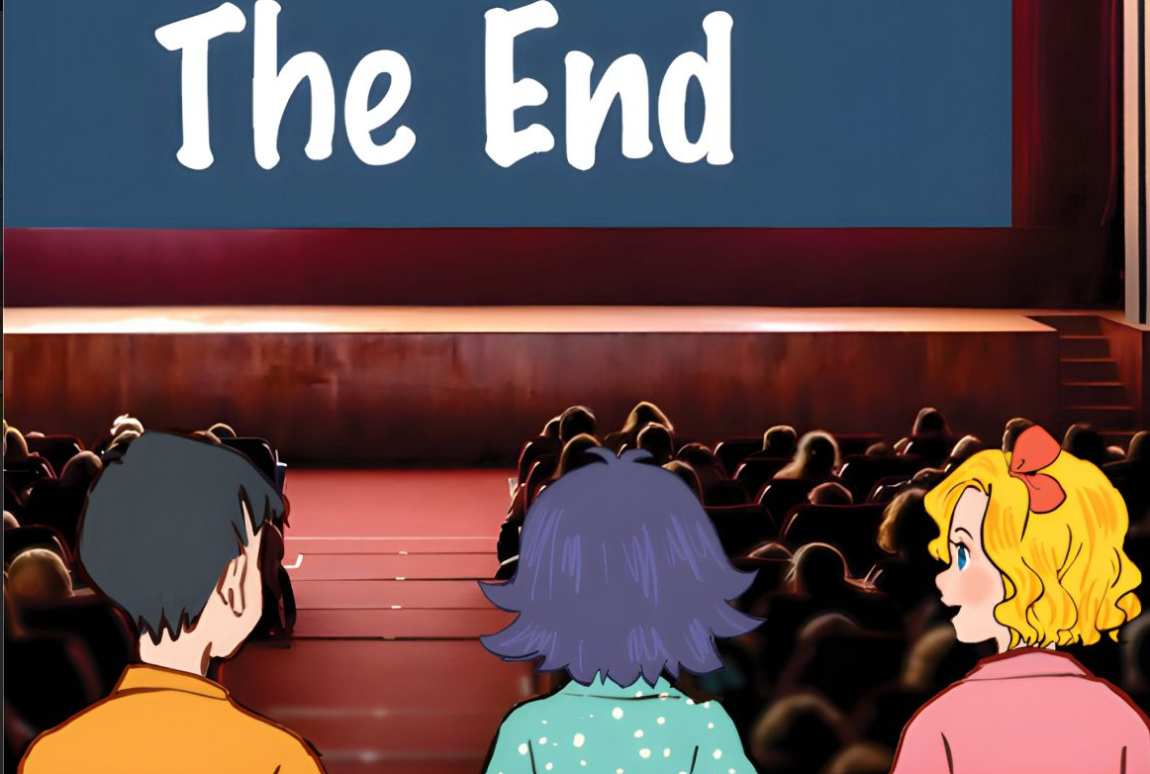

Slide 23
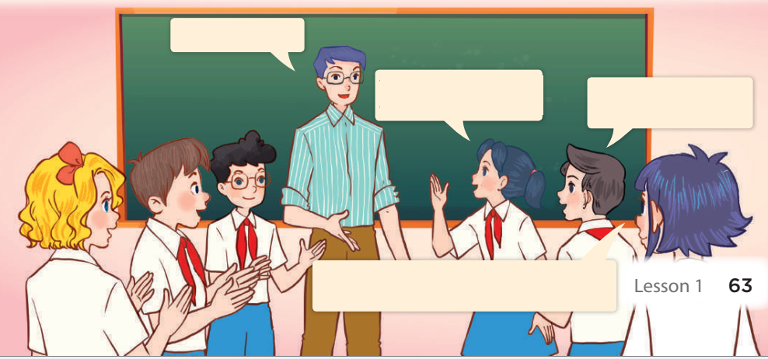
Memory game
funfair
at the campsite
We were at the campsite yesterday.
They were at the campsite yesterday.
funfair
funfair
funfair
They were at the campsite yesterday, and we were at the campsite, too.
funfair

