Slide 1
Unit 9:Our sports day
Welcome to class 4D
9
Lesson 1(4,5,6)
Teacher: Dang Thi Xuan Lan
Ngo Duc Ke primary school

Slide 2
01
Warm-up

Slide 3
02
Listen and match.

Slide 7
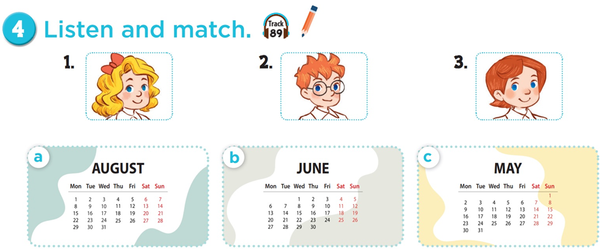

Slide 8
03
Look,complete and read.

Slide 10
1.
A: Is your sports day in June?
B: Yes, ______.
2.
A: Is your sports day in ______ ?
B: Yes, it is.
it is
August

Slide 11
3.
A: ____ your sports day in February?
B: No, it isn’t. It’s in _____. 4.
A: Is your sports day ____ July?
B: _________. It’s in March.
Is
May
in
No, it isn’t

Slide 12
04
Let's sing.

Slide 13
Our sports day
Sports day, sports day.
Is your sports day in May?
Yes, it is. Yes, it is.
It’s in May.
Sports day, sports day.
Is your sports day in June?
No, it isn’t. No, it isn’t.
It’s in July.

Slide 14
Our sports day
Sports day, sports day.
Is your sports day in ___ ?
Yes, it is. ___, it is.
It’s in May.
May
Yes
Sports day, sports day.
__ your sports day in June?
No, it ___. No, it isn’t.
It’s __ July.
Is
isn’t
in

Slide 15
Our sports day
Sports day, sports day.
Is your sports day in May?
Yes, it is. Yes, it is.
It’s in May.
Sports day, sports day.
Is your sports day in June?
No, it isn’t. No, it isn’t.
It’s in July.

Slide 16
Our sports day
Sports day, sports day.
Is your sports day in ____?
Yes, it is. Yes, it is.
It’s in ____.
Sports day, sports day.
Is your sports day in ______?
No, it isn’t. No, it isn’t.
It’s in ___.

Slide 17
05
Wrap-up

Slide 19
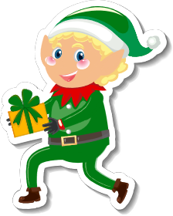
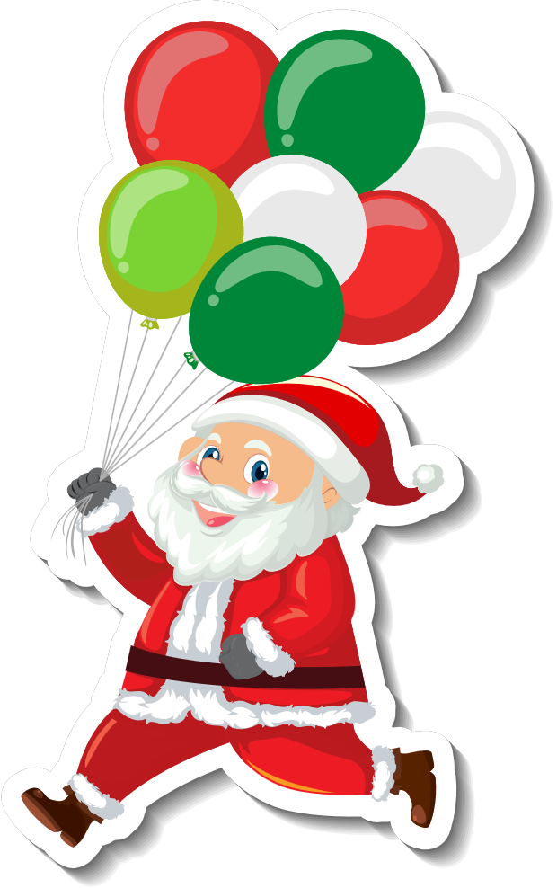
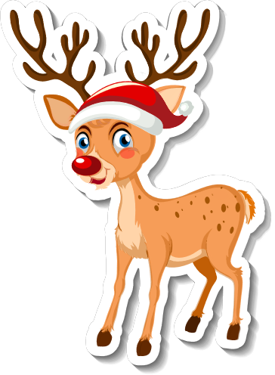
Merry Christmas

