Slide 1


Unit 2: School
Review 2
Page 18

Slide 2
Objectives
By the end of this lesson, students will review identifying classroom objects and say what school thing it is, using …
Vocabulary: pencil, book, bag
Structure: It’s a (pencil).

Slide 3
Lesson Outline
Warm-up
Practice
Production
Consolidation
Wrap-up

Slide 4

WARM UP

Slide 5
Let’s sing!

Slide 6


Slide 7

It’s time to learn …

Slide 8

New words
Pencil,
Book,
Bag

Slide 9
Structures
It’s a (pencil).

Slide 10

Review

Slide 11

Look and say
It’s a pencil.

Slide 12

Look and say
It’s a bag.

Slide 13

Look and say
It’s a book.

Slide 14
Let’s play!

Slide 15

School Objects

Slide 16

What is it?
GREAT
It’s a pencil.
It’s a bag.
It’s a pencil.

Slide 17
What is it?
GREAT
It’s a pencil.
It’s a book.
It’s a bag.

Slide 18
What is it?
GREAT
It’s a bag.
It’s a book.
It’s a pencil.

Slide 19


Slide 20

Practice

Slide 21

Listening

Slide 22

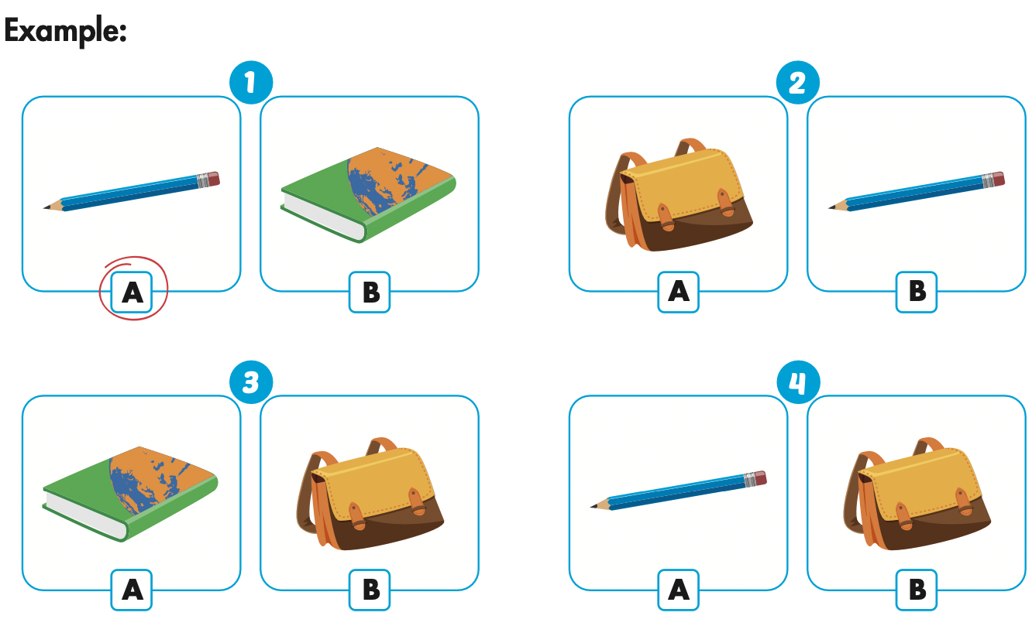
Click the icon to hear the sound.

Slide 23
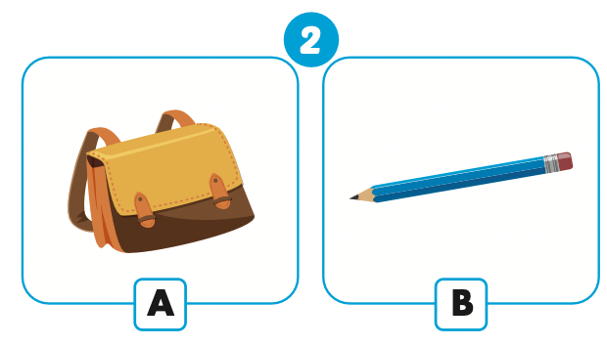
Let’s check!

Slide 24
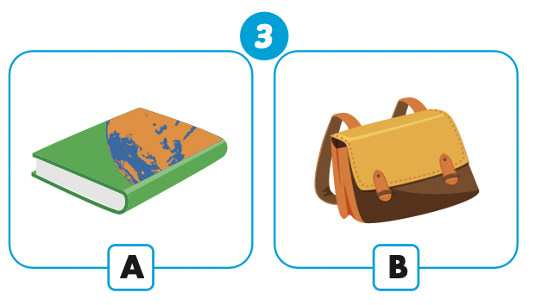
Let’s check!

Slide 25
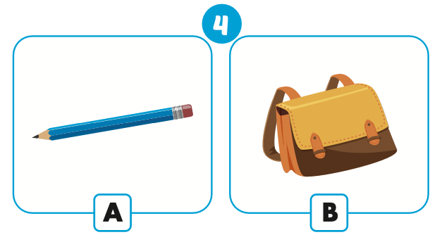
Let’s check!

Slide 26

Production

Slide 27

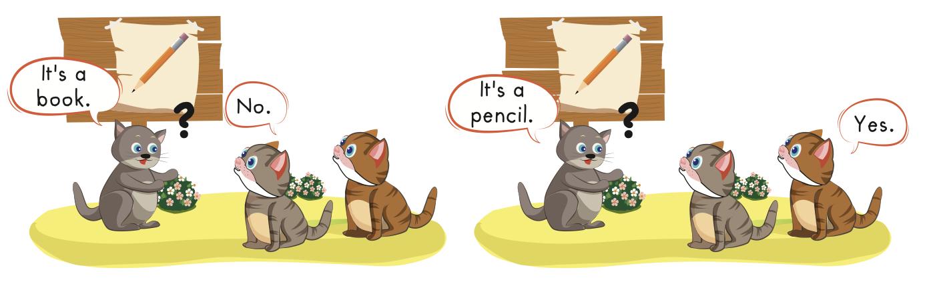

Slide 28

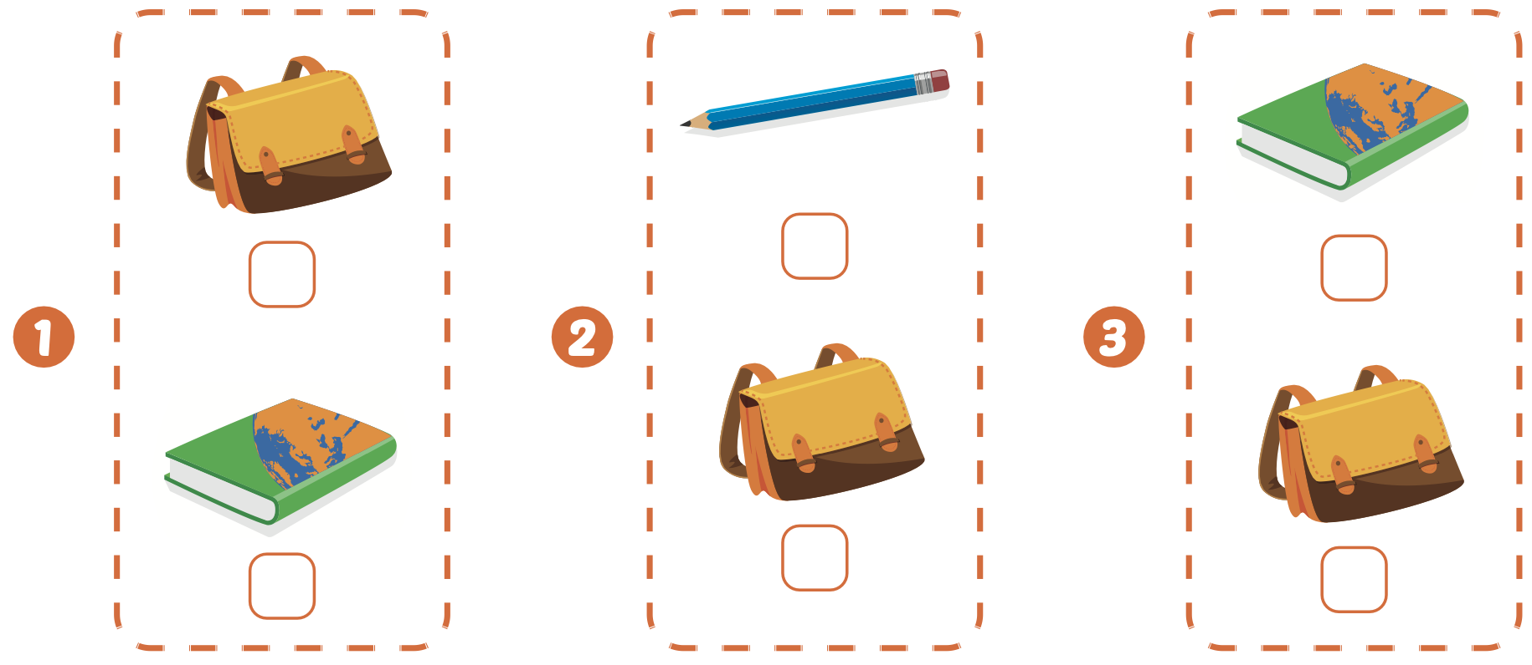

Extra Practice
WB, page 17

Slide 29
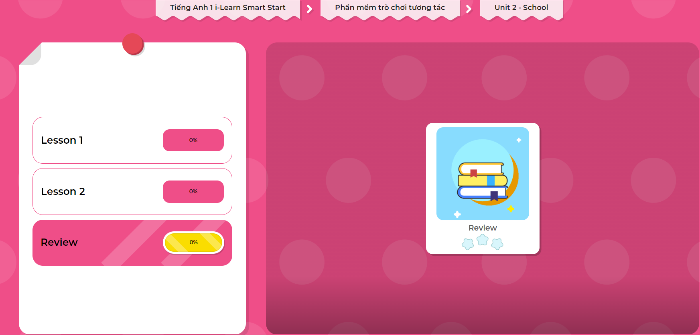
Extra Practice
DHA on Eduhome
LET’S PLAY!
Click on the picture below to play the games.

Slide 30

CONSOLIDATION

Slide 31

Let’s play!
What’s missing?

Slide 32

WRAP-UP

Slide 33
Today’s lesson
Vocabularies
Pencil,
Book,
Bag
Structures/ Sentence patterns
It’s a (bag).

Slide 34
Homework
Practice the vocabularies and structure; and make sentences using them.
Do the exercises in Tiếng Anh 1 i-Learn Smart Start WB (page 17)
Prepare the next lesson (page 20 SB)
Play the consolidation games in Tiếng Anh 1 i-Learn Smart Start DHA App on www.eduhome.com.vn

Slide 35

Enjoy your day!

