Slide 1
Unit 11: My home
Lesson 2 - period 3

Slide 2
Table of Contents
01
02
03
04
Warm-up
Look, listen and repeat.
Listen, point and say.
Let’s talk.
fun corner
& Wrap-up
05

Slide 3
01
Warm-up

Slide 4
Notes:
https://www.youtube.com/watch?v=L08bVyhfKpg&list=PL8_ETpRL2xNY6ptJqBTgFUP3I654rZ9bv&index=21

Slide 5
02
Look, listen and repeat.

Slide 6
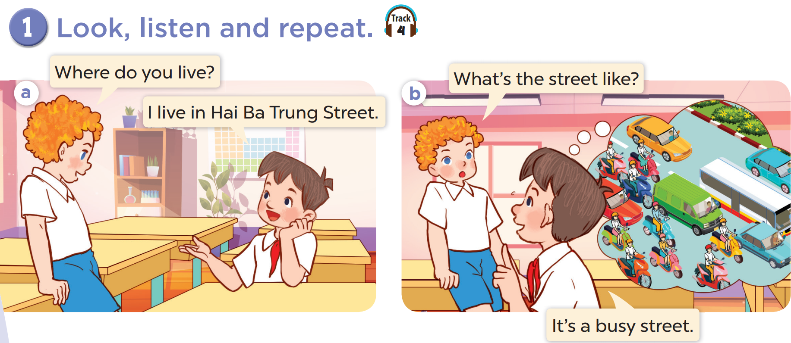

Slide 7
03
Listen, point and say.

Slide 8
vocabulary

Slide 9
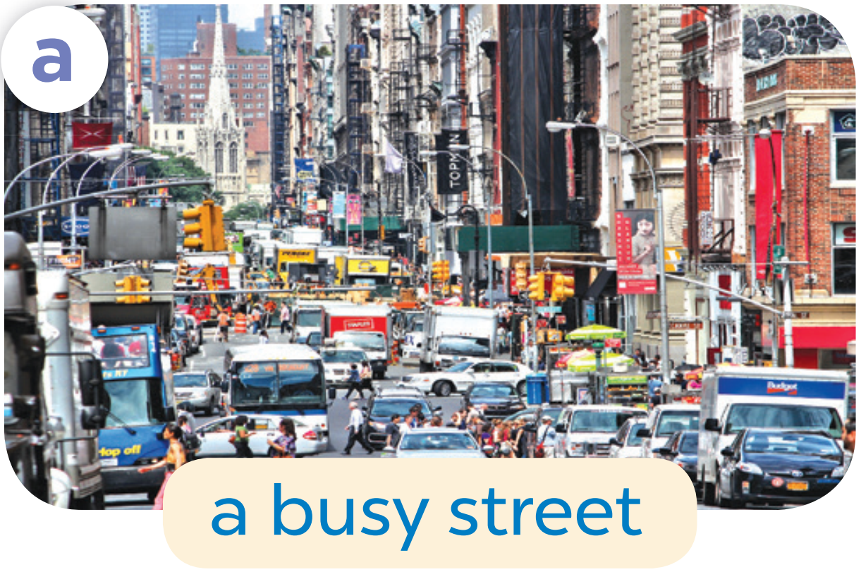

Slide 11
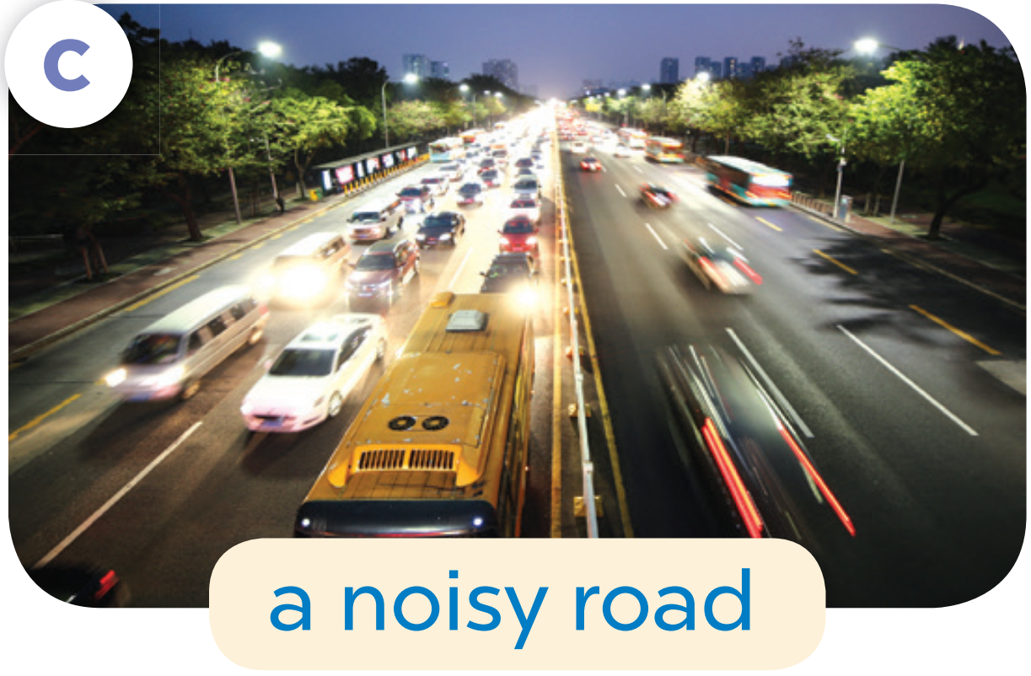

Slide 14
What the street like?
It’s a busy street.

Slide 15
04
Let’s talk.

Slide 17
05
fun corner & Wrap-up

Slide 18
Game
Can you guess what it is?
a quiet village
1
2
3
4
5
6
7
8
9
answer

Slide 19
Game
Can you guess what it is ?
a big city
1
2
3
4
5
6
7
8
9
answer

Slide 20
Game
a busy street
1
2
3
4
5
6
7
8
9
answer

Slide 21
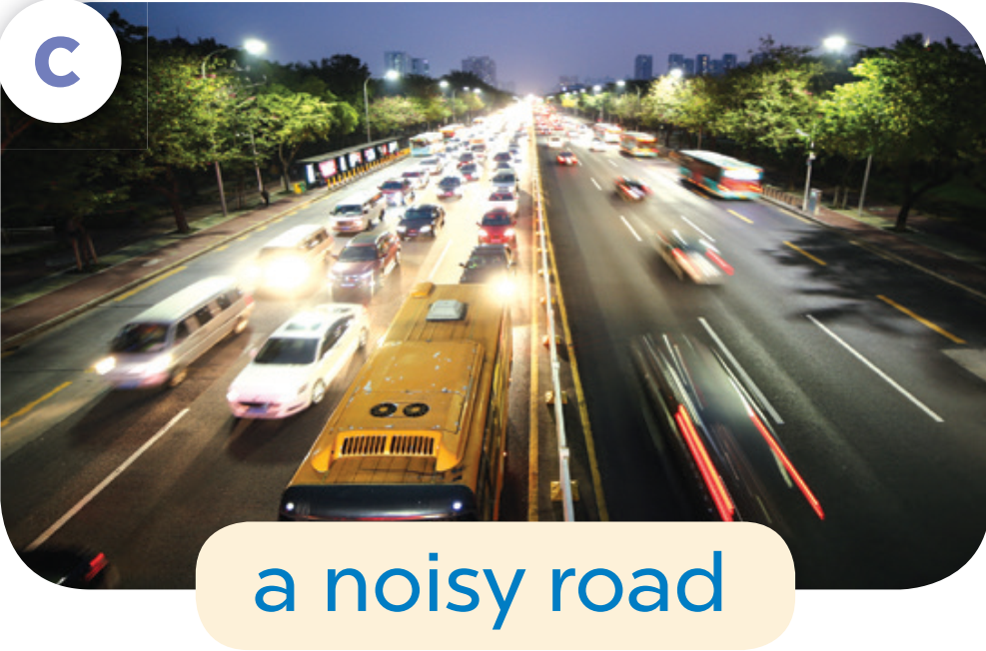
Game
a noisy road
1
2
3
4
5
6
7
8
9
answer

