Slide 1
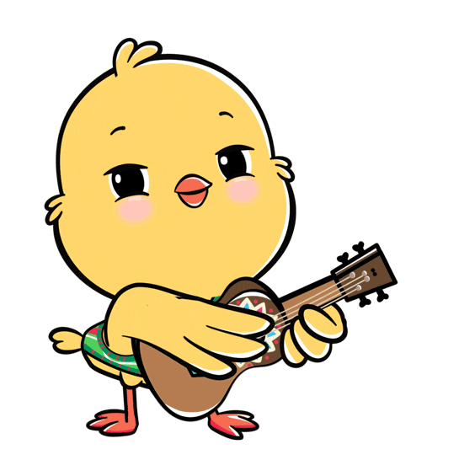
Welcome to
our class!

Slide 2
Warm-up

Slide 3
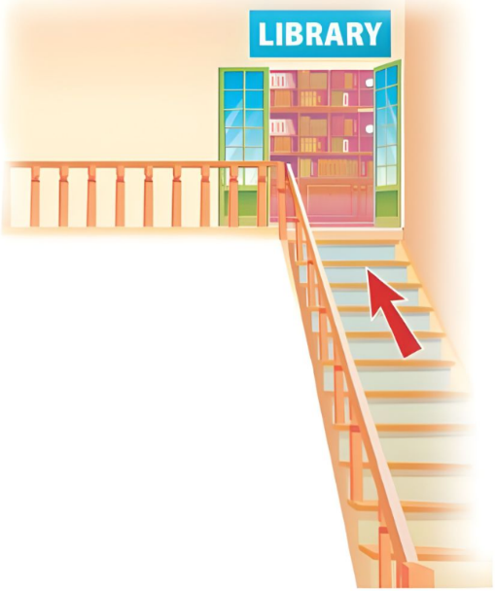
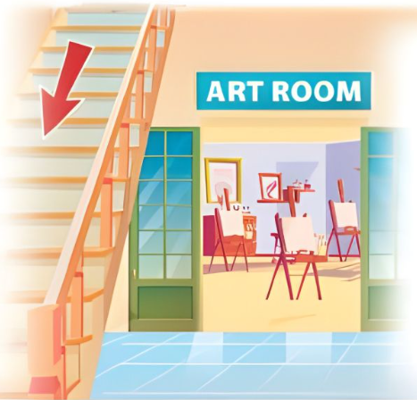
Let’s chant.
Upstairs,
upstairs.
We’re going upstairs.
To the library.
We can read books there.
Upstairs,
upstairs.
Downstairs,
downstairs.
We’re going downstairs.
To the art room.
We can draw pictures there.
Downstairs,
downstairs.

Slide 4
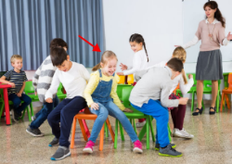
Monday, October 15th 2024
Unit 7
Our favourite
school activities
Lesson 1 (1+2+3)
Notes:
Bùi Liễu Powerpoint
0968142780

Slide 5
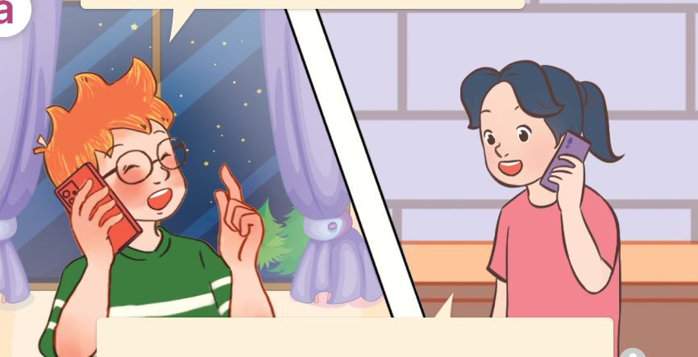
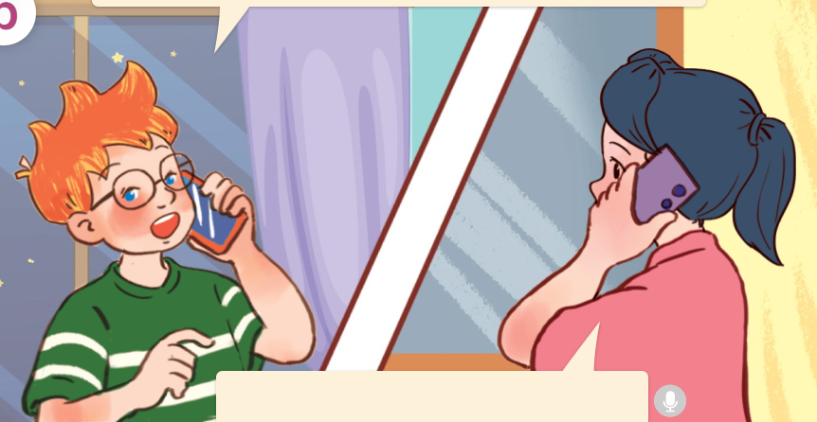
1. Look, listen and repeat.
What school activity does he like?
Hi, Mai.
What are you doing?
a
b
I’m helping my
brother solve a maths problem.
He likes reading books.
Hello, Ben.
Who are they?
They are Ben and Mai.
Where are they?
They’re at their houses.
They’re talking about the activities.
What are they talking about?
Click on the speaker / sentences to listen.

Slide 6
Vocabulary

Slide 7
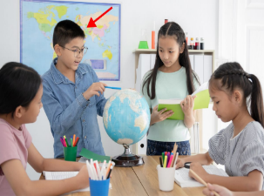
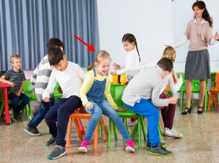
Vocabulary
activity
/ækˈtɪv.ə.tɪ/
hoạt động
Click on the English words to listen.

Slide 8
do projects
/duː ˈprɒdʒekts/
làm các bài tập dự án

Slide 9
play games
/pleɪ ɡeɪmz/
chơi trò chơi

Slide 10
read books
/rɪːd ˈbʊks/
đọc sách

Slide 11
solve maths problems
/sɒlv mæθs ˈprɒbləmz/
giải các bài toán

Slide 12
Review
activity
do projects
play games
read books
solve maths problems
Click on the English words to listen again.

Slide 13
Vocabulary
1. activity
: hoạt động
2. do projects
: làm các bài tập dự án
3. play games
: chơi trò chơi
4. read books
: đọc sách
5. solve maths problems
: giải các bài toán
Click on the English word to listen again.

Slide 14
Checking vocabulary!

Slide 15
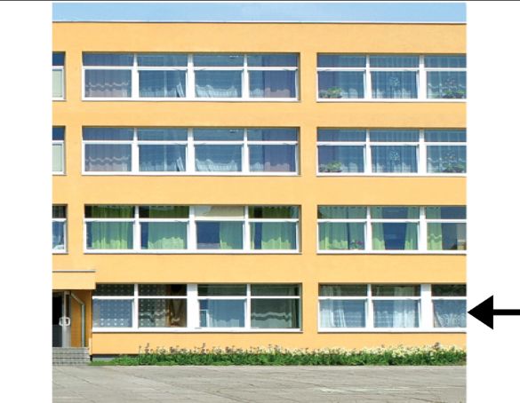
Look and choose.
a
b
activity

Slide 16
Look and choose.
a
b
play games

Slide 17
Look and choose.
a
b
solve maths problems

Slide 18
Look and choose.
a
b
read books

Slide 19
Structures

Slide 20
Cách hỏi hoạt động yêu thích ở trường của ai đó.
What school activity does he / she like?
( Anh ấy / Cô ấy thích hoạt động nào ở trường?)
He / She likes + V-ing.
( Anh ấy / Cô ấy thích _______.)
Example:
What school activity does he like?
He likes doing projects.

Slide 21
Sử dụng động từ sau “like”
Sau động từ “like”, ta sử dụng động từ thêm đuôi “ing”.
help
helping
do
doing
read
reading
play
playing
solve
solving
dance
dancing

Slide 22
Unit 7 lesson 1 (1+2+3)
What school activity does he / she like?
He / She likes + V-ing.
do projects
solve maths problems
read books
play games

Slide 23
2. Listen, point and say.
a
b
What school activity does he / she like?
do projects
read books
c
d
He / She likes+ V-ing.
play games
solve maths problems
Click on the words / phrases to listen again.

Slide 24
2. Listen, point and say.
a
do projects
What school activity does he like?
He likes doing projects.
Click on the sentences to listen.

Slide 25
2. Listen, point and say.
b
read books
What school activity does she like?
She likes reading books.

Slide 26
2. Listen, point and say.
c
play games
What school activity does she like?
She likes playing games.

Slide 27
2. Listen, point and say.
d
solve maths problems
What school activity does he like?
He likes solving maths problems.

Slide 28
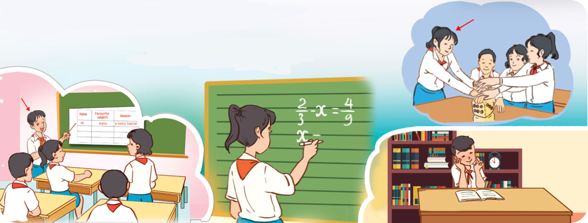
3. Let’s talk.
What school activity does ___ like?
__________________.

Slide 29
3. Let’s talk.
he
What school activity does ___ like?
__________________.
He likes doing projects

Slide 30
3. Let’s talk.
What school activity does ___ like?
she
She likes solving maths problems
___________________________.

Slide 31
3. Let’s talk.
What school activity does ___ like?
he
He likes reading books
__________________.

Slide 32
3. Let’s talk.
What school activity does ___ like?
she
She likes playing games
____________________.

Slide 33
Fun corner
& wrap - up

Slide 34
Review
What school activity does he / she like?
He / She likes + V-ing.
do projects
solve maths problems
read books
play games

