Slide 1
Welcome to our class!

Slide 2
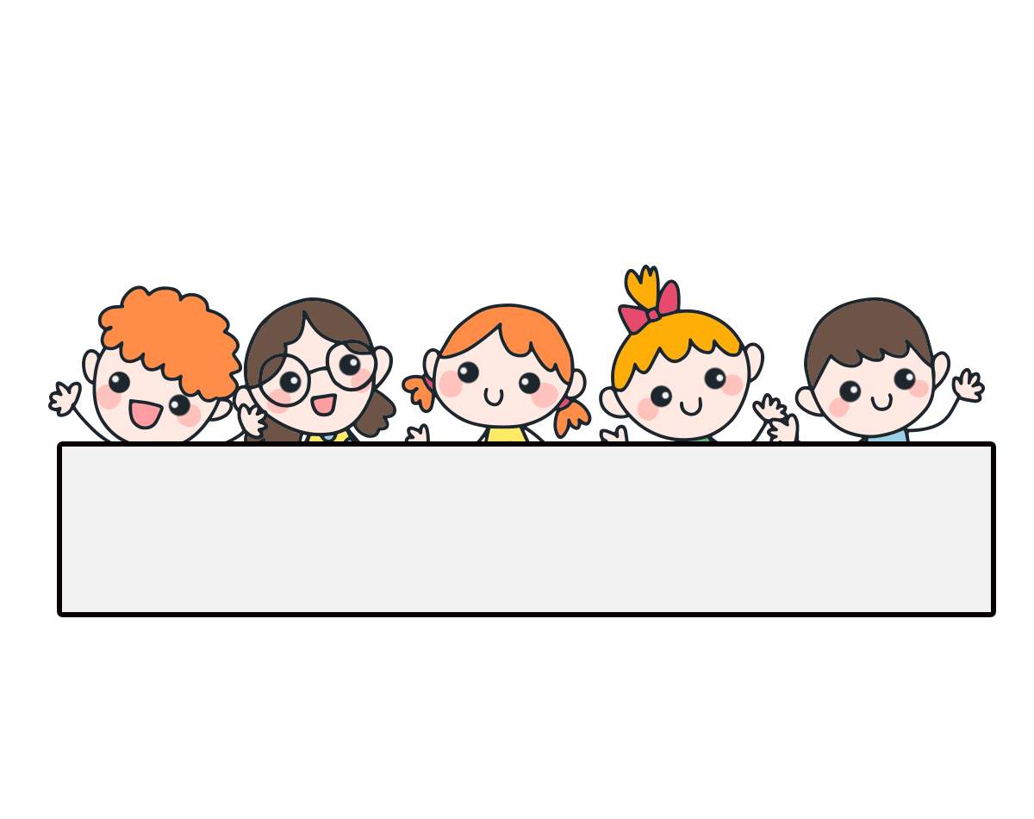
Warm-up

Slide 3
Let’s play!

Slide 4
Find Pikachu

Slide 5
1/10
A. English
B. Vietnamese
C. science

Slide 6
2/10
A. science
B. maths
C. Vietnamese

Slide 7
3/10
A. maths
B. science
C. English

Slide 8
4/10
A.timetable
B. subject
C. science

Slide 9
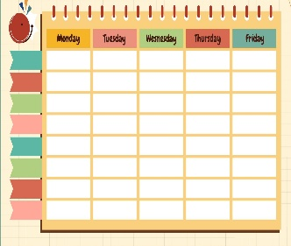
5/10
a
b
c

Slide 10
6/10
a
b
c

Slide 11
7/10
a
b
c

Slide 12
8/10
a
b
c

Slide 13
9/10
A. schools
A: What ____ do you have today?
B: I have science.
B. classes
C. subjects

Slide 14
10/10
A. What
A: ____ subjects do you have today? B: I have maths.
B. Where
C. When

Slide 15
Excellent!

Slide 16
Monday, May 10th 2024
Unit
7
Our timetables
Lesson 1 (4+5+6)
Facebook: Bùi Liễu Powerpoint
0968142780

Slide 17
Contents
Listen and tick or cross.
Look, complete and read.
Let’s play.

Slide 18
4. Listen and tick or cross.
1.
2.
3.
4.

Slide 19
5. Look, complete and read.
1.
A: What subjects do you have today?
B: I have ___________.
Vietnamese
2.
A: What subjects do you have today?
B: I ________________.
have maths
3.
A: ______ subjects do you have today?
B: I have English and _________.
What
science
do you have
4.
A: What subjects ___________ today?
B: I have ________and ________.
English
maths

Slide 20
6. Let’s play.
c
e
c
e
l
i
i
n
e
e
a
h

Slide 21
Wrap up

Slide 22
Unit 7 lesson 1
What subjects do you have today?
I have______.
i
Vietnamese
maths
English
science

Slide 23
Homework
……………………………………………
……………………………………………

Slide 24
Facebook : Bùi Liễu
0968142780
Thank you!

