Slide 1
Khanh Vinh Yen primary school
WELCOME TO OUR CLASS

Slide 2
Warm - up

Slide 3
Sing a song

Slide 4
Wednesday, November 08th 2023
Unit 6
HOW MANY LESSONS
DO YOU HAVE TODAY?
Lesson1: Part 1,2,3 (P. 40,41)

Slide 5
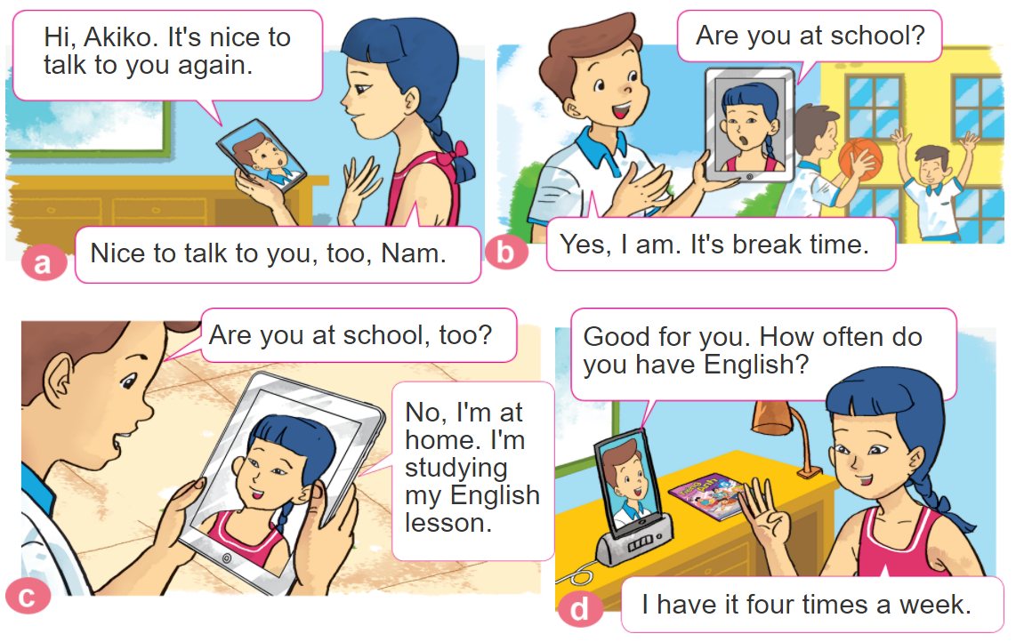
1. Look, listen and repeat.

Slide 6
Wednesday, November 08th 2023
Model sentences.
Nam: How often do you have English?
Akiko: I have it four times a week.

Slide 7
Wednesday, November 08th 2023
Structure.
Ask and answer about the frequency of a lesson.
(Hỏi và trả lời về tần suất của một môn học.)
How often do you have + name of lesson?
I have it + adverb.
EX: How often do you have English?
I have it four times a week.
.

Slide 8
Review vocabulary

Slide 9
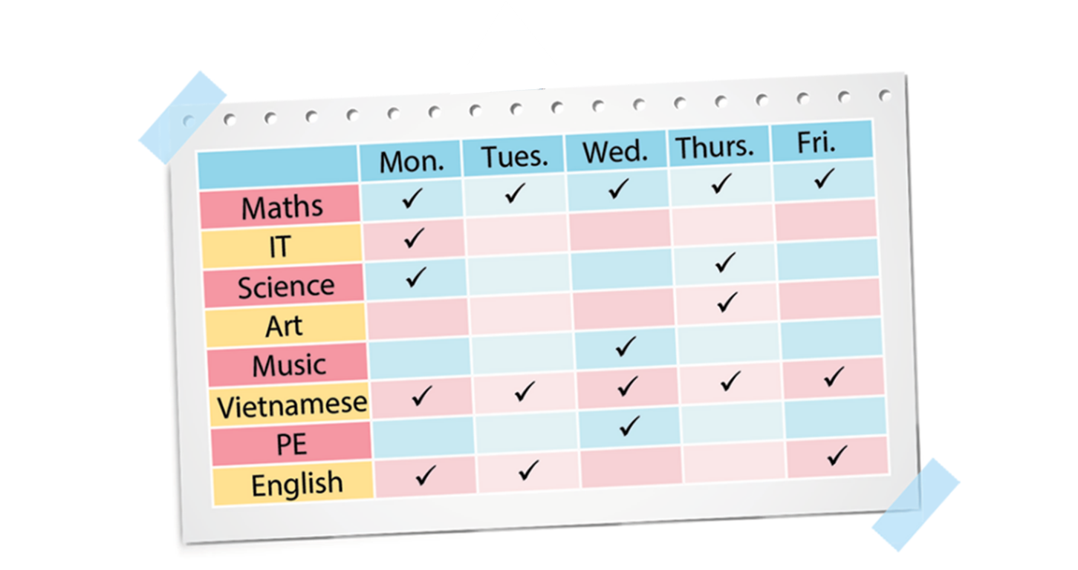
A. Vocabulary
(Adv)
every schoolday
Once
a week
Three times
a week
Twice
a week
✔
✔
✔
Four times a week

Slide 10
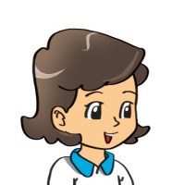
2. Point and say
How often do you have______?
I have it _________.
Maths
every day
Music
once a week
Science
twice a week
Vietnamese
four times a week

Slide 11
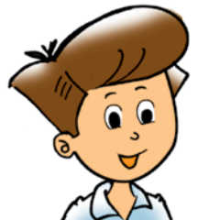
3. Let’s talk
How many lessons do you have today?
I have______.
I have it ______.
How often do you have ____________?
+ adverb
+ name of lesson
(Tớ học nó ________)
(Bạn học môn _______
thường xuyên như thế nào?)

Slide 12
survey

Slide 13
Ms Huyền Phạm
0936.082.789
Ms Huyền Phạm
0936.082.789
Ms Huyền Phạm
0936.082.789
Ms Huyền Phạm - 0936.082.789 – YOUTUBE: MsPham. Facebook: Dạy và học cùng công nghệ.
Ms Huyền Phạm
0936.082.789
Notes:
Ms Huyền Phạm - 0936.082.789 – YOUTUBE: MsPham. Facebook: Dạy và học cùng công nghệ.

Slide 14
How often do you have IT?
Next
I have it
everyday.
I have it twice
a week.
I have it
once a week.
I have it
one a week.
Notes:
Ms Huyền Phạm - 0936.082.789 – YOUTUBE: MsPham. Facebook: Dạy và học cùng công nghệ.

Slide 15
How often do you have Maths?
Next
I have it
once a week.
I have it twice a week.
I have it everyday.
I have it every schoolday.
Notes:
Ms Huyền Phạm - 0936.082.789 – YOUTUBE: MsPham. Facebook: Dạy và học cùng công nghệ.

Slide 16
How often do you have English?
Next
I have it
once a week.
I have it
twice a week.
I have it three times a week.
I have it
everyday.
Notes:
Ms Huyền Phạm - 0936.082.789 – YOUTUBE: MsPham. Facebook: Dạy và học cùng công nghệ.

Slide 17
How often do you have Science?
Next
I have it
twice a week.
I have it
once a week.
I have it three times a week.
I have it
everyday.
Notes:
Ms Huyền Phạm - 0936.082.789 – YOUTUBE: MsPham. Facebook: Dạy và học cùng công nghệ.

Slide 18
How often do you have Vietnamese?
Next
I have it
once a week.
I have it three times a week.
I have it
twice a week.
I have it
Every schoolday.
Notes:
Ms Huyền Phạm - 0936.082.789 – YOUTUBE: MsPham. Facebook: Dạy và học cùng công nghệ.

Slide 19
How often do you have PE?
Next
I have it three times a week.
I have it
once a week.
I have it
everyday.
I have it
twice a week.
Notes:
Ms Huyền Phạm - 0936.082.789 – YOUTUBE: MsPham. Facebook: Dạy và học cùng công nghệ.

Slide 20
Notes:
Ms Huyền Phạm - 0936.082.789 – YOUTUBE: MsPham. Facebook: Dạy và học cùng công nghệ.

