Slide 1
Welcome to our class!

Slide 2
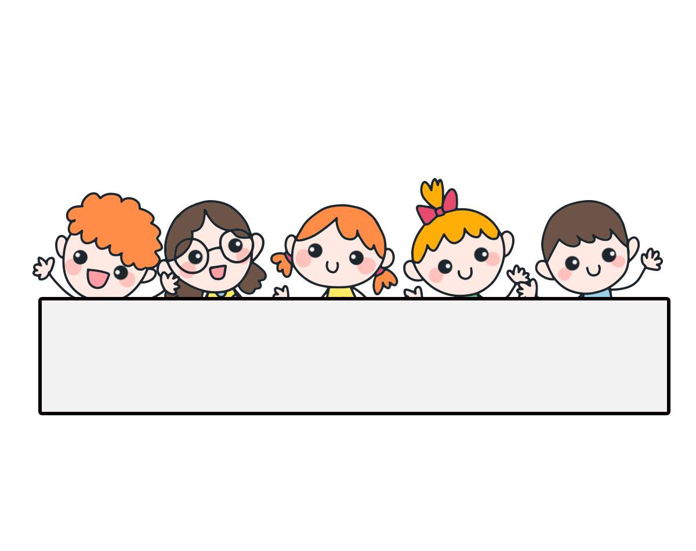
Warm-up

Slide 3
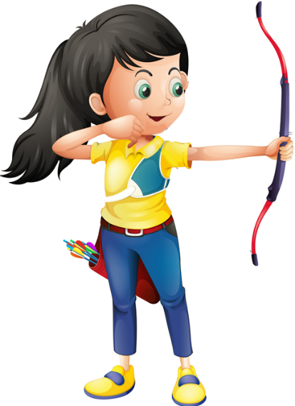
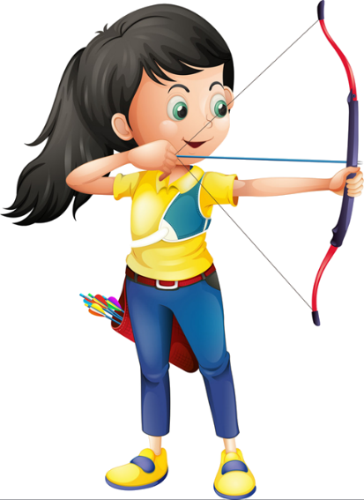
Ms Huyền Phạm
0936.082.789

Slide 4
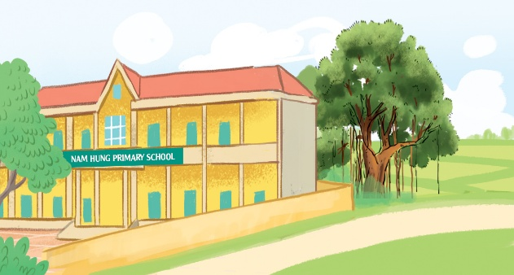
A: Where’s your school?
B: It’s in the ______.
A. town
B. village
Ms Huyền Phạm
0936.082.789

Slide 5
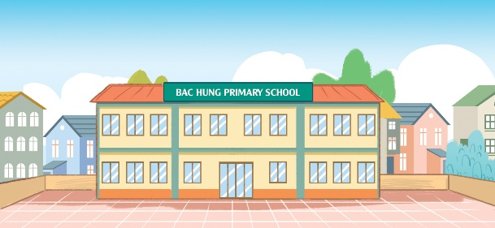
A: Where _____ your school?
B: It __ in the town.
A. are - are
B. is - is
Ms Huyền Phạm
0936.082.789

Slide 6
A: Where’s your school?
B: _____________.
A. It’s in the city.
B. There is one.
Ms Huyền Phạm
0936.082.789

Slide 7
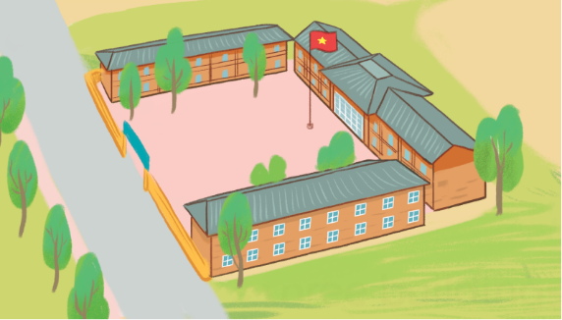
A: How many buildings are there at your school?
B: _______ three.
A. There is
B. There are
Ms Huyền Phạm
0936.082.789

Slide 8
Monday, May 10th 2024
Unit
7
Our timetables
Lesson 1 (1+2+3)

Slide 9
Contents
Look, listen and repeat.
Listen, point and say.
Let’s talk.

Slide 10
1. Look, listen and repeat.
What time do you have class today, Minh?
What subjects do you have today?
a
b
At eight, Mum.
I have English and maths.
What are they talking about?
Where are they?
Who are they?

Slide 11
Vocabulary

Slide 12
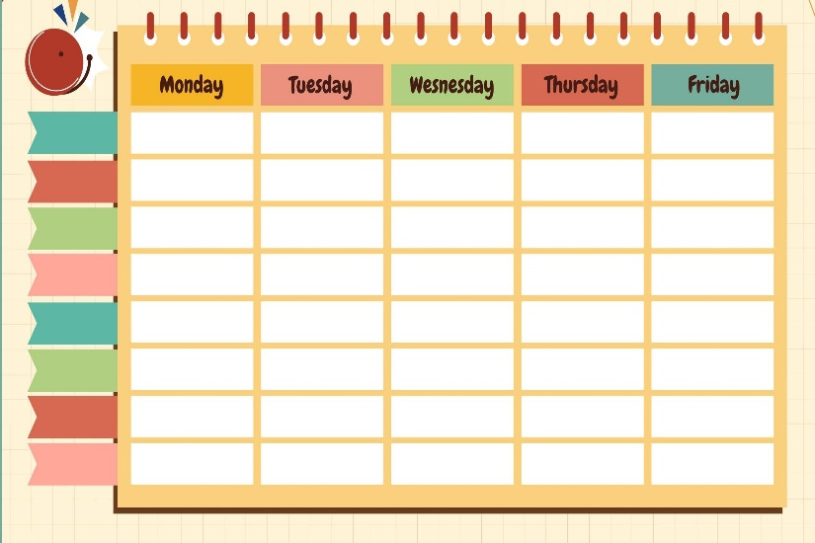
timetable
/ˈtaɪmˌteɪbəl/
thời khóa biểu

Slide 13
subject
/ˈsʌb.dʒekt/
môn học

Slide 14
Vietnamese
/ˌviːetnəˈmiːz/
môn Tiếng Việt

Slide 15
maths
/mæθs/
môn Toán, toán học

Slide 16
science
/ˈsaɪəns/
môn Khoa học

Slide 17
English
/ˈɪŋɡlɪʃ/
môn tiếng Anh

Slide 18
Review
timetable
subject
Vietnamese
English
maths
science

Slide 19
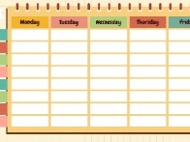
Vocabulary
1. timetable
: thời khóa biểu
2. subject
: môn học
3. Vietnamese
: môn Tiếng Việt
4. English
: môn Tiếng Anh
5. maths
: môn Toán
6. science
: môn Khoa học

Slide 20
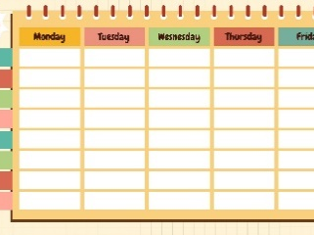
Checking vocabulary
Look and match.
1
2
3
4
5
6
a
b
c
d
e
f
science
English
maths
Vietnamese
subject
timetable

Slide 21
Structures

Slide 22
Structures
Hỏi “ngày hôm nay bạn có môn học gì”:
What subjects do you have today?
I have _______.
(Hôm nay bạn có môn học gì?)
(Tôi có ______.)

Slide 23
Unit 7 lesson 1 (1+2+3)
What subjects do you have today?
I have______.
i
Vietnamese
maths
English
science

Slide 24
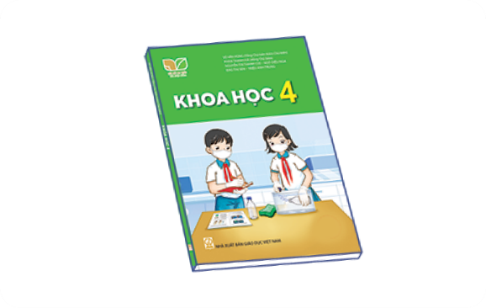
2. Listen, point and say.
a
b
What subjects do you have today?
Vietnamese
English
I have______.
c
d
maths
science

Slide 25
2. Listen, point and say.
a
What subjects do you have today?
I have______.
Vietnamese
What subjects do you have today?
I have Vietnamese.
Click on the sentences to listen again.

Slide 26
2. Listen, point and say.
What subjects do you have today?
b
I have______.
English
What subjects do you have today?
I have English.

Slide 27
2. Listen, point and say.
c
What subjects do you have today?
I have______.
maths
What subjects do you have today?
I have maths.

Slide 28
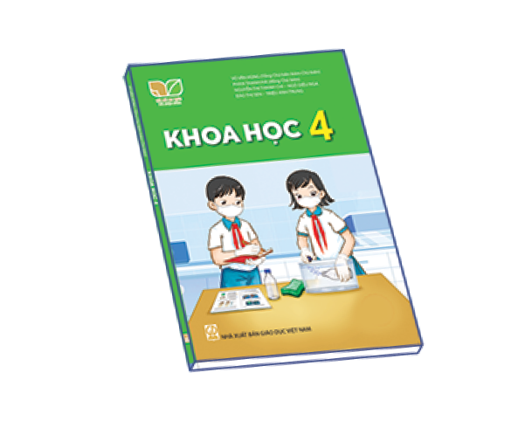
2. Listen, point and say.
d
What subjects do you have today?
I have______.
science
What subjects do you have today?
I have science.

Slide 29
3. Let’s talk.
What subjects do you have today?
_______.

Slide 30
Wrap up

Slide 31
Homework
Learn by heart all the new words and the model sentences.
Read again the dialogue in part 1.

Slide 32
Facebook : Bùi Liễu
0968142780
Thank you!

