Slide 1
4B-Khanh Vinh Yen
primary school

Slide 2
My birthday party
4
Lesson 2 – Period 3

Slide 3
Table of contents
Warm-up
Activity 1
Activity 2
01
02
03
Look, listen and repeat.
Listen, point and say.
REVIEW
04
Activity 3
05
Game
Let’s talk.

Slide 4
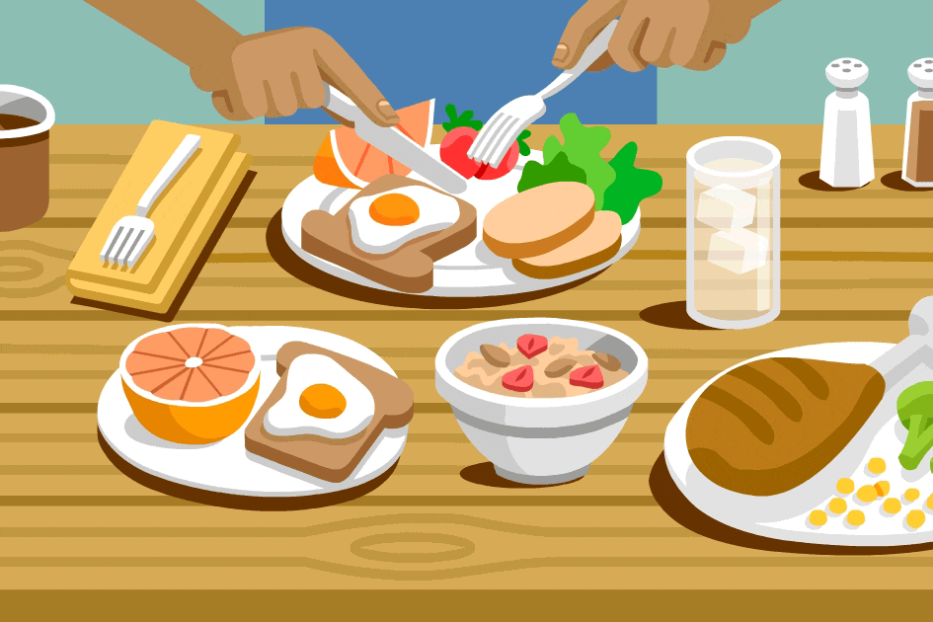
01
Warm-up
REVIEW.

Slide 5
02
Activity 1
Look, listen and repeat.

Slide 6
vocabulary

Slide 7
Some chips

Slide 8
some grapes

Slide 9
some lemonade

Slide 10
some water

Slide 11
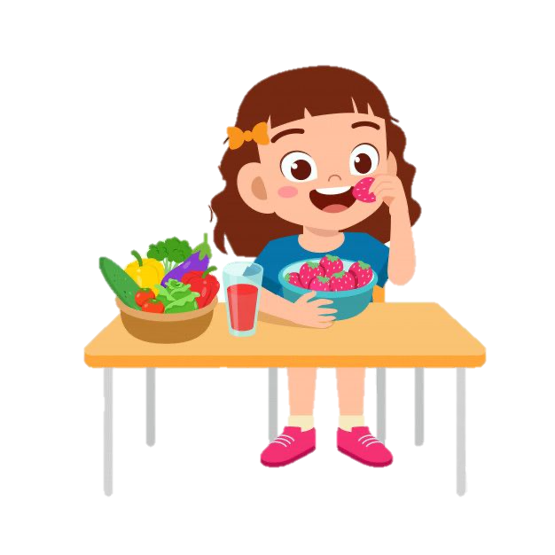
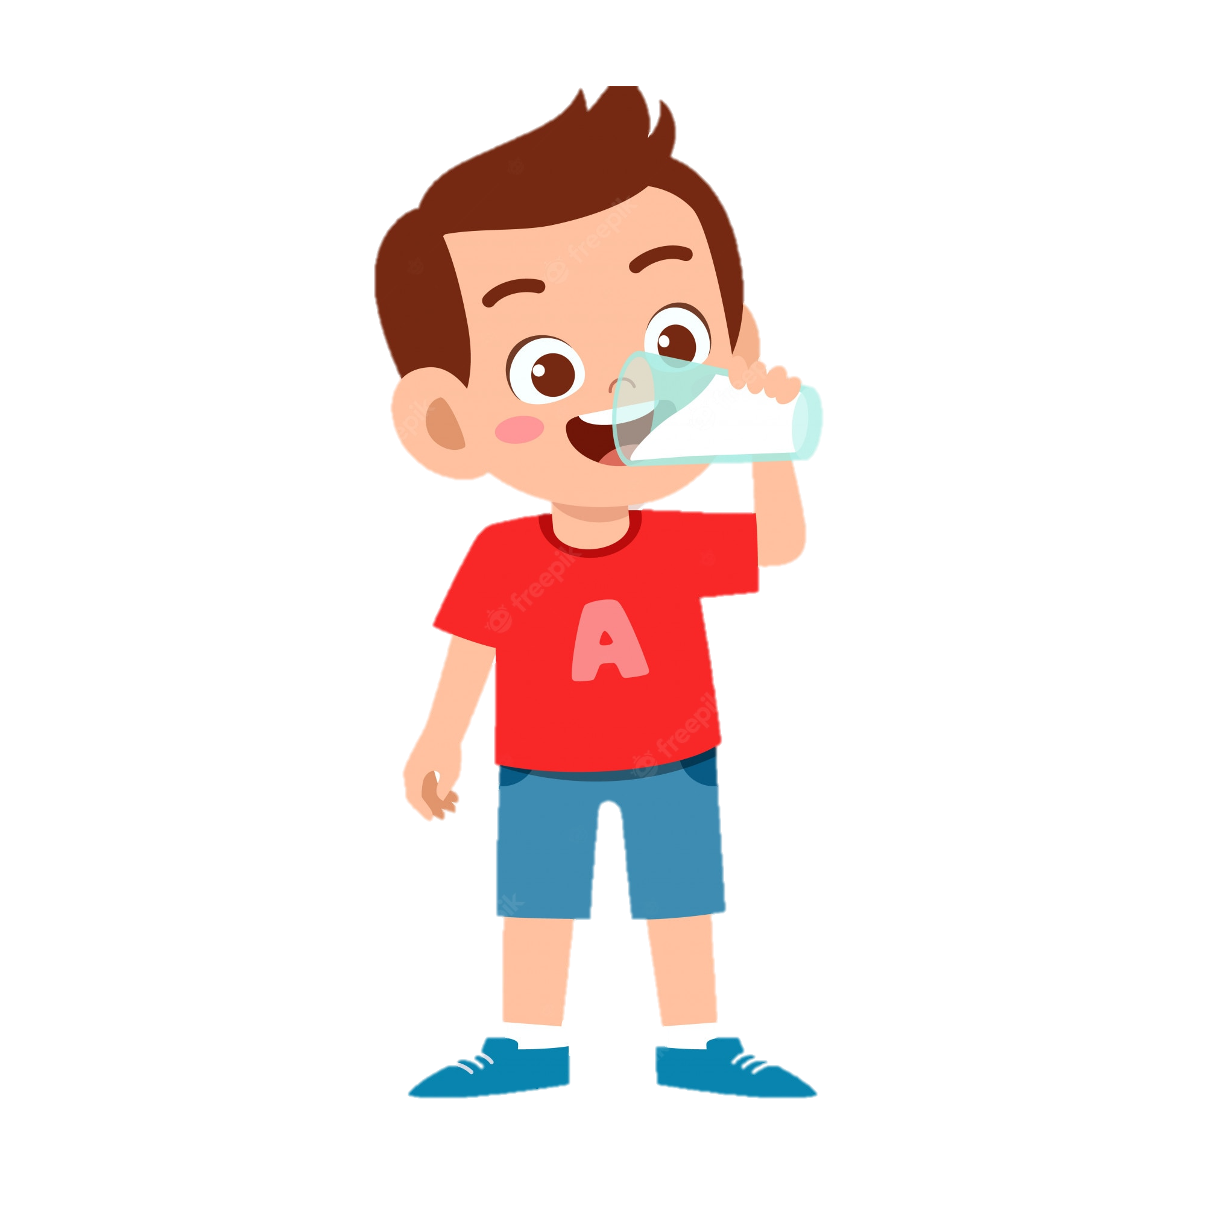
eat
drink

Slide 12
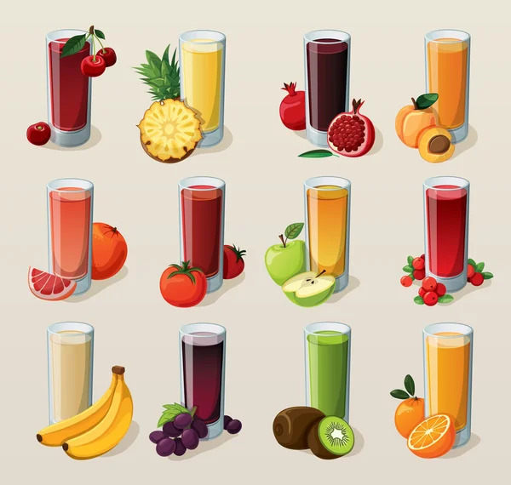
chips
grapes
juice
jam
water
lemonade

Slide 13
What is missing?

Slide 14
chips

Slide 15
juice

Slide 16
lemonade

Slide 17
grapes

Slide 18
water

Slide 19
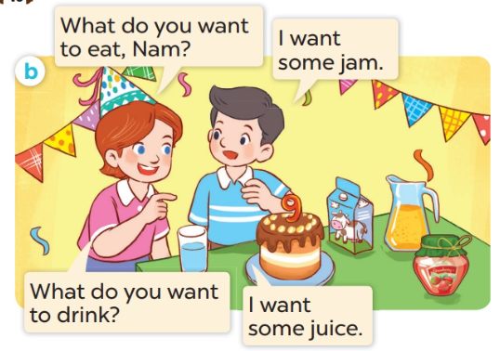

Slide 20
03
Activity 2
Listen, point and say.

Slide 21
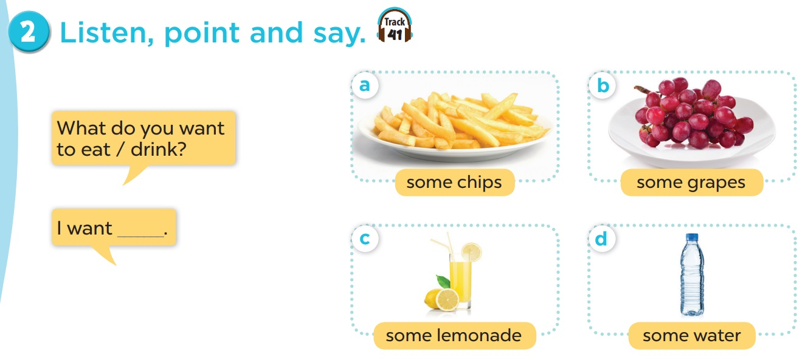
Listen and repeat.
Work in pairs. Role play.

Slide 22
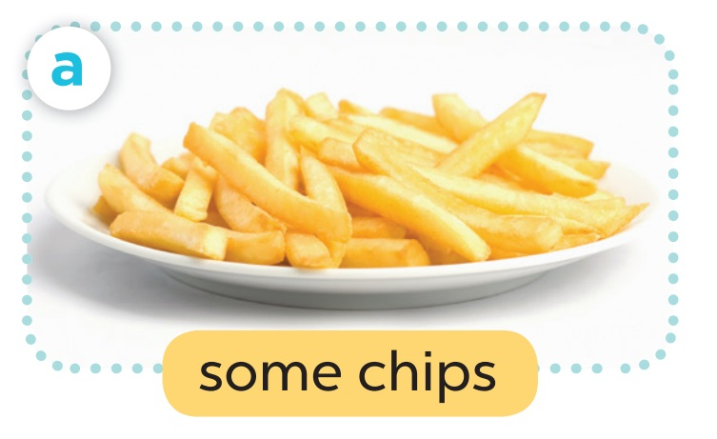
- What do you want to eat?
- I want ______.

Slide 23
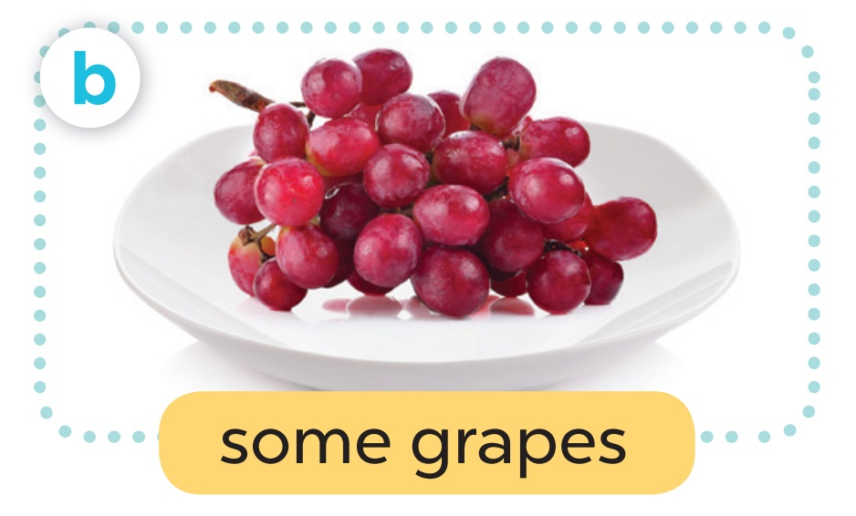
- What do you want to ___?
- I want _____.

Slide 24
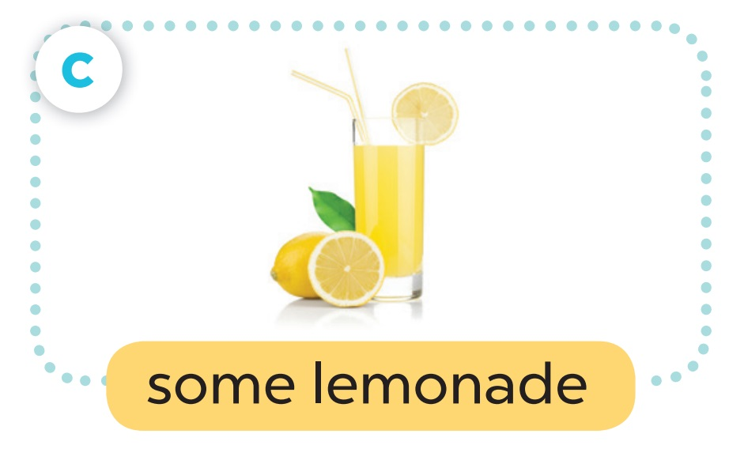
- What do you want to ___?
- I want _______.

Slide 25
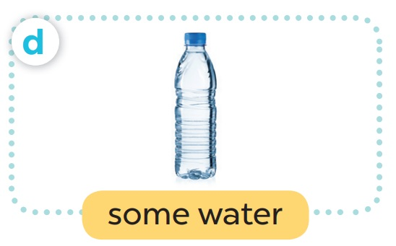
- What do you want to____?
- I want ____.

Slide 26
- What do you want to __?
- I want _____.

Slide 27
- What do you want to ____?
- I want ______.

Slide 28
- What do you want to____?
- I want ____.

Slide 29
- What do you want to ___?
- I want _____.

Slide 30
04
Activity 3
Let’s talk.

Slide 31
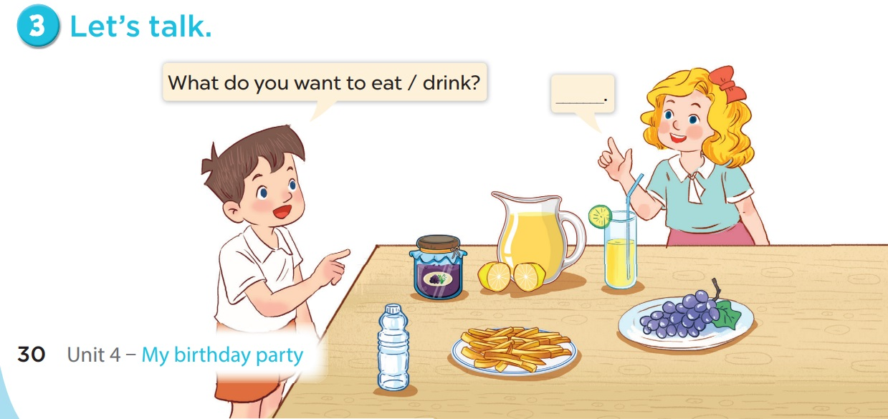

Slide 32
- What do you want to eat/drink?
Work in groups
- I want some .
No | Name | Foods/ Drinks
1 | Diep Chi
2 | Duy
3
4

